Slide 1
Introduction to the REC Code Manager for Price Comparison Websites

Slide 2
Housekeeping
Session is being recorded and the recording will be made available on Portal next week
Please keep questions until the end as we may answer these as we go along.
Raise your hand to ask a question verbally
Keep cameras off and remain on mute unless asking a question.

Slide 3
Meeting Agenda
Introduction to the REC and REC Code Manager
Communication and Engagement Plan
REC Portal
Q&A
Energy Switch Guarantee

Slide 4
What is the Retail Energy Code?
The Retail Energy Code (or REC) is a set of obligations governing market participants operating in the retail energy market within Great Britain.

Slide 5
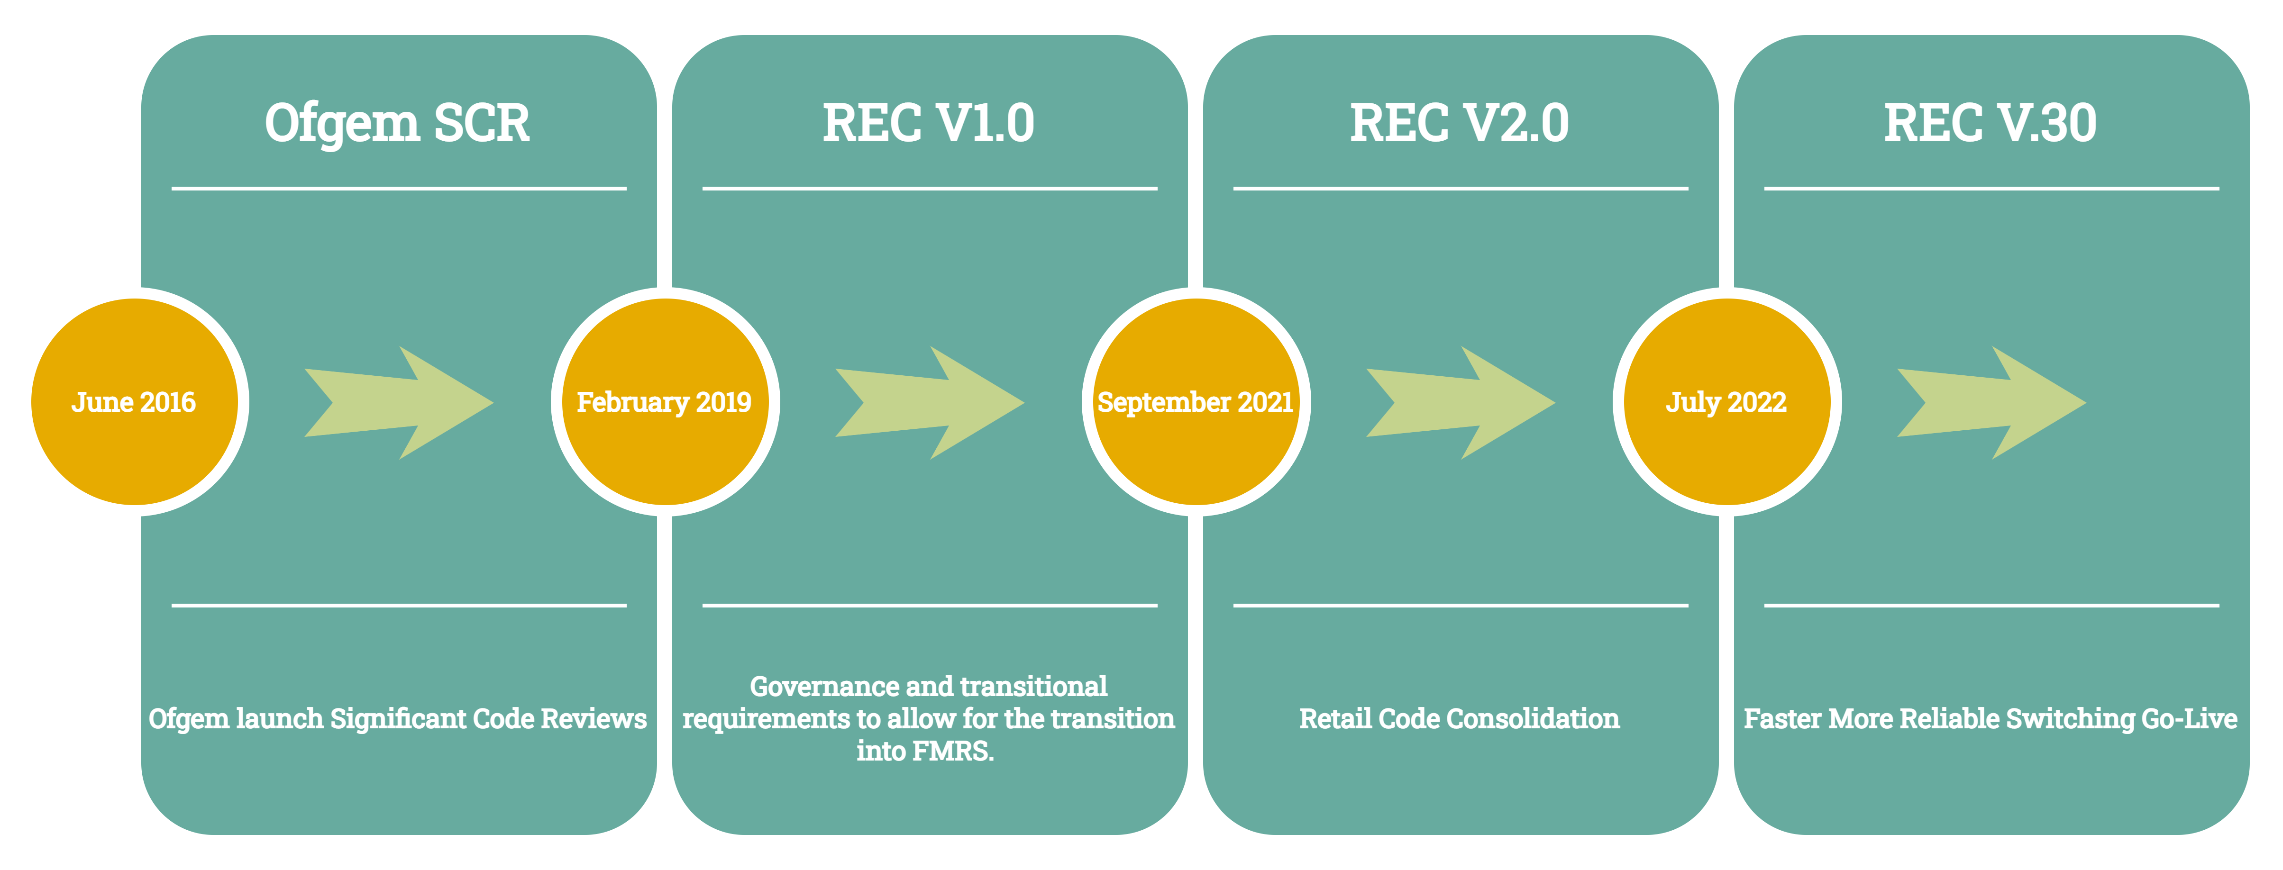
Background of the Retail Energy Code

Slide 6
Governance of the REC
RETAIL ENERY CODE COMPANY (RECCo)
REC Code Manager
REC Professional Services
REC Performance Assurance
REC Technical Services

Slide 7
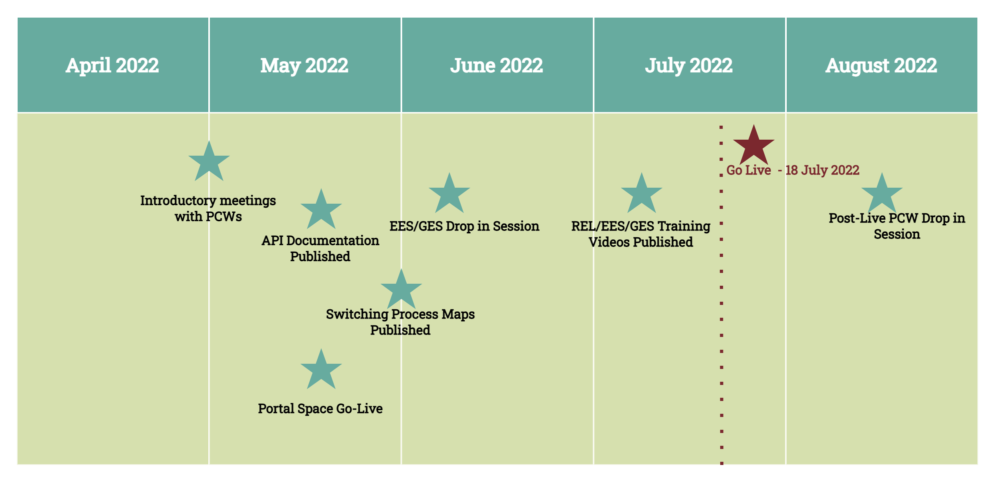
Communication & Engagement Plan

Slide 8
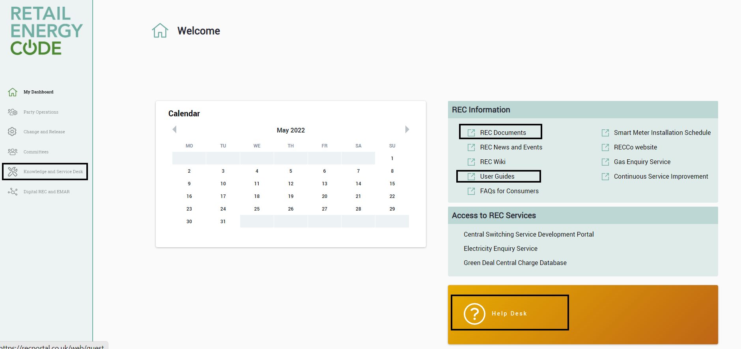
REC Portal

Slide 9
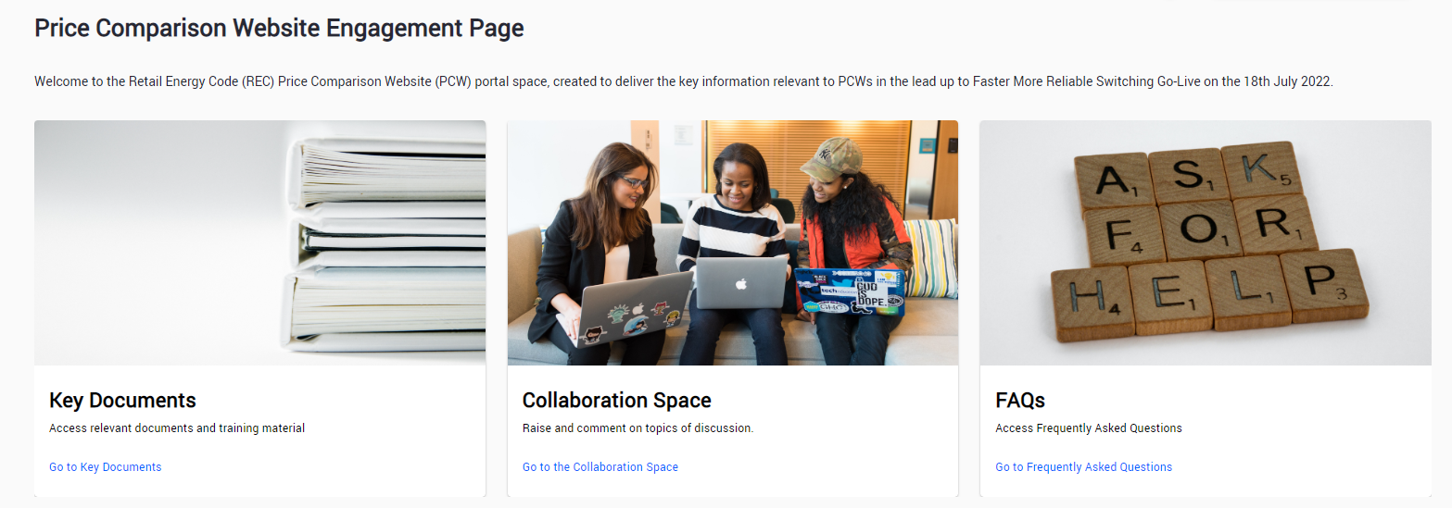
PCW Portal Space

Slide 10
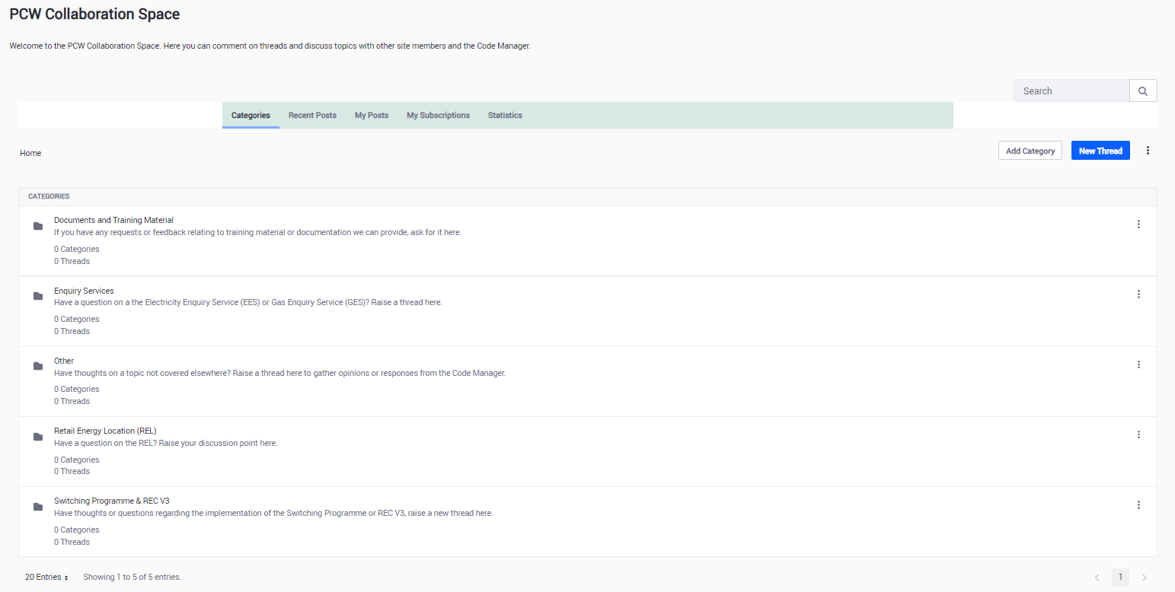
Collaboration Space

Slide 11
Any Questions?

Slide 12
THANK YOU FOR ATTENDING please provide any feedback you may have at slido.com

