Slide 1

REC PERFORMANCE ASSURANCE
USER GUIDE
May 2022

Slide 2





WELCOME
This User Guide will help you understand the Performance Assurance Framework (PAF) and the assurance activities that will be conducted by the Code Manager to assess your performance.
Animation holder
Animation holder

Slide 3
CONTENTS
The Code Manager monitors and assures the performance of organisations operating in the retail market. These organisations are referred to as PAF Participants and include REC Parties, REC Service Providers and specific Non-Parties that use REC Services. This assurance process focuses on risks to retail energy consumer outcomes and the effectiveness of the retail market. This will be provided through a Performance Assurance Framework (PAF) underpinned by a comprehensive Risk Register and associated interventions. The Performance Assurance Board (PAB) oversees the PAF.
Click on the links below to navigate to the relevant sections.
INTRODUCTION TO THE PA FRAMEWORK
MEASURING RETAIL RISKS
APPEALS AND ESCALATIONS
READ MORE
CLICK HERE
READ MORE
CLICK HERE
READ MORE
CLICK HERE
ASSURANCE TECHNIQUES AND DETERMINATIONS
RETAIL RISK REGISTER
ENGAGING WITH PA USING THE REC PORTAL
READ MORE
CLICK HERE
READ MORE
CLICK HERE
READ MORE
CLICK HERE

Slide 4

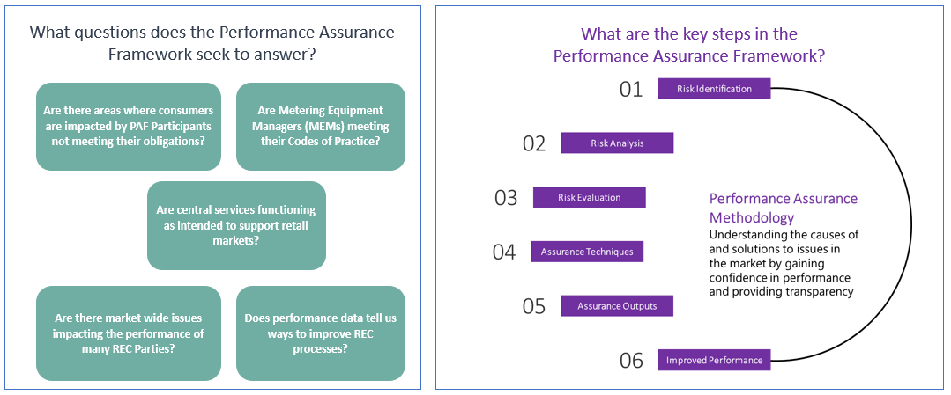
INTRODUCTION TO THE PERFORMANCE ASSURANCE FRAMEWORK (PAF)
REC Performance Assurance aims to measure and improve market performance. The Performance Assurance Board oversees a risk based Performance Assurance Framework to do so.
Animation holder
Animation holder

Slide 5
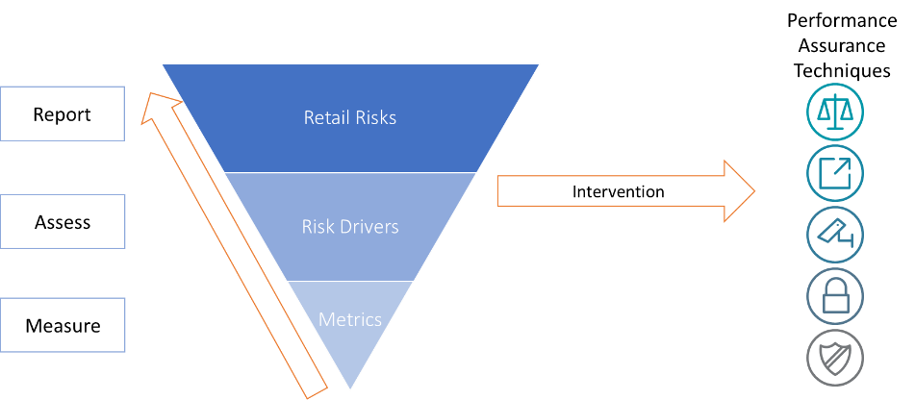
MEASURING RETAIL RISKS 1/3
The Code Manager has put in place a Performance Assurance Methodology which describes how relevant risks are identified, measured and evaluated. This focuses on three levels of risk information:
Retail Risks are high level risks focused on consumer outcomes based on the intent and purpose of a given REC objective.
Risk drivers associated with a Retail Risk, focus on REC processes and the causes of consumer harm, or non-compliance.
Performance Measures are a set of metrics which demonstrate a party’s performance in respect of a risk driver.
The Performance Assurance Methodology includes more information on this, including the definition of a Retail Risk, principles in applying this definition and details of the information recorded on each risk.
PERFORMANCE ASSURANCE METHODOLOGY
READ MORE
CLICK HERE
Animation holder
READ MORE
CLICK HERE
Animation holder

Slide 6


MEASURING RETAIL RISKS 2/3
Once risks and their drivers are identified the Code Manager can take one of two approaches:
Ongoing risk monitoring
Best applied where there are many parties to compare, and performance data exists
Additional intervention is applied when performance is observed to be below standard
Puts onus on parties to decide how to meet their obligations, but focus on achieving key outcomes
Direct application of techniques
Appropriate for areas where we seek to prevent, instead of detect and correct (e.g. information security)
Suitable for service providers or code managers, where we may test some areas on a cyclic basis
Sets expectations of how outcomes are met, e.g. with specific processes that are of a high standard.
Can involve additional, more detailed monitoring if risk escalates
More frequent, broader or deeper interventions can be completed if risk escalates
✓
✓
✓
✓
✓
✓
PERFORMANCE ASSURANCE METHODOLOGY
Ongoing risk monitoring is described in more detail in the Performance Assurance Methodology
READ MORE
CLICK HERE
READ MORE
CLICK HERE
Animation holder

Slide 7
Animation holder
Animation holder
MEASURING RETAIL RISKS 3/3
Performance data is collated from central systems
This is analysed against a specific organisation’s obligations
Each area where an organisation does not meet their obligation is scored
The Performance Assurance Methodology also sets out an approach to scoring risk performance and using this to inform assurance activities.
For the most part we expect organisations will either pass or have minor breaches. However for some performance measures an organisation may have major breaches or areas of significant underperformance (referred to as a fail).
The Code Manager uses the number of majors and minors to determine where to focus its assurance. It uses a threshold set by the PAB for each metric to do so. Any fails are immediately acted upon.
Pass
Minor
Major
Fail
REC Party meets minimum threshold of the measurement rule
REC Party does not meet minimum threshold, but is within the tolerance of the measurement rule
REC Party does not meet minimum threshold, and exceeds the tolerance of the measurement rule
REC Party does not meet minimum threshold where it has been deemed that they must not fail

Slide 8
RETAIL RISK REGISTER
The areas that the Code Manager is measuring are set out in the Retail Risk Register. These are prioritised and include the performance measures. Performance measures are data driven and they are used to assess performance against the risk driver to evaluate the likelihood of the Retail Risk causing customer detriment or market inefficiencies. This register will evolve over time as the market evolves. You can:
Read and understand the register to get a detailed understanding of the areas of focus Assurances for REC Performance
Suggest new risks, or updates to existing ones to make them better
Understand which risks relate to customer vulnerability or the effectiveness of retail markets
Identify the obligations related to risks, as well as who is affected by each risk
Recognise performance levels and minimum thresholds
RETAIL RISK REGISTER
READ MORE
CLICK HERE

Slide 9
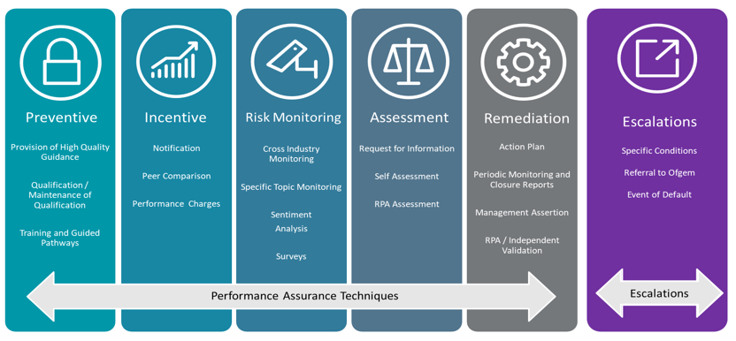
Animation holder
Animation holder
ASSURANCE TECHNIQUES AND RISK MANAGEMENT DETERMINATIONS 1/5
In response to high, or increasing, risk scores the Code Manager can use Performance Assurance Techniques.
Each month the Code Manager will review performance data to decide which techniques to apply. This is referred to as the risk management determination process.
The Code Manager can apply one of 17 Performance Techniques, and 3 escalations, as set out below.
PERFORMANCE ASSURANCE TECHNIQUES
READ MORE
CLICK HERE

Slide 10
Animation holder
Animation holder
ASSURANCE TECHNIQUES AND RISK MANAGEMENT DETERMINATIONS 2/5
Every month the Code Manager uses data to decide which Performance Assurance Techniques should be applied. This process is called the monthly Risk Management Determinations.
Measurement of the risks in the Risk Register
Parties can see their risk data each month on the REC Portal. They should use this information to understand and improve their performance.
Performance Assurance Techniques can be used to understand the causes of issues, or to address issues.
Bringing together risk and assurance information will allow the Code Manager to target interventions at the causes of issues.
Individual Party Performance
Whole market performance
Information from Performance Assurance Techniques
Risk Management Determination
Contextual information on individual Parties
Techniques Applied

Slide 11
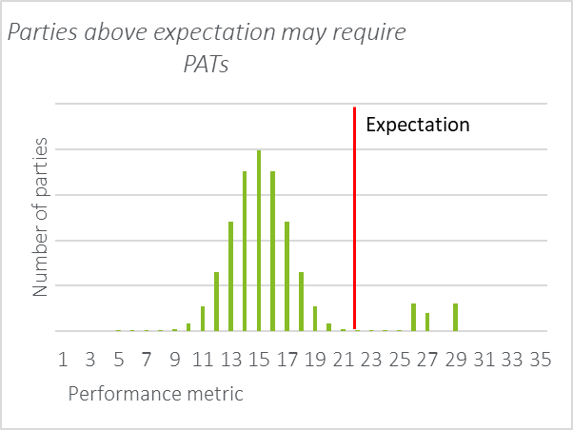
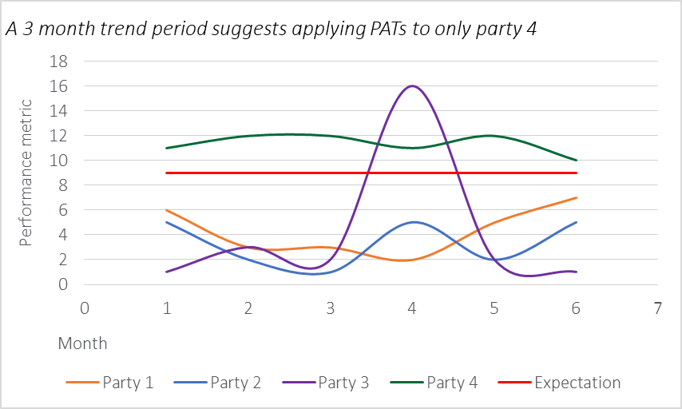
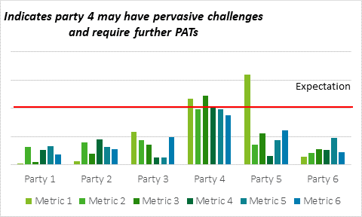
ASSURANCE TECHNIQUES AND RISK MANAGEMENT DETERMINATIONS 3/5
When the Code Manager applies Performance Assurance Techniques you will always be told why. The Performance Assurance Techniques document sets out the processes and safeguards in place over the use of these techniques. For some techniques, such as notifying PAF Participants of identified performance issues, the Code Manager will do this automatically. More complex Performance Assurance Techniques will only be implemented after PAB approval. This document also sets out:
How data is used to guide monthly determinations:

Slide 12
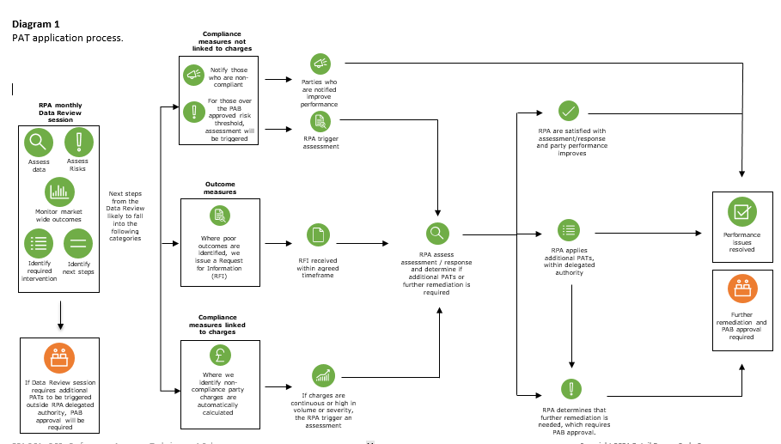
Animation holder
ASSURANCE TECHNIQUES AND RISK MANAGEMENT DETERMINATIONS 4/5
Detailed description on the PAT application process and further information on PAB’s involvement:
PERFORMANCE ASSURANCE TECHNIQUES
READ MORE
CLICK HERE

Slide 13
ASSURANCE TECHNIQUES AND RISK MANAGEMENT DETERMINATIONS 5/5
In addition to the monthly risk determinations the Code Manager produces an annual operating plan. This sets out the principles of how the Code Manager will apply Performance Assurance Techniques during the year. It covers:
A prioritisation of risks at the start of the year
How techniques are directly applied to risks, where monitoring is not appropriate
How the Code Manager is prioritising its time across different types of organisation
Timeline of assurance improvement activities
Specific considerations for the year
PERFORMANCE ASSURANCE OPERATING PLAN
In the first year this also includes the initial techniques that are planned to be applied. In future years it is likely that techniques will be applied at various points throughout the year as risks arise or are addressed.
READ MORE
CLICK HERE

Slide 14
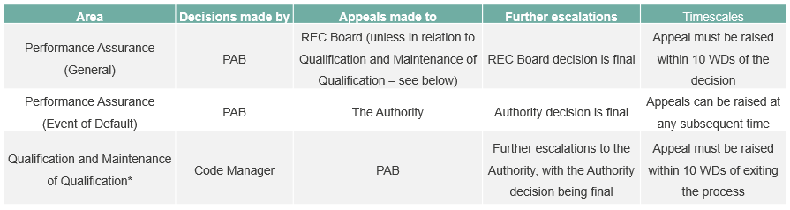
APPEALS AND ESCALATIONS 1/2
Performance Assurance appeals
If you disagree or would like to raise a query in relation to a decision made by the Code Manager or PAB in relation to Performance Assurance, the first thing you should do is get in touch with the Code Manager using the REC Portal. If this relates to a Performance Assurance Technique you should do this on the chat associated with that technique.
If you are unable to resolve your query or are still dissatisfied with the decision, you can raise an appeal by completing an appeal and escalation form on the REC Portal. The route for appeals will depend on the nature of the appeal and the entity that made the initial decision that is being appealed, as outlined in the table below. The timescales for raising appeals are also set out below.
APPEALS PROCESS
*Metering accreditation appeals are made to the PAB, with the PAB decision being final. This is set out in further detail in the Metering CoP User Guide.
READ MORE
CLICK HERE

Slide 15
APPEALS AND ESCALATIONS 2/2
Operational disputes
For operational disputes set out in the REC, escalations will go to the Code Manager for resolution in the first instance. All escalations relating to operational disputes must be made through the REC Portal appeal and escalation form.
The Code Manager will be responsible for receiving and managing escalations. This will include seeking further information from the appealing organisation or any other relevant stakeholders, to give further context and evidence for the escalation case. The Code Manager will communicate the decision on how to resolve the operational dispute by notifying impacted Parties via the REC Portal.
The Code Manager may escalate to the PAB for resolution. The PAB will then determine what the outcome of the dispute should be, including any resulting actions that should take place to resolve the dispute. Relevant organisations will be made aware of the decision through a notification on the REC Portal.
If a dispute is considered to be urgent, the Code Manager will prioritise this for resolution. The decision on urgency will be based on whether there is a significant or material impact on customer outcomes and/or the achievement of the REC objectives.
ESCALATION PROCESS
APPEAL AND ESCALATION FORM
READ MORE
CLICK HERE
READ MORE
CLICK HERE

Slide 16
What will this look like?
Engaging with performance assurance using the rec portal
The REC Portal is the key way you interact with the Code Manager. It is the place where all your Performance Assurance information and requests are held, and the easiest place to ask a question.
On a regular basis, you will log into the REC Portal using your organisation account.
Every month, you will find updated risk information on the portal (please refer to ‘Analytic Dashboard’ section for detail). You will be able to understand how your organisation is performing and can use this information to improve your own performance without intervention from the Code Manager.
Parties will have Performance Assurance Techniques applied to them, with better performing organisations having fewer and less intrusive techniques applied. For each technique you will be able to see a similar set of information, such as detail on the reasoning behind the application of the PAT. Moreover, you will be able to directly contact the Code Manager to help with queries you may have.
Additionally, there will be functionality to submit information required by the Code Manager per the Report Catalogue through your organisation account. Data items previously submitted by your organisation in the last 60 days will be visible to you, including the name of the item and date uploaded.

Slide 17
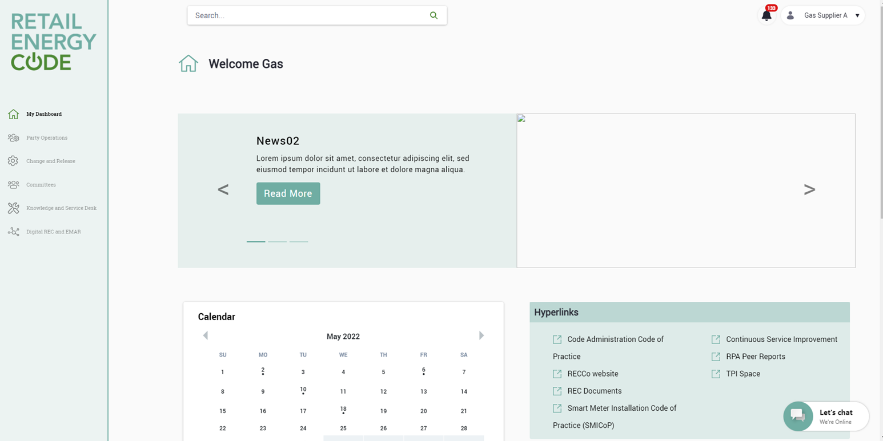
rec portal
The REC Portal is the key way you interact with the Code Manager. It is the place where all your Performance Assurance information and requests are held, and the easiest place to ask a question.
The following slides show a step by step guide on how to navigate all Performance Assurance related information on the REC Portal starting with the Home Page below:
Home page
Select ‘Party Operations’ on the left hand tab

Slide 18
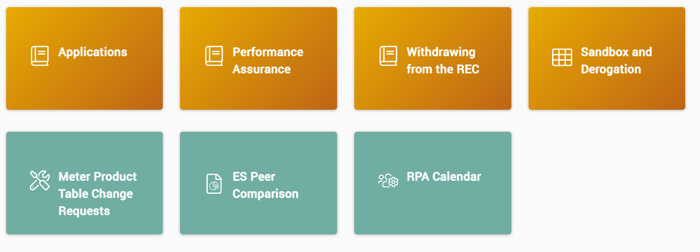
Party Operations
Once in the Party Operation area of the REC Portal, select the ‘Performance Assurance’ tile

Slide 19
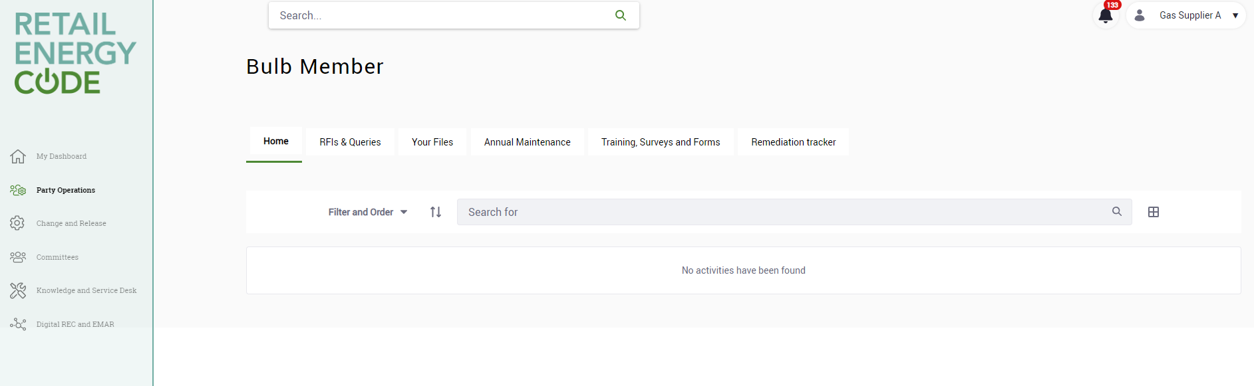
Performance Assurance Tile
‘Remediation Tracker’ tab will include follow up actions to track remediation actions
‘Home’ tab will list all actions assigned to your organisation
‘RFI’ tab will include requests for information, clarification requests and queries
‘Training / Survey’ tab will include links to surveys that Parties need to complete

Slide 20
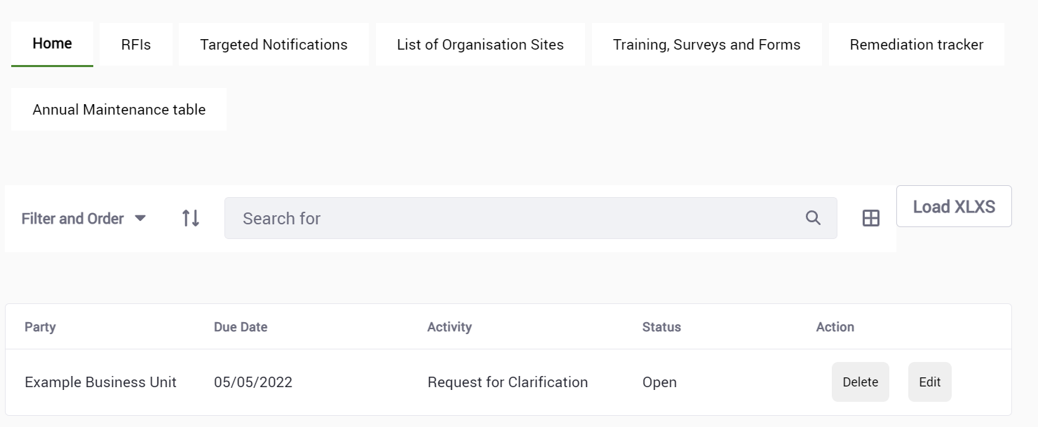
Home tab
‘Home’ tab will list all actions assigned to your organisations, these will usually result from the Code Manager monthly risk determinations

Slide 21
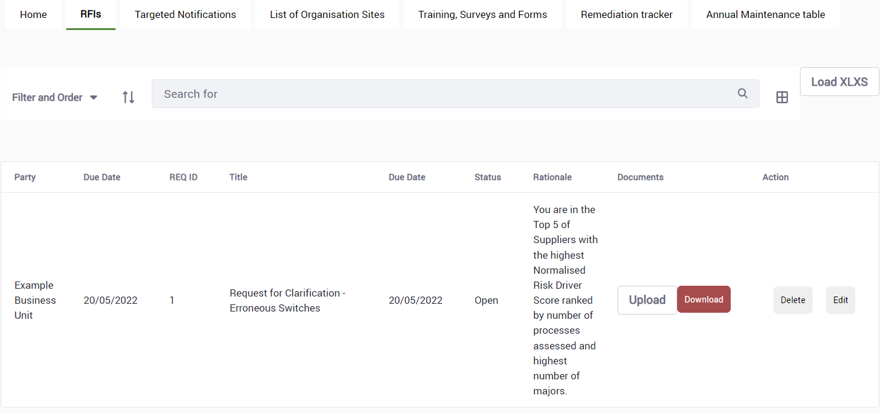
Rfi tab
‘RFI’ tab will list all request for information, clarification requests or any queries for which the Code Manager will require your organisation to provide further information on.
Due date to be completed by
Title which should provide context
Rationale to briefly summarise the reason / background
Action to download the file and complete attached requirements before re-uploading response to the Portal

Slide 22
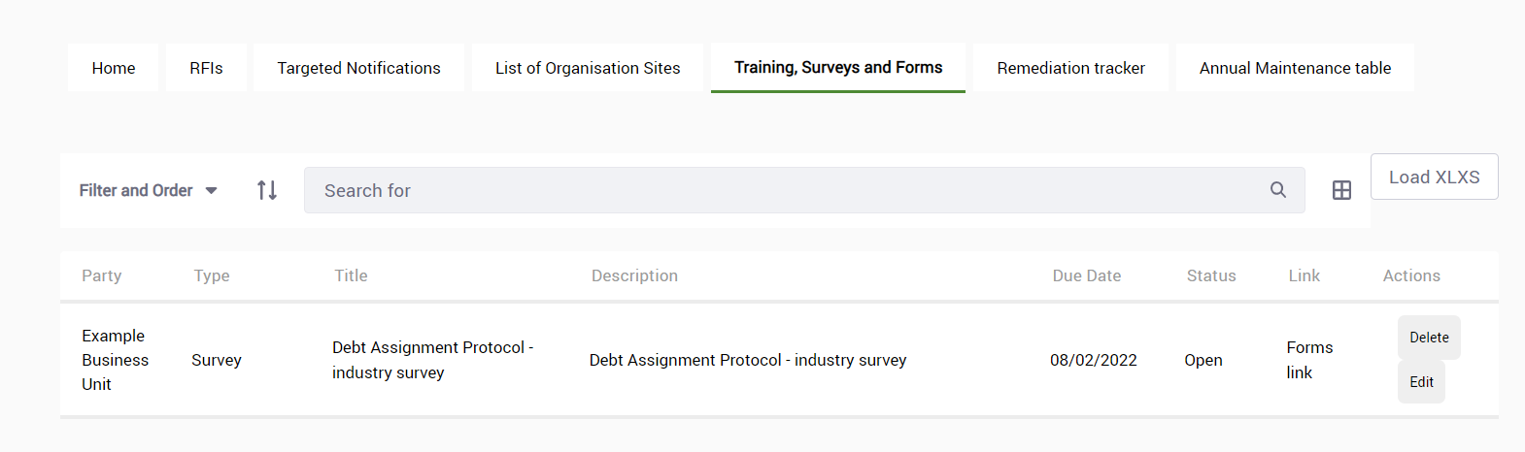
Training, surveys & forms tab
‘Training / Survey’ tab will include links to training, forms & surveys that organisations are required to complete
Link will be included for Parties to fill out as instructed in the description by the due date

Slide 23
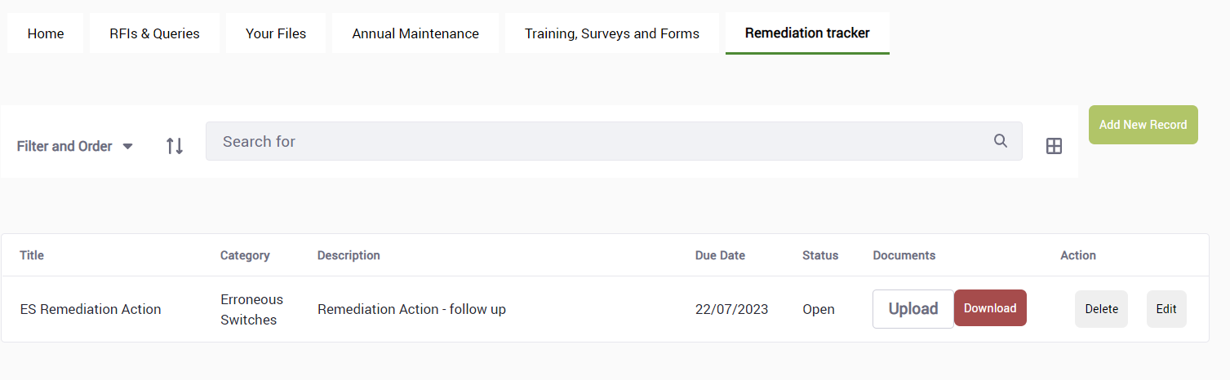
Remediation tracker tab
‘Remediation Tracker’ tab will include any follow up actions that have been identified following underperformance in one of the areas being monitored by the Code Manager
Description to briefly summarise the reason / background
Due date
Action to download the file and complete attached requirements before re-uploading response to the Portal

Slide 24
Animation holder
ANALYTICS DASHBOARD
    The below analytic outputs are in development and to be made available on the REC Portal. You will also be able to see the status of open actions or assurance activities directly on the Portal.
Output | Description
Retail Risk Summary | Analysis of party performance at the Retail Risk level.
Risk Driver Summary | Analysis of party performance at the Risk Driver level.
Party Summary | Overview of party performance at the Risk Driver & Retail Risk level for detailed comparisons.
Overall Party Score Summary | Overall summary of Risk Normalised Score by party.
Peer Comparison | Comparison of party performance for selected metrics to their peers. These metrics are Metering, Erroneous Switches and Address Data Quality Issues.
SMIS Survey | Summary of SMIS survey question responses at an overall or individual supplier level and across Micro-Business & Domestic categories.
Theft | Breakdown of type of Tip Offs, Investigated Thefts and Confirmed Thefts by Supplier, as well as a comparison of confirmed thefts to theft targets by supplier.
Quantitative SLA Summary | Overview of Quarterly Data Submissions relevant to specific Service Providers supporting the REC, to assess their performance against various metrics.
Qualitative SLA Summary | Overview of Monthly Data Submissions relevant to specific Service Providers supporting the REC, to assess their performance across detailed metrics that are constructed for a monthly output.
THE REC PORTAL
READ MORE
CLICK HERE

Slide 25

Further areas of Support
The Code Manager also provides further support to the industry.
KEY CONTACT
KEY CONTACT
Rebecca Mottram
Industry Stakeholder and Governance Lead / PAB Secretary
Anton Moden
Assurance Lead
Rebecca's primary role is PAB Secretary and will be the single point of contact for the PAB. She is responsible for leading PAB processes and interactions, such as the Change Process, appeals and escalations, and Derogation and Sandbox applications. She will also be the RPA lead for industry stakeholder training and guidance.
Anton is the single point of contact bringing the work the analytics, regulatory and PAF specific workstreams together. He is a key contact for PAB related matters, and will focus on establishing relations with the PAB. He will also be the designated point of contact for escalations from any of the three workstreams.
THE REC KNOWLEDGE BASE
READ MORE
CLICK HERE
If you have any feedback on this User Guide, please contact performanceassurance@recmanager.co.uk

