Slide 1
R0101 Safe isolation provider clarifications – consultation webinar
09 may 2023

Slide 2
INTRODUCING YOUR PRESENTERS
Paul Rocke
REC Code Manager
Head of Communications
Colette Baldwin
REC Code Manager
Regulatory Design Manager
Georgina Scott-Picton
REC Code Manager
Performance Assurance
Ryan Dale
REC Code Manager
Senior Consultant

Slide 3
Housekeeping
Videos and microphones
Event recording
Use of Slido
Opportunities for Q&A

Slide 4
Join at slido.com #3252739
ⓘ Start presenting to display the joining instructions on this slide.

Slide 5
Overview of r0021/R0101
Colette baldwin

Slide 6
What is Safe Isolation Provider Works?
A REC MEM may accede to DCUSA and become a Safe Isolator Provider and carry out Safe Isolation Works’ for Premise Owners
This means, in respect of an Entry/Exit Point, works by a SIP Party to:
(a) De-energise that Entry/Exit Point;
(b) (if reasonably necessary) adjust the terminals of the meter and associated equipment and re-make the connection to them to make safe and remedy any disturbance of the connection that may have occurred;
(c) if required, terminate/replace the customer tails on the Electricity Supplier's meter (provided that such tails must have been provided and tested by the SIP Party or the customer's electrical engineer); and
(d) Re-energise that Entry/Exit Point.

Slide 9
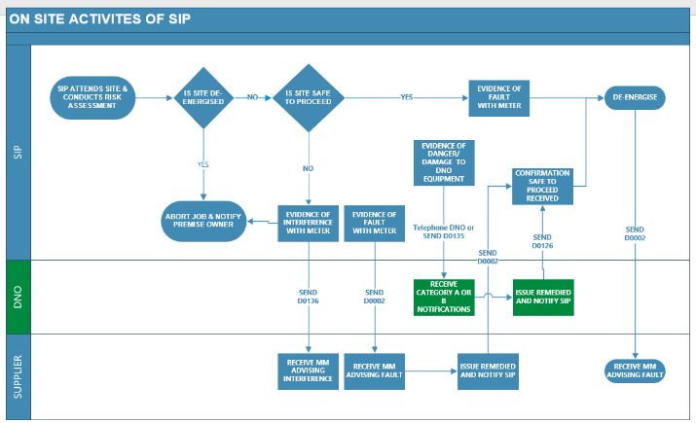

Slide 10
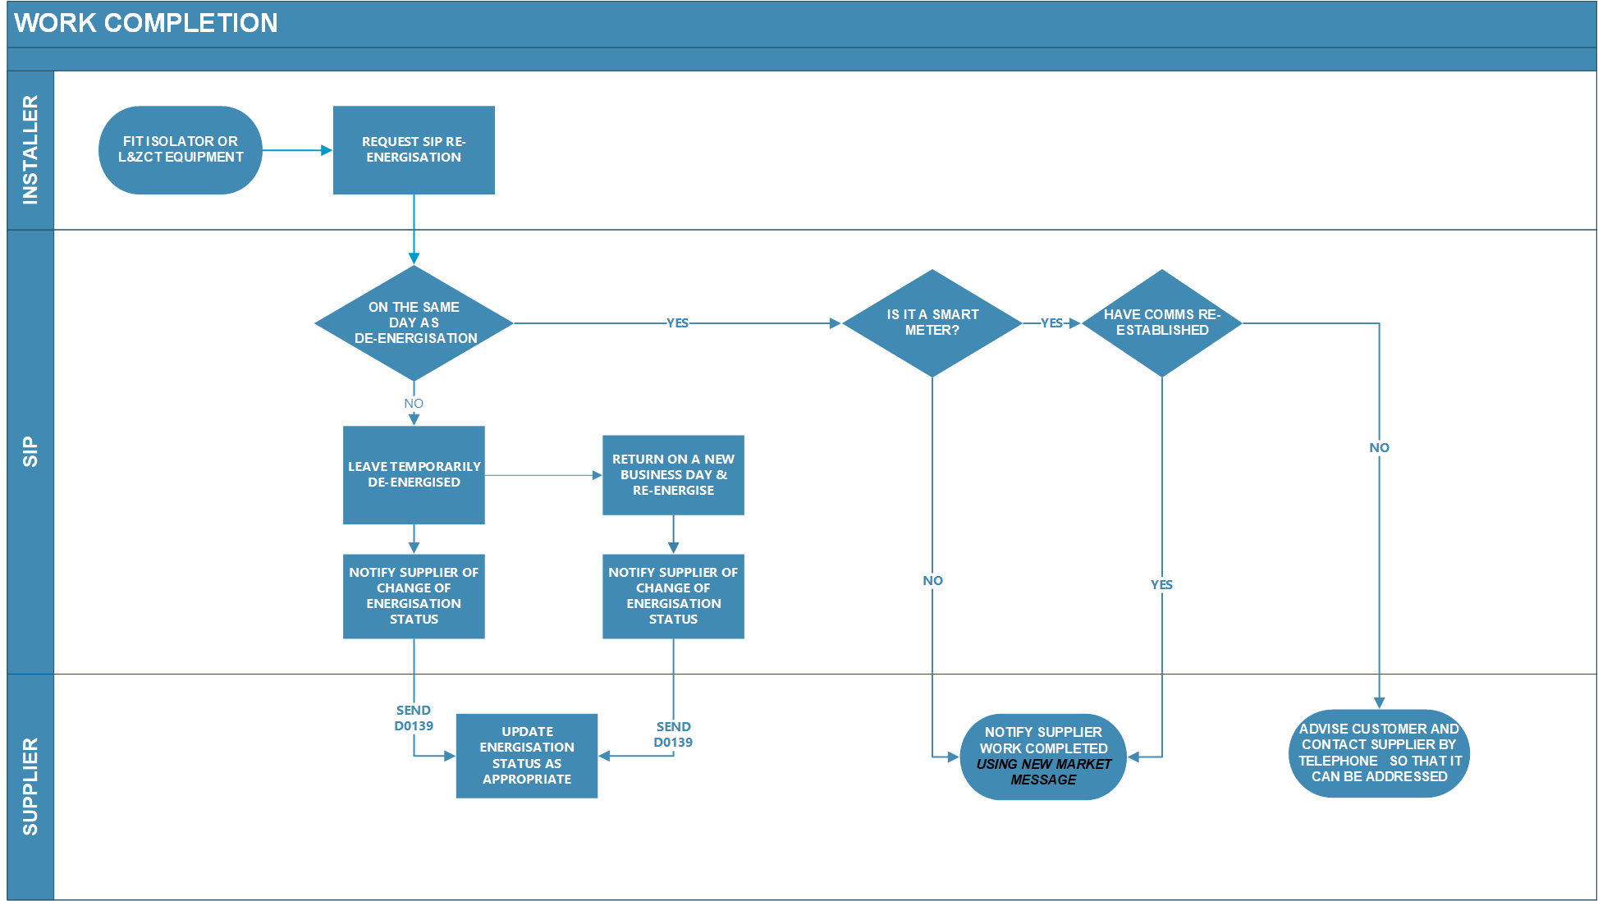

Slide 11
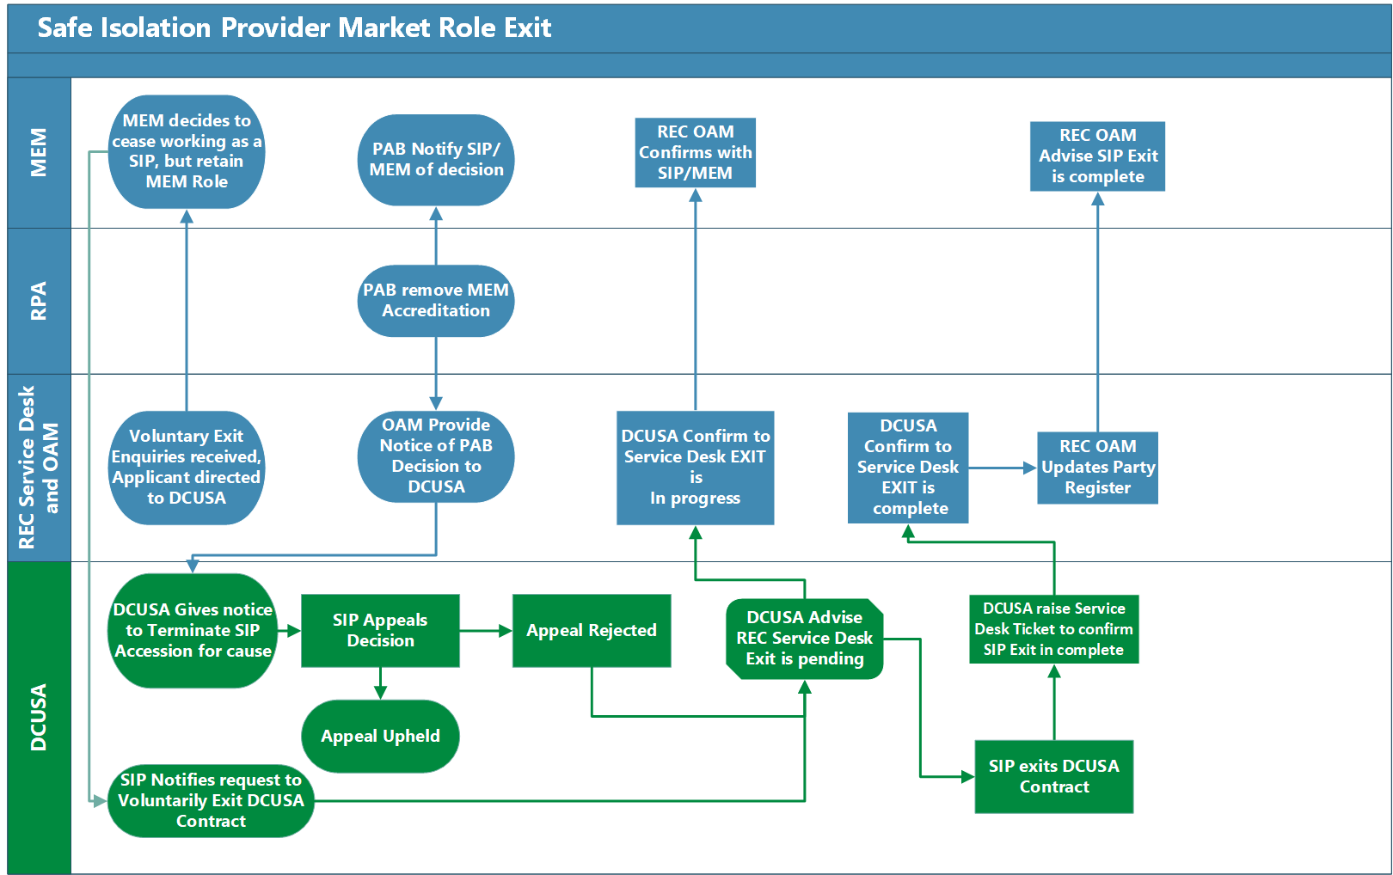

Slide 12
Market Messages

Slide 13
Existing Market Messages – Changes and New Scenario Variants
MM Number | Topic Area | As Per R0021 FCR | Proposed for R0101
MM00013/ D0002 | Scenario Variant | Included SIP to Supplier variant, but didn’t include a variant from the Supplier to the SIP for resolution reporting | New variant now included.
 | Scenario Variant Reference No | Not Included | Will be included in Pre-Release information
MM00016/ D0126 | Scenario Variant Reference No | Not Included | Will be included in Pre-Release information
MM00023/ D0135 | Scenario Variant Reference No | Not Included | Will be included in Pre-Release information
MM00029/ D0136 | Scenario Variant Reference No | Not Included | Will be included in Pre-Release information
MM00036/ D0139 | Scenario Variant Reference No | Not Included | Will be included in Pre-Release information
 | Recipients of the Flow | SIP to MEM was included in the red lining for the flows in R0021, but not in the solution | Confirmed as not required and updated into solution
Standards Definition Document | Data Service | Not Included | Now added SIP as a Data Service Provider

Slide 14
R0021 – Work Complete
Data Item ID | Legacy Reference | Name
DI50003 | J0003 | MPAN Core
DI##### | J#### | SIP ID
DI50045 | J0084 | Supplier Id
DI50007 | J0010 | Meter Register Id
DI50009 | J0014 | Date of Action
DI50016 | J0024 | Site Visit Check Code
DI50019 | J0040 | Register Reading
DI50041 | J0080 | Energisation Status
DI51025 | J1699 | Priority Services Category
DI51497 | J2208 | Consent to share data obtained
DI50008 | J0012 | Additional Information

Slide 15
R0101 Work Complete
Data Item ID | Legacy Reference | Name
DI50003 | J0003 | MPAN Core
DI50045 | J0084 | Supplier Id
DI50009 | J0014 | Date of Action
DI50008 | J0012 | Additional Information
DI50137 | J0263 | Metering Point Postcode
DI50488 | J1036 | Metering Point Address Line 1
DI50489 | J1037 | Metering Point Address Line 2
DI50490 | J1038 | Metering Point Address Line 3
DI50491 | J1039 | Metering Point Address Line 4
DI50492 | J1040 | Metering Point Address Line 5
DI50493 | J1041 | Metering Point Address Line 6
DI50494 | J1042 | Metering Point Address Line 7
DI50495 | J1043 | Metering Point Address Line 8
DI50496 | J1044 | Metering Point Address Line 9
DI##### | J#### | SIP ANI – Medical Dependency on Electricity
DI##### | J#### | SIP ANI – Third Party Presence Required
DI##### | J#### | SIP ID

Slide 16
Comparison between R0021 & R0101
Data Item | R0021 | R0101 | Name | Comparison
DI##### | J#### | J#### | SIP ID | Same in Both Flows
D150045 | J0084 | J0084 | Supplier ID | Same in Both Flows
D150003 | J0003 | J0003 | MPAN Core | Same in Both Flows
D150488-496 | J1026-J1034 | J1036-J1044 | Address Lines 1, 2, ….. | Only 2 populated in R0021, but changed to Metering Point Address in R0101
D150007 | J0010 | - | Meter Register Id | Not included in R0101
D150009 | J0014 | J0014 | Date of Action | Same in Both Flows
D150016 | J0024 | J0024 | Site Visit Check Code | Not included in R0101
D150019 | J0040 | - | Register Reading | Not included In R0101
D150041 | J0080 | - | Energisation Status | Not included in R0101
D151497 | J1699 | - | Priority Service Category | Not included In R0101
D1500008 | J0012 | J0012 | Additional Information | Same in Both Flows
D1##### | - | J#### | SIP ANI - Medical Dependency on Electricity | New in R0101
D1##### | - | J#### | SIP ANI - Third Party Presence Required | New in R0101

Slide 17
Q&A
All

Slide 18
Audience Q&A Session
ⓘ Start presenting to display the audience questions on this slide.

Slide 19
Thanks for attending
Contact us: enquiries@recmanager.co.uk

Slide 20
Feedback
ⓘ Start presenting to display the poll results on this slide.

