Slide 1
Data Specification Workshop
17 May 2023

Slide 2
Amelia Bray
REC Code Manager
Communications and Events Manager
Neil Brinkley
REC Code Manager
Roz Timperley
REC Code Manager
April Harbour
REC Code Manager

Slide 3
Housekeeping
Videos and microphones
Event recording
Use of Slido
Opportunities for Q&A

Slide 4
Join at slido.com #2377496
ⓘ Start presenting to display the joining instructions on this slide.

Slide 5
Agenda For today
Agenda Item | Presenter
The Data Specification | April Harbour
Non-REC Owned Data & Messages | Rosalind Timperley
Machine Readable Access – New SQL version guidance document | Neil Brinkley
Upcoming Data Specification Changes | April Harbour, Rosalind Timperley, Neil Brinkley
Q&A and request for feedback | Amelia Bray

Slide 6
The Data Specification

Slide 7
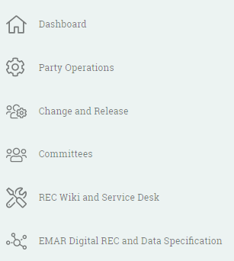
Data specification –overview & access
What is the REC Data Specification?
The REC Data Specification describes the Data Items and Market Messages that used by industry parties to send and receive information. It includes not only REC owned items but also messages and data items which are owned and governed under the Balancing and Settlement Code (BSC), Distribution, Connection and Use of System Agreement (DCUSA) and Smart Energy Code (SEC).
Accessing the Data Specification
The REC Data Specification is available to view within the Energy Market Architecture Repository (EMAR) Digital Navigator. Users are able to access this via the REC Portal home page. You do not need to sign into the REC Portal to access this, however users that are not signed in to the REC Portal will only be able to access the Digital Navigator, not IBM Jazz.

Slide 8
Navigating The data specification
The Digital Navigator home page will display two rows, as shown above. You are given the option to select between the Codes Schedules and Data Specification as well as the Dashboard and Detailed Search. Your selected options will turn into a darker green.
The Data Specification dashboard includes 6 sections:
Data Specification Catalogue(s): contains the full REC Data Specification in HTML and Access formats.
Data Access Matrices: contains both electricity and gas access matrices
Data Specification Documents: contains multiple documents which outline rules and information related to the data specification build
Meter Product Data (MPD) Table(s): contains the latest Gas Meter Products tables and response codes
Guidance Documents: contains legacy documents (such as DTC annexes)
Data Specification Pre-Release Information: contains upcoming versions of the Data Specification
Notes:
Dashboard overview: Codes Schedule includes all REC Code Schedules (latest and previous versions) which can be accessed via a click and read within the UI, or you can choose to download (in MS word format).
Dashboard overview: Data Spec

Slide 9
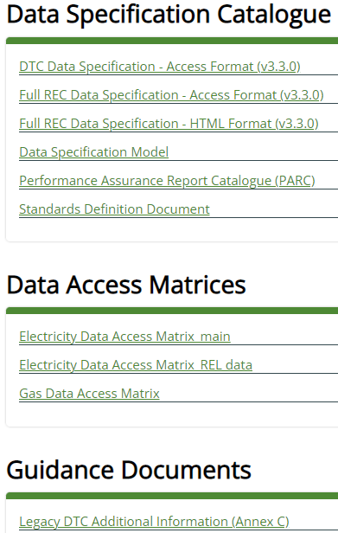
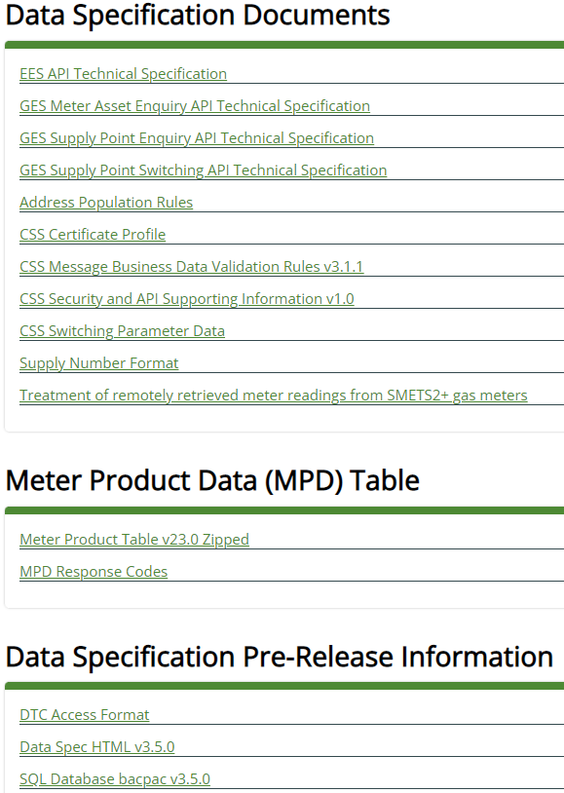
Data Specification - dashboards
In order to view or download any of the artefacts within the dashboard sections, you select the item.
Once selected, one of three things will occur:
In cases where a downloadable file is the only manner to access, it will automatically start the download in your internet browser download history. Once download has completed you can select to open or save.
You will be re-directed to another page within EMAR which will provide all relevant information.
In most instances, your browser page will automatically open the document or image where you will be able to download or print in a non-editable format.
TIP: Unless an automatic download is occurring, the artefact will open within the same browser window. You can navigate back to the dashboard by selecting the back button within your browser.
However, if you need multiple items we recommend ‘opening link in new browser window’ by using the right finger tab on your laptop/ mouse.

Slide 10
data specification – detailed search
When using the Detailed Search function, a new page will be displayed, as shown below. Here you have a number of options which will allow you to refine your search and access any data within the Data Specification.
Notes:
You can search by Market Messages, Scenario Variants or Data Items, where a full list of results is provided on the same page. As the images on screen show.
You can also further refine results, using the text Search field and Filter options for source / target (for Market Messages and Scenario Variants). The search function allows for EMAR id’s, Legacy id’s and Names, partial search criteria will also return results.

Slide 11
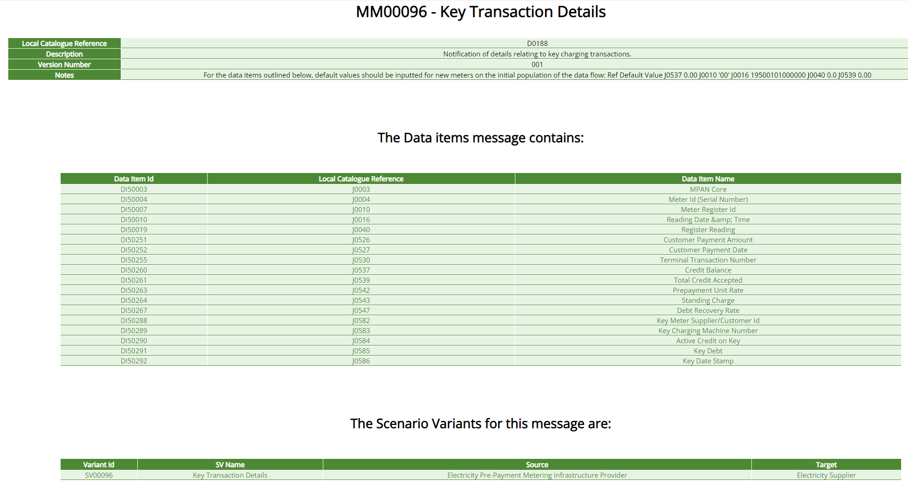
data specification – Market messages

Slide 12
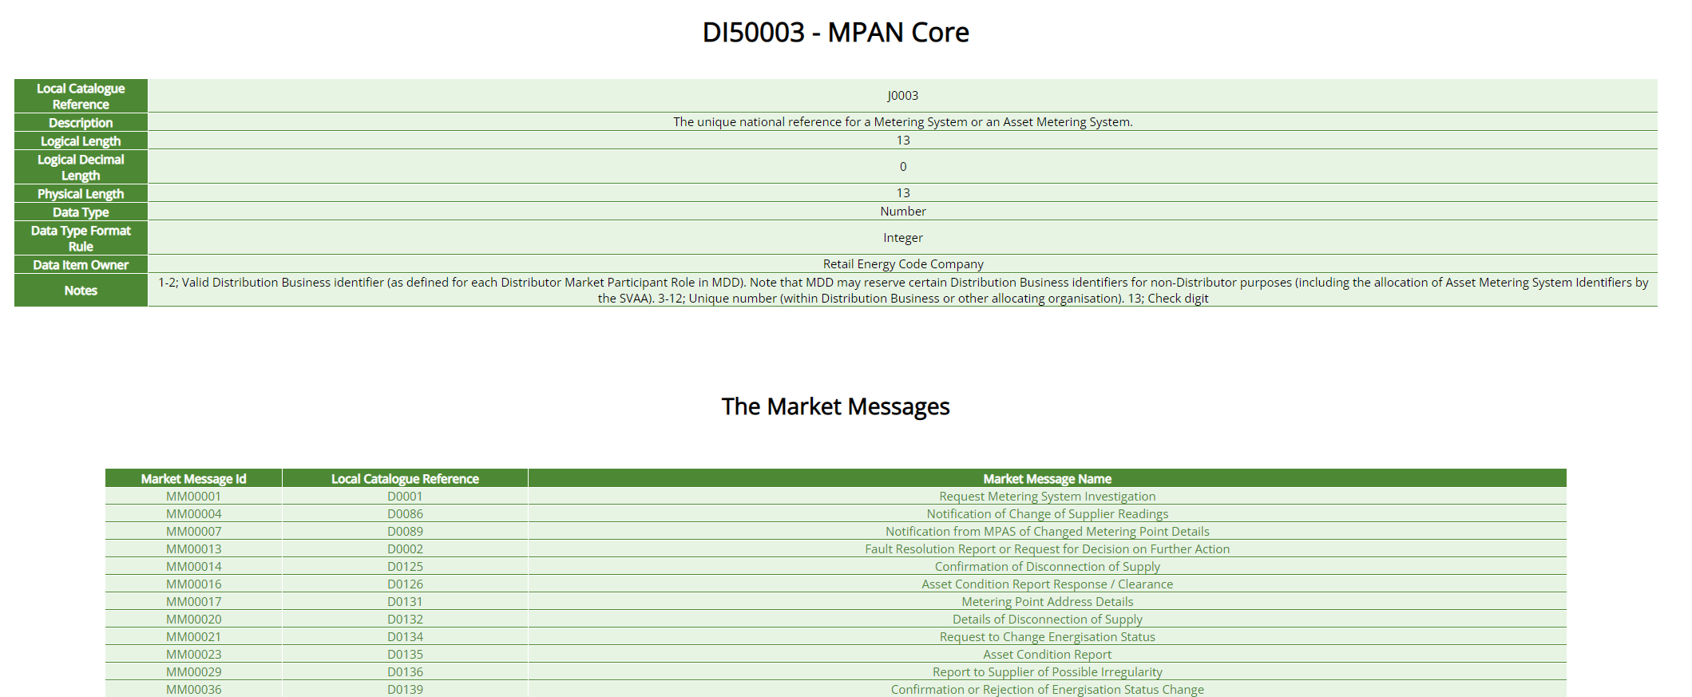
Data specification – data items
Notes:
While we’ve navigated to this page through the Key Transaction Details MM, the same action would be performed from the main detailed search function. You would select Data Items as an option, or use the search tab to refine for the MPAN Core DI reference and the page as shown would be available.
In this page, you are shown a number of items. This includes the name/ description of the DI, but also the formatting rules that it needs to adhere to (Logical/ Physical lengths, Data Type, and format) In addition you can identity who the data item owner is (in this case RECCo), but as we mentioned earlier this could be BSC/DCuSA/ SEC plus any applicable notes which need to be advised or adhered too.
The bottom table provides a full overview of all the associated Market Messages where the Data Item is included. MPAN Core is a highly used electricity item and therefore is included in a number of MM’s (only including a snapshot of what has been included on screen) as mentioned previously you can select any of the market messages here and you’ll be navigated back to the Market Message details page.
In addition, if a Data Item has multiple enumerations, this information can be sourced through this area of the Data Specification (example PSR Flows)

Slide 13
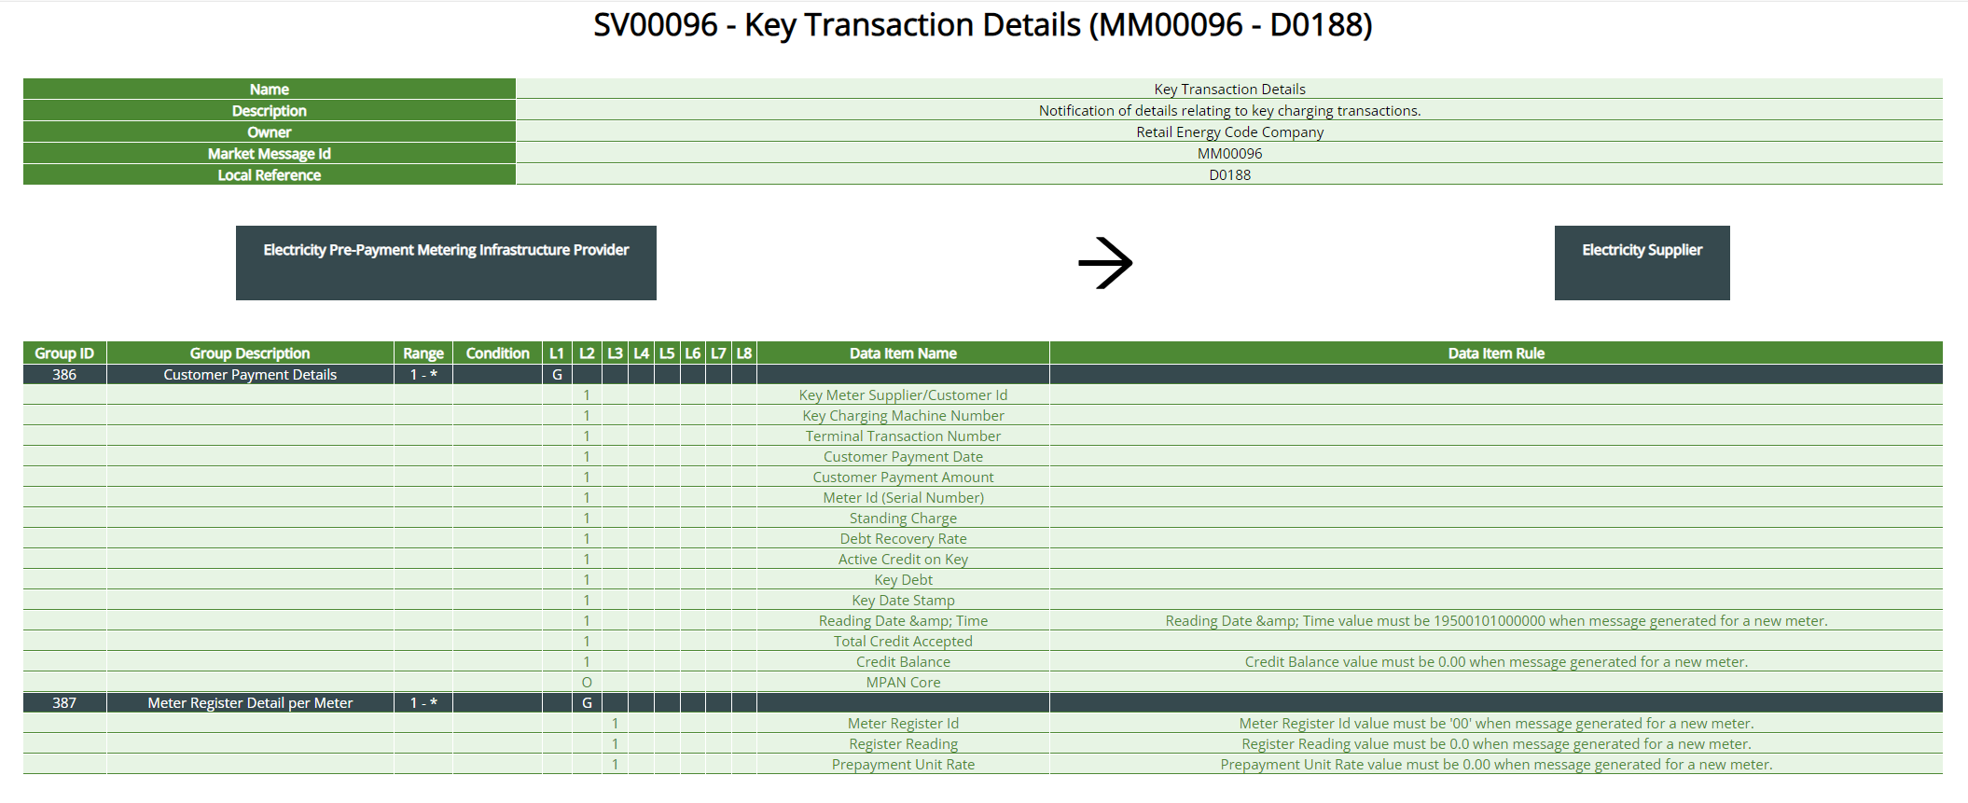
Data specification – scenario variants
Notes:
Using the same example as we’ve been looking at, and much like the Data Items, the Scenario Variants page as shown on screen can be navigated too directly from Market Messages, this is likewise the same screen which is presented if navigated to from the Detailed search page. In this example we only have 1 permitted SV instance, however in other MM’s several SV’s may be permissible based upon the source / target parties. Importantly the SV page confirms the Source (left) and Target (right) (Blue boxes) and the entire message (flow) structure, broken down by group to data item and rules.
The flow structure table includes all the relevant information which enables messages to be built within parties' systems and sent to other parties. Confirming aspects such as Grouping ID’s and descriptions. Ranges of Modality (min) and Cardinality (max). Levels and Data Item conditionality (Mandatory/ Optional). There is also a reference to any rules that must be applied to data items in certain conditions. (i.e for reading date & time, the time value must be as stated upon first issue of the message for a new meter).

Slide 14
Data Specification - Guidance
As of May 2023, a new Data Specification Guidance document has been created and will be released imminently.
This will be available through the REC Portal Wiki. It includes a knowledge article and a downloadable guidance document.
The Code Manager will review and improve this guidance to ensure parties are empowered and enabled to conduct their actions within the Data Specification.
If you would like to receive email updates on the REC Data Specification, such as when a pre-release has been published or if you have any queries in future, or require any support with the Data Specification, please direct these to: enquiries@recmanager.co.uk

Slide 15
Non-REC Owned Data Items

Slide 16
Non-REC Owned Data Items and Messages
Updates are initiated by the Market Message or Data Item Owner
The REC Data Spec contains message information for both REC and Non-REC industry flows
REC BSC DCUSA SEC UNC
REC Data Specification

Slide 17
data Specification Updates
There are a number of scenarios under which the REC Data Specification might be updated:
Non-REC Owned, with No REC Impacts: If you have a known Data Specification change and the message/data items are non-REC owned and there are no potential REC impacts, go directly to the Code Manager/Administrator that is the Owner. The Owner should ensure approval under the appropriate governance mechanism. We will then implement the change on the approved implementation date.
Non-REC Owned, plus REC System, Legal Text or Data Specification Impact: As above, the non-REC Owned Data Specification changes should be progressed via the Owner. If there is also a known or suspected REC system, legal text or Data Specification impact email enquiries@recmanager.co.uk for support in raising a REC Change Proposal. This will be progressed in collaboration with the other impacted Code modification, via the Cross Code Steering Group
Only REC Owned Data Specification Impact (with or without REC System and/or legal text Impacts): If the only Message/Data Item(s) that require changing are owned by REC, email enquiries@recmanager.co.uk for support in raising a REC Change Proposal. The REC Change process will also consider any cross-code impacts.
If you are unsure and would like any guidance or support, email enquiries@recmanager.co.uk

Slide 18
The Principles
We are liaising with the other Code Managers that own data items to agree a set of principles, which would provide consistency in approach across the codes. The draft principles are:
Principle 1: No Ad-hoc releases: Data Specification changes will be applied in the three standard industry releases (February, June, November).
Principle 2: Minimum Lead Time (approval): there will be a minimum of four months between approval of a data specification change under the relevant Code and its implementation.
Principle 3: Minimum Lead Time (pre-release): there will be a minimum of three months between the publication of the data specification pre-release information and implementation.
Principle 4: Communication of changes: the Code Manager/Administrator that owns the items being updated will be responsible for issuing communications to industry on data specification changes, as part of its own change and release processes.
Principle 5: Communication of Releases and Pre-Releases: the REC Code Manager will issue communications to industry when a pre-release to the Data Specification is available and when the release has gone live, as will the Code under which the change was approved.
Principle 6: Code Managers will endeavour to co-ordinate communications: the Code Manager/Administrator that owns the items being updated and the REC Code Manager will co-ordinate to ensure consistent communications.

Slide 19
Audience Q&A Session
ⓘ Start presenting to display the audience questions on this slide.

Slide 20
Machine readable access – new SQL Version

Slide 21
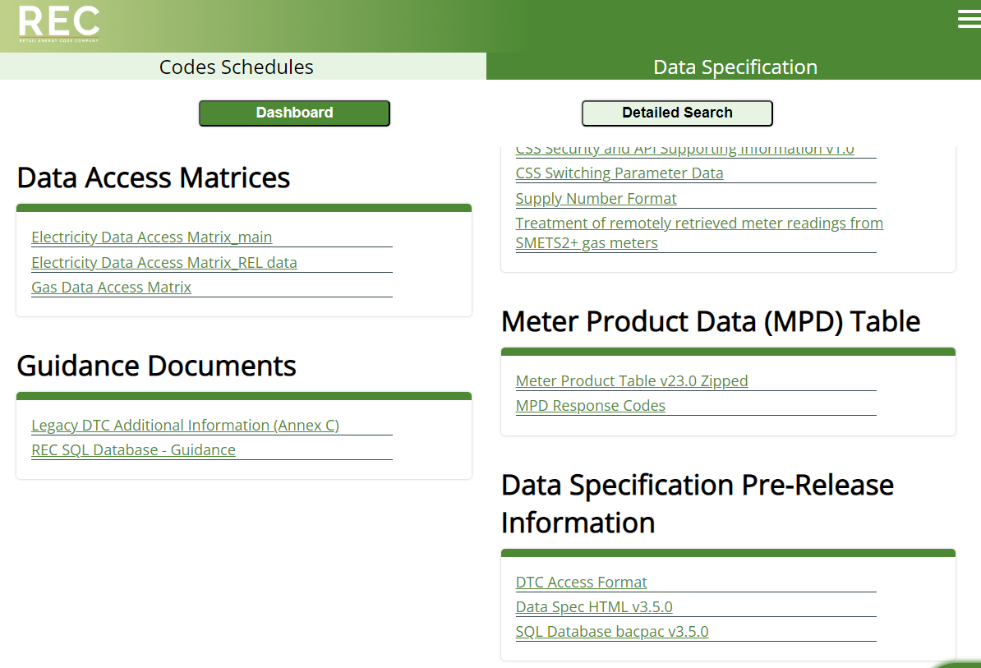
REC Data Specification – SQL version
At present MS Access is the current method for viewing/ accessing the Full REC Data Specification.
The February 2023 release (v3.3.0) was the final ‘full REC’ version to be released in the MS Access format. To view the ‘machine readable’ versions of the full REC Catalogue going forward, parties will need to download and install the SQL Database bacpac v3.5.0 to access the same level of data.
Why Change?
SQL Server is a more robust database solution
The solution is available to both Windows & Mac users (no degradation of use)
Secure & future proof method for sharing data structures
Can handle large and complex queries
Easier to manage data integration between different applications

Slide 22
SQL Guidance
Guidance Document
This can be found within the Data Specification Dashboard, under ‘Guidance Document’ section
To download, just select the item
Live Database
The live database is a .bacpac file
This is found under the ‘Data Specification Pre-Release Information’ section
To download, just select the item

Slide 23
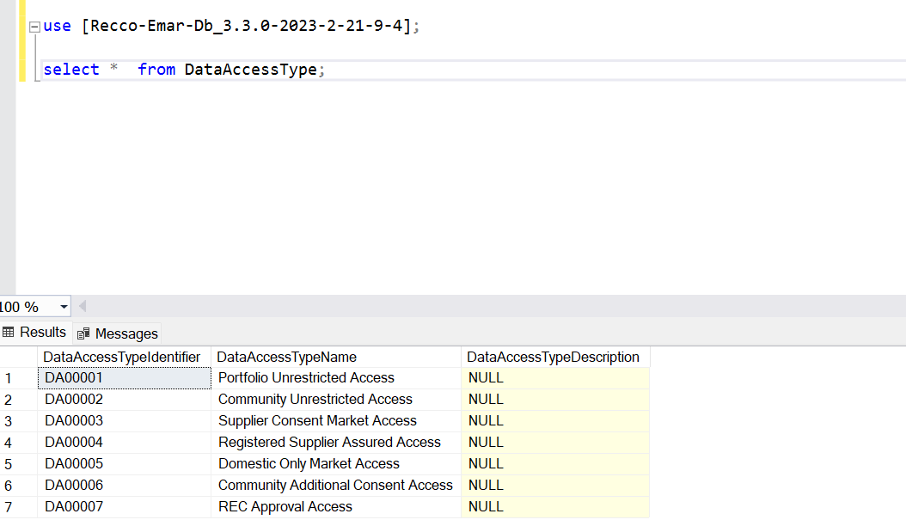
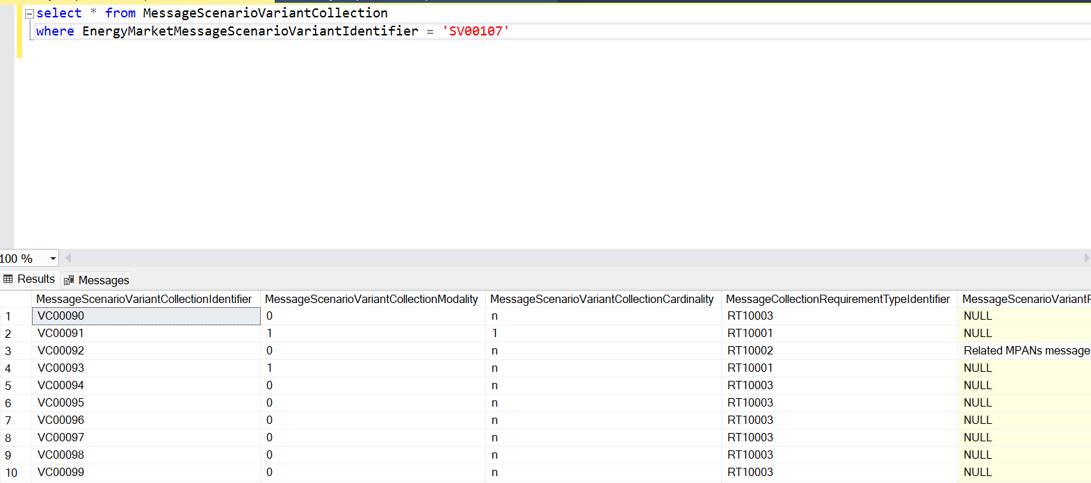
SQL Use
Who can complete this action?
Technical members who build and maintain systems within your organisation
Who will use it?
Members of your organisation who want to conduct complex queries against the data
How can this be used?
SQL Server uses the SQL syntax to build queries

Slide 24
Audience Q&A Session
ⓘ Start presenting to display the audience questions on this slide.

Slide 25
Future Changes to data specification - Code Manager initiated
Notes:
DTC Style Access Database

Slide 26
Data specification – Upcoming Changes
The REC Code Manager are working on a number of future changes to the REC data specification
R0113 - Housekeeping and Clarifications Change Proposal
Purpose: To remove ambiguity in the data specification, reducing the risk of incorrect interpretation of the data specification.
MHHS – Changes to the REC Data Specification
Purpose: To update the REC Data Specification for Market Wide Half-Hourly Settlement Impacts.
Data Specification Roadmap Changes
Purpose: To carry out a cleanse of the REC Data Specification to ensure accuracy, quality and consistency in the contents of the specification.

Slide 27
Data specification – Upcoming Changes
The REC Code Manager are working on a number of future changes to the REC data specification
R0113 - Housekeeping and Clarifications Change Proposal
Purpose: To remove ambiguity in the data specification, reducing the risk of incorrect interpretation of the data specification.
MHHS – Changes to the REC Data Specification
Purpose: To update the REC Data Specification for Market Wide Half-Hourly Settlement Impacts.
Data Specification Roadmap Changes
Purpose: To carry out a cleanse of the REC Data Specification to ensure accuracy, quality and consistency in the contents of the specification.

Slide 28
R0113 - Data specification – housekeeping and clarifications change proposal
The purpose of this Change Proposal is to remove any ambiguity, especially for new entrants/ parties looking to build systems under the REC. This CP will look to align/ remove gaps between the REC Data Specification and pre-REC legacy documents. It includes aspects such as:
Updates to the REC Standards Definition Document to:
Ensuring alignment between pre-REC products and REC, removing any ambiguity.
Include clarifications on Data Type Formats for unit of measurements (for applicable data items).
Signpost where readers can find appropriate information to different products.
Updates to relevant Market Messages/ Scenario Variants to:
Remove references which are no longer relevant
Update references which have typo’s which may cause confusion
Further additions may be included following Industry Workshop(s) to be held with parties to ensure there are no unforeseen potential impacts for parties who will build their systems upon issuing market messages to parties whose systems have been built under legacy system rules.
Notes:
Confirm dates for workshop will be confirmed as soon as possible. We would encourage parties to attend this workshop so as to ensure that all potential risks can/ are mitigated before this change proposal progresses on it’s pathway.
The change proposal pathway will be established following the completion of the Industry workshops.

Slide 29
Data specification – Upcoming Changes
The REC Code Manager are working on a number of future changes to the REC data specification
R0113 - Housekeeping and Clarifications Change Proposal
Purpose: To remove ambiguity in the data specification, reducing the risk of incorrect interpretation of the data specification.
MHHS – Changes to the REC Data Specification
Purpose: To update the REC Data Specification for Market Wide Half-Hourly Settlement Impacts.
Data Specification Roadmap Changes
Purpose: To carry out a cleanse of the REC Data Specification to ensure accuracy, quality and consistency in the contents of the specification.

Slide 30
Data specification – changes as a result of mhhs implementation/ release
The REC Data Specification brings together multiple ‘local’ catalogues, with various owners, ranging from the Retail Energy Code itself, to the BSC and DCUSA
These catalogues cover dual-fuel industry systems and processes including the Central Switching Service, Retail Gas Metering Arrangements, the legacy MRA ‘Data Transfer Catalogue (DTC)’ and Settlement Arrangements
The REC Technical Design Authority (TDA) has been requested to add the DIP Interface messages, and Reporting Catalogue to the REC Data Specification, in order to provide a one-stop-shop for all industry messages, as well as removing duplication and potentially costly development of a standalone DIP data catalogue
The TDA has begun to break down and translate the DIP IFs into the current Data Specification model, as well as making structural updates to the format where required
Please note:
We are working with the programme to work through a number of questions so the following slides are based on current understanding. Some minor changes may be made to the structure and content prior to consultation.
We are working to an assumption that Business and Validation rules will be hosted in separate documents. The hosting and provision of those documents is yet to be defined.

Slide 31
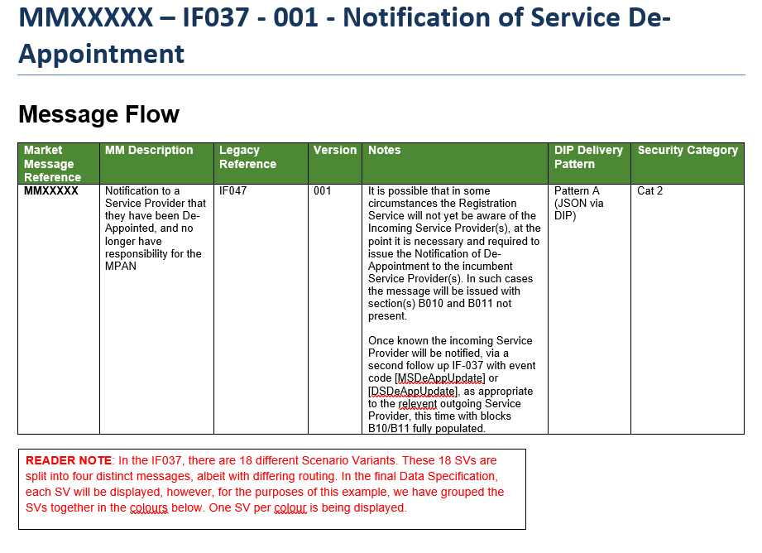
Market Message Meta-Data
Market Message Meta-Data is displayed in a clear and consistent manner
Version number structure to continue as per REC Data Specification structure (to be validated)
From and To Parties are split out into Scenario Variants (see next slide)
Notes are taken from the bottom of each IF (in IF Catalogue)

Slide 32
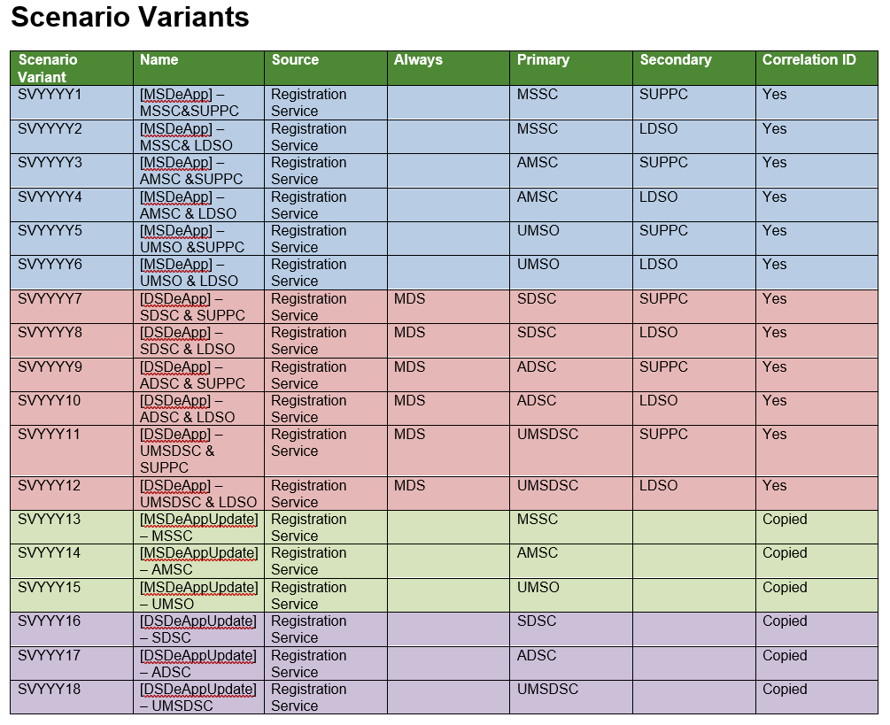
Display of routing options
Routing of DIP IFs has been split into ‘Scenario Variants’
Each SV is unique to the business process (MSDeApp etc) as well as to the combination of Primary and Secondary Routing

Slide 33
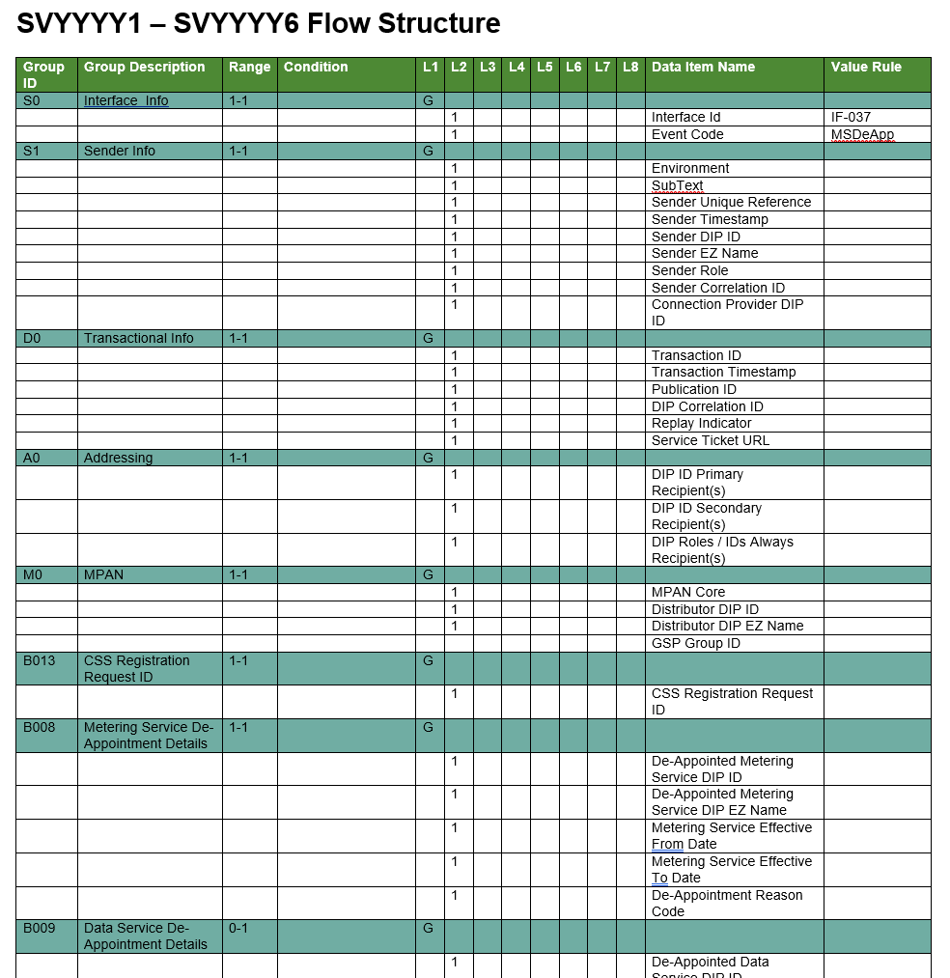
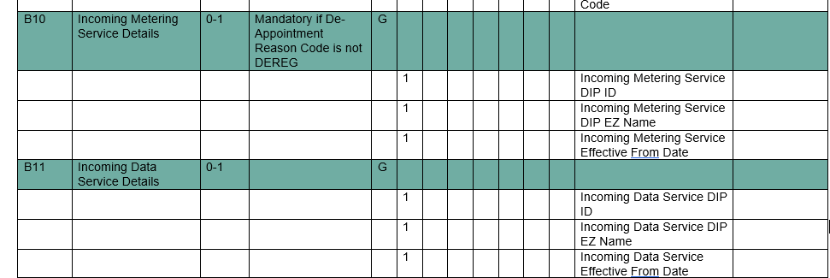
Market Message Structure
Value Rules to help with population
Group Names
Data Items
Group / ‘Block’ IDs
Data Item Optionality/Obfuscation
Group Cardinality & Range
Conditional Population Rules

Slide 34
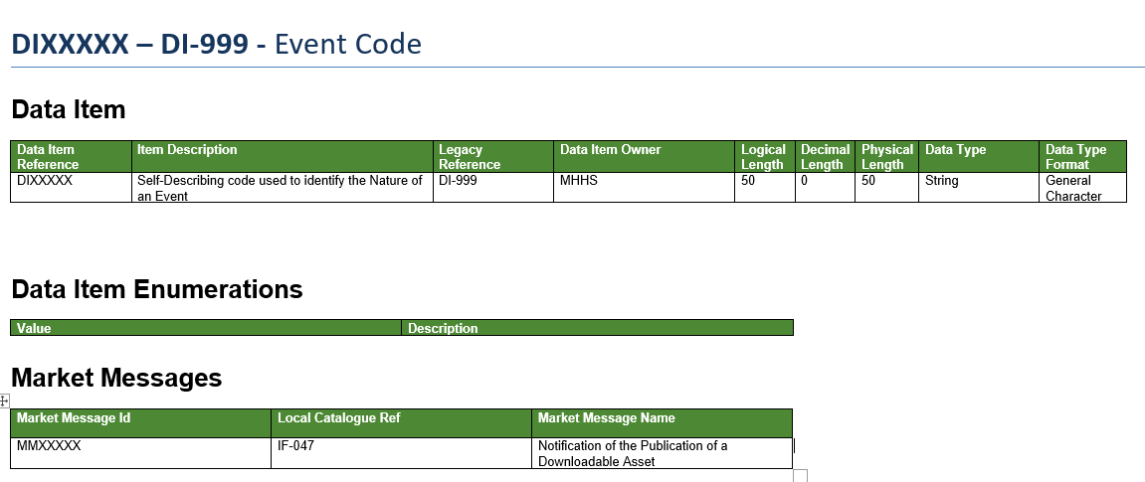
Data Item Structure
REC Catalogue Reference
No Data Item Enumerations for DI-999
List of Messages Item is contained in (not exhaustive in example)

Slide 35
Data specification – Upcoming Changes
The REC Code Manager are working on a number of future changes to the REC data specification
R0113 - Housekeeping and Clarifications Change Proposal
Purpose: To remove ambiguity in the data specification, reducing the risk of incorrect interpretation of the data specification.
MHHS – Changes to the REC Data Specification
Purpose: To update the REC Data Specification for Market Wide Half-Hourly Settlement Impacts.
Data Specification Roadmap Changes
Purpose: To carry out a cleanse of the REC Data Specification to ensure accuracy, quality and consistency in the contents of the specification.

Slide 36
Codes Roadmap Data Specification Changes
Once R0113 ‘Housekeeping and Clarifications Change Proposal’ and the MHHS changes are baselined, the Code Manager will be raising a further CP, under the Codes Roadmap, to address errors and gaps in the data specification not covered under R0113.
This CP will include:
Adding missing data items descriptions
Ensuring that no descriptions are ambiguous
Correcting typos, spelling errors and incorrect characters (e.g. text with “'This is the reason for the work â€”)
Removing/correcting incorrect references (e.g. “MRA” in the DTC Access database and amending the ‘Supplier Volume Aggregation Agent" to "Supplier Volume Allocation Agent“)
It is intended that changes will be housekeeping only, with no impact on party systems.

Slide 37
Questions & answers
Notes:
DTC Style Access Database

Slide 38
Audience Q&A Session
ⓘ Start presenting to display the audience questions on this slide.

Slide 39
Thanks for attending
Contact us: enquiries@recmanager.co.uk

Slide 40
Feedback
ⓘ Start presenting to display the poll results on this slide.

