Slide 1
Performance Assurance Webinar
25 May 2023

Slide 2
Introducing Your presenters
Jenny Hyskaj
REC Code Manager
Communications and Events Analyst
Katie Costa Fernandes
REC Code Manager
Performance Assurance Engagement Lead
Andrew Waghorn
REC Code Manager
Performance Assurance Analytics & Technology Lead
Lewis Williams
REC Code Manager
Performance Assurance Analytics Manager
Vaishnavi Sharma
REC Code Manager
Party Assurance Manager

Slide 3
Housekeeping
Videos and microphones
Event recording
Use of Slido
Opportunities for Q&A

Slide 4
Join at slido.com #1099044
ⓘ Start presenting to display the joining instructions on this slide.

Slide 5
Agenda For today
Agenda Item | Presenter
Introduction | Jenny Hyskaj
Performance Assurance overview | Vaishnavi Sharma
Performance Assurance Dashboard Developments | Lewis Williams
Energy Theft | Lewis Williams
Data Cleanse Approach | Lewis Williams
MEM Flow Assurance | Vaishnavi Sharma
Priority Service Register | Vaishnavi Sharma
Upcoming Change Proposals- R0025 Service Provider Performance Charges (DCC) | Vaishnavi Sharma
Forward look at Performance Assurance activity | Andrew Waghorn
Q&A | Jenny Hyskaj

Slide 6
Performance Assurance Overview
Vaishnavi Sharma

Slide 7
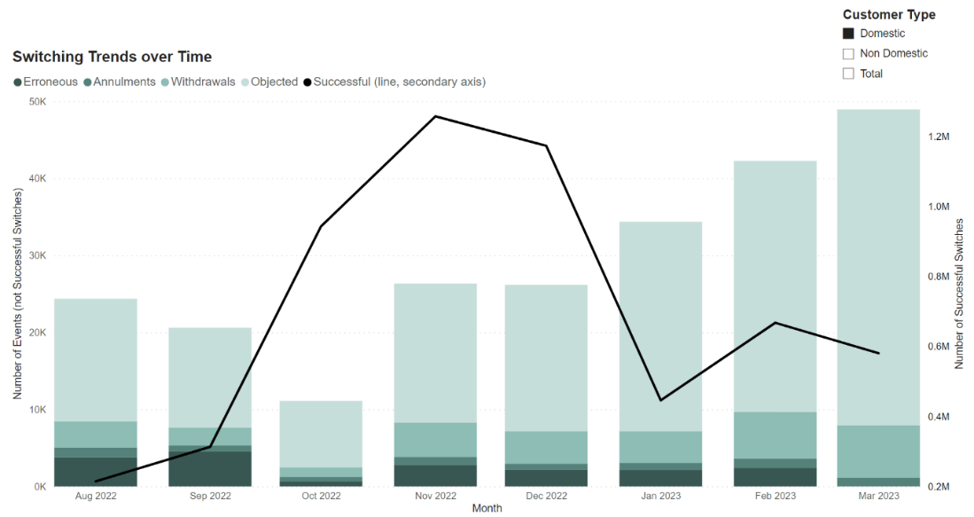
Switching Performance - Domestic
In the last quarter, switching volumes across the market remained low.
Total switching volumes were driven up by internal migration activity by two REC Parties, with actual switching volumes remaining low at c.200,000 switches per month.
The use of Objections, Withdrawals and Annulments is increasing despite the low volume of switching.
Figure 1 – Switching trends amongst domestic customers

Slide 8
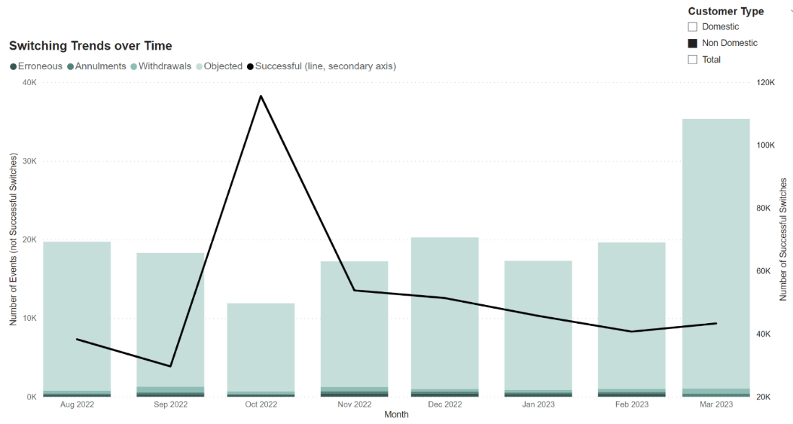
Switching Performance – Non-Domestic
For the non-domestic market segment, the objection volumes nearly doubled in March.
The Code Manager issued RFCs to understand the drivers for the increase in the use of Objections despite the volume of switches remaining low.
RFCs were also issued to understand whether Parties are using Annulments and Withdrawals appropriately and in accordance with the Code.
Figure 2 – Switching trends amongst non-domestic customers

Slide 9
Market Observations – Performance Assurance Priorities
Our priorities in the last quarter:
Area of focus for the coming months:
Switch Meter Reading Dispute Resolution
MEM RFI
The Code Manager has issued guidance on how Parties can improve their performance in this area. This was taken to the REC Issues Group (RIG) in March and has since been published on the Portal.
We are allowing time for Parties to improve their processes.
We will apply further PATs where no improvement is evident.
As the use of the DTN/RGMA is not mandated in all cases, reports from central data sources do not provide a complete view of how MEMs across the industry are performing against their REC obligations. To improve coverage of our risk monitoring, we are requesting information from MEMs.
Data Cleanse
Maintenance and Sharing of PSR Information
Data Cleanse sprints will focus efforts to drive a reduction in volumes across market.
The Code Manager issued self-assessments to Distribution Network Operations and Gas Transporters to understand whether the processes they operate meet the Code requirements around maintenance and sharing of PSR data.
This has also helped identify challenges faced across the industry when appropriately providing Priority Services.
The insights from this have been presented to PAB and shared with RECCo.
Objections and Annulments
Through current PATs, we have identified an opportunity to issue guidance to Parties on appropriate use of Objections and Annulments as permitted within the Code.
Where Parties are found to misuse these processes to prevent switching, further escalations will be applied, which may include referral to Ofgem with approval from PAB.

Slide 10
Performance Assurance Activities over the last quarter
We currently monitor performance against 14 Risk Drivers.
The Normalised Risk Score across the industry has remained consistent over the last quarter.
Greater utilisation of Notifications when Parties breach a threshold has enabled them to proactively improve their performance.

Slide 11
Performance Assurance Activities over the last quarter
In the last quarter, we have seen through our interventions where Parties are engaging well with the Performance Assurance process.
We have also seen examples of where Parties are proactively reviewing Performance Assurance Dashboards to support their internal monitoring and improvement efforts.
Where Parties repeatedly fail to engage with the Performance Assurance process, the Code Manager, with approval from PAB, has revoked their access to REC Services, and applied an acquisition cap.
1
Identify
Following the risk monitoring activities in December, the Code Manager issued a Request for Clarification to a Party to understand reasons for dip in their Erroneous Switch (ES) process performance.
2
Intervene
Based on insights from the RFC, the Code Manager issued an Action Plan to this Party in February to drive improvement in performance.
3
Improve
The Party engaged with the Code Manager since February to report progress against the Action Plan. They demonstrated reduction in % of total Gains resulting in an ES and % of total ES requiring SDEP escalations for resolution, and improved response times to ES data flows.

Slide 12
Performance Assurance Dashboard Developments
LEWIS WILLIAMS

Slide 13
Dashboard UPDATES
UPDATE | PARTIES AFFECTED | RELEASE DATE
Theft Target Publication | Energy Suppliers | February 2023
Release Notes Tab | All | March 2023
Theft Row Detail Tab | Energy Suppliers | May 2023
Additional Theft Visuals | Energy Suppliers | May/June 2023
Data Cleanse Summary Tab | Suppliers & DNOs | May 2023
Data Export/Download Functionality | All | May/June 2023
Use Case Walkthroughs | All | June 2023
MPxN Publication by Default | Suppliers & DNOs | July 2023
Dashboard Viewer Permissions | All | TBC

Slide 14
Useful Resources
The recordings of the various webinars held on dashboard go-live are available on the REC Portal:
Performance Assurance Dashboards (REC Parties) Webinar
Performance Assurance Dashboard (Service Providers) Webinar
Performance Assurance Dashboards Post Go-Live Webinar
Performance Assurance Webinar (12 January 2023)
The dashboard user guide, detailing the process for accessing and using the functionality available within the dashboards is also available on the User Guides area of the Portal here.
For any specific issues, or to share any suggestions on future improvement, please contact the REC Service Desk.

Slide 15
Energy Theft
LEWIS WILLIAMS

Slide 16
2022-23 Reporting Year
Final Data Submission
Provisional Totals
Review & Query Window
Final Totals
Payments Communicated
The final submission deadline has passed, with submissions due by 02 May 2023.
The Code Manager published provisional total confirmed theft figures via the Dashboard on 23 May 2023.
The review and query window is open for 20 WDs, closing on 21 June 2023.
New functionality has been provided to allow for reviewing of individual Supplier Investigation IDs
The Code Manager aims to publish final total confirmed theft figures via the Dashboard on 18 July 2023 subject to any unresolved disputes or queries.
Incentive payment amounts will be communicated within 144 days of the end of the Reporting Year, i.e. by 23 August 2023.
Invoices will be provided by RECCo Finance.

Slide 17
2023-24 Reporting Year
Changes made for the 2023-24 Scheme Year:
Introduction of a data submission cut-off for confirmed thefts
Results published by the Code Manager solely via the Performance Assurance dashboards
Introduction of a formal query window
Theft investigations to be reported once initiated, with updates submitted in subsequent months if appropriate
1 June 2023 Submit April 2023 data
20 June 2023 Totals available on the dashboard
Review and query totals within 10 WDs
3 July 2023 Submit May data and any updates to April data

Slide 18
Useful Resources
Schedule 7 – Energy Theft Reduction
Energy Theft Incentive Scheme Reporting Timeframes
File Validation Wiki
For any specific issues, or to share any suggestions on future improvement, please contact the REC Service Desk.

Slide 19
Data Cleanse Approach
LEWIS WILLIAMS

Slide 20
Data cleanse sprints
Approach
A sprint-based approach, selecting a small number of reports per sprint
Sprints of 3-6 months
Pot reduction targets approved by the PAB
Monthly progress updates shared by the Code Manager at the RIG
Benefits
Alignment of efforts across industry
Focused resourcing
Long-term and sustainable reduction
Key Actions & Dates
PAB to approve targets for the first sprint - 30 May 2023
Code Manager to communicate targets to industry - 9 June 2023 newsletter & RIG meeting
3-month performance review - September 2023
Sprint ends – December 2023
Reports Selected – Sprint 1
Invalid Electricity MAP ID
Report AR3C
Report 3A Unflagged

Slide 21
MEM Flow Assurance​
Vaishnavi sharma

Slide 22
MEM Flow Assurance
The REC Code Manager’s risk monitoring procedures include specific topic monitoring on particular areas to observe the behaviours of certain groups of Parties (i.e. Suppliers, DNOs, MEMs, etc.).
The Metering Specific Topic Monitoring provides assurance over MEM flows focusing on installations, removals, exchanges, smart meter configurations, energisation, de-energisation and fault resolution.
The current analysis utilises DTN and RGMA data to reduce the data collection burden and standardise the data collected. However, the Code Manager is aware that the use of DTN/RGMA is not mandated in all cases.
Therefore, the Code Manager has developed a Request for Information for Electricity and Gas MEMs to improve coverage of our Metering Specific Topic Monitoring.
The first exercise focuses on the following REC obligations:
In subsequent cycles, we may look to expand to cover Meter Installations, Removals, Configuration, Energisation and De-energisation.
REPORT TYPE
TOPIC COVERED
REC Reference
Aggregate data but we may ask for MPxN-level data from some parties to validate the aggregate data submitted or where further analysis is required.
Faults
REC Schedule 14, Clause 18.4 and 18.8
Meter Exchanges
REC Schedule 14, Clause 8.5

Slide 23
MEM Flow Assurance - RFI
One-off Request for Information (RFI)
Pilot detailed monitoring
The pilot MEM RFI will be issued to all Electricity and Gas MEMs.
This covers obligations related to Fault resolution and Meter Exchanges.
The data returned by MEMs will be analysed and presented on performance dashboards.
Organisations with performance concerns will be asked to explain and improve their performance.
We will present the results to the PAB, who will determine either to make this a regular assessment, complete this work annually or stop at this stage.
Any need to report this regularly would be formally captured in the PARC and hence subject to the REC Category 2 Change Process (with consultation including on timeframes to implement).
PAB decision on ongoing usefulness
TIMELINES:
PROCESS:
9 June 2023 The Code Manager will issue the MEM RFI template to 'Your Files' section of the REC Portal.
21 July 2023 All Electricity and Gas MEMs are required to completed and return these data requests via the REC Portal
July and August
Reporting to PAB and application of PATs.
The reporting template will be uploaded to ‘Your Files’ section of the REC Portal by 09 June 2023.
Parties are required to complete these templates and return their submission via the REC Portal. Please upload these to the ‘Your Files’ section by 5 PM on 21 July 2023.
Any queries on the RFI can be submitted via enquiries@recmanager.co.uk.

Slide 24
Priority Service Register
Vaishnavi Sharma

Slide 25
Priority Service Register (PSR)
In March, The Code Manager issued a self-assessment on Priority Services Register requirements to all GTs/IGTs and DNOs/IDNOs to assure the PSR information management process and identify key challenges experienced across the industry.
The assessment covered the following areas:
Identification and Maintenance of PSR Records
Awareness of REC Obligations
Sharing of PSR Information
Macro issues
Rate of engagement with this exercise:
100% DNOs / IDNOs
responded on time
72%
GTs / IGTs
responded on time

Slide 26
Priority Service Register (PSR)
The following insights were noted and shared with REC PAB, and RECCo to support their work in this area:
Data quality issues such as incorrectly populated D0225 flow, inconsistencies over Needs Code used across the market and lack of data alignment across registers held and maintained by Registered Suppliers, DNOs and IDNOs.
Consumers are unaware of the role of DNOs and GTs.
Lack of standardised process or system for sharing PSR information across and between industry e.g. Gas, Electricity, Water.

Slide 27
Implementation of R0025 Service Provider Performance Charges (DCC)​​
Vaishnavi Sharma

Slide 28
Our role with service providers
BACKGROUND:
All Parties to the Code are subject to Performance Assurance, including Service Providers.
RECCo provide many of these services, with the following provided by REC Parties:
SERVICE PROVIDER PERFORMANCE CHARGES:
The Code Manager put in place a financial incentivisation process for the Centralised Registration Service Provider (DCC) from 01 April 2023, which involves margin at risk based on performance against service definitions. These were introduced by REC Change Proposal R0025.
Since this time, we have seen improvements in DCC’s reported SLA performance.
This incentivisation regime is in its early days, and we will continue to assess its effectiveness.
This approach fundamentally focuses on the performance levels required in the REC Service Definitions. These are also continually under review, for example, as part of R0092.
Central Switching Service (CSS), CSS Certificate Authority and Switching Operator Service by DCC
Electricity Retail Data Service (ERDS) by Distribution Network Operators
Gas Retail Data Service (GRDS) by Gas Transporters

Slide 29
Background on R0092
R0092 – DCC Service Level Agreements for the Switching Incentive Regime.
Under the REC, and as part of R0025 – Service Provider Performance Charges (DCC), from 01 April 2023 performance charges apply related to the CRS Provider’s performance against current SLAs under the Ofgem-led Switching Programme. As these SLAs were based on assumptions made in the early phases of the Programme, the DCC has proposed these be reviewed to ensure they are realistic regarding physical systems design and user behaviour.
The three areas proposed for SLAs to be reviewed are:
Message Response Targets
Gate Closure Targets
Incident Management Targets
There are also a number of exclusions proposed by DCC.

Slide 30
Industry Consultation for R0092
INDUSTRY CONSULTATION
To ensure the solution that is taken forward is fair and reasonable for the DCC and leads to good consumer outcomes, there will be regular updates provided to industry forums as well as Party Impact Assessments and Consultations triggered with notifications provided through the weekly Change Bulletin. To feed into the solution outside of these opportunities, contact elise.handy@recmanager.co.uk.
REC CHANGE PANEL
The Initial Assessment Report and Change Proposal Plan will be taken to the Change Panel for decision on 06 June 2023 and this will kickstart the solution development phase. The Initial Assessment Report proposes that the Responsible Committee be the Performance Assurance Board.
A review of these proposals will be conducted via a workgroup with representatives from:
ERDA
GRDA
EES Provider
One DNO
Three Suppliers
RECCo
Code Manager

Slide 31
Forward look at Performance Assurance activity ​​​
Andrew Waghorn

Slide 32
Forward look at Performance Assurance activity
Data Sharing / Publication
The Return of Mass Market Switching
The Performance Assurance operating plan
MHHS Programme

Slide 33
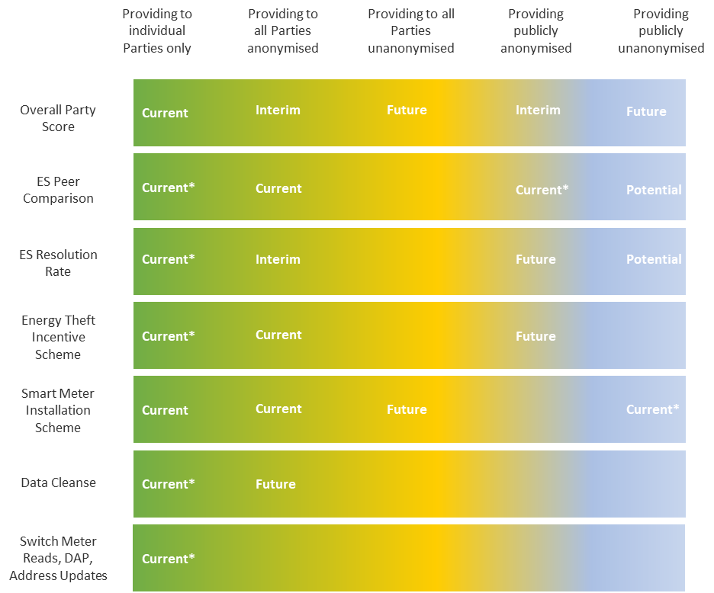
Overview
Transparency and accountability are key priorities of the PAB. They are focusing on increasing data sharing to drive this accountability.
The REC Performance Assurance dashboards were the key first step.
We have agreed with the PAB an incremental approach to sharing data more widely. A critical element of this is the reputational incentive, firstly of your peers knowing your performance level, but also your customers.
We are taking a gradual approach so that you can understand your data, work with us to improve the data we track, and you can act to improve your performance.
Overall transparency strategy

Slide 34
Key areas of data sharing
Over time we expect the following data shared with the public. Some of this will be anonymised.
Overall Party Score
SMIS Survey Performance
ES Resolution Rate
ES Rate
Energy Theft performance
We also envisage de-anonymising the following data, when shared with your peers:
We will continue to review our approach, considering levels of performance.
ES Resolution Rate
ES Rate

Slide 35
An annual rating
We will provide an annual rating on a four-point scale. This will cover both your performance demonstrated through performance data, as well as your conduct and wider performance.
We’ve set out below the criteria by which we will assign Parties to a specific rating. Criteria are applied independently, and the most significant rating is selected.
Criteria | No material weakness | Minor weakness | Moderate weakness | Severe weakness
Maximum risk drivers over threshold | 0% | 10% | 25% | 50%
Minimum performance against theft target | 75% | 75% | 50% | 10%
Maintenance of Qualification Delay |  |  | ✓ | ✓
Action plan PAT applied? |  | ✓ | ✓ | ✓
Management assertion PAT applied? |  |  | ✓ | ✓
Missed data cleanse sprint target |  |  | ✓ | ✓
Specific conditions PAT applied / CME breach? |  |  |  | ✓

Slide 36
The timeline for data sharing
You have access to the underlying performance data currently, giving you the opportunity to improve your performance, understand the underlying data and work with the Code Manager to refine the underlying metric if relevant.
We will roll out data sharing in a phased way:
Seeing your own
This was provided in November 2022
You will have been working since then to drive performance improvements
Seeing your peers
From June dashboard publication we will amend our current Party score so that you can see your monthly performance relative to others on an anonymised basis.
Early view of your annual performance
We will provide you an early view on your performance against the annual rating in September 2023.
Peers annual performance
We will share with you other Parties performance from 1 April 2024.
Anonymised data will be shared in the PA annual report to the public.
Public data sharing
We will share annual performance with the public from 1 September 2024

Slide 37
The return of mass market switching
Wholesale energy prices continue to fluctuate and are affected by unpredictable global factors. Switching could continue to stay at low levels, gradually climb, or dramatically increase.
We understand this creates some real operational and compliance challenges, particularly having the right levels of resource to respond to the various flows involved in switching, as well as the different data quality and customer service challenges involved.
The Code requires Parties to comply with all areas 100% of the time, however you may end up with real compliance issues. There are three key things you can do:
Have a plan in place for how to deal with this
Identify the key priority areas you must get right
Be proactive when you have an issue, don’t wait for an RFI

Slide 38
Your key actions
Have a plan in place for how to deal with this
Identify the key priority areas you must get right
Be proactive when you have an issue, don’t wait for an RFI
Having a clear plan will help you get support from around your business.
It will help you avoid compliance issues.
If you do have issues, you can demonstrate to the PAB that you were diligent and took your obligations seriously.
As a Party you have committed to meet the REC requirements 100% of the time.
You may need to scale up very quickly, preparatory work can make this easier.
If you do become really stretched, you might have to make difficult choices. You should identify in advance what is essential and prioritising key consumer outcomes, including those beyond the REC.
If you have to make difficult choices, having set these priorities out clearly in advance will demonstrate your commitment to doing the right thing, even if you have compliance issues should you encounter unexpected challenges.
We expect Parties to take the REC seriously and actively manage their compliance. You should know about performance issues before we do.
If you have an issue, letting us know that you are aware of it and actively working to address it creates a totally different dynamic to waiting for an RFI.
When deciding which PATs to apply a critical factor is if you demonstrate ownership of your performance and properly engage in the assurance process.

Slide 39
The Performance Assurance operating plan
The Performance Assurance Operating Plan (PAOP) sets out our work plan for the year. Particularly, it includes things like our key direct assurance priorities.
Your view on the key factors affecting the market and the priorities we should have are essential and we will be engaging with consumer representatives, REC Parties, affected organisations outside of REC governance, RECCo and the REC PAB in order to gain meaningful insight and ensure priority focus is given to the right areas.
Throughout June, we will be sharing a link to a survey as well as hosting two drop-in sessions to discuss key priorities and obtain feedback on the POAP.
When we have completed our work, we will publish the PAOP on the REC Portal.

Slide 40
MHHS Qualification
The Market-wide Half-Hourly Settlement (MHHS) Programme is a major reform within the Electricity sector sponsored by Ofgem with the objective to develop and then implement an enduring process for MHHS that delivers benefits for consumers by maximising the opportunities provided by smart metering in enabling an intelligent, flexible electricity system.
MHHS will change many processes that are governed under the BSC. However, it will also result in changes under the REC, which will need changes to processes for Suppliers, electricity MEMs, DNOs, EES and CSS, with associated technology changes.
MHHS Qualification assesses whether Programme participants that plan to operate in MHHS, have the appropriate systems, processes and controls in place to undertake the Balancing and Settlement Code (BSC) and the Retail Energy Code (REC) requirements for the MHHS Design.
The MHHS Programme does not deliver Qualification activities, with this responsibility remaining with the BSCCo and the REC Code Manager.
To assess this, the Code Bodies are jointly developing the Qualification process in consultation with Programme participants through the Qualification Working Group (QWG). If you are interested in joining this working group as a subject matter expert, please contact PMO@mhhsprogramme.co.uk.
Participants will be required to complete MHHS Qualification in order to operate within the MHHS arrangements.
As all MPANs are due to have moved to the new arrangements by the end of the migration period, agents will be unable to continue to operate within the Supplier Volume Allocation (SVA) arrangements if they have not completed MHHS Qualification by 05 October 2026 (Milestone M15).

Slide 41
Q&a ​​​
Jenny Hyskaj

Slide 42
Audience Q&A Session
ⓘ Start presenting to display the audience questions on this slide.

Slide 43
Thanks for attending
Contact us: enquiries@recmanager.co.uk

Slide 44
Feedback
ⓘ Start presenting to display the poll results on this slide.

