Slide 1
Performance assurance Operating Plan Drop-in Session
14 September 2023

Slide 2
Introducing Your presenters
Jenny Hyskaj
REC Code Manager
Communications and Events Analyst
Katie Costa Fernandes
REC Code Manager
Performance Assurance Engagement Lead
Anton Moden
REC Code Manager
Performance Assurance Lead
Vaishnavi Sharma
REC Code Manager
Party Assurance Manager

Slide 3
Housekeeping
Videos and microphones
Event recording
Use of Slido
Opportunities for Q&A

Slide 4
Join at slido.com #1933078
ⓘ Start presenting to display the joining instructions on this slide.

Slide 5
Agenda
Agenda
What is the PAOP?
What Are Our Ideas?
What Are Our Key Activities?
Our Questions For You
Q&A

Slide 6
What is the PAOP
The Performance Assurance Operating Plan (PAOP) sets out Performance Assurance activity for the upcoming year. It identifies areas that are particular priorities for the Performance Assurance Board (PAB) and will be focus areas to improve performance.
As the PAOP is a Category 3 document, an industry wide consultation is not required as part of updating the document. Notwithstanding, we have identified that engaging with industry is a key part of making sure we get our Operating Plan right and are therefore seeking feedback in order to support our Performance Assurance activity in Year 3.

Slide 7
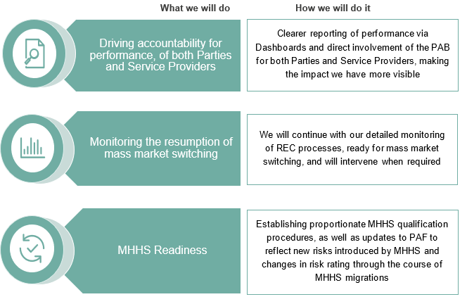
What are our ideas
For 2023/24 Performance Assurance will have three key strategic areas of focus:

Slide 8
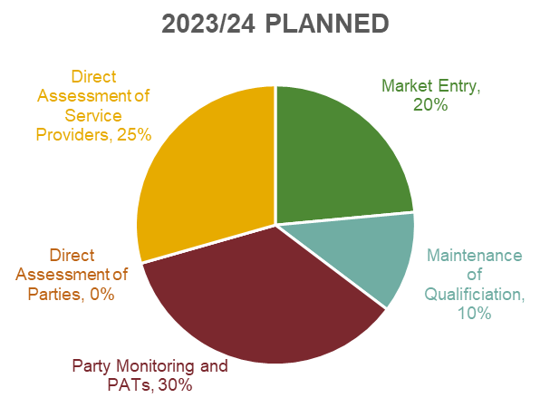
What are our ideas
As we move into Year 3, we expect that MHHS will become a more prominent focus for Performance Assurance as the market prepares to transition to the new arrangements. As a result of this, it is expected that there is a shift from new entrants into the market towards companies focusing on qualifying for MHHS.
Through effective use of PATs and deep dive reviews, the Code Manager will be adopting a forward-looking risk management approach which will help to underpin proactive prevention of Service Provider issues, reducing the need for application of reactive techniques in response to incidents.
We therefore have created a plan based on an overall time allocation as follows:

Slide 9
What are our key activities?
 | Sep-23 | Oct-23 | Nov-23 | Dec-23 | Jan-24 | Feb-24 | Mar-24 | Apr-24 | May-24 | Jun-24 | Jul-24 | Aug-24 | Sep-24
Baseline Techniques
Market entry assessment
Maintenance of Qualification
Re-communicating Maintenance deadlines for 1 Jan 2024 – 31 Dec 2024
Core Party Monitoring, Assessment and Remediation
Monthly risk determinations where all Retail Risks are monitored
Additional Performance Assurance Techniques
Annual Rating of Party Performance
Additional PATs Applied
Direct assessment of data access to CSS
Peer comparison on Erroneous Switches
Specific topic monitoring on Metering updates
Analysis of MEM data reconciliation by CDSP
Theft Detection Incentive Schemes
Theft target published
Final theft submission for the reporting year
Theft credits / debits communicated
TDIS reporting
Associated Operational Processes
Meter Accreditation
Helpdesk Service
Improvement activities related to Change Management
Communication and improvement
Performance Assurance engagement session, providing insight to the market
Market entry training sessions
Dashboard engagement and feedback
Reporting on Change Process improvement and integration to PAB
PAB self-assessment

Slide 10
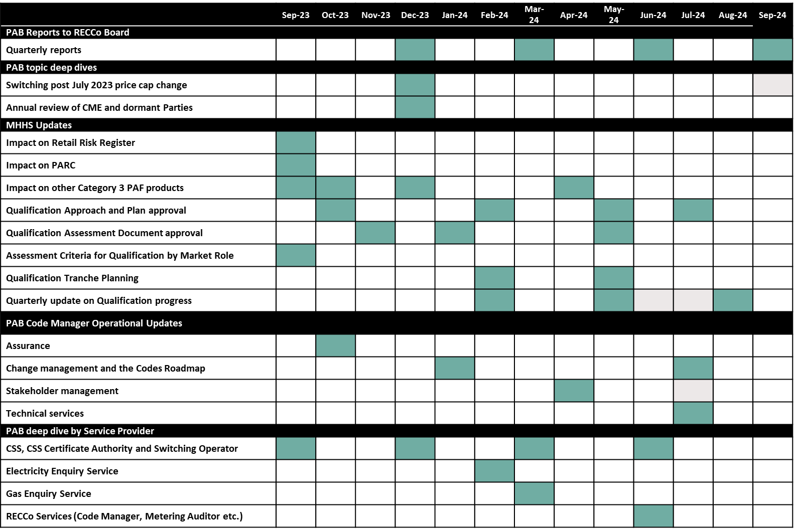
What are our key activities?
Plus, a review of all of the deliverables, including the PARC

Slide 11
1. Is there anything you were expecting to see but isn't not on our list?
ⓘ Start presenting to display the poll results on this slide.

Slide 12
2. Are any of these activities more onerous than we would think?
ⓘ Start presenting to display the poll results on this slide.

Slide 13
3. Are the timings of the activities proposed appropriate and achievable?
ⓘ Start presenting to display the poll results on this slide.

Slide 14
4. Any other thoughts or ways in which we can improve?
ⓘ Start presenting to display the poll results on this slide.

Slide 15
Audience Q&A Session
ⓘ Start presenting to display the audience questions on this slide.

Slide 16
Thanks for attending
Contact us: enquiries@recmanager.co.uk

Slide 17
Feedback
ⓘ Start presenting to display the poll results on this slide.

