Slide 1
Performance Assurance Webinar
28 September 2023

Slide 2
Introducing Your presenters
Jenny Hyskaj
REC Code Manager
Communications and Events Analyst
Anton Moden
REC Code Manager
Performance Assurance Lead
Vaishnavi Sharma
REC Code Manager
Party Assurance Manager
Lewis Williams
REC Code Manager
Analytics Manager
Nirav Vyas
Performance Assurance Team
Analytics Manager

Slide 3
Housekeeping
Videos and microphones
Event recording
Use of Slido
Opportunities for Q&A

Slide 4
Join at slido.com #1941677
ⓘ Start presenting to display the joining instructions on this slide.

Slide 5
Agenda For today
Agenda Item | Presenter
Introduction | Jenny Hyskaj
Performance Assurance – Why Is It There? | Anton Moden
Annual Rating | Lewis Williams
Performance Assurance Dashboard Developments | Lewis Williams
Theft Target Methodology Options Paper | Nirav Vyas
Performance Assurance Update | Vaishnavi Sharma
MHHS Update | Vaishnavi Sharma
Risk Register Consultation | Vaishnavi Sharma
Forward look at Performance Assurance activity (PAOP) | Anton Moden
Q&A | Jenny Hyskaj

Slide 6
Performance Assurance - why is it there?
Anton Moden

Slide 7
Our purpose
Active monitoring of market participant and service provider performance, using an effective tool kit of techniques to drive improvements.
How do we actually do this?
Active gatekeepers – relating to entry, data access and metering codes of practice
Our key focus is on REC obligations – our vires is tightly defined
Retail Energy Code
Assessing value – particularly in service provider performance
Our scope
Incentivising others, both financially and reputationally
Each other
Consumers
Other Codes
Beneficiaries
Actively driving improvements

Slide 8
What does Our annual report tell us?
Switching is working
But real performance challenge remain with REC Services
There is a huge demand for REC data from outside REC Parties
Engaging in the right way has driven real valuable change

Slide 9
What good news is there?
Whilst there were some issues in the first month of switching, switching timelines, erroneous switch rates have improved – and most importantly of the processes work in reality!
Switch Meter Reads have improved significantly after we provided better guidance – and we will be taking this through to Code clarifications.
There were issues with Annulments and Withdrawals, again caused by unclear drafting, which we have supported industry with.
We have taken action in relation to inappropriate objections, and pin pointed an area where policy needs development.
Theft detection has stayed consistent, but we have provided much better tools to validate inputs and improved the process.

Slide 10
How are we evolving our work?
It needs to evolve with REC arrangements – which have developed over the last 2 years ago.
It needs to build trust that REC Services are delivering great service and value.
It needs to be more visible. Some of our key achievements are not ones in which we are able to share specific details and in other areas we can do more.
We need to find ways to encourage digitalisation and efficient data collection but be pragmatic with the data requests we issue today.

Slide 11
Audience Q&A Session
ⓘ Start presenting to display the audience questions on this slide.

Slide 12
Annual Rating
Lewis Williams

Slide 13
What is the Annual Rating?
The Annual Rating is a new methodology introduced this year to assess the performance of Supplier and DNO Parties on an annual basis.
The assessment criteria used in determination of Annual Rating was developed through PAB consultation. It may change each year depending on the PAB’s focus areas.
The application of the criteria results in Parties being rated on a four-point scale:
No Material Weaknesses: No significant issues identified with the Party’s processes, and they have met their Code compliance obligations.
Minor Weaknesses: Some of the Party’s processes did not meet Code requirements in a minor way, but no evidence of any significant concern was identified.
Moderate Weaknesses: The Party has either multiple minor Code compliance issues, or a single significant Code compliance issue, or data indicated an increased risk of providing poor consumer outcomes.
Severe Weaknesses: It has been identified that a significant proportion of the Party processes have failed to meet the requirements of the Code, or their data indicated providing poor consumer outcomes.

Slide 14
How Has the Rating Been Calculated?
The Annual Rating has been calculated by assessing Supplier and DNO Parties against the following criteria over the period 1 April 2022 – 31 March 2023:
Criteria | No Material Weakness | Minor Weakness | Moderate Weakness | Severe Weakness
Percentage of Risk Drivers over Threshold | 0 < 10% | >= 10 and < 25% | >= 25 and < 50% | >= 50%
Percentage of Theft Target Achieved (de-minimus applied for small market share) | > 60% | > 40 and <= 60% | 0 <= 40% | -
Maintenance and Qualification Delay | - | - | ü | ü
Action Plan PAT Issued | - | - | ü | ü
Management Assertion PAT Issued | - | ü | ü | ü
Specific Condition PAT Issued | - | - | ü | ü
CME Condition Breach | - | - | - | ü

Slide 15
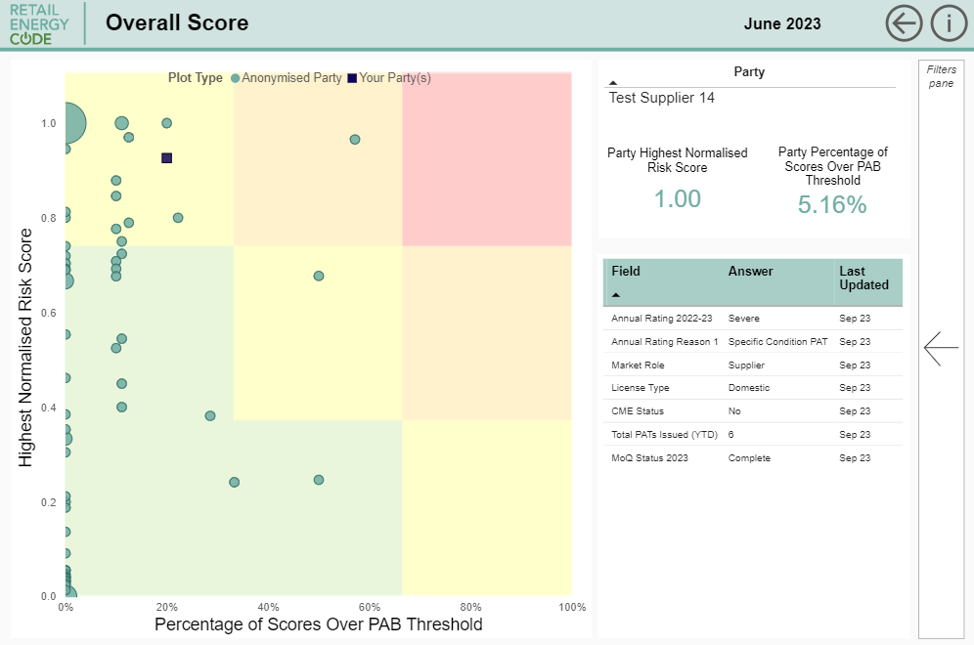
What's Next?
If applicable, the Annual Rating for your organisation is available in the Table within the Overall Score tab of the Performance Assurance (PA) Dashboard.
Review the Annual Rating REC Wiki Page for further background.
Please review you Annual Rating as soon as convenient and raise any queries you may have with the Code Manager via the REC Service Desk (enquiries@recmanager.co.uk).

Slide 16
Performance Assurance DASHBOARD UPDATE
Lewis Williams

Slide 17
Dashboard UPDATES
Update | Parties Affected | Release Date
Overall Score of Peers made available | Suppliers & DNOs | July 2023
Publication of Theft Payments | Suppliers | August 2023
Publication of Annual Rating | Suppliers & DNOs | September 2023
Updated User Guide | All | September 2023
MPxN Publication by Default (depending on survey response) | Suppliers & DNOs | October 2023
Video Walkthroughs | All | October/November 2023
Annual Dashboard Review | All | November 2023
Dashboard Viewer Permissions | All | TBC

Slide 18
Audience Q&A Session
ⓘ Start presenting to display the audience questions on this slide.

Slide 19
Theft Target Methodology 2024-25 options paper
Nirav Vyas

Slide 20
Change Options
Change options for Incentive pots:
The Domestic customer segment would have an additional split by meter type and include Traditional Prepayment, Traditional Credit and Smart/AMR
Introduce disaggregation of the Non-Domestic customer segment into Small Medium Enterprise (SME), Industrial & Commercial (I&C) and Domestic Type customers
Introduce further splitting of the SME customer type in the Non-Domestic customer segment is further split between Smart/AMR and Traditional meters
Change options for Theft Detection Values:
Considering the incentive pot split options, the TDV would be revisited to determine appropriate values
For the avoidance of doubt, no change is proposed to the underlying definition of the TDV – such as basing it on the value of theft avoided or setting it in a way designed to incentivise specific behaviours
Change options for Theft target:
Considering the incentive pot split options, the Theft Targets would be revisited to determine appropriate values
Propose retaining the overall target of 41,000 confirmed thefts
Adjustment of targets for the existing customer segments and new additional splits

Slide 21
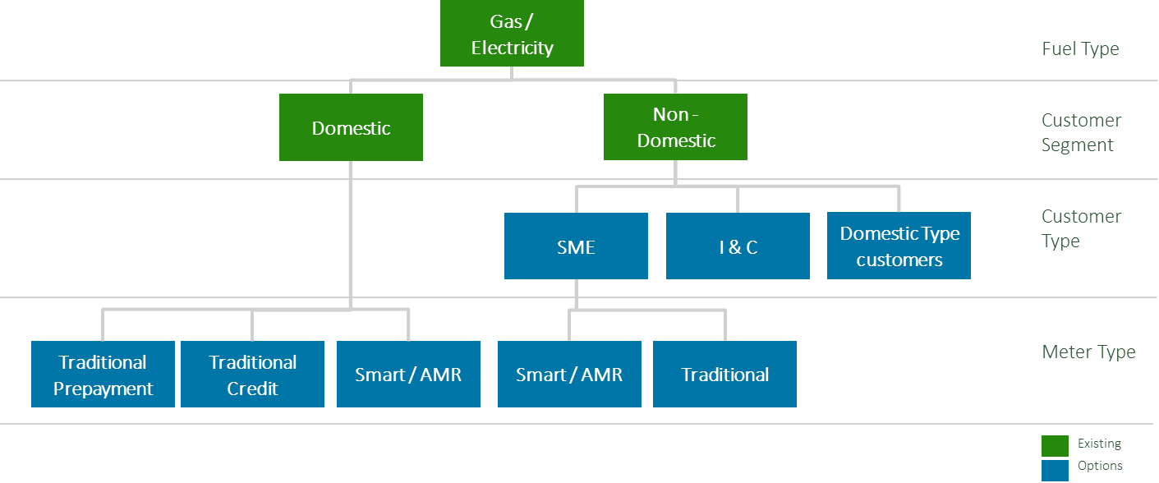
Incentive pots and TDV
Each option can be considered individually
The Domestic type customer split is proposed as these meters would be expected to exhibit levels of theft and investigation costs more closely aligned to the wider domestic sector and hence suppliers with a significant number of meters in this population would otherwise have a significant potential advantage in identifying and confirming thefts compared to the wider non-domestic pot
TDV has not significantly changed from 2022/23 to 2023/24, with only an inflation adjustment using the Consumer Price Index (CPI)
Given the incentive pot change options and the limited update to TDV over the past scheme years we believe it is important to refresh the evidence base for the setting of the TDV
For the avoidance of doubt, no change is proposed to the underlying definition of the TDV – such as basing it on the value of theft avoided or setting it in a way designed to incentivise specific behaviours
TDIS Survey indicated a majority agreed that weighting should be applied in order to incentivise detection activity
Request that participants provide as much information as possible in response to the TDV consultation questions

Slide 22
Theft Targets
The new Theft Targets would be based on the market share of each Supplier in the relevant segment and not industry averages.
We propose retaining the overall target of 41,000 confirmed thefts
Performance against target does not directly impact the calculation of credits/debits positions of Parties – rather this is based on performance of Suppliers relative to others in the same segment, but the pot value impacts the scale of the credits/debits.
Adjustment of the current targets for the existing customer segments
Fuel Type | Customer Segment | Current | Option
Electricity | Domestic | 30,000 | 31,500
 | Non-Domestic | 4,000 | 3,000
Gas | Domestic | 5,110 | 5,500
 | Non-Domestic | 1,890 | 1,000
Customer Segment | Customer Type | Meter Type | Weighting
Domestic | - | Traditional Prepayment | 0.8
 | - | Traditional Credit | 1
 | - | Smart | 0.6
Non-Domestic | SME | - | 1
 | SME | Smart / AMR | 0.6
 | SME | Traditional | 1
 | I&C | - | 0.5
 | Domestic Type | - | 1
Will be necessary to further split down the targets for the new proposed incentive pots
Approach based on market share with a weighting applied to segments where there could be a disproportionate focus applied – based on TDIS survey and TEM analysis
There is a bias in investigation of theft in prepayment meters and a higher conversion rate of investigations to confirmed thefts
Smart / AMR meters are expected to exhibit a lower level of theft vs traditional metering and hence a reduced weighting
Feedback is that there is limited theft in the I&C market and hence a reduced weighting is applied

Slide 23
Consultation
The purpose of this is both to gather feedback on the proposed options and be a call for evidence to support the determination of specific aspects of the potential changes.
The REC Theft Target Methodology 2024/25 Options Paper has been published on the REC Portal alongside a TTM 2024-25 Response Template
The information gathered through this process will be used to develop an updated TTM for the 2024/25 Theft Scheme Year which as a Category 3 document will go through a formal change process including industry consultation later in 2023/early 2024.
All feedback should be provided by return of the questions template to enquiries@recmanager.co.uk with the email title as “TTM Options Paper 2024/25” by 27 October 2023.

Slide 24
Audience Q&A Session
ⓘ Start presenting to display the audience questions on this slide.

Slide 25
Performance Assurance Quarterly Update
Vaishnavi Sharma

Slide 26
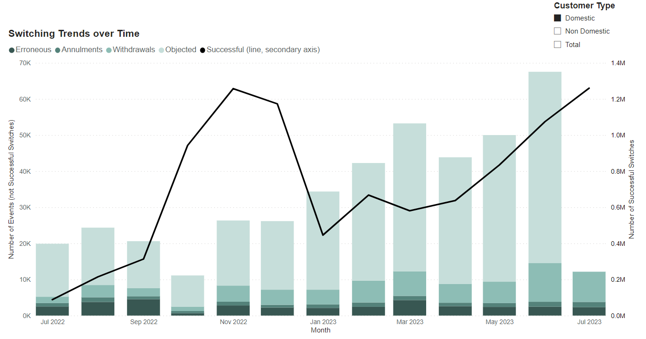
Switching Performance - Domestic
Figure 1 – Switching trends amongst domestic customers. NB: Objection data for July was not provided by CSS and hence not included within this figure.
In the last quarter, switching volumes across the market remained low.
The actual switching volumes across the market have increased to c.615,440, after deducting known internal migration activity.
The data from July 2023, reflects the changes to switching volumes resulting from changes to the price cap and we have seen actual switching volumes nearly double in comparison to June.
Despite the increase in domestic switching volumes, the number of erroneous switches, objections, annulments and withdrawals has remained consistent in the last quarter.

Slide 27
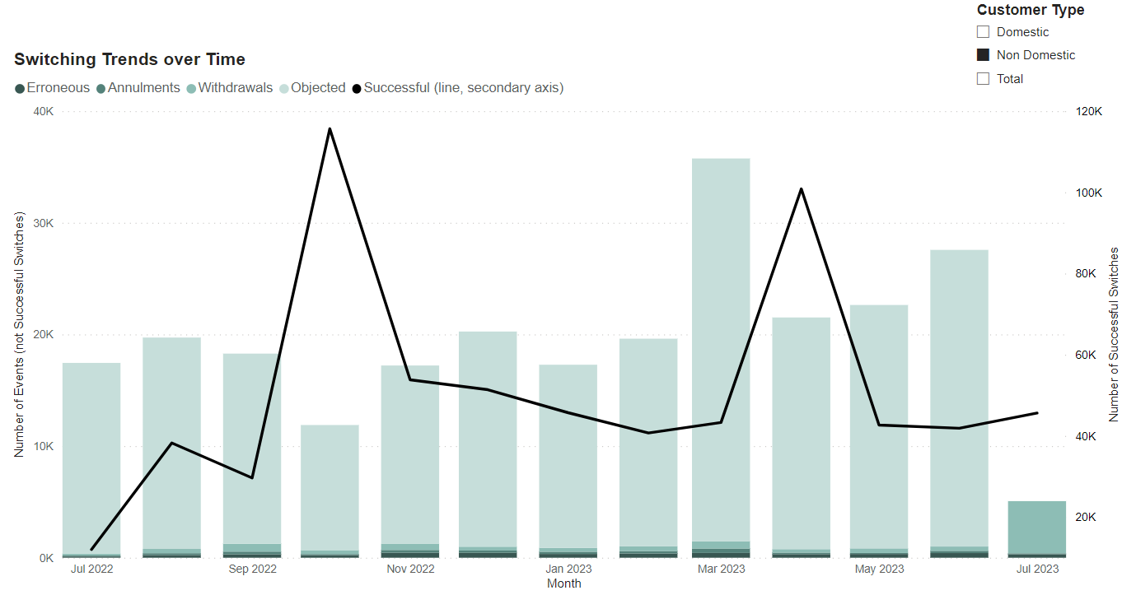
Switching Performance – Non-Domestic
Figure 2 – Switching trends amongst non-domestic customers. NB: Objection data for July was not provided by CSS and hence not included within this figure.
For the non-domestic market segment, we have seen switching in July return to similar volumes noted previously as the significant increase in switching during October and April coincides with contract renewals period.
RFCs were also issued to understand whether Parties are using Annulments and Withdrawals appropriately and in accordance with the Code and the Code Manager created guidance to provide clarity of the process.
As a result, we have seen annulments and objections decrease in volumes in July.
The increase in number of withdrawals is coincidental with the CSS P1.

Slide 28
Market Observations – Performance Assurance Priorities
Areas of focus in the last quarter:
We are halfway through the first Data Cleanse sprint, which began in June and will run until December, so have carried out a progress review by Party for the 3 reports identified to be prioritised.
The purpose of the sprint was to align industry efforts to reduce the number of reported MPANs with achievable targets agreed for each of the reports,
Invalid Electricity MAP ID
AR3C
MTC 3A Unflagged
We are issuing PATs to Parties who are at risk of not meeting the targets for Data Cleanse set by PAB.
Parties that fail to meet their target by the end of this sprint will be escalated to PAB.
MEM RFI
Data Cleanse Sprints
Objections and Annulments
As the use of the DTN/RGMA is not mandated in all cases, reports from central data sources do not provide a complete view of how MEMs across the industry are performing against their REC obligations. To improve coverage of our risk monitoring, we requested information from MEMs via the MEM RFI issued in June.
As we noted anomalous use of Objections and Annulments through our risk monitoring, we developed guidance for Parties on the use of these processes.
This was taken to the REC Issues Group (RIG) and published on the REC Portal under Useful Documents within the Party Operations section.
Where Parties were found to misuse these processes to prevent switching, further escalations were applied, which included referral to Ofgem with approval​ from PAB.​
Electricity MEMs using DTN in more than 95% of their process were exempt from providing certain data items within the RFI.
Where MEMs have not responded to the MEM RFI, we are applying the Management Assertion PAT to enforce submission.
We are also applying PATs where MEMs have demonstrated poor performance against fault resolution and meter exchange processes.

Slide 29
Performance Assurance Activities over the last quarter
We currently monitor performance against 20 Risk Drivers monthly.
The Normalised Risk Score across the industry has demonstrated a slight reduction from 0.48 in March to 0.40 in July – i.e. overall performance is improving.
Greater utilisation of Notifications when Parties breach a threshold has enabled them to proactively improve their performance.
We have applied 50% fewer RFIs while doubling the use for the “softer” RFCs in comparison to the previous quarter.

Slide 30
Market Observations – Performance Assurance Priorities
Areas of focus in the coming months:
In our continuous strive for improvement, we are identifying opportunities to streamline the Performance Assurance process:
We have previously introduced the Request for Clarification (RFC) as a “softer” alternative to the Request for Information (RFI) where we’re looking to obtain further information or understanding on an emerging potential issue.
We have been making use of the RIG and similar groups to discuss and build an understanding of emerging issues. We will continue to develop this route to limit the volume of RFIs/RFCs being raised. We will also consult with the PAB where appropriate prior to raising RFIs to obtain the benefit of their knowledge and experience.
Through the PAF products review, we are proposing to move to a two-tier data review process, monthly, where urgent things will get acted upon, and quarterly, where we will then batch up RFCs for industry consultation first, then issue.
Performance Assurance Framework (PAF) Refresh
We will drive accountability for performance of both Parties and Service Providers by enhancing reporting via Dashboards and finding opportunities for direct involvement of the PAB, making the impact we have more visible.
In recent months, major Centralised Registration Service incidents have impacted ability of customers to switch effectively.
As a first step towards this, we have revised the priority score of the Retail Risk which measures performance of REC Services that may prevent a Customer from switching Suppliers effectively.
We will continue to apply focussed PATs on REC Service Providers, whilst also covering their performance through direct assurance.
Performance of REC Services
We will continue with our detailed monitoring of REC processes, ready for mass market switching and will intervene when required.
July data demonstrates that the price cap change effective from 01 July 2023 has resulted in domestic switching volumes doubling. As switching volumes rise, our focus will be to ensure that volumes of switching-related events such as erroneous switches, switch meter read issues, which may lead to a negative consumer outcome, remain within permissible levels.
Resumption of Domestic Switching

Slide 31
Market Observations – Service Providers Performance
These include:
The Switching Services, covering Central Switching Service (CSS) and CSS Certificate Authority (provided by DCC), as well as related data services Electricity Registration Data Service (ERDS) (provided by DNOs) and Gas Registration Data Service (GRDS) (provided by Xoserve on behalf of GTs) and the Switching Operator (provided by DCC).
The Enquiry Services, covering Electricity Enquiry Service (EES) (provided by C&C) and Gas Enquiry Service (GES) (provided by Xoserve).

Slide 32
Audience Q&A Session
ⓘ Start presenting to display the audience questions on this slide.

Slide 33
MHHS Updates​
Vaishnavi sharma

Slide 34
MHHS Update
Background:
We continue to work closely with the BSCCo to develop the MHHS Qualification process that Suppliers, DNOs and MEMs (governed under the REC) will undergo to demonstrate their ability to operate under the new arrangements.
We encourage all Parties to participate in the Qualification Working Group (QWG) facilitated by the MHHS Programme to feed into discussions relating to development of MHHS Qualification. If your organisation is not already a part of this working group, you can join by contacting the PMO@mhhsprogramme.co.uk.
Important Dates:
REC Assessment Criteria:
All DNOs are required to be qualified before M11 (April 2025) to support the start of migration to the new arrangements.
Migrated MPANs will not be allowed to be moved back to NHH regime on Change of Supplier from M14 (March 2026). Therefore, all Suppliers must complete their Qualification and be ready to operate in the new arrangements by M14 to be able to accept new customers.​ Ofgem is considering sanctions that will apply on Suppliers who have not qualified by this date.
As all MPANs are due to have moved to the new arrangements by the end of the migration period (M15, October 2026), Parties will be unable to continue to operate within the Supplier Volume Allocation (SVA) arrangements if they have not completed MHHS Qualification.
For MHHS Qualification under REC, the PAB have approved the high-level assessment criteria that is published on the REC portal. This will be reviewed and updated as lower-level MHHS Design is published.
REC Portal
Party Operations
Useful Documents
MHHS Qualification Assessment Criteria

Slide 35
Risk Register Consultation
Vaishnavi Sharma

Slide 36
Risk Register Consultation
In line with the PAOP, the Code Manager has reviewed the Retail Risk Register and made the following changes, along with housekeeping updates:
MHHS Design Artefacts currently available have been reviewed along with REC Code drafting for MHHS to add MHHS considerations. As next steps, the Code Manager will work with the DIP Manager, Electralink and the Registration Services to agree appropriate reporting to monitor Retail Risks.
1
2
Retail Risk Priority Score has been reviewed and updated. The Priority Score for Retail Risk 9, which looks that performance of REC Service impacting the ability of customers to switch, has been increased based on recent market events.
3
Retail Risks and Risk Drivers have been updated to focus on areas of greater impact to consumers and/or to the retail energy market.
As next steps, we have initiated the Category 3 Change Process. As a part of this process, the Code Manager will imminently issue an industry-wide consultation and encourages Parties to respond to it. The key dates will be communicated within the REC Weekly Bulletin.

Slide 37
Audience Q&A Session
ⓘ Start presenting to display the audience questions on this slide.

Slide 38
Forward look at Performance Assurance activity ​​​
Anton Moden

Slide 39
What is the PAOP?
The Performance Assurance Operating Plan (PAOP) sets out Performance Assurance activity planned for the upcoming year. It identifies areas that are particular priorities for the Performance Assurance Board (PAB) and will be focus areas to improve performance.
As the PAOP is a Category 3 document, an industry wide consultation is not required as part of updating the document. Notwithstanding, we have identified that engaging with industry is a key part of making sure we get our Operating Plan right and are therefore seeking feedback in order to support our Performance Assurance activity in Year 3.

Slide 40
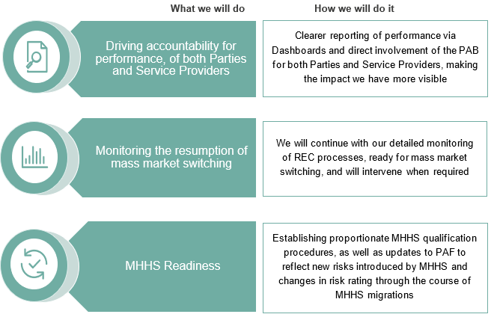
Areas of Focus
For 2023/24 Performance Assurance will have three key strategic areas of focus:

Slide 41
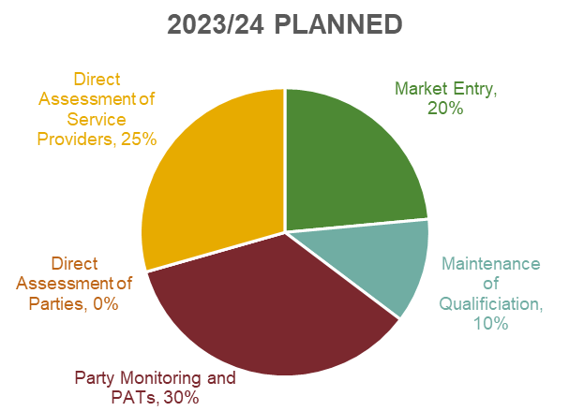
Areas of focus
As we move into Year 3, we expect that MHHS will become a more prominent focus for Performance Assurance as the market prepares to transition to the new arrangements. As a result of this, it is expected that there is a shift from new entrants into the market towards companies focusing on qualifying for MHHS.
Through effective use of PATs and deep dive reviews, the Code Manager will be adopting a forward-looking risk management approach which will help to underpin proactive prevention of Service Provider issues, reducing the need for application of reactive techniques in response to incidents.
We therefore have created a plan based on an overall time allocation as follows:

Slide 42
What are our key activities?
 | Sep 23 | Oct 23 | Nov 23 | Dec 23 | Jan 24 | Feb 24 | Mar 24 | Apr 24 | May24 | Jun24 | Jul 24 | Aug 24 | Sep 24
Baseline Techniques
Market entry assessment
Maintenance of Qualification
Re-communicating Maintenance deadlines for 1 Jan 2024 – 31 Dec 2024
Core Party Monitoring, Assessment and Remediation
Monthly risk determinations where all Retail Risks are monitored
Additional Performance Assurance Techniques
Annual Rating of Party Performance
Additional PATs Applied
Direct assessment of data access to CSS
Peer comparison on Erroneous Switches
Specific topic monitoring on Metering updates
Analysis of MEM data reconciliation by CDSP
Theft Detection Incentive Schemes
Theft target published
Final theft submission for the reporting year
Theft credits / debits communicated
TDIS reporting
Associated Operational Processes
Meter Accreditation
Communication and improvement
Performance Assurance engagement session, providing insight to the market
Market entry training sessions
Dashboard engagement and feedback
Reporting on Change Process improvement and integration to PAB
PAB self-assessment

Slide 43
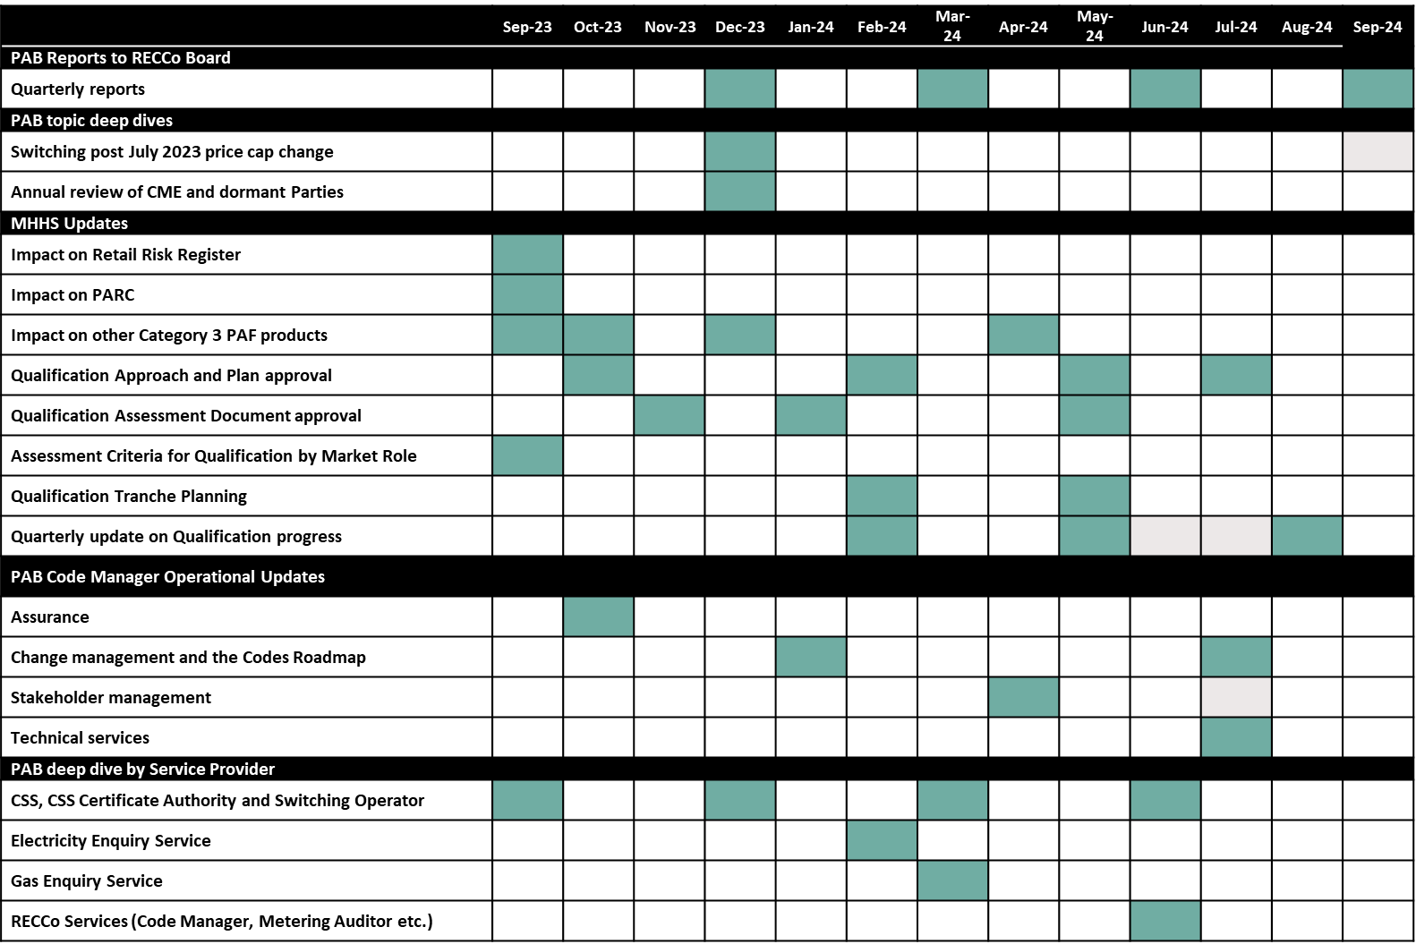
What are our key activities?
Plus a review of all of the deliverables, including the PARC
Please note this month there is also recommunication of the 2024 MoQ deadlines

Slide 44
Q&a ​​​
Jenny Hyskaj

Slide 45
Audience Q&A Session
ⓘ Start presenting to display the audience questions on this slide.

Slide 46
Thanks for attending
Contact us: enquiries@recmanager.co.uk

Slide 47
Feedback
ⓘ Start presenting to display the poll results on this slide.

