Slide 1
Performance Assurance Webinar
14 December 2023

Slide 2
Introducing Your presenters
Jenny Hyskaj
Communications Team
Communications and Events Analyst
Anton Moden
Performance Assurance Team
Performance Assurance Lead
Vaishnavi Sharma
Performance Assurance Team
Party Assurance Manager
Nirav Vyas
Performance Assurance Team
Analytics Manager
Lewis Williams
Performance Assurance Team
Analytics Manager

Slide 3
Housekeeping
Videos and microphones
Event recording
Use of Slido
Opportunities for Q&A

Slide 4
Join at slido.com #1207528
ⓘ Start presenting to display the joining instructions on this slide.

Slide 5
Agenda For today
Agenda Item
Introduction
What do I need to do? Update of RFI approach Clarity on the PARC changes Performance Dashboard Updates CoMCoP Derogation
How is the REC improving things for me? Reviewing end to end MEM processes Key successes of Party Assurance Theft Target Methodology Domestic Premise Indicator
Do I get the services I expect for the money I spend on REC services? Service Provider Update
How is my reputation being protected? Information Security Breaches and Interventions
Q&A

Slide 6
Introduction
We are structuring our webinar around the 4 key questions that we think REC Service Users have of us.
Performance Assurance is a complex service – that does many different things with many different types of organisation – we aim to provide you an update on the breadth of this activity.
We’d welcome your feedback after the webinar if there are other questions you have of us.
What do I need to do?
Do I get the services I expect for the money I spend on REC services?
How is the REC improving things for me?
How is my reputation being protected?

Slide 7
What have PAB been doing this quarter?
Annual Report and this year’s Operating Plan (PAOP)
Identifying positive ways to improve Gas MEM performance
Operational review of the assurance process
Significant focus on addressing the CSS P1
Reviewing in flight derogations
Establishing a direct role for PAB in managing service provider performance
Review of security issues
Derogations to cover ES experimentation and CoMCoP
Applying Performance Charges to the CRS Provider
Review of the change process

Slide 8
What do I need to do?

Slide 9
Update on RFI approach
Vaishnavi Sharma

Slide 10
Update on RFI Approach
From feedback received, we have updated the cadence of when PATs will be issued. The timeline below highlights that we will align the issuing of PATs (i.e. Queries/ RFIs etc) with SMIS reporting on a quarterly basis with the aim to improve the effectiveness of PATs.
Dec 23 | Jan 24 | Feb 24 | Mar 24 | Apr 24 | May 24 | Jun 24 | Jul 24 | Aug 24
SMIS
SMIS
SMIS
PATs
PATs
PATs
Continuous monitoring on Parties’ performance with regards to Risk Drivers will continue to be carried out monthly and reported to PAB.
We will notify Parties to make them aware of their performance where they are above threshold. This notification will signpost them to their dashboard and highlight any relevant guidance that is available on the REC portal.
Where serious non-compliances or performance issues are identified, we will continue to raise as identified, with appropriate PATs applied.

Slide 11
Clarity on PARC changes
Lewis Williams

Slide 12
Clarity on PARC Change – R0154
Last month we raised a change to the Performance Assurance Report Catalogue (PARC)
R0154 has now been published and industry consultation is expected in the New Year
The change includes a full redlined version of the PARC
It focuses on reducing the burden on REC Parties by:
Removing several items for Suppliers, DNOs, GTs and MAMs
Proposing a simplified version of the Energy Theft file for the 2024-25 Reporting Year
We will also ask Parties if there are alternative data sources that we could use that would be lower impact, but achieve a similar or better result.

Slide 13
Dashboard Review Responses​​​
Nirav Vyas

Slide 14
Dashboard Review Responses
The Performance Assurance Dashboards were launched in November 2022.
Survey was in November 2023 with a purpose to gather feedback to help make the dashboards better and easier to use.
Feedback was received from 7 organisations, including four from Suppliers, and one each from a Gas Transporter (GT), Gas and Electricity Meter Equipment Manager (MEM) and a Gas-only MEM.
Key challenges and/or requests for changes included:
Simplified layouts / navigation. Additional functionality to permit downloading of information and provision of un-anonymised MPxN data. Clearer guidance on the usage of dashboards and linkage to specific requirements / KPIs within the REC. Having access to more up-to-date data. Availability of data for all risk drivers (note that not all risk drivers can be measured through the regular data analytics cycle). The option to perform peer comparison against all risk drivers and the annual rating (with conflicting feedback requesting that only party specific information is displayed).

Slide 15
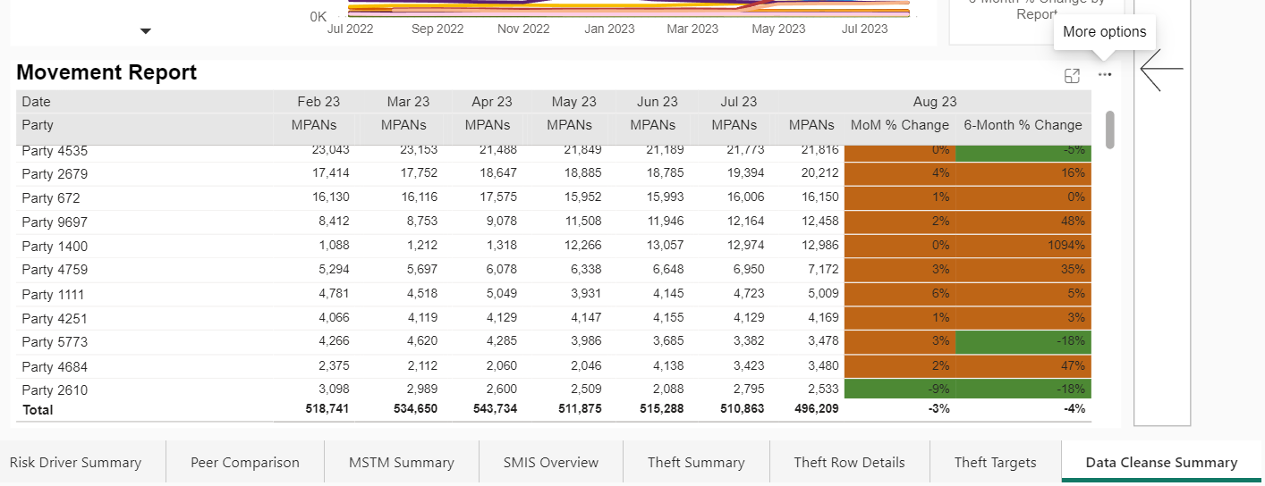
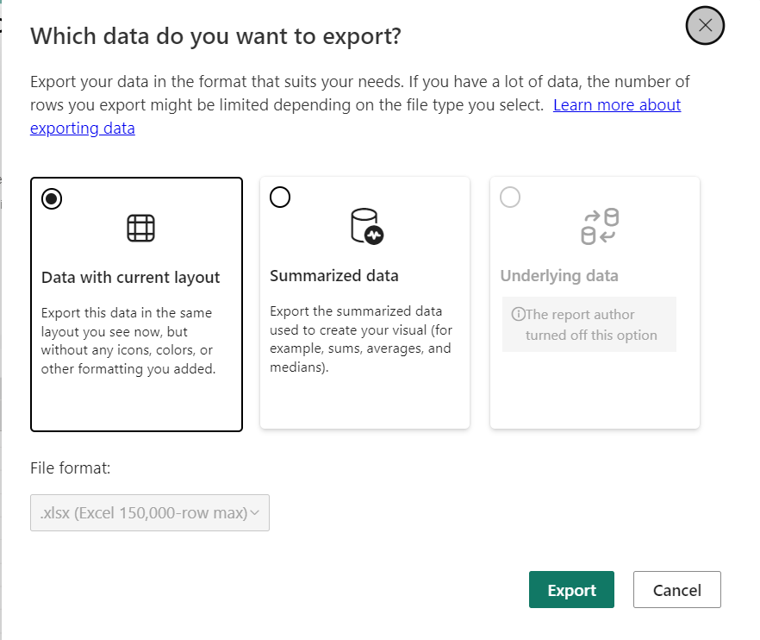
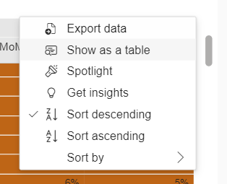
Exporting Data
1. Hover over the three dots until ‘More options’ appears
3. Follow instructions to export data into preferred folder
2. Click Export data

Slide 16
HOW OFTEN IS EACH DASHBOARD REFRESHED
Dashboard Tab | Data Available Up To
Release Notes | Previous Month
Overall Score​ | 2 Months Prior
Retail Risk Summary​ | 2 Months Prior
Risk Driver Summary​ | 2 Months Prior
Risk Driver – MPxN Level | 2 Months Prior
Peer Comparison​ | 2 Months Prior
Meter Specific Topic Monitoring Summary | 2 Months Prior
SMIS Overview​ | Previous Quarter - 2 Month Delay
Theft​ Summary | Previous Month
Theft Row Details | Previous Month
Theft Targets | Previous Month (except Debit/Credits, which is annually)
Data Cleanse Summary | Previous Month
Quantitative SLA Summary ​ | Previous Month
Qualitative SLA Summary​ | Previous Quarter

Slide 17
Comcop Derogation
Anton Moden

Slide 18
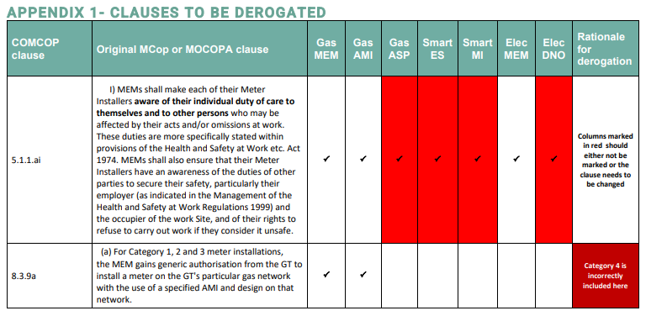
Comcop Derogation
Following consolidation of metering codes, several clauses were identified with issues with the drafting.
A derogation on 63 specific clauses has been agreed at the PAB. We request all Parties to:
Please review the derogation and how it affects you.
Please engage in the R0152 change process that seeks to address the issues identified.
Be clear if you think that there are other clauses that are not possible to comply with and share them with enquiries@recmanager.co.uk.
PAB will be further reviewing this area.
The Derogation Report is published on the REC Portal.

Slide 19
Audience Q&A Session
ⓘ Start presenting to display the audience questions on this slide.

Slide 20
How is the REC improving things for me?

Slide 21
Key Successes
Vaishnavi Sharma

Slide 22
How is the REC improving things for me?
PREPAYMENT (PPM) LEVELISATION PROJECT​ Being involved in the prepayment levelisation project. This involves RECCo or the REC Code Manager developing a calculator to level the cost of standing charges on PPM by socialising (or 'levelising') prices across payment types, to make them more equal or equitable (but less cost-reflective).
Improving consumer outcomes through positive engagement
Based on April’s data a large Supplier was breaching the threshold for Risk Driver 5.6 Delays in responding Switch Meter Read Disputes.
Request for Clarification was issued to the Party to understand if they were aware of the issue and if they have put any controls in place to resolve the issue.
This large Supplier responded that they were not aware of the issue.
Party identified further issues with their disputed reads processes that were impacting their SLAs for D0300s (Disputed Readings or Missing Readings on Change of Supplier) and Supplier Agreed Read (SAR) gas flows.
Party provided information on the appropriate actions that are being taken to ensure that the issues are being managed.
We have seen improvement in the Party’s performance and large Supplier confirmed that all fixes were planned to be implemented by October.
1
2
CODE MANAGER LED PROGRAMME Active participation in improvements in the Codes Roadmap, Change Improvement Project and RECCo Forward Work Programme. These are all key activities led by different parts of RECCo and the Code Manager.
CHANGE OF TENANCY RULES Supporting the development of new microbusiness change of tenancy rules. This was an issue identified through assurance activities, of which RECCo has led the development. We anticipate that there will be a need for assurance of compliance with new Code requirements once they are implemented. We anticipate that this activity would be prioritised through the usual PAOP processes.
3
THIRD PARTY INTERMEDIARY (TPI) CODE OF PRACTICE Inputting into RECCo’s establishment of a TPI Code of Practice, as well as the establishment of an assurance regime for this Code of Practice. Given the large number of TPIs and diversity of their business models this will require a separate scheme to assess compliance. This could be analogous to the CoMCoP metering accreditation, where the organisation pays for a targeted assurance activity. The Code Manager has fed into the nature of requirements, the design of a risk-based assurance scheme, thematic reporting and the technology required to efficiently deliver such a scheme.
4
5
DATA CLEANSE We thank Parties for supporting the first sprint of Data Cleanse, which recently concluded. Many Parties have demonstrated significant progress. The Code Manager will be providing further communications on next steps in the new year.

Slide 23
MEM Updates
Vaishnavi Sharma

Slide 24
Schedule 14 metering operations engagement UPDATE
Background:
REC Schedule 14 sets out the obligations on Metering Equipment Managers (MEMs) and Energy Suppliers in respect of metering operations, covering management of MEM appointments and maintenance of Meter Technical Details (MTD) across Parties. These involve updating central systems in gas, namely the Central Data Service Provider (CDSP), a role performed by Xoserve primarily governed by the Joint Office of Gas Transporters. The Code Manager and PAB monitor performance in relation to these obligations to mitigate Retail Risk 7: Inaccurate meter point master data results in errors that impact consumers.
In accordance with the Central Data Service Provider (CDSP) Further Services Service Definition which sets out CDSP responsibilities under the REC, the CDSP conducts an annual comparison exercise between the gas MTD data provided directly by each gas MEM and the MTD data held within the Central Gas Register. The findings from this reconciliation activity are shared with the appointed Gas MEM, the Gas Supplier that has appointed the MEM, and the Code Manager.
Problem Statement:
We are aware of performance issues in relation to MEMs from the CDSP reconciliation, MEM RFI and Metering-specific topic monitoring. We think that for this issue to be resolved the requirements defined within the Code and how operational processes are delivered by MEMs will need to change.
Current requirements do not obligate data retention for effective performance monitoring and reporting, so a more Party-focused approach will not work.
Non-domestic customers may have direct contracts with MEMs, reducing the ability of Suppliers to ensure MEMs meet standards of service through contract management.
Smaller Suppliers often have limited ability to incentivise MEM performance.

Slide 25
Schedule 14 metering operations engagement UPDATE continued…
We held a working group in November which focused on understanding the as is process in the code. We are focusing on Gas first as Electricity is more mature.
Here it included representatives from other relevant Codes and Supplier organisations (ensuring coverage of both Domestic and Non-Domestic sector, as well as organisation scale).
We will hold follow-up workshops with the working group to explore potential solutions and evaluate their cost-benefits.
Develop proposal for Standards of Service for MEMs
Actionable Deliverables:
1
2
3
As-Is process and data mapping
An articulation of issues at each process points.
Recommendations on changes to systems or data required for REC Change
4
Recommendations on the appropriate assurance approaches for each requirement that does not meet required performance levels.
NEXT STEPS:
Based on feedback provided, it was clear that we need to ensure our working group is driven by the data. It has been made apparent to us that the reconciliation work completed by the CDSP was inherited from Supply Point Administration Agreement (SPAA). With this in mind, we must review what information is currently requested and how we could improve the data to ensure it is fit for purpose under the Retail Energy Code (REC). The work currently carried out, investigates the following data line items:
Model Manufacture MSN
We plan on doing a review of the data items requested to understand if we should be focusing our review here or if industry feel that there are other data line items which are more appropriate under REC governance. For this we need insights from various market participants on which piece of information are most critical for them.

Slide 26
Theft Target Methodology
Nirav Vyas

Slide 27
Change Options Survey
This is the first year that responsibility for the Theft Target Methodology was with the Code Manager.
Options paper and call for evidence was released in September 2023.
Survey questions scope covered all areas of the TTM with the intention to gather as much feedback and evidence as possible and explore a wide range of possible changes.
13 organisations responded, including ICoSS.
Many responses received were of mixed opinions on key questions.
Limited evidence provided to form a basis for change on many aspects, notably:
Splitting of the Non-Domestic pot to facilitate differential TDV and focussing of target
Updating the TDV to reflect current costs and differential costs by segment
TTM changes are developed based on the nature and detail of the responses received, availability of sufficient and suitable evidence to support change and constraints within the wider industry data model.
Item | Summary of Changes
Incentive Pots Split | Gas/Electricity Domestic customer segment to be split further by Smart and Non-Smart meter types. Support in responses received for the view that a Smart meter itself should be a deterrent for meter tampering.
Theft Detection Value | Adjusted for inflation using December 2023 CPI figure published by the Office for National Statistics (December CPI figure will be used once published).
Theft Targets | Addition of Smart and Non-Smart meter type targets within Domestic customer segment, with weighting applied to focus target on traditional metering. Overall target levels maintained to preserve scheme value.
Attribution Methodology | Addition of data used to split pots between Smart/Non-Smart incentive pots. Acknowledgement of potential issue with domestic premise indicator (under investigation).

Slide 28
Change Options not taken Forward and Future Plans
For those options that were considered but not progressed at the current time, we will be gathering additional data and engaging further with Parties.
Splitting for Traditional Domestic Meter Type further between Prepayment, and Credit
We will consider results from the periodic refresh of the TEM to gather additional information that may support need for split
Non-Domestic customer Type splits to include SME, I&C and Domestic Type customers and
Non-Domestic Meter Type Splits to include ”domestic like”, Traditional and Smart/AMR
Engage with Ofgem and DESNZ on their work to define Non-Domestic thresholds
Theft Detection Value
Extended evidence gathering to commence following publication of 2024/25 targets
Theft Targets
Continue to monitor industry performance against targets and following updates to TDV we will consider the need for any consequential change

Slide 29
Domestic Premise Indicator
Lewis Williams

Slide 30
Domestic Premise Indicator
The version of the Domestic Premise Indicator (DPI) used in CSS is: DI90016
To update/maintain the data item:
Use the CSS Market Message: CSS02000
Refer to REC Schedule 23 – Registration Services, Section 16 for further guidance on the process
We’re currently investigating concerns around the accuracy and reliability of the DPI and trying to gain access to further data to allow us to confirm whether there is a real issue or not.
Subject to the investigation, we may run a specific sprint to make sure the DPI is accurate for use in the Energy Theft Target calculations and our wider risk monitoring.

Slide 31
Audience Q&A Session
ⓘ Start presenting to display the audience questions on this slide.

Slide 32
Do I get the services I expect for the money I spend on REC services?

Slide 33
Service provider performance
Anton moden

Slide 34
Service Provider assurance
There are 10 REC Services plus the Code Manager, provided by RECCo, DCC, DNOs and GTs. The PAB aims to:
Drive accountability through reporting
Intervene to improve specific organisations
Get direct updates from the responsible Party, including scrutiny of where performance needs to improve
The most recent update on assurance activities and improvements covered:
Market Entry
Metering accreditation
Party Assurance
Service Provider Assurance
Communication and the REC Helpdesk
Key forwards looking activities
The PAB has a schedule of performance deep dives:
CSS / SO quarterly Operational Updates from the Code Manager 5 times a year
EES / GES annually Other RECCO Services annually

Slide 35
Overview of performance levels

Slide 36
Assurance activities
The PAB has approved the highest level of CRS Performance Charge for 2 consecutive quarters.
The PAB reviewed the Change Improvement Plan, and agreed five actions to improve
The Performance Assurance team has reviewed the accuracy of reporting across the Code Manager and DCC, recommending improvements.
RECCo and the Code Manager have taken a deep dive into the CSS P1 lessons learned and the PAB have agreed an action plan. This involved meetings with 32 organisations people, 7 organisations responding to a survey, review of 110 comments and resulted in 24 key actions. Webinars to feed these back to industry will be provided in January.
Every month the Code Manager provides analysis of performance issues with other service providers and commentary on the improvement activity being undertaken. PATs have not currently been applied, due to the action in flight to address the underlying causes.

Slide 37
How is my reputation being protected?

Slide 38
Information Security Breaches and Interventions
Anton Moden

Slide 39
Information Security Breaches and Interventions
One of the Code Manager’s roles is on protecting your information, and the reputation of industry.
This work has some confidential elements, however in the past quarter we have:
01
Identified and addressed a Supplier who was over sharing EES and GES data via API
Confirmed that GES wasn’t oversharing information
02
03
Supported the resolution of a Supplier who had been attacked, and this resulted in excessive EES and GES API calls
Acted on identified REC Portal issues, to avoid accidental sharing of data
04
05
Reviewed an information security incident involving a TPI to ensure enquiry services data was not compromised.

Slide 40
Q&a ​​​
Jenny hyskaj

Slide 41
Audience Q&A Session
ⓘ Start presenting to display the audience questions on this slide.

Slide 42
Thanks for attending
Contact us: enquiries@recmanager.co.uk

Slide 43
Feedback
ⓘ Start presenting to display the poll results on this slide.

