Slide 1
MARKET ENTRY ENGAGEMENT SESSION
18 January 2024

Slide 2
Introducing Your presenters
Jenny Hyskaj
REC Code Manager
Communications and Events Analyst
Daniel Rodgers
REC Code Manager
Market Entry Team Lead

Slide 3
Housekeeping
Videos and microphones
Event recording
Use of Slido
Opportunities for Q&A

Slide 4
Join at slido.com #3703408
ⓘ Start presenting to display the joining instructions on this slide.

Slide 5
Agenda For today
Agenda Item | Applicable To
Market Entry Process Overview (20 mins) Overview Business Solutions Assessment (BSA) Information Security and Data Protection Assessment (ISDP) BSA/ISDP Tips Market Scenario Testing (Internal Testing) Market Scenario Testing (DTN/CSS External Testing) Managed Service Providers Enquiry Services Data Access Matrices | Suppliers (BSA, ISDP, Market Scenario) DNOs (BSA, ISDP, Market Scenario) MEMs (BSA, Potentially ISDP, Market Scenario) Non-Party REC Service Users (ISDP)
Controlled Market Entry (5 mins) Entering CME Exiting CME | Suppliers, DNOs
Metering Accreditation (10 mins) CoMCoP Business Solutions Assessment (BSA) Initial Audit & Renewal Audits R0064 (Proposed MOA/EMO roles) Safe Isolation Providers (SIPs) | MEMs
Maintenance of Qualification (5 mins) Overview R0059 (Housekeeping Changes) | Suppliers, DNOs, MEMs, Non-Party REC Service Users
Marketwide Half Hourly Settlement (5 mins) Overview | Elec Suppliers, Elec DNOs, Elec MEMs
Q&A (15 mins)

Slide 6
Market Entry Process Overview

Slide 7
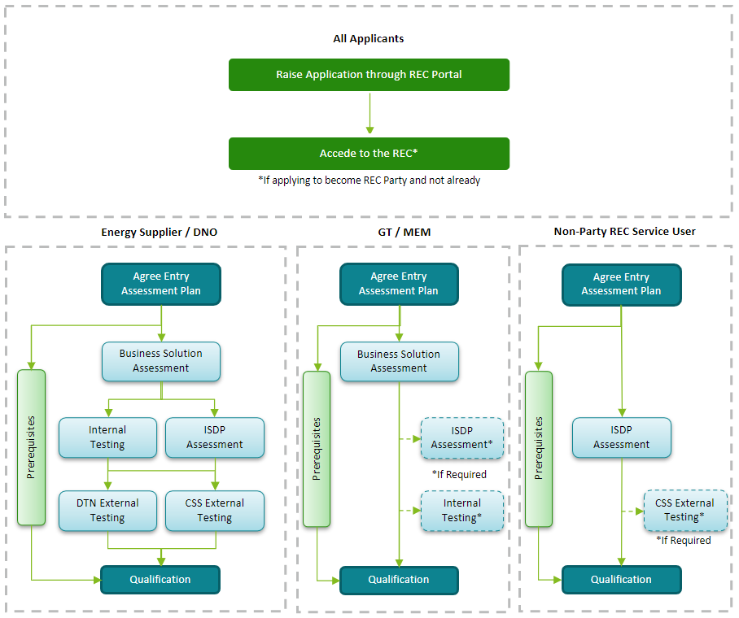
Market entry – overview (Process)

Slide 8
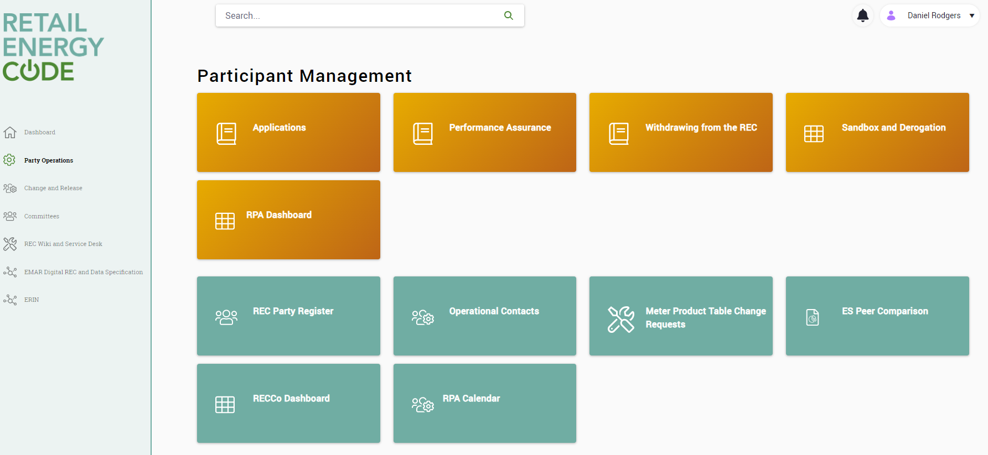
Market entry – overview (Submissions)

Slide 9
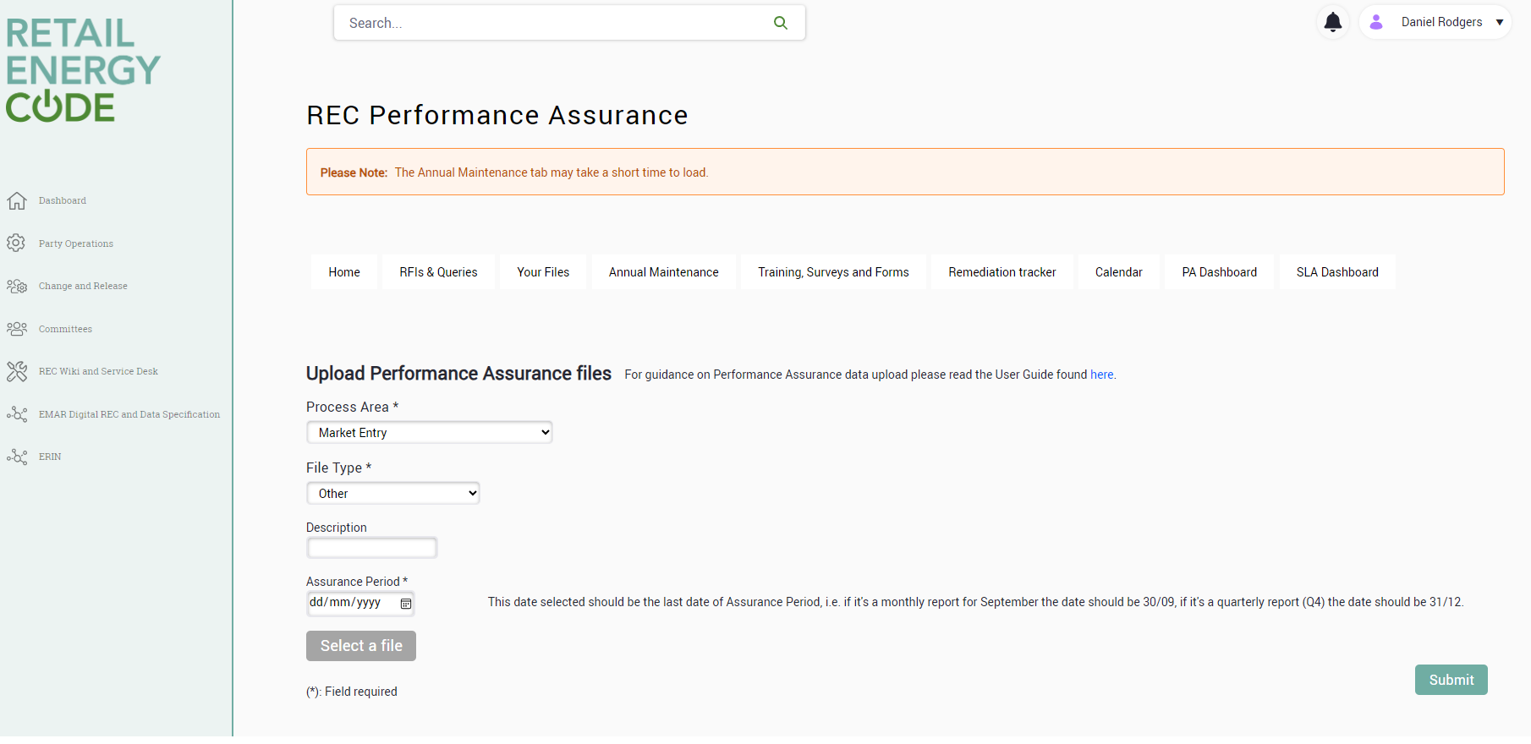
Market entry – overview (Submissions)
Email
performanceassurance@recmanager.co.uk

Slide 10
Market entry – overview (Submissions)
Process
Outcome
Receipt of BSA
The applicant uploads the submission to the REC Portal for Code Manager Review.
Assessment
The Code Manager assesses the applicant’s submission, ensuring it contains sufficient information and evidence.
Remediation
A risk-based approach is used to assess the submission. Outcome is communicated back to applicant.
Approval
Observation
Follow-Up
Finding

Slide 11
Market entry – overview (Submissions)
Scope
The Business Solution Assessment (BSA) is required for Suppliers, DNOs or MEMs.
Purpose
The aim of the BSA is to evaluate your systems and processes are adequate for you to operate in the market in line with code obligations.
Suppliers/DNO Sections
Business Solution e.g. what is your intended scale of operation within the first 1, 3 and 5 years of operations
Technical Solution e.g. How have you ensured that all of the applicable functions, obligations and working practices embodied in your REC obligations are included within your processes and applications?
Configuration Solution e.g. How have you developed and implemented your test strategy and/or plans to demonstrate that you are able to operate the service?
Guidance on responses and example supporting evidence can be found in Section 2 of the Entry Assessment Form

Slide 12
Information security and data protection (isdp) assessment
Scope
The Information Security and Data Protection (ISDP) is required for Suppliers, DNOs, and applicants for REC Services (e.g. EES, GES, CSS)
Purpose
To ensure you have adequately identified and looked to address ISDP risks that you would face if you successfully qualify, and you have processes defined to adequately manage those ISDP risks.
Sections
Section 1 (All Applicants) e.g. How has your business taken steps to ensure appropriate information security and control procedures are in place, proportionate to the relevant Information Security and Data Protection risks, and are reviewed on a regular basis?
Section 2 (Situational e.g. API) e.g. What processes does your business have in place in relation to incident
management?
Guidance on responses and example supporting evidence can be found in Section 3 of the Entry Assessment Form

Slide 13
Submissions – Top Tips
We tailor our BSA and ISDP assessment to proposed business solution, system architecture, and your information security risk register. Ensure you provide these in your first submission, as delays in these will cause additional rounds of remediation to be required.
01
Many of the BSA and ISDP questions can be covered by providing supporting policies as these will substantiate your written answers and can help reduce follow-up questions. We recommend that you attach supporting policies to substantiate each answer where relevant and available.
Please ensure these policies and other pieces of evidence are clearly labelled in your answers for easy identification at the assessment stage.
02
A key area of consideration is risk management which is assessed via the risk register and risk methodologies. Demonstrating how you identify and resolve these risks builds assurance that you can protect data from the enquiry services.
The risk register is not required to contain in-depth details of individual vulnerabilities you might want to keep confidential.
03

Slide 14
Market Scenario Testing - INTERNAL
Scope
Internal Testing is required for Suppliers, DNOs and MEMs (if dataflows are sent on the DTN). This differs from other stages of assessment as it is not a prescribed list of questions.
Overview
The Internal Testing Assessment involves the applicant running tests to demonstrate their systems and processes can operate against a defined list of market scenarios. The full list of the scenarios can be found in the Joint BSC and REC Storyboards document on the portal.

Slide 15
Market Scenario Testing - INTERNAL
Process
Applicant submits a testing pack containing:
Test Plan e.g. showing the execution of all market scenarios including expected start, duration and end dates
Test Scope e.g. list of Market Scenarios agreed with the Code Manager have been included
Test Approach e.g. A copy of the data to be used in each script
Test Procedures e.g. A complete set of the business processes and work instructions that are to be used during your Internal Testing
Test Results e.g. Test results are documented in a 'Test Summary' or similar
Test Assurance e.g. Been run under ordinary operational conditions and where changes to processes have been made these have been flagged
Test Owners e.g. A list of named business users involved in the Internal Testing
Test Governance e.g. Are results being reported and where?
Guidance on responses and example supporting evidence can be found in the Entry Assessment Information Pack.

Slide 16
Market Scenario Testing – DTN External
Scope
External testing is carried out by the REC Code Manager Technical Services team and is a requirement for Suppliers and DNOs.
Overview
The outputs found from Internal Testing will be used to determine the scenarios that will be tested in the external testing. The Code Manager team will agree with the applicant when external testing can begin.
The Code Manager evaluate results from testing and where an applicant has outstanding findings, they will request the applicant resolves these before proceeding.

Slide 17
Market Scenario Testing – DTN External
Scope
External testing is carried out by the DCC testing team and is a requirement for both Suppliers and DNOs, and optional for other applicants such as MEMs and MAPs.
Overview
The outputs found from internal testing will be used to determine the scenarios that will be tested in the external testing. The Code Manager will raise an onboarding request to CSS for the applicant, and will agree the scope and start date of the external testing scenarios with the applicant.
The External testing will then be carried out by the DCC testing team, who will provide a summary of the testing results to the Code Manager. The Party will have dedicated CSS technical contacts to support them through the testing process.
Further CSS External Testing guidance can be found in the Category 3 Documents.

Slide 18
Managed Service Providers
Scope
The REC requires organisations to follow specific processes and data specifications, it does not set business models. Many Parties opt to use managed service providers to provide systems and processes.
Overview
In certain circumstances, applicants can place reliance on evidence from a managed service provider currently operating in the market, including areas like developing systems to meet REC process requirements, integrating systems with REC Services, providing internal testing that the software works as intended
From a technical side, applicants will still need to show be sent via the right mechanisms to test connectivity to the DTN and CSS, that the new staff have been trained on their responsibilities and have trialled key processes, and that a minimum level of information security risk management is in place, as would be expected for a new business.
Additionally, the Business Solutions Assessment and any pre-requisites will still also be required.

Slide 19
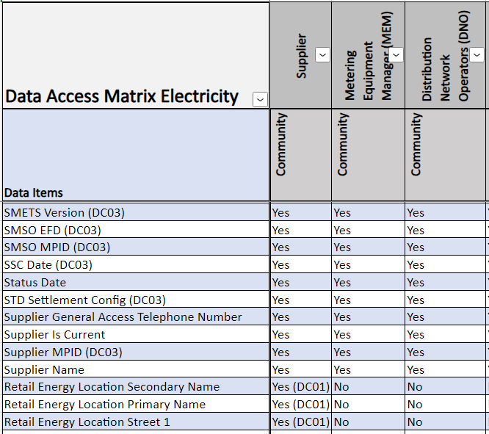
Enquiry Services
Scope
Electricity Enquiry Service and Gas Enquiry Service access is provisioned in-line with the Data Access Matrix and Schedule 12 Data Access. Depending on the access requested, it may be provisioned via an Online Portal, API, or Report.

Slide 20
Audience Q&A Session
ⓘ Start presenting to display the audience questions on this slide.

Slide 21
Controlled Market Entry (CME)

Slide 22
Controlled Market Entry (CME) Entry
Purpose
Controlled Market Entry (CME) conditions are designed to reduce the risk to consumers and the market arrangements relating to the performance of new entrants and may be applied by the Code Manager at the point of Qualification.
Overview
When you propose CME conditions, please include supporting context and rationale considering areas such as:
Business plan and expected number of registrations
Relevant operational experience
Use of business systems and processes
Market Role(s) / Sector(s) (e.g. HH or NHH)

Slide 23
Controlled Market Entry (CME) Entry
Overview
There is no specific form to propose CME conditions since it is decided on a case-by-case basis, but we would expect a proposal to include areas such as:
Maximum Registration Cap (i.e. total registrations)
Maximum Registration Rate (i.e. registrations per month)
Criteria to initiate CME exit (time-based and/or number of registrations)
When the Party will begin operations
When Party is required to notify Code Manager (e.g. after first registration)
Additionally, there is no set time for CME conditions to be applied, but generally the minimum length of time is 6 months to allow the REC Code Manager to monitor the performance of the Party as they operate in the market.

Slide 24
Controlled Market Entry (CME) Exit
Exiting from CME
When a REC Party believes it has met the completion criteria for removal of Controlled Market Entry Conditions, it should contact the Code Manager with a self-assessment statement signed by a director (or, if the applicant is not a company, an equivalent representative) confirming its ability to operate in accordance with this Code.
Guidance on responses and example supporting evidence can be found in Section 4 of the Entry Assessment Forms document on the Portal.
Parties will also be assessed on their performance against each of their risk drivers as part of the Code Manager’s consideration to exit them from CME.
The Code Manager will decide to exit the Party from CME, adjust the CME conditions, or continue the Party in CME.

Slide 25
Audience Q&A Session
ⓘ Start presenting to display the audience questions on this slide.

Slide 26
METERING ACCREDITATION

Slide 27
CoMCoP Overview
The REC Performance Assurance Board (PAB) is the key oversight body for CoMCoP. Audits are carried out by a recognized scheme auditor working alongside the REC Code Manager for obtaining and maintaining your accreditation.
Consolidated Metering Code of Practice
Gas MEMs and MIs who would like to participate in the retail gas market.
Electricity MEMs who would like to participate in the retail electricity market.
An optional accreditation within the gas market for Automated Meter Reading Service Providers.
Smart Metering Installations conducted by gas and electricity suppliers of domestic and micro business consumers.

Slide 28
CoMCoP Overview
Will I send data flows?
Internal
Testing
Gain REC
Portal Access
Complete Entry
Assessment Application Form
Complete REC
Accession
BSA
Desktop Audit
Receive
Certificate
Annual Maintenance
ISDP
Assessment
Will I require
access to GES or EES?

Slide 29
Business Solution Assessment
As part of the Business Solution Assessment (BSA), you will need to submit evidence relating to the following areas so that the Code Manager can decide whether you meet the requirements of the CoMCoP to proceed with the process for obtaining your gas and/or electricity accreditation.
Gas MI & Gas MEM
Electricity MEM
Contact details for engineers
Training processes
Org chart
Agents and sub-contractors
Health and safety processes
Policies for vulnerable customers
Insurance
Company policy
Records relating to competency of staff
Sub-contractor processes
Training and expertise
Working practices
Meter install, removal, and commissioning processes
Method of communication for RGMA
Technical competency
Provisional registration
Internal audit processes
GT authorisation processes
Systems and processes in relation to data flows
Internal testing of systems
Systems and processes in relation to data flows
Internal testing of systems

Slide 30
Automated Meter Reading Service Provider (ASP)
Becoming an Automated Meter Reading Service Provider (ASP) in the gas market is voluntary and there are no specific regulatory obligations involved. Instead this accreditation is to inform best practice.
Upon initial accreditation your scheme will only comprise the desktop audit, and you will then receive a provisional one-year certificate . At the end of your first year of operating, you will then undertake both a desktop audit and a site audit before receiving a full two-year certification.
There is no requirement for ASPs to complete BSAs, ISDPs, any internal testing or any annual statements in respect of their ASP role. However, any organisation wishing to be registered as an ASP will be required to comply with a periodic audit to demonstrate their compliance with the ASP requirements under CoMCoP.
Complete Application
Form on the REC Portal
Scheme Audit
Receive
Certificate
Bi-Annual Maintenance

Slide 31
Smart Meter Installation (SMI)
The provisions of the SMI requirements under CoMCoP are applicable to Energy Suppliers who install smart meters for Domestic Customers and Micro Business Customers. There is no formal requirement to become ‘accredited’ – by acceding to the REC, you are agreeing to the provisions for SMIs under CoMCoP, and will need to declare your compliance.
BSA
Annual Statement
As part of the market entry process, you will be required to provide specific evidence around your ability to meet Smart Meter Installation requirements under CoMCoP, including
Details of business processes around the installation of smart meters
Details of how you will maintain compliance with all relevant clauses of Smart Meter Installation under CoMCoP
As part your annual statement, you will be required to make a self declaration confirming that your organisation
Is compliant with the relevant clauses for Smart Meter Installation
The type of supplier you are (e.g. Large Supplier, Small Supplier or Micro Business Supplier)
Gain REC Portal access
Complete Entry Assessment Application Form
Complete REC Accession

Slide 32
Audits
Regular audits are required to monitor ongoing compliance with CoMCoP. Please note that it is your responsibility to pay the relevant audit fee to the scheme auditor – a failure to make payment could be escalated to the PAB and could result in you losing your accreditation. The scheme auditor will work with you to schedule and execute audits and report findings to the Code Manager.
Accreditation date
reviewed to determine
bi-annual audit dates.
Full Scope
Audit (desktop and site)
Resolve remedial
actions
Pay audit fee
When you approach
10,000 customers,
install more 1,500 smart meters or declare non-compliance as part of your annual statement.
Notify code
manager you are ready to be audited
Pay
audit
fee
Audit
Initial
findings
shared
Audit
report
issued
Resolve
Remedial actions

Slide 33
R0064
R0064 is an ongoing Change Proposal to split the Electricity MEM role into MOAs and EMOs (equivalent of Gas MAMs and Gas AMIs).
This would clarify whether Electricity MEMs they are an Appointed Party, who is accountable for the work carried out to Metering Equipment and send the Market Messages and/or whether they are responsible for completing the field work on site.
Under the proposal existing Qualifications would be carried over, and going forward new Parties could qualify as either or both a MOA and EMO.

Slide 34
Safe Isolation Providers (SIPs)
Scope
Safe Isolation Provider (SIP) is an additional role available to existing accredited Metering Equipment Managers (MEMs) to allow them to accept instructions to undertake a limited set of activities at the request of the premise owners without the need to use the Registered Suppliers’ MEMs.
Process
Accede to the REC as a Metering Equipment Manager
Obtain accreditation to work as Metering Equipment Manager with CoMCoP
Set up a Market Participant Identifier (MPID)
Demonstrate the ability to send and receive Market Messages through the Data Transfer Network (DTN)
Accede to DCUSA
Apply to BSC for a SIP Role Code (“Y”)

Slide 35
Audience Q&A Session
ⓘ Start presenting to display the audience questions on this slide.

Slide 36
Maintenance of Qualification (MoQ)

Slide 37
Maintenance of qualification
Each year all REC Service Users (i.e. Parties and non-Parties) need to maintain their qualification/access to REC Services.
This involves a combination of:
.
The different REC Service User obligations are set out in the REC Service User Categorisation and Assessment Document.
Annual Statement
Compliance Statement
External Assessment
Change or Incident Notification
Required by all REC Service Users.
External Assessments are an assessment of information security and data protection risks and controls. This is performed every 3 years.
The Compliance Statement is a shorter sign off that is required in the intermediary 2 years.
This is only completed if a change or incident has occurred is being made. This can be submitted at any point during the year – and the Code Manager should be notified at the early stages of the change being implemented.

Slide 38
R0059 Updates
Change or Incident Notification
Clarification that all REC Service Users, including MEMs, need to complete the change and incident notification, however also clarification that only significant changes should be reported to the Code Manager.
Data Access Restrictions
Clarification that non-Party REC Service Users will still be bound to some relevant areas of the Code (Schedule 9 Qualification and Maintenance, Schedule 12 Data Access) which will be delineated in their access agreement.
The different REC Service User obligations are set out in the REC Service User Categorisation and Assessment Document.

Slide 39
Audience Q&A Session
ⓘ Start presenting to display the audience questions on this slide.

Slide 40
MarketWide Half Hourly Settlement (MHHS)

Slide 41
MHHS Overview
Scope
Qualified Electricity Parties as well as Market Entrants will be required to complete an MHHS
‘Qualification Assessment Document’ to provide information and assurance that they are ready to
operate in line with Code Requirements during and after the MHHS Migration;
information regarding the requirements for MHHS Qualification will be shared via the MHHS
Programme. Qualification updates are discussed in a monthly Qualification Working Group (QWG); please email PMO@mhhsprogramme.co.uk if you would like to attend.
Timeframes
Qualification activities are currently underway, with Participants expected to submit their Pre-Qualification between 05 February and 26 April 2024.
The different REC Service User obligations are set out in the REC Service User Categorisation and Assessment Document.

Slide 42
Q&A

Slide 43
Audience Q&A Session
ⓘ Start presenting to display the audience questions on this slide.

Slide 44
Thanks for attending
Contact us: enquiries@recmanager.co.uk

Slide 45
Feedback
ⓘ Start presenting to display the poll results on this slide.

