Slide 1
Introduction to Rec Data Specification
30 January 2024

Slide 2
Introducing your Presenters
Jenny Hyskaj
REC Code Manager
Communications and Events Analyst
Roz Timperley
REC Code Manager
Technical Design Authority

Slide 3
Housekeeping
Videos and microphones
Event recording
Use of Slido
Opportunities for Q&A

Slide 4
Join at slido.com #1604170
ⓘ Start presenting to display the joining instructions on this slide.

Slide 5
Agenda For today
Agenda Item
An Introduction to the REC Data Specification
Guided Tour
How to make Changes to the Data Specification
Q&A

Slide 6
An introduction to the rec Data Specification

Slide 7
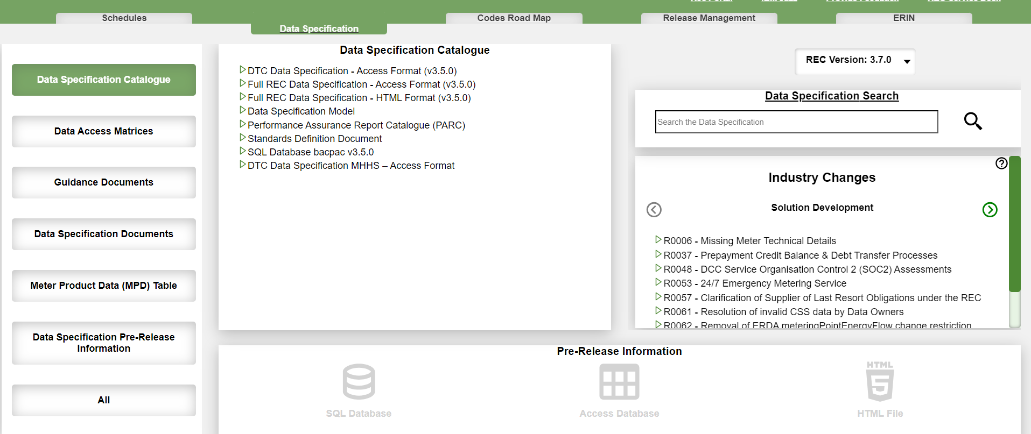
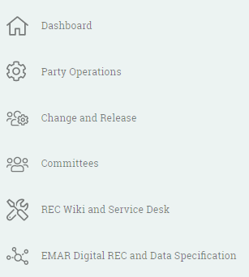
Data specification –overview
Accessing the Data Specification
The Data Specification can be accessed from the REC Portal:

Slide 8
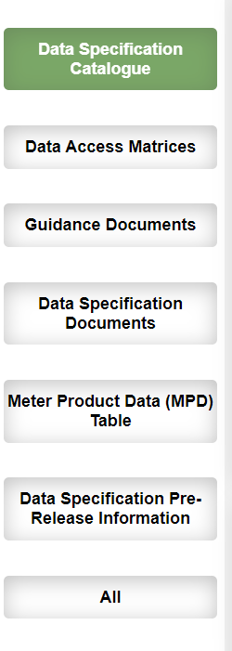
Navigating The data specification
The Digital Navigator home page will display a series of tabs, as shown above. You are given the option to select between the Codes Schedules and Data Specification as well as the Dashboard and Detailed Search. Your selected options will turn into a darker green.
The Data Specification dashboard includes 6 sections:
Data Specification Catalogue(s): defines market messages and data items
Data Access Matrices: define which organisations can access which data types within the Enquiry Services
Data Specification Documents: contains multiple documents which outline rules and information related to the data specification
Meter Product Data (MPD) Table(s): contains the latest Gas Meter Products tables and response codes
Guidance Documents: contains legacy documents (such as DTC annexes)
Data Specification Pre-Release Information: contains upcoming versions of the Data Specification
Notes:
Dashboard overview: Codes Schedule includes all REC Code Schedules (latest and previous versions) which can be accessed via a click and read within the UI, or you can choose to download (in MS word format).
Dashboard overview: Data Spec

Slide 9
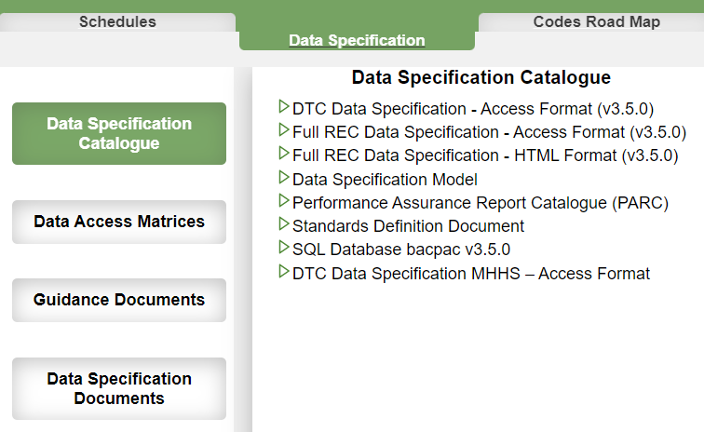
Data Specification - dashboards
Some items will automatically download others will open in your browser
TIP: Unless an automatic download is occurring, the artefact will open within the same browser window. You can navigate back to the dashboard by selecting the back button within your browser.
However, if you need multiple items we recommend ‘opening link in new browser window’ by using the right finger tab on your laptop/ mouse.

Slide 10
Data specification Catalogue
What is the REC Data Specification Catalogue?
The REC Data Specification describes the Data Items and Market Messages that used by industry parties to send and receive information. It includes not only REC owned items but also messages and data items which are owned and governed under the:
Balancing and Settlement Code (BSC)
Distribution, Connection and Use of System Agreement (DCUSA)
Uniform Network Code (UNC)
and Smart Energy Code (SEC)

Slide 11
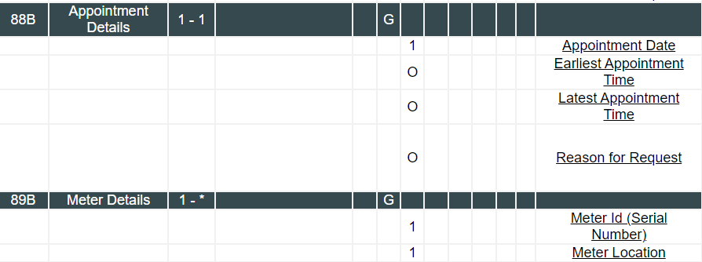
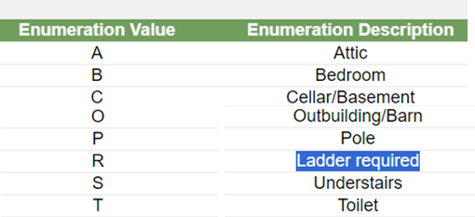
Data specification –overview
By clearly defining data items and market messages, the data specification ensures that information can be shared from machine to machine, smoothing the way for the thousands of pieces of information shared by energy market participants daily.
Here is my list of appointments for 1 Feb. Looks like I am going to need a ladder.
Computer A
Computer B
I’ve made an appointment for the Data Collector to read the customer’s meter between 8am and 11am on 1 Feb. I need to tell the DC that they’ll need a ladder to reach it.
88B|01022024|0800|11000
89B|i9bea33| R
Data Specification
File Format
Valid Meter Locations

Slide 12
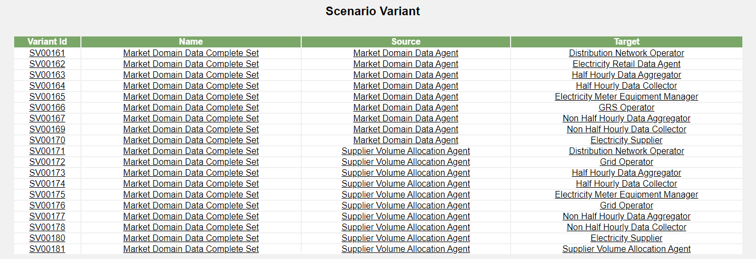
New To REC: the Scenario Variants
Market Messages
Scenario Variant = Unique combination of Market Messages + Sender & Receiver

Slide 13
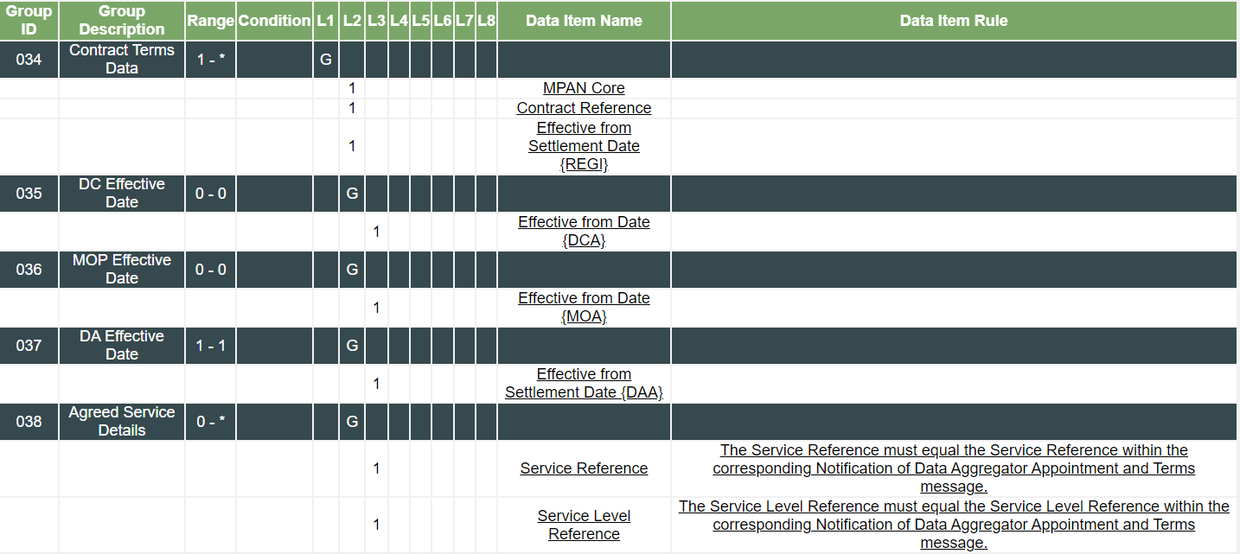
Market Message Structure
Flow No.
Role Code A: HHDA
Role Code X: Supplier
Header
ZHV|0000000079|D0011001|A|CIDA|X|CIDB|20220221100000||||TR01|
034|1920492479118|CIDADA0002|20220222|
037|20220222|
038|0002|0002|
ZPT|0000000079|3||1|20220221100000|
Content
Footer

Slide 14
Digital Navigator: Guided Tour

Slide 15
Test your Data Specification navigation
Role Code A: HHDA
Role Code X: Supplier
Flow No.
Header
ZHV|0000000079|D0011001|A|CIDA|X|CIDC|20220221100000||||TR01|
034|1920492479118|CIDCDA0002|20220222|
037|20220222|
038|0002|0002|
ZPT|0000000079|3||1|20220221100000|
1
Content
2
3
Footer
What is the Group Description for this row?
Contract Terms Data
Agreed Service Details
Supplier Identification Data
2a. What data item is this field showing?
Supplier Effective From Date
DA Effective From Settlement Date
2b. How many other flows does this data item appear in?
3. Is group 038 mandatory or optional?

Slide 16
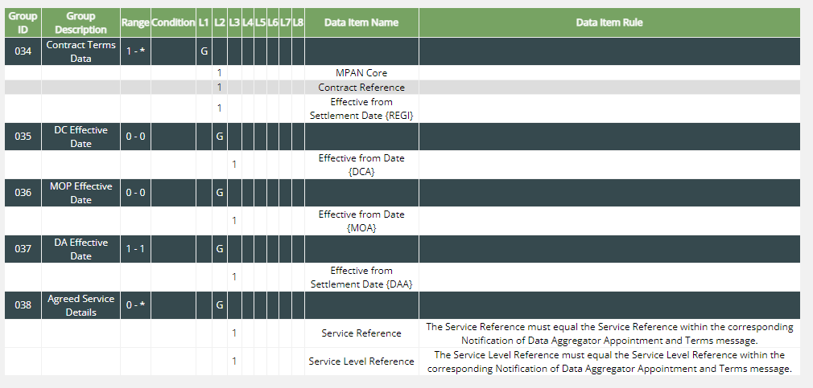
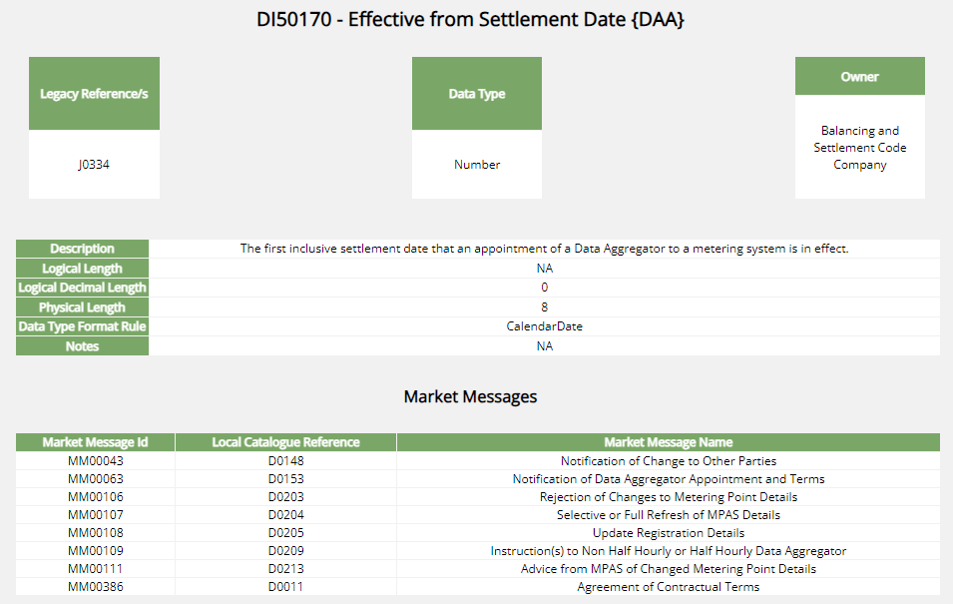
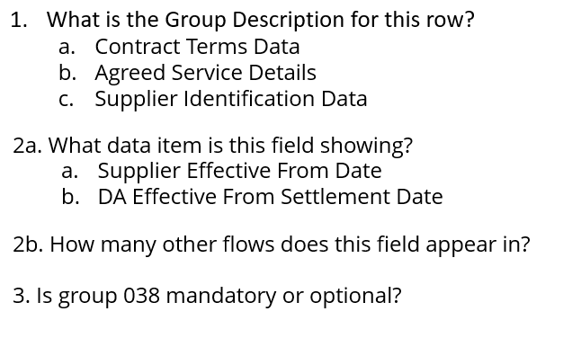
Answers
1
2a
3
7
It has a minimum value of 0 and a maximum value of *, so optional
2b

Slide 17
Making changes to the data specification

Slide 18
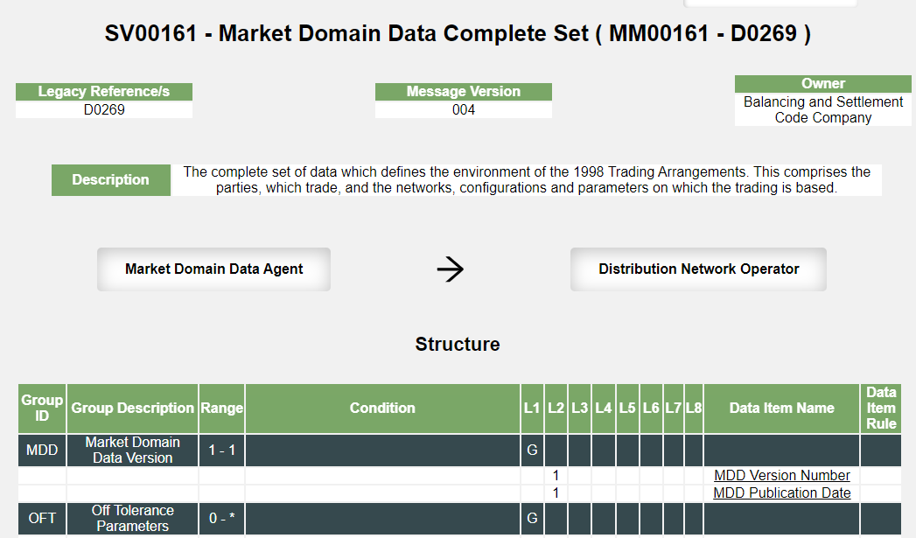
Data items and messages are owned by a Code
Changes must be approved under the governance mechanism of the Scenario Variant or Data Item Owner
The REC Data Spec contains message information for both REC and Non-REC industry flows
REC BSC DCUSA SEC UNC
REC Data Specification
Caution: different Scenario Variants can be owned by different codes

Slide 19
data Specification Updates
There are two potential scenarios that a non-REC owned data specification change can fall under
Single Code Impact: go directly to the Code Manager/code administrator that is the owner. The owner should seek approval under the appropriate governance mechanism.
Multiple Code Impacts: Where multiple codes are impacted, a change should be raised under each impacted code. Where there is a cross code impact, the Cross Code Steering Group will ensure that the change plans for all linked changes are aligned across the code bodies, and that engagement is, wherever possible, co-ordinated, so that industry parties get a holistic view of the complete change.
If you are unsure and would like any guidance or support, email enquiries@recmanager.co.uk
Example 1: A new BSC defined process that requires a new data flow, with new data items which will all be BSC owned
A BSC change would be needed to amend the BSC legal text and approve the Data Specification
Example 2: Addition of a new data item to the D0002 Market Message.
The D0002 Market Message has scenario variants owned by REC and the BSC, so a BSC and REC change will be needed

Slide 20
Audience Q&A Session
ⓘ Start presenting to display the audience questions on this slide.

Slide 21
Direct updates on the data specification
Join our REC Data Specification Distribution list to get email updates on the REC Data Specification (e.g. when a new pre-release is available) by emailing:
enquiries@recmanager.co.uk

Slide 22
Thanks for attending
Contact us: enquiries@recmanager.co.uk

Slide 23
Feedback
ⓘ Start presenting to display the poll results on this slide.

