Slide 1
ENERGY THEFT REDUCTION USER GUIDE June 2023
Notes:
n

Slide 2
WELCOME
This guide will help you understand the Energy Theft Reduction process under the REC, your responsibilities, including how to upload theft files to the REC Portal to enable the REC Code Manager to calculate whether you’ve met your theft target.
Animation holder
Animation holder

Slide 3
Contents page
The REC Code Manager administers the Theft Detection Incentive Scheme (TDIS) on behalf of RECCo, and this includes working with RECCo to determine theft targets, administering monthly and annual reporting, and escalating issues where Energy Theft Tip Off Service (ETTOS) reports are not accessed in line with the Unbilled Energy Code of Practice.
This guide covers the following areas:
DETERMINATION OF THEFT TARGET
ANNUAL REPORTING
USING THE REC PORTAL
READ MORE
CLICK HERE
READ MORE
CLICK HERE
READ MORE
CLICK HERE
MONTHLY TARGET REPORTING
ETTOS
REVIEWING YOUR RESULTS
READ MORE
CLICK HERE
READ MORE
CLICK HERE
READ MORE
CLICK HERE

Slide 4
Determination of Theft Target 1/2
RECCo will procure a Theft Estimation Methodology indicating the likely scale of energy theft in Great Britain. This methodology will be periodically reviewed in consultation with interested persons. Once established, the methodology shall be used to inform determinations made pursuant to the Code, such as the proportionality and potentially the efficacy of measures to mitigate energy theft, including the scale and scope of any future theft detection incentive schemes.
RECCo will also continue to procure a Theft Assessment Calculator, produced by the Energy Savings Trust, to determine the likely amount of gas or electricity involved in each individual instance of theft.
The Theft Target Methodology will be established and maintained by the REC Code Manager from 1 April 2023 onwards and used to determine your targets for identifying instances of theft in relation to the TDIS. The objective of this methodology is to set targets that result in a net benefit to consumers as compared to taking no action, taking into account the likely cost of identifying a Confirmed Energy Theft.
Once determined, your theft targets will be made available through the REC Performance Assurance dashboards.
2023-2024 THEFT TARGET METHODOLOGY
READ MORE
CLICK HERE

Slide 5
Determination of Theft Target 2/2
Targets will be adjusted following acquisition / disposal of customer book from / to another REC Party
Market share based on available CSS data
CALCULATING YOUR TARGETS
Published on the REC Portal no later than 1 March each year
Calculated Targets are rounded down to the nearest whole number, including zero
Animation holder
*Please notify your OAM as soon as possible if your theft target needs to be adjusted to take into account a change in your customer book
Animation holder

Slide 6
How ARE incentive payments CALCULATED?
(TOTAL INCENTIVE POT VALUE x (YOUR CONFIRMED THEFTS / TOTAL INDUSTRY CONFIRMED THEFTS))
– (TOTAL INCENTIVE POT VALUE x YOUR MARKET SHARE)
=
INCENTIVE PAYMENT (£)
If you have a smaller customer base and no assigned theft targets, but would still like to participate in the incentive scheme, you are still able to report confirmed thefts to the REC Code Manager and receive payment.
Once you have acceded to the REC and have built up your customer base, the Code Manager will notify you of your theft target and potential incentive payments.

Slide 7
Monthly Target reporting 1/2
Each month you are required to submit theft files to the REC Code Manager so that the REC Code Manager can administer the incentive scheme. The files submitted to the Code Manager are the monthly outcome files that were historically prepared by Suppliers in relation to the historic TRAS arrangements and the data within these files will be used to determine the size of your incentive payments. The file format can be found below in the Performance Assurance Report Catalogue within the list of ‘Operational Documents’. Further detail on the Scheme timeframes can also be found below.
You submit report on the REC Portal by the 1st WD of the following month (data for 1-30 Sept submitted by 1 Nov).
Code Manager publishes results monthly via the Performance Assurance Dashboard.
You may raise a query or challenge the results within 10 WDs of publication.
Challenge investigated and report re-published where applicable.
THEFT INCENTIVE SCHEME REPORTING TIMEFRAMES
PERFORMANCE ASSURANCE REPORT CATALOGUE
Animation holder
READ MORE
CLICK HERE
READ MORE
CLICK HERE

Slide 8
Monthly Target reporting 2/2
YOUR SUBMITTED REPORT
ENERGY THEFT TIP-OFFS
NUMBER OF THEFTS INVESTIGATED
NUMBER OF THEFTS CONFIRMED
Animation holder
Animation holder

Slide 9
Annual reporting
The REC Code Manager will aim to publish the final confirmed theft results for the Reporting Year by the end of July, after the closing of the final query window.
Based on Confirmed Energy Thefts reported by you and the overall market compared to your market share you will be determined to be in a net debit or credit position for the Reporting Year. Note that this calculation is performed separately for each incentive pot.
You will be notified of your debit/credit value within 144 days after the end of the TDIS Reporting Year.
You will be informed of your debit/credit amount within 144 days after the end of the TDIS Reporting Year.

Slide 10
ETTOS
The Energy Theft Tip Off Service (ETTOS) continues to operate as part of the REC. As required by the Unbilled Energy Code of Practice, Energy Suppliers are required to read any tip-offs received within 10 Working Days. Where a GT or a DNO receives a tip off from ETTOS, it must notify ETTOS of the relevant supplier in relation to the tip off within 10 Working Days, as required by the Unbilled Energy Code of Practice. If you do not respond to ETTOS tip offs, the following escalation process will be followed:
Code Manager sends communication to you seeking a response in respect of tip offs that haven’t been actioned
Second attempt at communication and call with Theft Contact.
PAB determines next steps, which may include escalation to Ofgem.
Code Manager notifies PAB, formal letter sent to your Theft Contact.
>10 working days without response between steps
UNBILLED ENERGY CODE OF PRACTICE
READ MORE
CLICK HERE
Energy Theft tip offs reports will be emailed directly to your chosen email address rather than via the current web portal as of 31 January 2022.

Slide 11
Using the REC Portal

Slide 12
Submitting Energy theft Files 1/4
Firstly navigate to ‘Party Operations’ and click on Performance Assurance. Then click upload.
Note: Portal users assigned to the REC Contract Manager role will have access to the Performance Assurance tile. For those users that aren’t REC Contract Managers these instructions are not applicable.

Slide 13
Submitting Energy theft Files 2/4
Select Energy Theft from the drop down under ‘Process Area’ and select the type of file you wish to upload under ‘File Type’ drop down.

Slide 14
Submitting Energy theft Files 3/4
Select the Reporting Month relating to your submission and add a description

Slide 15
Submitting Energy theft Files 4/4
Finally click ‘Select a File’, upload the desired file and click submit. If you receive a rejection message, please refer to the File Validation Wiki page for guidance.

Slide 16
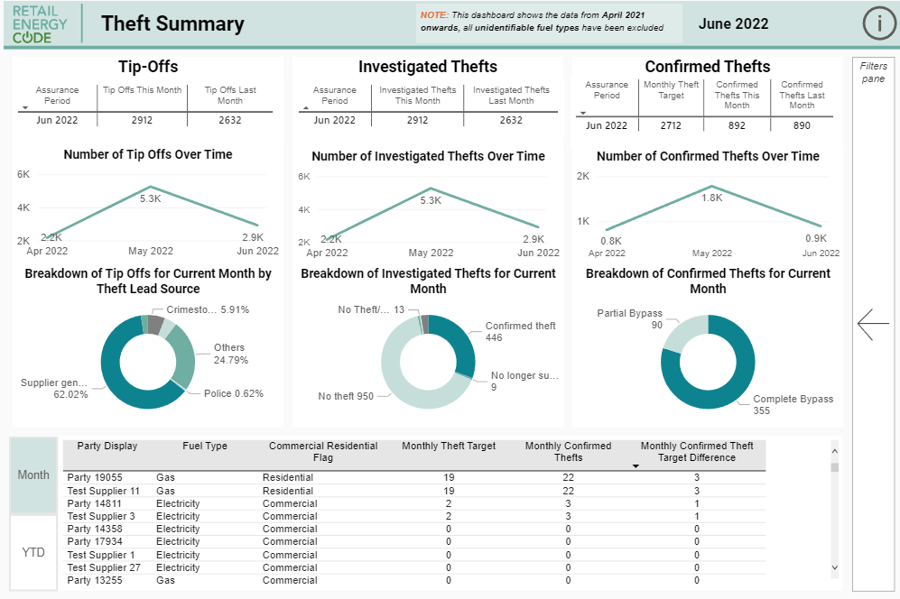
Reviewing your results
The REC Code Manager will publish each Party’s results every month via the Performance Assurance Dashboards. The Dashboard User Guide is included below.
Please make every effort to review your results on a monthly basis and flag any differences between the Code Manager reporting and what you were expecting within the defined Party Query Deadline. This will help resolve any issues before the end of the Reporting Year.
PERFORMANCE ASSURANCE DASHBOARD USER GUIDE
READ MORE
CLICK HERE

Slide 17
Further areas of Support
The Code Manager also provides further support to the industry.
KEY CONTACT
KEY CONTACT
Anton Moden
Assurance Lead
Lewis Williams
Analytics Manager
Anton is the single point of contact bringing the work the analytics, regulatory and PAF specific workstreams together. He is a key contact for PAB related matters, and will focus on establishing relations with the PAB. He will also be the designated point of contact for escalations from any of the three workstreams.
Lewis manages the day-to-day operations of the analytics team. He is the primary contact for matters relating to the Performance Assurance Dashboard, the Performance Assurance Report Catalogue and file submission.
THE REC WIKI AND SERVICE DESK
READ MORE
CLICK HERE
If you have any feedback on this User Guide, please contact enquiries@recmanager.co.uk

