Slide 1
METERING CODES OF PRACTICE USER GUIDE April 2023

Slide 2
WELCOME
This user guide outlines how various processes will be administered by the Code Manager, and highlights the key factors organisations need to comply with to adhere to the Metering Code of Practice.
Animation holder
Animation holder

Slide 3
CONTENTS
The Retail Energy Code (REC) is responsible for the Consolidated Metering Code of Practice (CoMCoP). This user guide outlines how various processes will be administered by the Code Manager, and highlights the key factors organisations need to comply with to adhere to CoMCoP.
Click on the links below to navigate to the relevant sections.
METERING
CODE OF PRACTICES: OVERVIEW
WHAT IS A MEM
A MI?
MOREADRE
CLICK HERE
READ MORE
CLICK HERE
BECOMING
ACCREDITED
AUDITS
READ MORE
CLICK HERE
READ MORE
CLICK HERE
SUSPENSION
AND
WITHDRAWALS
SUBMITTING
CUSTOMER
SURVEYS
READ MORE
CLICK HERE
READ MORE
CLICK HERE

Slide 4
Animation holder
Animation holder
Metering Code of Practices: Overview
The REC Performance Assurance Board (PAB) is the key oversight body for CoMCoP. Audits are carried out by a recognized scheme auditor working alongside the REC Code Manager for obtaining and maintaining your accreditation.
Consolidated Metering Code of Practice
Gas MEMs and MIs who would like to participate in the retail gas market.
Electricity MEMs who would like to participate in the retail electricity market.
An optional accreditation within the gas market for Automated Meter Reading Service Providers.
Smart Metering Installations conducted by gas and electricity suppliers of domestic and micro business consumers.

Slide 5
Animation holder
Animation holder
What is a mem and a mi?
The REC defines the term Metering Equipment Manager (MEM) as either: ‘a) for electricity, the ‘Meter Operator Agent’ appointed by an Electricity Supplier or b) for gas, the ‘Meter Asset Manager’ appointed by the Gas Supplier.
A Meter Installer (MI) is defined in the Gas Supply licence as ‘in relation to any Gas Meter, a person a class or description of persons possessing the expertise to connect that meter satisfactorily so that the gas supplied through it is duly registered, or a person whose staff have such expertise; and approved in accordance with Retail Energy Code.’
A Market Participant means ‘a participant in either or both of the gas and electricity markets of Great Britain, each of which identified by a Market Participant Role’.
A MEM who is a Market Participant is an organisation which is qualified to send information relating to metering operations to central systems.
CoMCoP – Gas MEM
CoMCoP – Electricity MEM
The Ofgem Licence condition refers to MAMs as ‘‘(a) a person or a class or description of persons possessing the expertise satisfactorily to design, install, commission, inspect, repair, alter, reposition, remove, renew and maintain the whole or part of the Supply Meter Installation as defined in Section M, paragraph 1.2 of the Network Code as at 1 August 2007; or a person whose staff have such expertise; and (b) a person or a class or description of persons approved in accordance with the Retail Energy Code.”
The BSC’s definition of a MOA is ‘an agent ‘to install, commission, test and maintain, and rectify faults in respect of, Central Volume Allocation (CVA) Metering Equipment and/or Supplier Volume Allocation (SVA) Metering Equipment.’

Slide 6
Becoming accredited (Electricity and Gas)
If you are a MEM who was not accredited on 1 April 2023, you will need to complete a Business Solution Assessment (BSA) and be audited before you can become accredited. However, if you are a MEM currently accredited under the codes replaced by CoMCoP, you are accredited at the start of April 2023 and will not be subject to initial accreditation audits. Upon initial accreditation your scheme will only comprise the desktop audit, and you will then receive a provisional one-year certificate . At the end of your first year of operating, you will then undertake both a desktop audit and a site audit before receiving a full two-year certification.
Additionally, if you want access to either the Electricity Enquiry Service (EES) and/or Gas Enquiry Service (GES), you will need to complete an Information Security and Data Protection (ISDP) form. If you plan on sending data flows, you will need to complete internal testing. The Code Manager will take a risk based approach to internal testing, evaluating your ability to send data flows to central systems based on evidence you submit.
Will I send data flows?
Internal
Testing
Gain REC
Portal Access
Complete Entry
Assessment Application Form
Complete REC
Accession
BSA
Desktop Audit
Receive
Certificate*
Annual Maintenance
ISDP
Assessment
MORE DETAILS ON MARKET ENTRY
Will I require
access to GES or EES?
*For electricity MEMs, you'll need to confirm your sealing IDs to the Code Manager before you receive your provisional one-year certificate*
READ MORE
CLICK HERE

Slide 7
Becoming accredited (BSA)
As part of the Business Solution Assessment (BSA), you will need to submit evidence relating to the following areas so that the Code Manager can decide whether you meet the requirements of the CoP to proceed with the process for obtaining your gas and/or electricity accreditation.
Gas MI & Gas MEM
Electricity MEM
Contact details for engineers
Training processes
Org chart
Agents and sub-contractors
Health and safety processes
Policies for vulnerable customers
Insurance
Company policy
Records relating to competency of staff
Sub-contractor processes
Training and expertise
Working practices
Meter install, removal, and commissioning processes
Method of communication for RGMA
Technical competency
Provisional registration
Animation holder
Animation holder
Internal audit processes
GT authorisation processes
Systems and processes in relation to data flows
Internal testing of systems
Systems and processes in relation to data flows
Internal testing of systems

Slide 8
Animation holder
Becoming accredited (ASP)
Becoming an Automated Meter Reading Service Provider (ASP) in the gas market is voluntary and there are no specific regulatory obligations involved. Instead this accreditation is to inform best practice.
Upon initial accreditation your scheme will only comprise the desktop audit, and you will then receive a provisional one-year certificate . At the end of your first year of operating, you will then undertake both a desktop audit and a site audit before receiving a full two-year certification.
There is no requirement for ASPs to complete BSAs, ISDPs, any internal testing or any annual statements in respect of their ASP role. However, any organisation wishing to be registered as an ASP will be required to comply with a periodic audit to demonstrate their compliance with the ASP requirements under CoMCoP.
Complete Application
Form on the REC Portal
Scheme Audit
Receive
Certificate
Bi-Annual Maintenance

Slide 9
Becoming Accredited (SMI)
The provisions of the SMI requirements under CoMCoP are applicable to Energy Suppliers who install smart meters for Domestic Customers and Micro Business Customers. There is no formal requirement to become ‘accredited’ – by acceding to the REC, you are agreeing to the provisions for SMIs under CoMCoP, and will need to declare your compliance.
BSA
Annual Statement
As part of the market entry process, you will be required to provide specific evidence around your ability to meet Smart Meter Installation requirements under CoMCoP, including
Details of business processes around the installation of smart meters
Details of how you will maintain compliance with all relevant clauses of Smart Meter Installation under CoMCoP
As part your annual statement, you will be required to make a self declaration confirming that your organisation
Is compliant with the relevant clauses for Smart Meter Installation
The type of supplier you are (e.g. Large Supplier, Small Supplier or Micro Business Supplier)
Gain REC Portal access
Complete Entry Assessment Application Form
Complete REC Accession

Slide 10
AUDITS
Regular audits are required to monitor ongoing compliance with CoMCoP. Please note that it is your responsibility to pay the relevant audit fee to the scheme auditor – a failure to make payment could be escalated to the PAB and could result in you losing your accreditation. The scheme auditor will work with you to schedule and execute audits and report findings to the Code Manager.
Accreditation date
reviewed to determine
bi-annual audit dates.
Full Scope
Audit (desktop and site)
Resolve remedial
actions
Audit report
issued
Pay audit fee
When you approach
10,000 customers,
install more 1,500 smart meters or declare non-compliance as part of your annual statement.
Notify code
manager you are ready to be audited
Further
audit
where
required
Pay
audit
fee
Initial
findings
shared
Audit
report
issued
Resolve
Remedial actions
Audit

Slide 11
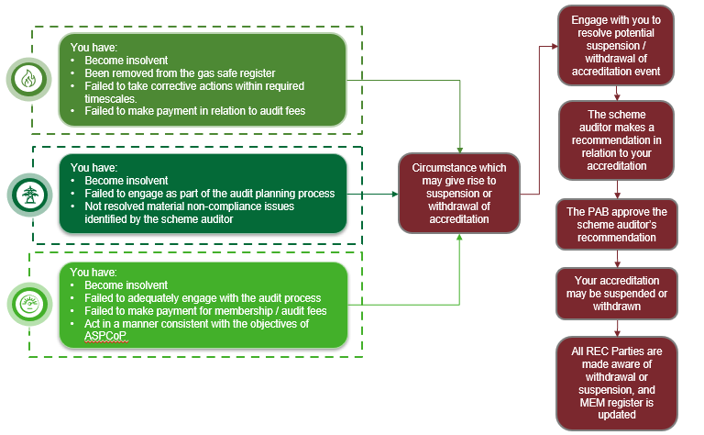
Animation holder
Animation holder
SUSPENSION AND WITHDRAWALS
Accreditations across CoMCoP can be suspended or withdrawn in certain circumstances. In any of the circumstances, the Code Manager and the scheme auditor will work with you to resolve any non-compliance issues before the matter is escalated to the PAB.
Role of the PAB:
Receive written representations relating to the suspension/withdrawal.
Approve the decision recommended by the scheme auditor
You have:
Become insolvent
Failed to adequately engage with the audit process
Failed to make payment for membership/audit fees
Act in a manner inconsistent with the ASP objectives of CoMCoP
PAB PROCEDURES DOCUMENT
READ MORE
CLICK HERE

Slide 12
SUBMITTING CUSTOMER SURVEYS
The REC requires those operating as SMIs to undertake quarterly surveys of Domestic and Micro Business customers. The questions can be found in CoMCoP. If surveys have not been received in line with the reporting submission deadline, you will be notified and the matter may be referred to the PAB or Ofgem as appropriate.
Upload Smart Meter Installation Monitoring and Compliance spreadsheet to REC Portal.
The Code Manager will publish the data from your survey into your REC portal account.
You will have 5WD from the publication of your specific data to challenge the aggregation of data by the Code Manager.
Assuming any challenges are resolved, the Code Manager will consolidate survey responses from all suppliers.
The Code Manager will then publish the results of the survey on the REC portal and for the PAB.
Yes
Have you submitted a Customer Survey before?
Calendar Quarter (CQ) | Relevant Reporting Period | Reporting Submission Deadline | Publication of Domestic Survey Results
CQ1 | 1 Jan to 31 Mar | No later than 30 WDs after 31 Mar | No later than last WD of Jun
CQ2 | 1 Apr to 30 Jun | No later than 30 WDs after 30 Jun | No later than last WD of Sep
CQ3 | 1 Jul to 30 Sep | No later than 30 WDs after 30 Sep | No later than last WD of Dec
CQ4 | 1 Oct to 31 Dec | No later than 30 WDs after 31 Dec | No later than last WD of Mar
Complete and send a methodology statement to DESNZ and Ofgem.
No

