Slide 1
CSS readiness webinar may 2022

Slide 2
Housekeeping
Please turn off cameras and remain on mute
Questions can be asked using Slido
Please raise your hand to ask a question verbally
Session is being recorded and the recording will be shared on the REC Portal next week

Slide 3
Agenda
The focus of today’s webinar is to provide REC stakeholders an update on performance assurance for CSS readiness arrangements and the setting of risk monitoring thresholds. ​
The agenda for the session is separated into two parts:
Part 1: CSS Readiness – what’s changing in the REC Performance Assurance service?
Changes to the Risk Register and the PARC and our monitoring approach
Market Entry Process post CSS go-live
New REC Performance Assurances Board (PAB) responsibilities
Part 2: Risk Monitoring Thresholds – how will thresholds be set under the REC?
Risk threshold methodology
How the REC Code Manager will use risk thresholds?
How will risk thresholds impact REC Parties?

Slide 4
Introduction
Break
10 Minutes

Slide 5
the Role of the Performance assurance delivered by the code manager
The Code Manager monitors REC Parties and REC Service Provider performance, using dynamic risk assessments, digital technologies, and analytics to help drive market and code improvements.
The RPA Code Manager is responsible for:
developing and implementing the Performance Assurance Framework (PAF) to identify, assess and mitigate retail market risks
supporting the running of the Performance Assurance Board (PAB)
administering the REC Party entry and exit process on behalf of the PAB
performing market monitoring and REC Party compliance audits
undertaking performance assurance over the REC Service Providers
The Code Manager has designed and developed the PAF and products for the REC Performance Assurance regime, as illustrated on the right-hand side.
PAF Core Components
Performance Assurance Methodology (PAM)
Retail Risk Register
Performance Assurance Techniques (PATs)
Report Catalogue

Slide 6
the Role of the code manager
Other key performance assurance activities include:
Market Entry Assessments
Data Access Assurance
Metering accreditation and audit
Sandbox, Derogation and Dispute applications
Energy Theft

Slide 7
Part 1 – css readiness
Break
10 Minutes

Slide 8
Changes to the risk register & our monitoring approach
Break
10 Minutes

Slide 9
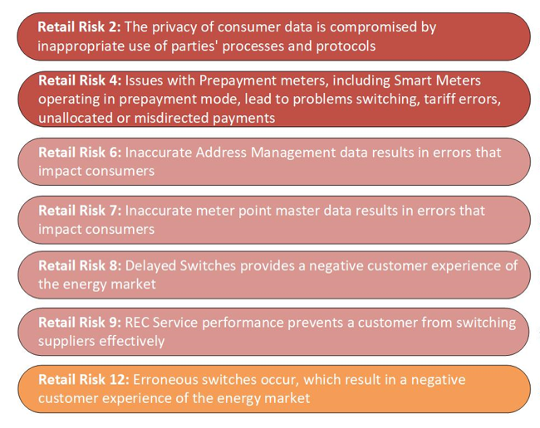
Changes to the Risk Register and our monitoring approach
At CSS go-live there will be significant changes to industry systems and processes. These require changes to the REC Retail Risk Register, as risks change and the way in which the Code Manager can measure them changes.
The Performance Assurance Board (PAB) has been engaged with these updates, which they considered and approved during the 22 February 2022 meeting. The PAB also noted that an industry consultation would take place following PAB approval (currently ongoing).
The changes that have been made to the Retail Risk Register include updates to 16 Risk Drivers within 7 Retail Risks (listed to the right) either improving the description or moving them to a more appropriate Risk.
Key point: we are not changing our approach, or looking to do more – but we are updating our documents so they are consistent with REC V3.

Slide 10
Please refer to the risk register Consultation for further details on the changes made
Key Risk Register Updates
Introduction of CSS
Wording simplification
Introduction of GES in the Service Provider Assurance
New processes – i.e. Annulments & Withdrawals
Risk Driver Consolidation
Change to measuring approach (Data Led vs. Service Provider Assurance)
https://recportal.co.uk/group/guest/-/risk-register-updates
Notes:
Our approach:
As part of REC V3, the Code Manager reviewed the updates to the Code in order to identify potential amendments to the Risk Register and the Performance Assurance Report Catalogue (PARC).
The first step was to identify the key Retail Risks and Risk Driver updates and as a second step, assess the data needed to monitor the risks which would result in updates the PARC.
Its worth noting that we are still focusing on the same areas with the key difference being that in some instances, we will be able to acquire more data from central systems

Slide 11
Changes to the Performance Assurance Report Catalogue (PARC)
In March 2022, a Category 2 Change Proposal (CP) was raised to update the PARC in line with REC V3. The CP will be progressed to industry consultation in June.
Most of the changes made impact REC Service Providers, with additional centrally provided data being requested in order for the Code Manager to assess the new and updated risks being monitored.
Some changes have been made to REC Party data provision, with:
Some adjustment to reports 1430 / 1440 incorporating clarifications / updates to guidance that reflect queries received from Parties through the helpdesk
The addition of one new item based on existing data capture and reporting performed currently with the Switching Programme DWG.
Further detail is provided on the next slide

Slide 12
Changes to the Performance Assurance Report Catalogue (PARC)
Applicable party type | Updates | Detail
Distribution Networks & Gas Transporters | N | N/A
Gas MEMs | Y | Housekeeping change to correct an error – no impact expected
Suppliers | Y | New item added – Data Cleanse Exception Report Modification to the switching data items 1430 and 1440 following Party feedback
Service Providers (RPA, RTS, RPS, DCC, EES, SDES, GDCC, ERDS, GRDS) | Y | Proposed update to capture all Service Provider monitoring reporting requirements within the PARC
CSS Provider | Y | Items requested from the CSS Provider as a result of REC V3, covering address data quality and switching activity
SDES Provider | Y | Items requested from the SDES Provider to monitor activity in accordance with the REV V3 Schedule - Resolution of Consumer Facing Switching and Billing Issues.
GES Provider | Y | Three items requested from the GES Provider covering GES usage and performance

Slide 13
Changes to the Risk Register and our monitoring approach
Summary of PARC updates:
Useability updates – improved navigation and cover sheet updates
Removal of references to REC V2 Schedules (replaced by REC V3)
Additional central service provider data items from the CSS Provider, GES Provider and SDES Provider
Addition of a single Party provided data item (1780 – Data Cleanse Exemption Report)
Removal of two items (70 – CAB Complaints Data and 870 – ECOES Address Data Quality Report)
Updates to other central service provider data items including updates to descriptions
Update to Party provided data item (670 – Content provided within RGMA flow – ONDET) to correct an error in the data specification
Update to Party provided data items (1430 - Gaining Supplier Switch Data / 1440 – Losing Supplier Switch Data) following Party feedback.
Key point: the Risk Register already covered CSS, this update is about removing legacy items, updating to refer to REC V3 and improving the document to make it clearer.

Slide 14
Changes to market entry process
Break
10 Minutes

Slide 15
Market Entry Process post CSS go-live
Market Entry Process Post CSS Go-Live Date continues with the addition of the aspects of the Entry Assessment process relating to the Central Switching Services, Gas Enquiry Service and Switching Operator Service will apply.
REC Party Onboarding Process
Non-REC Party Onboarding Process
Notes:
The principals of the Market Entry Process remain the same, with the main difference being that there is a wider variety of services available i.e. the Gas Enquiry Service and Central Switching Service.
Access Agreements
These are only required to be signed by Non-REC Parties
For non-REC Party users requesting access to EES, GES and/or CSS, there will only be one access agreement signed which will cover both enquiry services
On the go-live date (July 18th), all Non-REC Party users on services transitioning to GES will have their existing access agreements expire and these will be replaced with new access agreements with the REC
For all parties in the process of gaining GES access, they will not be permitted access until the go-live date where they will sign the new access agreement with the REC
For Non-REC Parties with access to a service transitioning to GES whose existing access agreement is expiring prior to go-live, an access agreement with the REC will be signed on the date of expiry

Slide 16
changes to market entry documents
Market Entry documentation has been updated in preparation for CSS readiness activities
The Joint Storyboards have been updated in line with up-to-date REC schedules
Entry Assessment Forms – In the BSA and ISDP, new questions have been added and existing questions updated.
REC Entry Assessment Information Pack – ISDP and External Testing entry criteria updates.
Maintenance of Qualification External Assessment – new questions have been added and existing questions updated to align with latest REC schedules.
REC Service User Categorisation and Assessment Document – updates made in relation to GES and CSS Interface Providers.
REC Maintenance of Qualification Guidance – This document currently includes the forms (Entry, ISDP and BSA) that organisations need to fill in to complete their Maintenance of Qualification. However, these forms are yet not available on the REC Portal. When organisations can directly access this information on the Portal, the embedded forms in this document (Entry, ISDP and BSA) will be removed.
Joint Storyboards
Joint Storyboards details the test scenarios that a REC Party would need to execute its ability to meet the requirements of the processes within the REC

Slide 17
INTRODUCTION: CSS ONBOARDING
All organisations that have successfully completed testing in accordance with the Transition Schedule are considered to have qualified to become a CSS user and CSS onboarding does not apply.
From CSS Go-Live Date, those Energy Suppliers who were Qualified before CSS Go Live but did not successfully complete testing, will continue to be Qualified, however need to carry out certain steps to become a CSS User.
The Code Manager plays a role in the process. We are responsible for the following aspects of the process:
Facilitate and support the applicant through the entry process (as required →BSA/Internal Testing/ISDP).
Raise a Service Request via SMS to initiate CSS External Testing.
Raise a Service Request via SMS to initiate CSS Onboarding for applicant.
Role of REC Code Manager in CSS Onboarding
Who are the CSS users?
Energy Suppliers
MEMs
Gas Shippers
Smart Meter Data SP
ERDS
Data Aggregators
Enduring CoS P
Code Manager
GRDS
Data Collectors
CSS IPs
MAPs
GES SP
EES SP

Slide 18
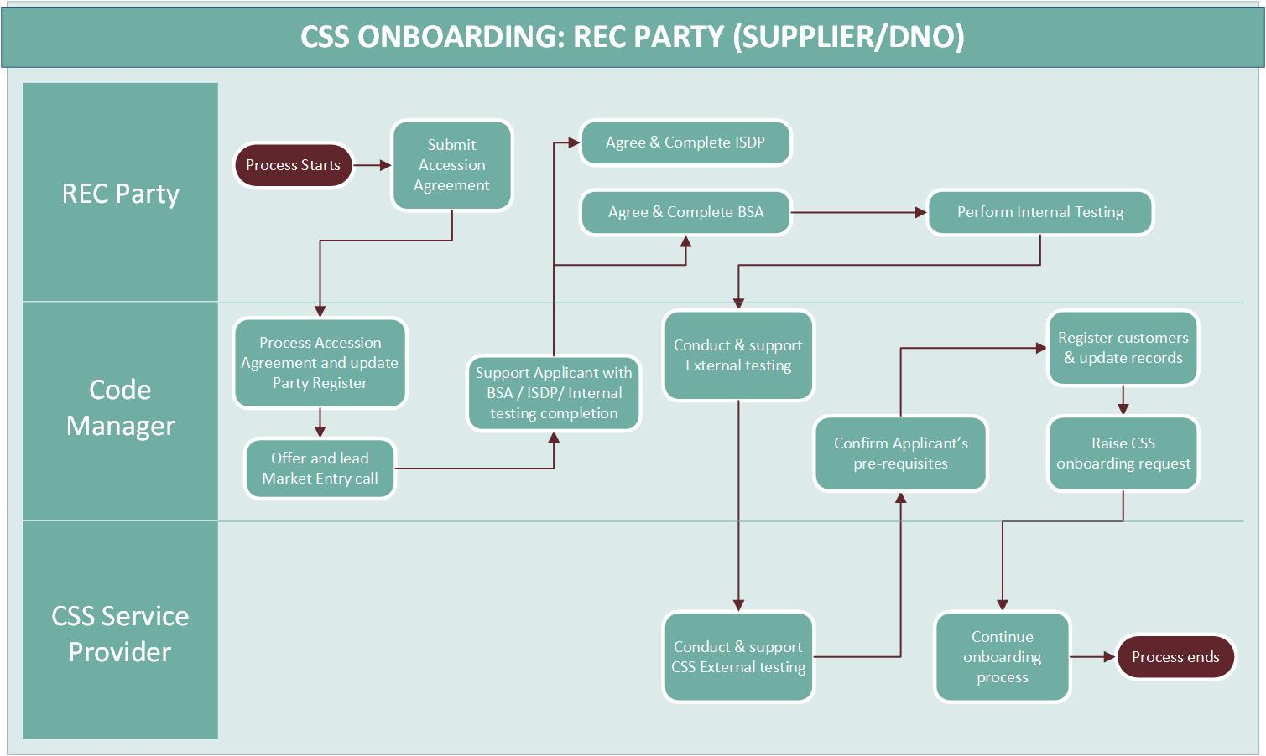

Slide 19
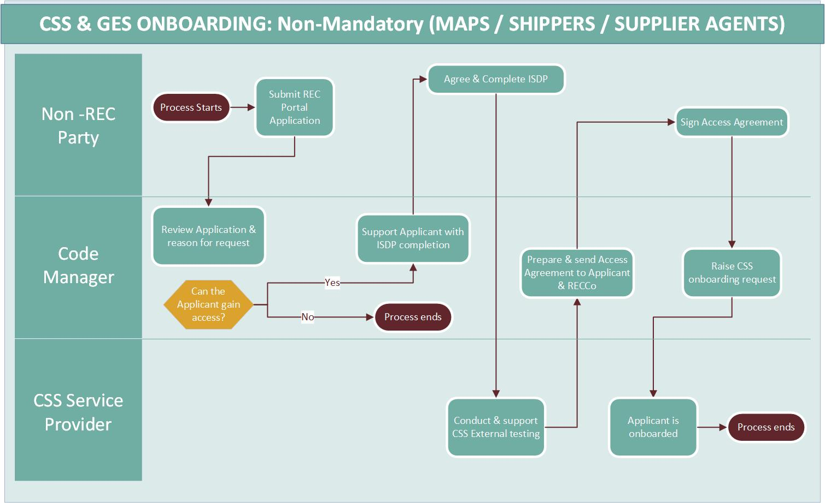
Notes:
Meter Asset Provider, Shipper or Supplier Agents can decide to become CSS Users or not.
Where they decide not to become CSS users, they undergo REC Access process
This is similar to the current entry process, except the applicant must complete CSS External Testing in addition to an ISDP if they wish to become a CSS User.

Slide 20
New REC pab responsibilities
Break
10 Minutes

Slide 21
New REC PAB responsibilities
The PAB has a number of responsibilities that have not changed and will continue after CSS go-live. These include oversight and monitoring of:
Switching, Address Management and other Retail Risks
Market Entry including Metering Accreditation
Energy Theft
Service Provider Assurance
REC Change Proposals
Sandbox and Derogation applications
Appeals and escalations
There are two further responsibilities that will be in place from CSS go-live:
Additional Service Provider assurance that will cover CSS related Service Providers, e.g. the Central Services Switching Provider (DCC), the CSS Certification Authority (CSS CA), Gas Enquiry Service (GES), Gas Retail Data Service (GRDS) and Electricity Retail Data Service (ERDS).
A new appeal route from the Switching Change Advisory Board (CAB) to the PAB where agreement cannot be reached on an operational change.
Notes:
The PAB Terms of Reference and PAB Procedures have been updated in line with up-to-date REC schedules

Slide 22
Any questions?
Break
10 Minutes

Slide 23
Part 2 - Risk monitoring thresholds
Break
10 Minutes

Slide 24
Threshold setting - overview
The Code Manager uses a data-led approach to undertake Performance Assurance activities identifies performance changes over time, or indicates poor consumer outcomes. However, it does not tell us however, does not tell us the significance of these issues. For example:
1,000 inappropriate disconnections are not equivalent to 1,000 address updates that are 1 day later than required
The PAB will set thresholds above which the Code Manager will apply PATs. The Code Manager can apply PATs at lower levels, typically asking for clarification around unusual or unexplained data, or on rapidly worsening performance.
Thresholds exist to enable the PAB make more efficient and effective decisions. This approach will focus on performance above thresholds / anomalies and indicate where to invest and prioritise our time.
Thresholds are intended to drive market improvement; Parties are expected to comply with the Code and deliver appropriate consumer outcomes.
Key point: Things that affect all organisations like a DTN outage are really obvious when you have thresholds. They help us work out when problems are market wide.
Notes:
Key point: Having thresholds is like having a ‘reasonable endeavours’ clause for the entire Code (driving speeD)

Slide 25
Risk threshold methodology
The approach to identifying and assessing risks is included in the Performance Assurance Methodology (PAM). The Code Manager will use the PAM to monitor risks, risk drivers and risk metrics, analysing party performance on a monthly basis
The Code Manager will use three thresholds to determine where to apply Performance Assurance Techniques (PATs) outlined in the table below.
Metric | Description
Minimum Activity Level | A minimum number of processes (events or transactions), below which we would not automatically intervene if poor performance was observed.
Trend Period | The frequency in which a Risk Driver is monitored, based on the historic volatility in performance and the priority of the risk.
Baseline Performance Expectation | The current performance expectation, based on historical trends, PAB guidance and Code obligations.
Notes:
Minimum Activity Level – a minimum number of processes (events or transactions), below which we would not automatically intervene if poor performance was observed. We initially propose this is set as a percentage of the mean number of transactions in the market per month over the past six months, but we will validate this for each metric as we set thresholds.
Trend Period - the frequency in which a Risk Driver is monitored, based on the historic volatility in performance and the priority of the risk. For example, a high priority metric may be assessed monthly whereas a lower priority or higher volatility metric may be assessed quarterly or biannually.
Baseline Performance Expectation – the current performance expectation, based on historical trends, PAB guidance and Code obligations.

Slide 26
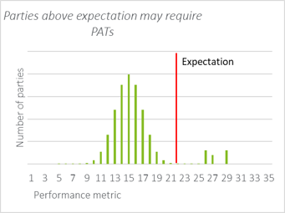
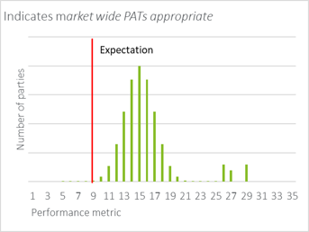
How will the Code Manager use risk thresholds?
The Code Manager will use a risk based approach to identify the most appropriate PATs to apply.
The key threshold to do this is – Baseline Performance Expectation - the current performance expectation, based on historical trends, PAB guidance and Code obligations.
Key point: Being over a threshold shows there is a problem. The Code Manager then needs to work out if the data suggests the problem is with systems, processes, data or an individual Party.
Consideration of the overall profile of Party performance – e.g. if all Parties are performing significantly worse than the performance expectation, a market wide approach may be more appropriate, whereas if individual Parties are outliers targeted interventions may be more appropriate.

Slide 27
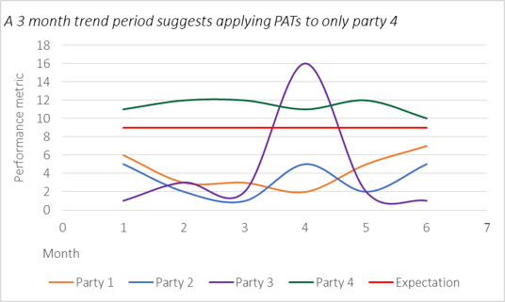
How will the Code Manager use risk thresholds?
It is also important to be intelligent in responding to the nature of the data, not simply comparing the average performance of Parties. To do this we use 2 other metrics (Minimum Activity Level & Trend Period)
The Code Manager would not automatically intervene when an organisation has fewer processes than this minimum activity level. This is intended to focus on Performance Assurance of meaningful performance.
Consideration of a Party’s performance trend will be taken into account before intervening. For each risk metric a trend period will be set and the rolling average over the trend period considered.
In the example overleaf if the trend period is one month Parties 3 and 4 would be considered for PATs, but if the trend period is three or six months only Party 4 would be considered.
Key point: People are going to have blips. The Code Manager is much more interested in understanding the causes of sustained underperformance.
Key point: There is also a human review of the data, to pick up anomalies. The Code Manager must act when Parties exceed a threshold, but they can discuss any anomaly with PAB.

Slide 28
Forward look
What are we setting thresholds on?
We only set thresholds for Risk Drivers we monitor through data - others are covered by different techniques. For example, we test information security controls to assess security risks and PSR processes to understand how effective Parties are at managing Priority Services data updates.
We set thresholds when we have a track record of data. For some Party submission there is not sufficient data yet to set thresholds, as well as for CSS specific risks.
PAB members have proposed thresholds for the following risk drivers. These will be proposed to the PAB for approval at the PAB meeting on 31 May.
Retail Risk | Risk Driver | Area
5 | 5.1 | Switch Meter Readings
 | 5.2
6 | 6.1 | Address Management Data
 | 6.2
8 | 8.1 | Switching Issues
 | 8.5
 | 8.6
10 | 10.1 (a) | Inaccurate Data
 | 10.2
12 | All (12.1 -12.2) | Erroneous Switches

Slide 29
Forward look
What will the future look like?
Thresholds are there to help the Code Manager focus in the right place. It is really important not to see these as a ‘target’ or ‘speed limit’.
Dashboards are being developed so that you can see the same thing about your performance as the Code Manager.
We think that this information is essential for Parties to understand the thresholds.
When dashboards are ready we will share more information on the thresholds. There is a live discussion at the PAB on how best to share this information, whether it is the numerical thresholds, the PAB’s approach to each risk driver or something else.
Thresholds are not static - they could be tightened or relaxed by the PAB, depending on events.
Key point: We want thresholds to help address some of the issues consumers face and help us tell the difference between things Parties should address and things that need to be resolved across the industry. We know this is nuanced, but it is really important to be open about this.

Slide 30
Any questions?
Break
10 Minutes

Slide 31
THANK YOU FOR ATTENDING please provide any feedback you may have at slido.com

