Slide 1
R0147 Prepayment Levelisation Pre-Release Webinar
14 March 2024

Slide 2
Introducing Your presenters
Jenny Hyskaj
REC Code Manager
Communications and Events Analyst
Holly Law
REC Code Manager
Release Manager
Vaishnavi Sharma
REC Code Manager
Performance Assurance
Chris Stock
Recco
Business Analyst
Jonathan Windeatt
Ofgem
Principle Industry Operations and Commercial Expert

Slide 3
Housekeeping
Videos and microphones
Event recording
Use of Slido
Opportunities for Q&A

Slide 4
Join at slido.com #3814849
ⓘ Start presenting to display the joining instructions on this slide.

Slide 5
Agenda For today
Agenda Item | Presenter
Levelisation Policy | Jonathan Windeatt Ofgem
Payment Method Levelisation (PML) Reconciliation Pre-release Information and Readiness | Holly Law Code Manager
Recco Operational Delivery Update | Chris Stock Recco
Assuring Payment Method Levelisation | Vaishnavi Sharma Code Manager
Q&A R0147 Go Live | All
Post Implementation Support | Holly Law Code Manager
Supplier Audit Requirements | Jonathan Windeatt Ofgem
Treatment of Multi Rate Metering | Jonathan Windeatt Ofgem
Q&A on Supplier Audit Requirements and Treatment of Multi Rate Metering | Jonathan Windeatt Ofgem

Slide 6
Levelisation Policy
Jonathan Windeatt

Slide 7
The cost-of-living crisis and forced Pre-Payment Meter (PPM) installations have put a spotlight on PPM customers and the premium they may pay compared to Direct Debit (DD) customers, with vulnerable customers potentially disproportionately affected as there is a higher proportion of vulnerable PPM customers than DD. This premium is driven by the higher operational costs of traditional PPMs which result in higher standing charges paid by PPM customers.
Standard Credit (SC) customers also pay significantly more than DD customers and are generally more vulnerable than DD customers (on a % basis). The differential is driven by both fixed operational costs and higher debt related costs, driving higher unit rates and standing charges.
What have we announced?
We have announced our decision to levelise PPM and DD standing charges from April 2024, for both capped and uncapped contracts. We also announced our current intention to levelise DD and SC debt related costs, following industry design of the systems and completion of the Opex review, but noted that this may change if either of these materially impact the benefits case. We will make a final decision next year, aiming to implement debt-related levelisaton by April 2025. We decided not to levelise standing charges between regions, or target levelisation, at this point in time. Levelisation will be supported by a supplier reconciliation by difference mechanism to support suppliers' ability to recover efficient costs.
Why is it good for consumers?
It means that PPM customers will continue to be supported once the EPG ends, which will have a (small) positive impact on self-disconnections. | The individual impact of levelisation varies but income weighted analysis shows that levelisation results in, on aggregate, low-income and vulnerable customers financially benefitting. | We calculate that the policy will have a positive impact on total and bad debt levels and working capital costs

Slide 8
Impacts of levelisation
Our approach to levelisation ensures that standing charges for PPM customers and DD customers are equalised. As DD standing charges have traditionally been lower than PPM standing charges, levelisation leads to a reduction in PPM standing charges offset by an increase in DD standing charges. Overall, levelisation is a transfer between customers and therefore the sum of impacts on the price cap levels nets to zero. Our decision to levelise PPM and DD standing charges reduces bills for PPM customers by £52, making PPM the cheapest payment method. Our decision increases bills for DD customers by £10.
Other quantified impacts
Our impact assessment finds that levelisation should result in positive impacts for consumers including: Distributional benefits: We utilised an income-weighted analysis to assess the impacts on consumers with differing levels of income and marginal utility. This analysis indicated an estimated £112m in saving from Phase 1 levelisation. Impacts on bad debt and working capital: Positive impacts on working capital and bad debt of £0.4m and £1.5m respectively Self-disconnections: Our assessment estimates a small but positive reduction in the number of PPM self-disconnections.
+£10
-£52

Slide 9
Payment Method Levelisation (PML) Reconciliation pre-release information and readiness
Holly Law

Slide 10
R0147 –Prepayment levelisation
R0147 seeks to introduce the necessary governance and charging arrangements into the Retail Energy Code, to reconcile the impact on Domestic Suppliers of levelling the cost of standing charges to Domestic Consumers paying by means of a Prepayment Meter with those paying by Direct Debit.
REC Products impacted by this change:
ARTIFACT | CURRENT VERSION | DESCRIPTION | IMPACT
CATEGORY 1 & 2 PRODUCTS
Schedule 31 - Payment Method Levelisation Reconciliation | N/A | New REC Schedule which sets out arrangements concerning Payment Method Levelisation Reconciliation | NEW
Schedule 1 – Interpretations and Definitions | V4.3 | New defined terms added around PML Reconciliation | AMENDED
Performance Assurance: Report Catalogue | V5.0 | New report added for aggregated view on Energy Suppliers' submission of payment portfolio data | AMENDED
CATEGORY 3 PRODUCT
Performance Assurance: Retail Risk Register | V3.1 | New Risk Driver to be added to measure and monitor Parties data submissions for PML Reconciiliation | AMENDED

Slide 11
R0147 –Prepayment levelisation
Stakeholders Impacted by this change:
STAKEHOLDER | STAKEHOLDER TYPE | DETAILS
Energy Suppliers | REC Party | Having PML Reconciliation in place will ensure that there is a mechanism for the timely and accurate invoicing of Energy Suppliers to reconcile the cost of the Levelisation policy.
Code Manager | REC Code Manager | Will have new ongoing operational responsibilities impacting the Performance Assurance Provider.
Recco | Code Administrator | Will have new ongoing operational responsibilities for provision of the technical solution and administration and finance processes.
EVENT / MILESTONE | DATE | COMMUNICATION METHOD
Release Plan V1.0 | 01/03/24 | Weekly Bulletin
Legal Text Pre-Release | 08/03/24 | Weekly Bulletin
Release Webinar | 14/03/24 | Microsoft Teams
Release Go Live communication | 28/03/24 | Email from REC Change Management
Release Go Live communication on REC Portal | 28/03/24 | Release Management Page

Slide 12
Recco Operational Delivery update
Chris Stock

Slide 13
Recap – High-level timeline
PML High level Process
Timeline
Ofgem
Service Provider
RECCo
Energy Suppliers
* WD = working days from Day 0
9 weeks from data cut to payment of credits
Day 0
+10WD
+15WD
+25WD
+30WD
+35WD
Data received:
15th of month
Data Processing
Invoice Production
Payment Window
Funds Allocation
Credits Window
Payment / Levelisation charges
Receive portfolio data
Submission report
Adjusted monthly levelisation rates
Expected in month charges
Monthly allocation of fund
Load and validate data
Calculate adjusted levelisation value
Calculate charges
Allocate funds
Produce and Validate Invoice Data
Collect Payments
Notify Industry of credit % to be received
Submission report
Adjusted monthly levelisation rates
Data extract:
12noon 1st month
Payment Due
Next payment cycle
Supplier receives funds
Missing or errors
Payment Portfolio
Automated non compliance
Invoices and Credit Advice
Late Payments
Notes:
Key updates:
Timeline confirmed
Additional reporting to Ofgem including confirmation of non compliance of supplier data to Ofgem and to RPA for performance assurance
Publication of adjusted levelisation rates, this is to avoid a ‘month 4’ reconciliation
Email notifications on receipt / absence of data

Slide 14
Overview of PML Reconciliation
Invoicing
Late Payments
Disputes
Payments
Funds allocation
Pay on demand, dispute later – maintaining cadence of cash flow
Minimum value of dispute set at £1000 in line with MSC
Calendar month billing periods
Suppliers receive invoice or credit based on net positions 15 WDs after the data submission date.
Suppliers to pay invoices within 10 WDs of receipt of invoice
All funds received are distributed equitably within 10 WDs of payments
Money in = Money out (i.e. 95% paid on time = 95% paid out as per MSC)
Late payment treated as an Event of Default and escalated to Performance Assurance Board
Ability to register new customers may be suspended
Ofgem informed
Notes:
Check working days

Slide 15
PML Levelisation Calendar
PML Reconciliation Invoice Schedule
Invoice periods as of: 01/04/2024
Reporting Month | Snapshot Date | Submission Date (15th Day of Month) | Invoice Date (+15WD after Submission Date) | Payment Deadline (+10WD) | Credit Deadline (+10WD)
Apr-24 | 01/04/2024 | 15/04/2024 | 07/05/2024 | 21/05/2024 | 05/06/2024
May-24 | 01/05/2024 | 15/05/2024 | 06/06/2024 | 20/06/2024 | 04/07/2024
Jun-24 | 01/06/2024 | 15/06/2024 | 05/07/2024 | 19/07/2024 | 02/08/2024
Jul-24 | 01/07/2024 | 15/07/2024 | 05/08/2024 | 19/08/2024 | 03/09/2024
Aug-24 | 01/08/2024 | 15/08/2024 | 06/09/2024 | 20/09/2024 | 04/10/2024
Sep-24 | 01/09/2024 | 15/09/2024 | 04/10/2024 | 18/10/2024 | 01/11/2024
Oct-24 | 01/10/2024 | 15/10/2024 | 05/11/2024 | 19/11/2024 | 03/12/2024

Slide 16
Data Submission Specifications
Payment reconciliation
Ofgem Regions
north_west
north_east
yorkshire
north_scotland
southern
south_scotland
merseyside_and_north_wales
london
south_east
east_england
east_midlands
midlands
south_west
south_wales
Each region must be populated, even if there is no data i.e. populate with zeros and with relevant date format
file name format for electricity: MPID_YYYYMM.csv
file name format for gas: SSC_YYYYMM.csv
Data should be submitted as a CSV file
Data must be supplied to the required location no later than 17:00 on 15th calendar day of the month
Data must be a snapshot for 12 noon on the 1st of the month
Exclude fix term contracts entered into prior to Ofgem decision date of 23rd February 2024
A template for the Gas and Electricity files will be available shortly

Slide 17
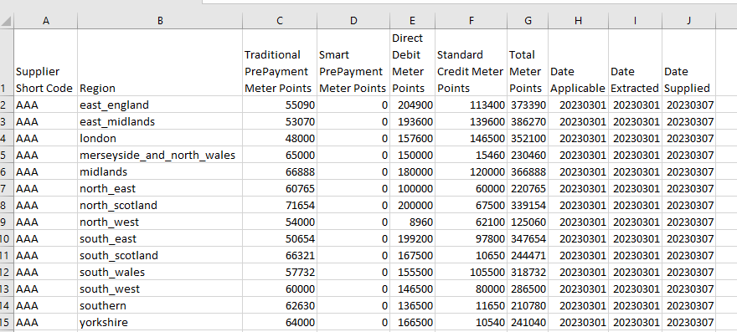
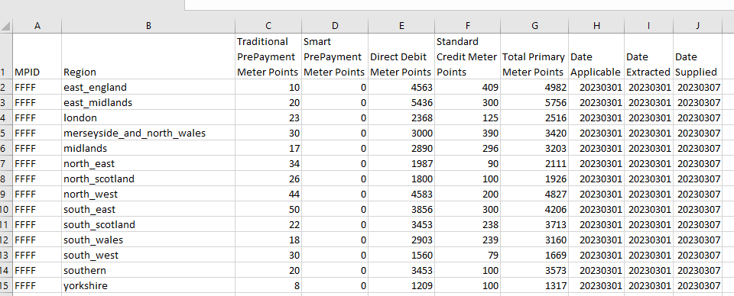
File Submission
All domestic Suppliers required to take a snapshot of their data on the 1st day of each Calendar Month.
They can use a provided template for exacting format:
The template files look like this:
Common areas to consider:
Ofgem Region;
File headers;
Case sensitivity;
Date applicable
Notes:
Check working days

Slide 18
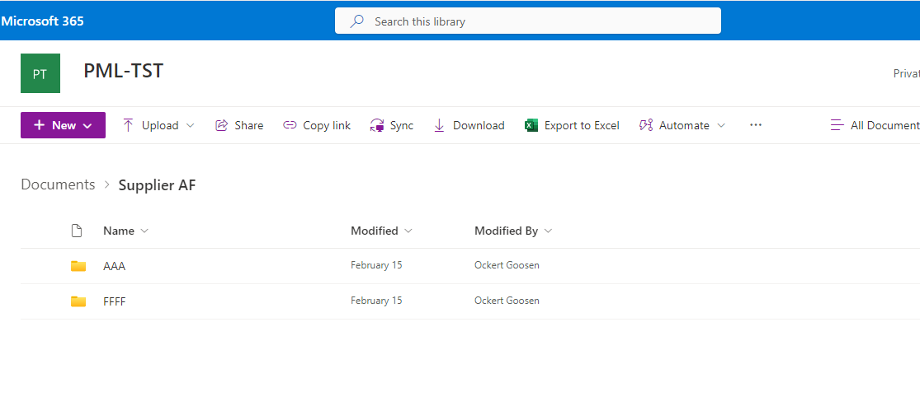
File Submission
SharePoint uploading is as below:
Common areas to consider:
Not having a Microsoft account
Initial set up can be flagged by security
Not uploading in CSV
Notes:
Check working days

Slide 19
Assuring Payment Method Levelisation
vaISHNAVI SHARMA

Slide 20
Assuring Payment Method LEvelisation
The R0147 solution, through collaboration with Ofgem, has considered how Performance Assurance will be delivered for the Payment Method Levelisation process. This includes defining the role for the REC PAB and REC Code Manager in relation to Performance Assurance.
Identifying and Monitoring Retail Risks
The REC Code Manager and REC Performance Assurance Board have assessed the solution and identified the following risk that the REC PAB will monitor from the implementation of the Prepayment Levelisation process:
The REC Code Manager is adding this to the Retail Risk Register and your Performance Assurance Dashboard in preparation for R0147 implementation.
Non-submission of Payment Portfolio Data impacts accuracy of redistribution of costs across the retail market.

Slide 21
Assuring Payment Method LEvelisation
The Role Of REC Performance Assurance Board
The R0147 solution requires REC PAB to play a role in the following scenarios, in line with the REC Performance Assurance Framework (PAF):
Non-submission of Payment Portfolio Data: REC PAB will approve the application of Performance Assurance Techniques (PATs) to Domestic Suppliers who do not provide a submission on time to mitigate the Retail Risk identified.
Failure to Pay: In line with the Payment Method Levelisation Charges Schedule, where RECCo notify the REC PAB of non-payment by a Supplier, which is not remedied by the Supplier within 20 Working Days after the due date, REC PAB shall trigger an Event of Default in line with REC Main Body, Clause 16.
Disputes regarding Payment Method Levelisation Reconciliation Amounts: In accordance with the REC Main Body Clause 22, the REC PAB will ensure any dispute is settled within a reasonable period of time following referral.

Slide 22
Assuring Payment Method LEvelisation
Performance Assurance Dashboard
Within their Performance Assurance Dashboards, Suppliers will be able to track if they have submitted the Payment Portfolio Data on time. This is based on the Service Provider’s record of submission.
This also provides Suppliers the opportunity to validate the Non-Submission of Payment Portfolio Data report to REC PAB.
Where a Supplier identifies a potential error within the Service Provider’s record of submission, or believe this process does not apply to them, we encourage them to speak to us so we can resolve the matter promptly. The REC Code Manager can be contacted via enquiries@recmanager.co.uk.

Slide 23
Questions

Slide 24
Questions on R0147 Go Live
ⓘ Start presenting to display the poll results on this slide.

Slide 25
Post Implementation Support
Holly Law

Slide 26
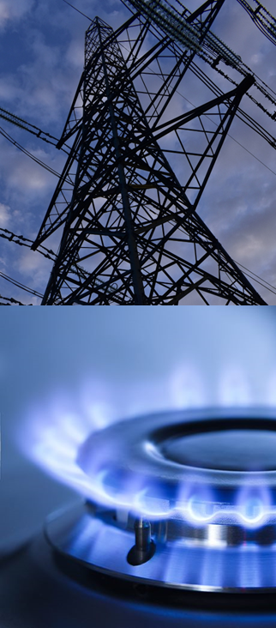
support
If you need support relating to this Release you can:
Raise a Service Desk Enquiry or email enquiries@recmanager.co.uk. Alternatively, you can contact your Operational Account Manager.

Slide 27
Supplier Audit Requirements
Jonathan Windeatt

Slide 28
Audit and Assurance
Background
HMT and ONS have classified Levelisation and Reconciliation as ‘Tax and spend’, which places an audit and assurance requirement on all parties participating in the scheme. This includes Ofgem, RECCo and all Domestic Suppliers.
Ofgem has appointed a body to provide assurance for the Ofgem and RECCo aspects of the process prior to Go-Live, and will be putting in place on-going and year end assurance systems.
As we set out in our decision document, suppliers will be responsible for demonstrating to the Authority that they have sufficient audit, assurance and controls in place.
We expect suppliers to maintain a clear and comprehensive audit trail of all activity undertaken under Reconciliation. Suppliers will be responsible for performing assurances on their activities and processes, particularly provision of timely and accurate data, monthly reconciliation payments and reporting.
Requirements
We would expect the audit to follow Agreed Upon Procedures which we will consult on . They will set out the minimum standards we expect the audit to meet. The audit must be signed off by the directors of the company or the company board.
Principles
We will put in requirement, agreed with industry, which give us a similar level of assurance to the SoLR Levy process
In the first year, we will require audit of all participating suppliers, in subsequent years we will take a risk-based approach
We expect most suppliers to satisfy the audit and assurance requirements via their internal audit function where these operate to accepted standards and have appropriately mature and robust controls in place. Other suppliers may wish to make use of external assurance.

Slide 29
Treatment of multi rate meters
Jonathan Windeatt

Slide 30
Calculation of electricity base levelisation rates (metering arrangement differentiation)
Background
The levelised price cap and levelisation rates will be calculated by Ofgem for each fuel, region and payment method and provided to the reconciliation operator and the industry on a quarterly basis, published alongside the cap level for that period.
The energy price cap (default tariff) calculates different maximum charges at nil consumption (‘standing charges’) for consumers on single-rate and multi-rate electricity metering arrangements in each region and as a result, different levelisation allowances have been calculated for both single-rate and multi-rate consumers within the price cap.
As outlined in the Levelisation Policy decision document, however, the reconciliation system which supports the levelisation policy, has initially only been designed to accommodate one set of levelisation rates per region and fuel type to be used when calculating the daily differential rates and thus the reconciliation amounts.
Impacts and next steps
Ofgem is only able to notify one rate per fuel, per region per payment type to RECCo due to the design of the system.
We will therefore notify RECCo of the electricity single rate standing charge for each payment type for each region, alongside a weighted blended levelisation rate.
This will mean that the amount recovered via reconciliation will, on a temporary basis, be slightly below that intended by the policy.
For most suppliers the impact per customer is +/- £0.01 per customer per year.
The impact range for all suppliers is between +£0.09 and -£0.12 per customer per year
We are working with RECCo to design and build the additional system requirements needed to process two sets of levelisation rates (i.e. both single-rate and multi-rate metering arrangements) as quickly as possible.
We will “true up” all suppliers to align their reconciliation payments with the individual levelisation rates for single-rate and multi-rate consumers by the end of the 2024/25 financial year
We wrote to you this week with some further details and would be happy to discuss individual impacts with each supplier on a bilateral basis

Slide 31
Treatment of Multi Rate Metering
The REC Code Manager will work with RECCo on development of a REC Change Proposal to progress the additional requirements for multi-rate metering.
We expect this to be fully developed prior to being raised in June/ July 2024.
The requirements will be based on the data that Ofgem will request on volumes of single or multi-rate tariffs, as detailed in their letter on Monday 11 March 2024.
We will engage with Industry prior to the CP being raised on the detailed requirements.

Slide 32
Questions

Slide 33
Questions on Supplier Audit Requirements and Treatment of Multi Rate Metering
ⓘ Start presenting to display the poll results on this slide.

Slide 34
Audience Q&A Session
ⓘ Start presenting to display the audience questions on this slide.

Slide 35
Thanks for attending
Contact us: enquiries@recmanager.co.uk

Slide 36
Feedback
ⓘ Start presenting to display the poll results on this slide.

