Slide 1
Performance Assurance Webinar
21 March 2024

Slide 2
Introducing Your presenters
Anton Moden
Performance Assurance Team
Performance Assurance Lead
Vaishnavi Sharma
Performance Assurance Team
Party Assurance Manager
Nirav Vyas
Performance Assurance Team
Analytics Manager
Amy Crowe-Lamont
Performance Assurance Team
Industry Engagement Manager
Daniel Rodgers
Performance Assurance Team
Qualification Manager
Anna Weeks
RECCo
Senior Operations Analyst

Slide 3
Housekeeping
Videos and microphones
Event recording
Use of Slido
Opportunities for Q&A

Slide 4
Join at slido.com #24266945
ⓘ Start presenting to display the joining instructions on this slide.

Slide 5
Agenda For today
Agenda Item
Introduction
What do I need to do? Recap on Risk Monitoring Theft Targets – Positive Confirmation Purpose of Submitting 1431/1441 Reports Data Cleanse Sprint 2 Dashboard Enhancements and Whitelisting Annual Rating
How is the REC improving things for me? Gas MEMs Switching Update Lessons Learned Programme Voice of the Consumer Assurance Improvement
Do I get the Services I expect for the money I spend on REC services? Service Providers
How is my reputation being protected? Escalations Process
Q&A

Slide 6
Introduction
We are structuring our webinar around the 4 key questions that we think REC Service Users have of us.
Performance Assurance is a complex service – that does many different things with many different types of organisation – we aim to provide you an update on the breadth of this activity.
We’d welcome your feedback after the webinar if there are other questions you have of us.
What do I need to do?
Do I get the services I expect for the money I spend on REC services?
How is the REC improving things for me?
How is my reputation being protected?

Slide 7
What do I need to do?

Slide 8
RECAP on Risk Monitoring
Vaishnavi Sharma

Slide 9
Why do we do risk monitoring?
The REC Performance Assurance approach includes detailed market monitoring, to reflect:
Switching markets in particular are really dynamic, things change rapidly.
Unlike other arrangements, there is no clear target of ‘good enough performance’.
We need to find areas the Code is not working and address them, as well as possible Party performance issues.
We have updated our approach to reflect a few things:
REC arrangements are much more stable following the change of Code Consolidation and CSS go live.
We’ve developed our understanding of performance and have multiple initiatives to improve things.
We know that there is a huge amount going on elsewhere in the industry.
We will continue to review performance each month, but focus on key areas, engagement with Parties and use of PATs where genuinely needed.
Notes:
What are we talking about and why
Changes made to PAT approach, reflect on the past quarter
Queries from Parties around threshold setting- give overview
RIG- lots of monitoring from central data sources, provide context xyz…what have we taken to RIG

Slide 10
Party assurance Technique Cadence update
From feedback provided we updated the cadence of when PATs are issued. Timeline below highlights that we have aligned the issuing of PATs (i.e. Queries/ RFIs etc) with SMIS reporting on a quarterly basis with the aim to improve the effectiveness of PATs.
Dec 23 | Jan 24 | Feb 24 | Mar 24 | Apr 24 | May 24 | Jun 24 | Jul 24 | Aug 24
SMIS
SMIS
SMIS
PATs
PATs
PATs
We are here
Continuous monitoring on Parties’ performance with regards to Risk Drivers is carried out monthly and reported to PAB.
We notify Parties to make them aware of their performance if they are above threshold. This notification signposts them to their dashboard and highlight any guidance that is available on the REC portal.
Notes:
Discussion around how last quarter went….

Slide 11
Sharing how we talk to Pab about this
The PAB set thresholds to instruct the REC Code Manager when they must look closer at the performance. This doesn’t mean there is necessarily an issue – but it does mean that there needs to be something understood. We take four generic strategies:
An alarm or ceiling, where current market performance is within acceptable bounds, but the threshold quickly highlights worsening performance.
This is based on data on current performance levels.
A clear intention to drive performance improvements, usually by setting the threshold so the worst performers today are captured, but not all Parties.
This is also based on data on current performance levels.
Irrelevant of where people are performing today it might simply feel unacceptable for underperformance above a certain level. The PAB might set a threshold from the heart, potentially requiring the whole market to improve to meet it.
Thresholds not the right approach. In some areas where any failure is unacceptable, we should not set a threshold.
THRESHOLD STRATEGIES:
APPLICATION:
Rates of Erroneous Switch
Use of objections
Use of the withdrawal process
DNO address updates
Related meter points
Switch Meter Reads
Annulments
Submitting invalid messages to CSS
Resolving Erroneous Switches in a timely manner
Sharing Address updates between Parties
Consumer issues using SDEP data, because of issues with the way it is tracked. E.g. crossed meters, duplicate RMPs etc.
Notes:
Pab approval and dashboard update

Slide 12
Theft – Positive Confirmations and Communication timelines
Nirav vyas

Slide 13
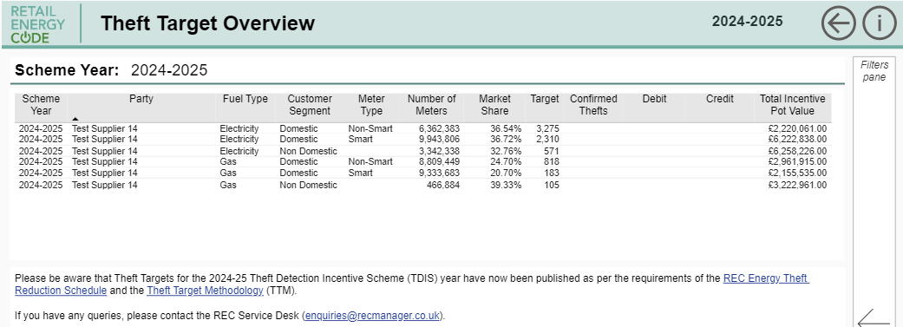
Positive Confirmation - Theft Targets 2024-2025
Theft Targets for 2024 - 2025 published in the PA Dashboards in the REC Portal on 01 March
Can be found in Theft Target tab as part of the Performance Assurance Dashboard
Please take an opportunity to login to your Supplier site on the Portal and access your Theft Targets via the Dashboards
Confirm back to us via enquiries@recmanager.co.uk

Slide 14
Timeframe Theft Targets 2023-2024
Date | Communication | Supplier Action Required
4 April 2024 | Reminder of Final Data Submission deadline – i.e. 1 June 2024, with query window closing 18 July 2024. | Submit data (as per normal requirements).
Prior to 18 July 2024 | Reminder of final query window deadline of 18 July 2024. Request for details of any portfolio acquisitions / disposals during the year. | Review final results. Provide positive confirmation that results have been reviewed and agreed or raise timely query. Provide details of any portfolio changes or positive confirmation of no change.
Post 18 July 2024 (subject to queries) | Query window has closed, and any submitted queries have been resolved. Reminder to provide details of any portfolio acquisitions / disposals during the year (if not already provided). | Review post-query results and confirm they reflect outcome of queries raised. Provide positive confirmation that results have been reviewed and advise details of portfolio changes (if not already provided).
By 22 August 2024 | Confirmation that debits/credits have been calculated and published to the PA Dashboard. | Review calculation results and provide confirmation results have been reviewed and agreed.

Slide 15
Purpose for submitting 1431/1441 reports
Nirav Vyas

Slide 16
Purpose for submission 1431/1441 reports
The Code Manager collects reports 1431 - Gaining Supplier Switching Data and 1441 - Losing Supplier Switching Data from Suppliers
Report definitions can be found in the Performance Assurance Report Catalogue (PARC)
The reports provide an additional dimension of data that complements the data provided via central sources
Additional dimension | Switching insight | Benefit / Purpose
Source of switching | Determine what has triggered the switch | Identify if switching issues (subject to performance assurance) driven by specific sub-processes / actors (e.g. TPIs)
Quantify single customer contract sites that switch | Non-Domestic switching that involves a single customer contract with multiple sites | Focus on switches on a contract level rather than meter level to avoid false positive application of PATs based on volumes
Gain additional insight into the nature of switching behaviours | Quantifying number of instances where customer has switched away resulting in early termination of a fixed term contract | Trends may indicate higher risk and help identify otherwise undetected / unmeasurable issues and help prioritise application of PATs.
This information helps us understand where the Code needs to be better and better focus our work on consumer issues.

Slide 17
Data Cleanse Sprint 2
Nirav Vyas

Slide 18
Data Cleanse Sprint 2
Sprint 2 will take place from 01 March 2024 – 30 August 2024
Interim progress review will be completed after May 2024
The August 2023 month-end reports will be used as the final snapshot to determine each Party’s compliance with their target
Data Cleanse Reports – Guidance Document
Performance Assurance Techniques may be applied where parties do not meet the target by the end of the sprint
Thanks to all of the Parties who engaged with us on the detail of these reports
Report | Target
Invalid Electricity MAP ID | Reduction of pot value to zero.
Energised No Meter Serial Number | Reduction of pot value to zero, excluding MPANs that have been energised within one month of the close of the sprint (based on Energisation EFD).

Slide 19
Dashboard enhancements and Whitelisting
Nirav Vyas

Slide 20
Enhancement Plan
Future enhancements | Timeline
Additional export capability | Continuing as request 2024
Data submission status and quality for Parties | March 2024
Simplification of dashboard layout and navigation | April 2024
Options to allow Parties to take a ‘single party view’ if desired | May 2024
Split dashboard into separate themes (e.g. theft, core performance assurance) | Being prioritised with other Portal changes

Slide 21
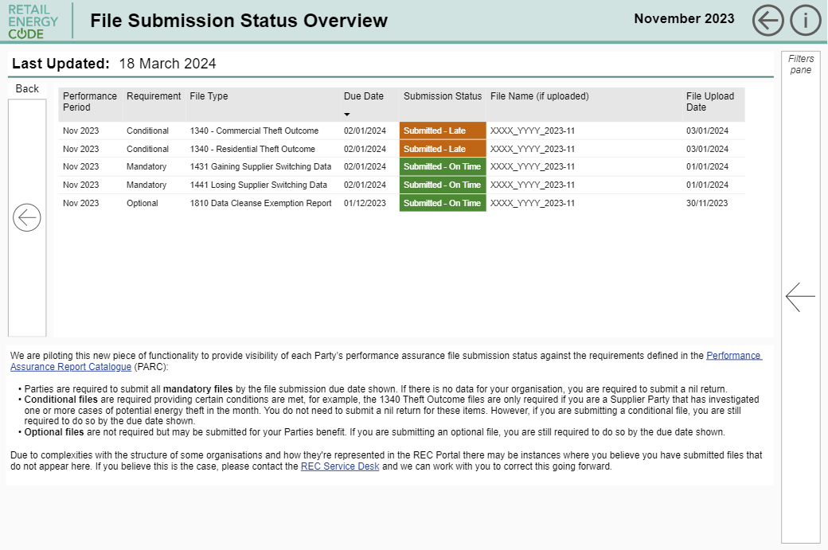
File submission Tracker
We are introducing new functionality so, please let us know if you see something that you think you have submitted and has not reflected in the dashboards via enquiries@recmanager.co.uk
Notes:
Some Parties don’t want to group, but still submit files grouped for a single party

Slide 22
CSS p1 WhiteListing
We have received the list of Meter Points impacted by the CSS P1 Incident from the CSS Provider.
We are undertaking work to whitelist any Meter Points impacted by the incident from being an exception against all Erroneous Switch and Switch Meter Read dispute Risk Drivers.
We expect to publish updated Risk Driver scores by end of April.

Slide 23
Annual Rating
Anton moden

Slide 24
Annual rating
The annual rating assigns an overall assessment of performance to each Party.
This allows us to assess the overall state of performance in the market and providing you with a perspective on your relative performance.
Our goal is to make the rating both useful and fair, and we are therefore reviewing the criteria.
We are minded to:
Continue to focus on theft performance
Remove ‘double counting’ of both PATs and risk data performance.
We committed to sharing unanonymised annual rating this year, so you will see your performance relative to peers. There has been a live discussion on whether this should be shared with the public this year, or in future years at PAB, who ultimately will determine this.
Next Steps to be aware of
Month | Description
March | Reviewing criteria that was applied for last year’s Annual Rating to ensure it aligns with our engagement approach.
June | Updated Criteria to be communicated to Parties. This would be required to be formally approved by PAB.
July | Provide individual scores to each Party to review and raise comments
August | Provide market wide scores for Parties

Slide 25
How is the rec improving things for me?

Slide 26
Gas mems Industry change
Amy crowe-lamont

Slide 27
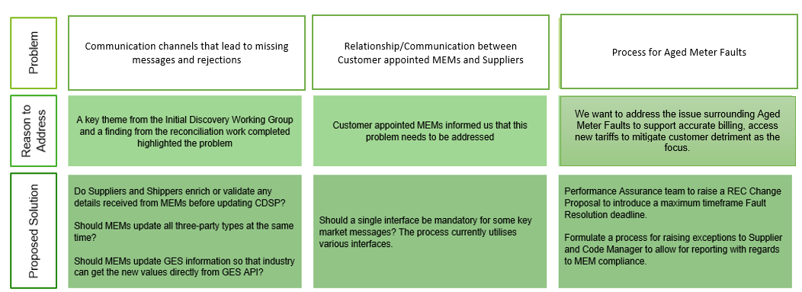
Gas mems Industry change

Slide 28
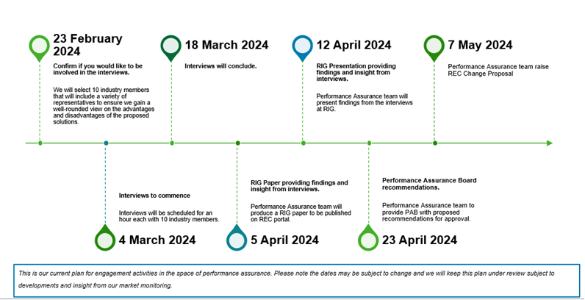
Gas MEM Engagement Plan
We are here
Notes:
Add a we are here
Check wording

Slide 29
Switching update
Amy crowe-lamont
Notes:
Check last PAB paper
Switching trends by dom/ non dom
Look at PAB webinar slides….prior sept

Slide 30
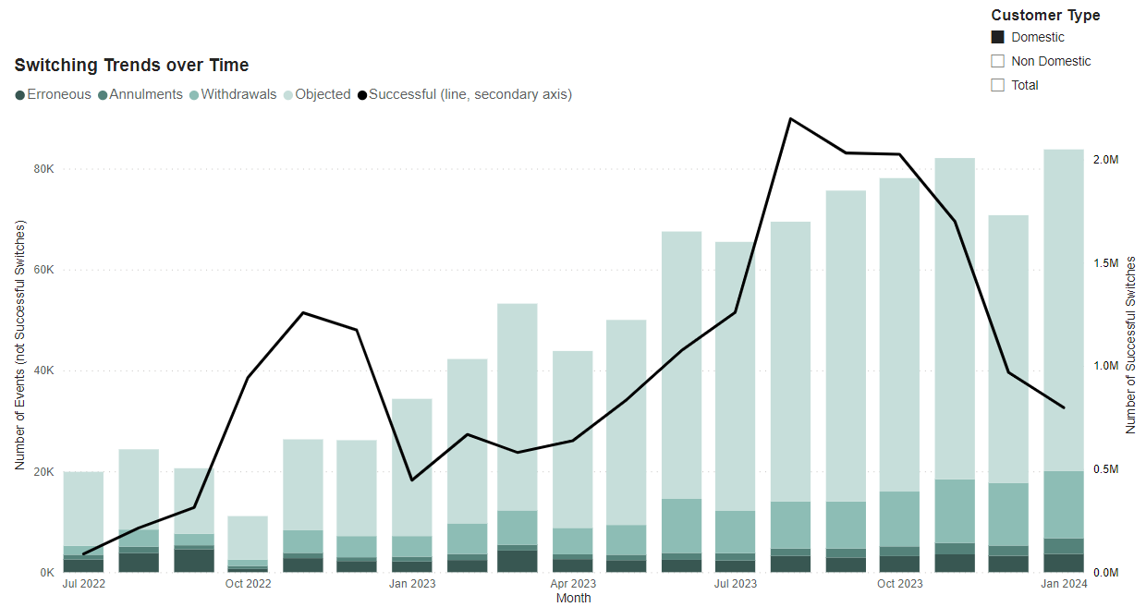
current Activity in the market
In previous months switching volumes have been primarily driven by high volumes of internal migration activity but we have noted significant decline in internal migration activities over the past two months. Internal migration volumes have fallen from c. 1,285,000 in November, to c. 350,000 in January. The estimate volume of actual switches has shown a small increase over the same period from 470,000 to 500,000
Domestic Supply:
Notes:
The month-on-month decline in domestic switching activity is primarily driven by the decline in internal migration activity observed (nearly all the observed internal migration activity is domestic). We are aware from our engagement with DCC that switching has returned to similar levels in February as internal migration projects pick up again.
The volume of objections and erroneous switches have remained consistent with the volume observed in recent months at 64,000 and 3,600, respectively. With a lower level of switch activity observed this month, the rates for both have increased slightly.
The volumes of annulments and withdrawals have increased slightly on prior month, with annulments increasing from 2,040 to 3,120 and withdrawals increasing from 12,400 to 13,300.

Slide 31
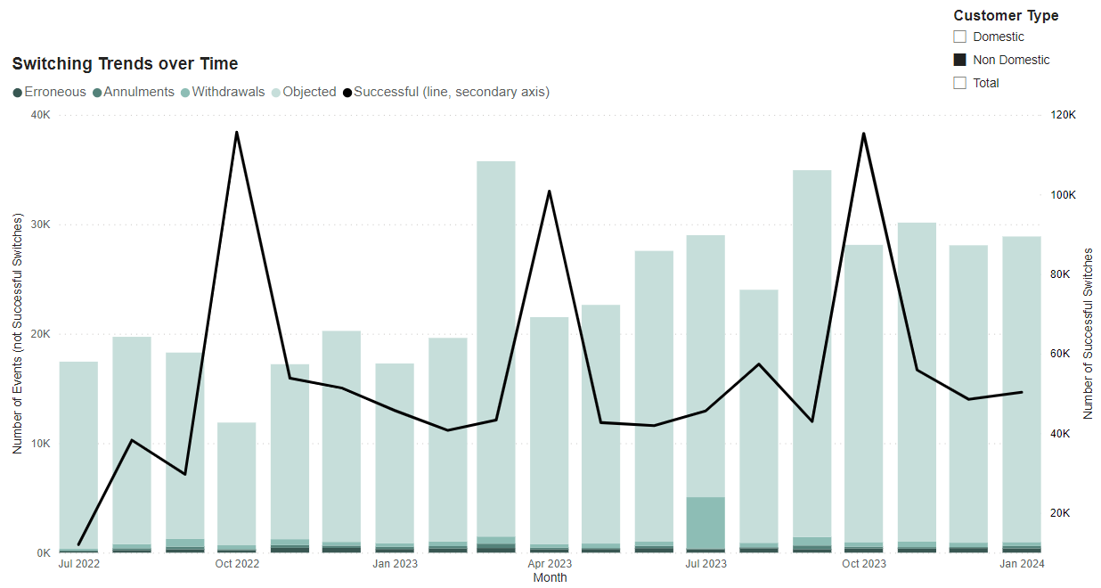
current Activity in the market
Non-Domestic Supply:
Notes:
Non-domestic switch volumes remain consistent with prior month at c. 50,000. Approximately 4,000 of the observed non-domestic switches are thought be a result of internal migrations.
Observed volumes of non-successful switching outcomes remain consistent to prior months.

Slide 32
Lessons learned programme
Anton moden

Slide 33
Lessons learned programme
Identification of topics
Lessons identification
Quality check and PAB presentation
Industry Presentation
Action tracking
The PAB have valued lessons learned work completed on the CSS P1, as well as asking of specific lessons learned presentations on other key issues, such as the COMCOP consolidation programme. We are therefore taking to PAB a paper for a regular process with five steps:
Identification of topics
Lessons identification
Quality check and PAB presentation
Industry Presentation
Action tracking

Slide 34
How will we work out where to focus
It’s really important that we pick the right areas. We can only pick one lessons learned activity at a time, but we propose to ask for a shortlist from the following sources:
REC Service Users (you!)
The REC Service Providers DCC and RECCo
REC Code Manager
PAB members
Recent service improvements / FWP / REC changes

Slide 35
Voice of the customer
Anton moden

Slide 36
Voice of the customer
The REC is about delivering great retail arrangements – making things better for both consumers and other market participants. However we have very little information on what is working or not for consumers. Currently only the Smart Meter Installation Survey provides a view on what is working for consumers. We committed to reviewing this in our PAOP alongside RECCo. We think that there are three options:
Each of these would require Party engagement and clarity on how this information would be used.
Are there any options we haven’t considered? Are there any we should rule out or strongly pursue?
Update the SMIS, addressing issues with the questions
Replace the SMIS with a broader metering survey and a switching survey
Centralise the survey, with RECCo driving this directly as a collective body

Slide 37
Assurance improvement
Anna weeks

Slide 38
We’re listening and taking action
RECCo and the Code Manager have been listening to your feedback and developed plans to improve our services. We’ve obtained feedback from:
RECCo on the Road
Code Manager Surveys
Direct Feedback
Stakeholder Survey

Slide 39
Communication
You’ve told us that you want clearer communication and engagement in relation to Performance Assurance
The Code Manager is acting by:
Training OAMs and the Service Desk so that more Performance Assurance related questions can be answered at first line
PATs now typically deployed quarterly and a call set up with the Code Manager
Improving Market Entry training sessions
Trialling Performance Assurance Check Ins

Slide 40
education
You’ve told us that you want more education on Performance Assurance and to understand more about its purpose and achievements
The Code Manager is acting by:
Trialling monthly newsletters – REC Party feedback on these is being requested now
Re-focussing quarterly Webinars
Developing its guidance for MEMs
Engaging with the REC Issues Group
In each of these, more education on the purpose of Performance Assurance, explanations of what you need to do and the benefit of doing it, as well as Performance Assurance successes will be provided to you.

Slide 41
Reporting
You’ve told us that you want it to be easier to submit Performance Assurance Data and for it to have a clear purpose. You also told us you want gaps in Performance Assurance data to be addressed.
The Code Manager is acting by:
Producing “How to” videos on the purpose of the dashboards, an explanation of the reporting required and how to submit it
Implementing a streamlined Performance Assurance Catalogue which removes any reporting that does not meaningfully feed into Performance Assurance processes
Introducing escalation processes where Performance Assurance data is missing
Working with industry when specific gaps are raised
Working with the Portal and RECCo to improve the useability and user experience of the portal

Slide 42
Theft PROCESSES
You’ve told us that you want the Theft Detection Incentive Scheme requirements to be clearer and greater controls put around the process
The Code Manager is acting by:
Producing guidance and a podcast making Suppliers requirements and actions clearer
Improving the controls over the key steps for the scheme
Presentation of theft data through Party dashboards

Slide 43
Let us know your views
We are very keen to hear whether these actions are making the difference we expect
Please feel free to provide any comments:
- Now;
- As part of your webinar feedback; or
- Contact me at: anna.weeks@retailenergycode.co.uk

Slide 44
Do I get the Services I expect for the money I spend on REC services?

Slide 45
Service providers
Vaishnavi Sharma

Slide 46
REC SERVICES Performance - HEADLINE
SWITCHING SERVICES
ENQUIRY SERVICES
CODE MANAGER SERVICES
These include…
The Central Switching Service (CSS), the CSS Certificate Authority (CSS CA), the Switching Operator (SO) (collectively the Central Registration Service or CRS), the Electricity Registration Data Services (ERDS) and the Gas Registration Data Service (GRDS)
Key Reflections
The CRS Performance Charge proved effective in catalysing performance improvements.
Switching Services operating as anticipated with some increase in operational hours above-peak volumes in line with the steady increase in switching volumes.
These include…
The Electricity Enquiry Service (EES) and the Gas Enquiry Service (GES)
Key Reflections
General performance is within acceptable limits.
Performance dips were noted in months where there was a major incident and acted on quickly.
There are also some metrics where performance levels either cannot be reported or remain below target levels. In such cases, the Service Providers have work-off plans in place which are actively monitored.
These include…
All REC Code Manager Services
Key Reflections
Positive performance through 2023.
97% of all metrics met or exceeded expectation.
All Accession and Entry Management metrics achieved 100%.
Overall Training satisfaction score was 98% compared to the 75% target.
Helpdesk achieved 90% satisfaction score, well above the target of 75%.
Improvement programmes in place for Change and Technology User Experience.

Slide 47
REC SERVICES Performance – Overall Performance
On average, the Service Providers successfully met 98% of their required Service Level targets. However, there was a noticeable decline in performance during October 2023, which was attributed to a Major Incident within the Gas Enquiry Service (GES) that occurred during the deployment of a change. RECCo and the Code Manager understand the root cause of this issue, and are working with the GES Provider to prevent recurrence. As seen in the chart below, the performance bounced back the following month. The Code Manager is closely monitoring the Service Providers' performance in meeting the Service Level targets to provide consistent and reliable service delivery.

Slide 48
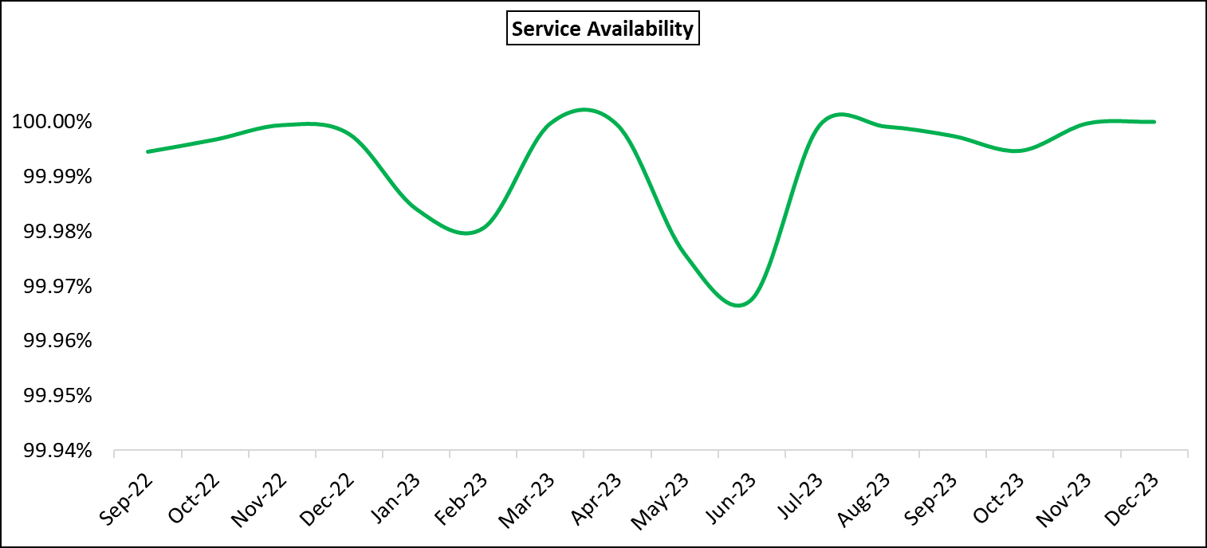
REC SERVICES Performance – Service Availability
REC Services broadly met the target for Service Availability, which varies by service from 99% to 99.75%.

Slide 49
REC SERVICES Performance – Operational Volumes
With the resumption of mass switching and increase in registration request volumes expected from the Market-wide Half Hourly Settlement Programme migration activity, it is essential that REC Services are ready to ramp up to cope with the increase and have robust capacity planning in place. This will be an area of focus in the coming months.

Slide 50
REC SERVICES Performance – User Support
User Support is an area where performance is improving, but requires further focus.
Since Switching Programme go-live, the average response time for incident tickets has been 96%, while the average resolution time for incident tickets has been 89%.

Slide 51
How is my reputation protected?

Slide 52
escalations
Daniel RoDgers

Slide 53
Operational disputes
02
04
Code Manager manages escalation
Code Manager communicates outcome
01
03
05
REC Party raises dispute through REC Portal
Code Manager may escalate to PAB
REC Party has the right to appeal
Notes:
For operational disputes set out in the REC, escalations will go to the Code Manager for resolution in the first instance. All escalations relating to operational disputes must be made through the REC Portal appeal and escalation form.
The Code Manager will be responsible for receiving and managing escalations. This will include seeking further information from the appealing organisation or any other relevant stakeholders, to give further context and evidence for the escalation case. The Code Manager will communicate the decision on how to resolve the operational dispute by notifying impacted Parties via the REC Portal.
The Code Manager may escalate to the PAB for resolution. The PAB will then determine what the outcome of the dispute should be, including any resulting actions that should take place to resolve the dispute. Relevant organisations will be made aware of the decision through a notification on the REC Portal.
If a dispute is considered to be urgent, the Code Manager will prioritise this for resolution. The decision on urgency will be based on whether there is a significant or material impact on customer outcomes and/or the achievement of the REC objectives.

Slide 54
Appeals and escalations
If you disagree with a decision, you should first raise this with the Code Manager
01
02
If you are unable to resolve this dispute with the Code Manager, you can escalate as below:
Area | Decisions made by | Appeals made to | Further escalations | Timescales
Performance Assurance (General) | PAB | REC Board (unless in relation to Qualification and Maintenance of Qualification – see below | REC Board decision is final | Appeal must be raised within 10 WDs of the decision
Performance Assurance (Event of Default) | PAB | The Authority | Authority decision is final | Appeals can be raised at any subsequent time
Qualification and Maintenance of Qualification* | Code Manager | PAB | Further escalations to the Authority, with the Authority decision being final | Appeal must be raised within 10 WDs of exiting the process
Notes:
If you disagree or would like to raise a query in relation to a decision made by the Code Manager or PAB in relation to Performance Assurance, the first thing you should do is get in touch with the Code Manager using the REC Portal. If this relates to a Performance Assurance Technique you should do this on the chat associated with that technique.
If you are unable to resolve your query or are still dissatisfied with the decision, you can raise an appeal by completing an appeal and escalation form on the REC Portal. The route for appeals will depend on the nature of the appeal and the entity that made the initial decision that is being appealed, as outlined in the table below. The timescales for raising appeals are also set out below.

Slide 55
Q&A
Jenny Hyskaj

Slide 56
Audience Q&A Session
ⓘ Start presenting to display the audience questions on this slide.

Slide 57
Thanks for attending
Contact us: enquiries@recmanager.co.uk

Slide 58
Feedback
ⓘ Start presenting to display the poll results on this slide.

