Slide 1
Introduction to the rec webinar
25 April 2024

Slide 2
Introducing Your presenters
Paul Rocke
REC Code Manager
Head of Communications
James Hardy
REC Code Manager
Change Analyst
Shelley Rouse
REC Code Manager
Head of Stakeholder Engagement
Rosalind Timperley
REC Code Manager
Technical Services
Elise Handy
REC Code Manager
Change Analyst
Amy Crowe-Lamont
REC Code Manager
Performance Assurance
Harriet Truss
REC Code Manager
Senior Change Lead
Nirav Vyas
REC Code Manager
Performance Assurance

Slide 3
Housekeeping
Cameras and microphones
Event recording
Use of Slido
Opportunities for Q&A

Slide 4
Join at slido.com #4081322
ⓘ Start presenting to display the joining instructions on this slide.

Slide 5
Agenda For today
Agenda Item | Presenter
Introduction (5 minutes) | Paul Rocke
Introduction to the REC Code Manager (30 minutes) | Paul Rocke
Stakeholder Engagement (10 minutes) Operational Account Managers Service Desk | Shelley Rouse
Performance Assurance (15 minutes) | Amy Crowe-Lamont Nirav Vyas
Break (10 minutes) | All
Change (20 minutes) | James Hardy Elise Handy
Digital REC (15 minutes) | Rosalind Timperley
MHHS (5 minutes) | Harriet Truss
How to engage with the REC (5 minutes) | Paul Rocke
Questions | All
Close | Paul Rocke

Slide 6
Introduction to the Rec
Paul rocke

Slide 7
What is your current level of understanding of the REC?
ⓘ Start presenting to display the poll results on this slide.

Slide 8
HISTORY OF THE Retail Energy Code
Switching Programme
REC V1
REC V2
REC V3
Future Change
Legacy Codes Framework
Notes:
The full Retail Energy Code arrangements became live on 01 September 2021. The Code Manager was established, change governance processes went live, and obligations in legacy code arrangements were switched off and transferred over to the REC.
But actually, that milestone was actually go-live for REC Version 2. Plenty had already happened to get to that point in the lifecycle of the code.
From 1998, at the point that the energy retail market was opened up to privatisation, industry codes were required to facilitate the change of supplier processes. The Master Registration Agreement in electricity, and the Supply Point Administration Agreement in gas supported the market and the consumer for over 20 years, as part of a wider codes infrastructure.
Over time, and with the Ofgem Faster Switching Programme a specific catalyst, it was identified that the code arrangements could be improved. The Retail Energy Code was designed to bring the MRA and SPAA together into a streamlined, dual fuel code which would more effectively support parties understand and meet their obligations. The REC would also incorporate safety and technical metering obligations previously housed in MOCOPA, MCOP, AMICOP and SMICOP. And critically, it would also provide a contracting vehicle for the new Central Switching Service Provider required for the Faster Switching arrangements to succeed.

Slide 9
Who Are the REC Parties?
Gas and Electricity Suppliers
Gas Transporters
Electricity Network Operators
Metering Equipment Managers
RECCo
The Data Communications Company

Slide 10
Scope of the REC
Energy Theft Reduction
Prepayment Arrangements
Data Access
Secure Data Exchange
Transfer of Consumer Data
Metering Operations
Green Deal Arrangements
Registration Services
Central Switching Service
Related Metering Points
Consumer Facing Switching and Billing Issues
Prepayment Method Levelisation
Schedule 7
Schedule 11
Schedule 12
Schedule 17
Schedule 13
Schedule 14
Schedule 18
Schedule 23
Schedule 24, 25, 26
Schedule 27, 28
Schedule 30
Schedule 31

Slide 11
RECCo and the REC Code Manager
REC Code Manager
REC Service Providers
REC Parties
Suppliers
Network Operators
REC Service Users
MEMs
DCC
EES
GES
CSS

Slide 12
Code manager Services
Change Management
EMAR, the Digital Navigator and ERIN
Performance Assurance and Dashboards
Accession and Withdrawal
Sandbox and Derogation
Operational Account Management
…all underpinned by the REC Portal

Slide 13
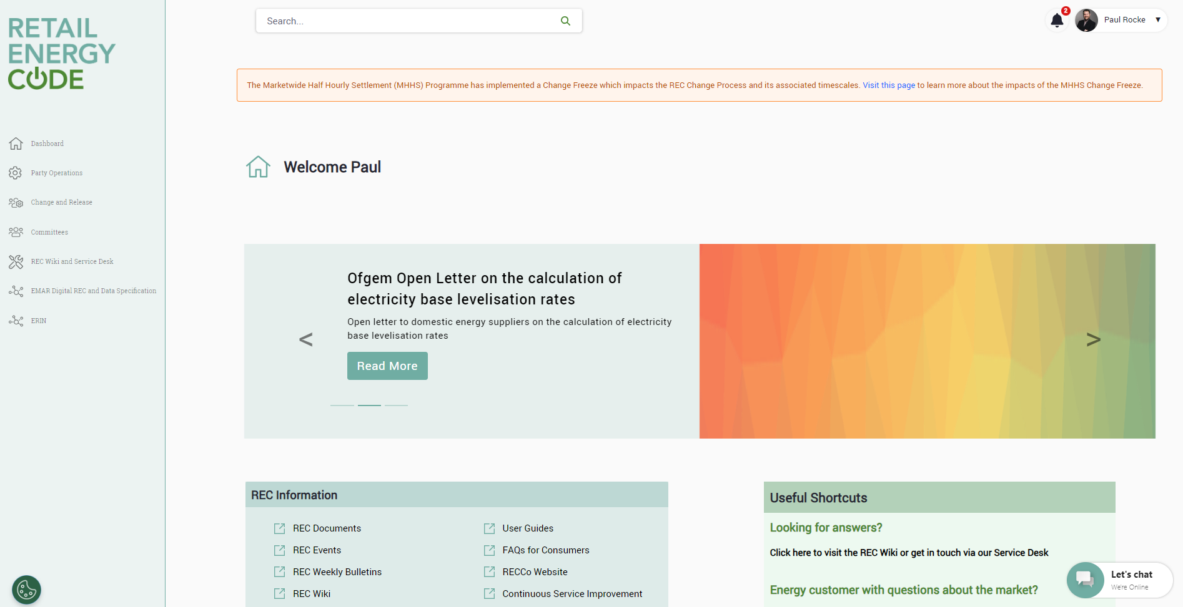

Slide 14
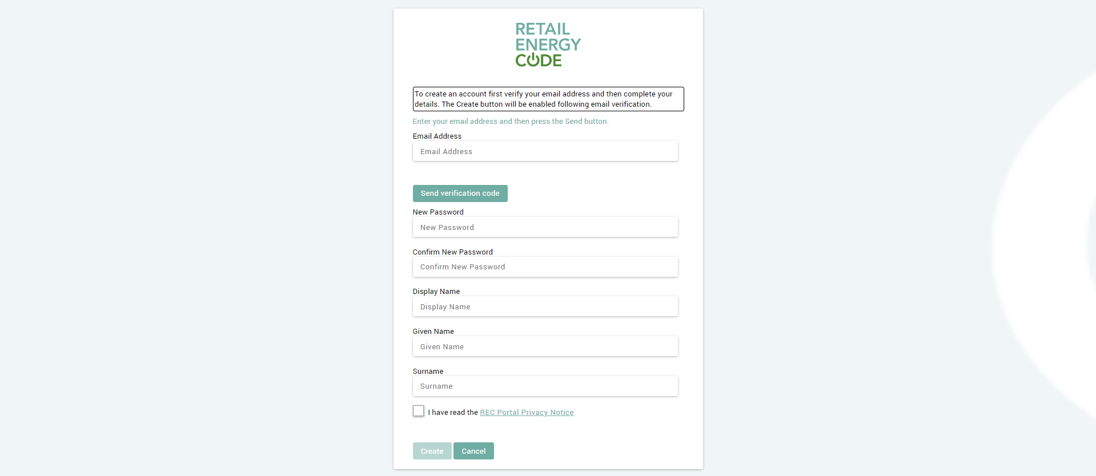

Slide 15
Do you have a REC Portal account?
ⓘ Start presenting to display the poll results on this slide.

Slide 16
Other REC Services
Electricity Enquiry Service
Gas Enquiry Service
Central Switching Service
Secure Data Exchange Service
Green Deal Central Charge
Energy Theft Tip Off Service

Slide 17
Audience Q&A Session
ⓘ Start presenting to display the audience questions on this slide.

Slide 18
Stakeholder engagement
Shelley rouse

Slide 19
Stakeholder ENgagement
Stakeholder Engagement under the REC is designed to give REC users a choice to enable them to work in a way which best suits their needs:
Operational Account Manager - All REC Parties, Non-Party REC Service Users and Voluntary Code of Practice TPIs have a dedicated contact or 'Operational Account Manager' (OAM)
REC Issues Group
REC Service desk (enquiries@recmanager.co.uk)
Webchat
Phone
Service desk tickets
REC Portal (https://recportal.co.uk)
Wiki
User Guides
ERIN
Hubs (metering/Theft)
REC Communications
Bulletins
User Guides
Webinars
Training

Slide 20
Stakeholder Engagement team
Stakeholder Engagement Team
Operational Account Management
REC Service Desk
REC Party OAMs
REC Service User OAMs
Shelley Rouse
Isaac Moore
Laura Venturini
Paul Witton-Dauris
Steve Brennan
Laura Delargy
Shane Denny
Eve Marriner
Carl Dennis
Marcello Cecchini

Slide 21
Operational Account Management
All REC Parties, Non-Party REC Service Users and Voluntary Code of Practice TPIs have an 'Operational Account Manager' (OAM)
OAM is appointed at the point of application
Welcome meeting
REC portal Navigation
Market entry/qualification discussion
Offer of regular 'catch ups'
REC Portal set up
Operational Contacts
Performance assurance reporting requirements

Slide 22
Audience Q&A Session
ⓘ Start presenting to display the audience questions on this slide.

Slide 23
Performance assurance
Amy crowe-lamont & Nirav vyas

Slide 24
What is performance assurance and how does the approach interact with my organisation?
Amy Crowe-Lamont

Slide 25
What is party assurance?
Background: In 2017, Ofgem decided to merge and strengthen pre-existing retail codes into the REC. One of the key parts of this was establishing a Code Manager to drive improvements, with a Performance Assurance service that brings credibility and trust to the arrangements.
Purpose: REC Performance Assurance exists to understand which of the bits are working and why. It can then intervene to drive improvements.
How? Performance Assurance follows a risk management framework and can act to drive improvements in how market participants act, in the performance of Service Providers or to address Code issues.

Slide 26
The methodology
Our Methodology
Performance Assurance Method
Risk Identification
Assurance Outputs and Improved Performance
Risk Analysis
Assurance Techniques
Risk Evaluation
Performance assurance focuses on risks to retail energy consumer outcomes and the effectiveness of the retail market. This will be provided through a Performance Assurance Framework (PAF) underpinned by a comprehensive Risk Register and associated interventions (Performance Assurance Techniques or PATs).
Understanding the causes of and solutions to issues in the market is key to gaining confidence in performance and providing transparency.

Slide 27
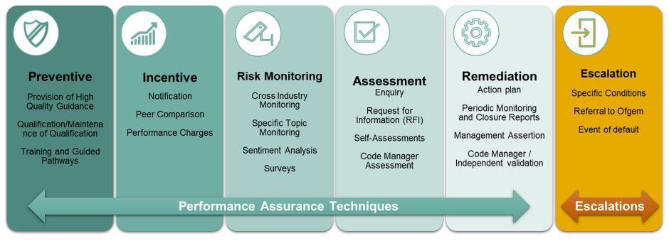
Performance Assurance Techniques

Slide 28
How do I maintain my qualification?

Slide 29
Performance Assurance Reporting Catalogue
Nirav Vyas

Slide 30
Performance Assurance Reporting Catalogue (PARC)
PARC contains all data submission requirements for Parties, including relating to energy theft reporting.
Recently updated on 28 March 2024 to streamline data submission requirements and simplify the files, making it easier for parties to submit data
You can filter it by organisation type to understand what you need to report. It also includes details of the format and frequency. If you have any queries about this, please speak to your OAM.

Slide 31
Dashboards
Nirav Vyas

Slide 32
Dashboard Purpose
We make sure that all of the information we see on your performance is available to you.
There are different things that apply to different organisations. These are organised into tabs. You can look at the information provided.
Where we can we provide drill down info, so if it looks like your performance is worsening you can see example cases to work out why.
We want to understand how well Parties are performing against REC obligations, which REC processes are being followed and identify outliers to assess if action needs to be taken to address issues.

Slide 33
Different Dashboards and Users
Dashboard | REC Party/User Type | Information Available
PA Risk Dashboard | Energy Supplier | Performance against Risks defined in the Retail Risk Register Performance against Peer Comparison PATs TDIS performance, Theft Targets and Debit/Credit Payments SMIS Submission Results Data Cleanse aggregate reporting
 | DNO/iDNO | Performance against Risks defined in the Retail Risk Register Data Cleanse aggregate reporting
 | Electricity MEM | Performance against the Metering Specific Monitoring technique
SLA Dashboard | REC Service Providers | Performance against defined SLAs.
PAB Dashboard | PAB Members & Code Manager | All information available in the Party Dashboard on an unanonymised basis. Select information available in the Service Provider Dashboard on an unanonymised basis.
Public Dashboard | All REC Users | Industry SMIS performance Anonymised industry performance against Peer Comparison PATs

Slide 34
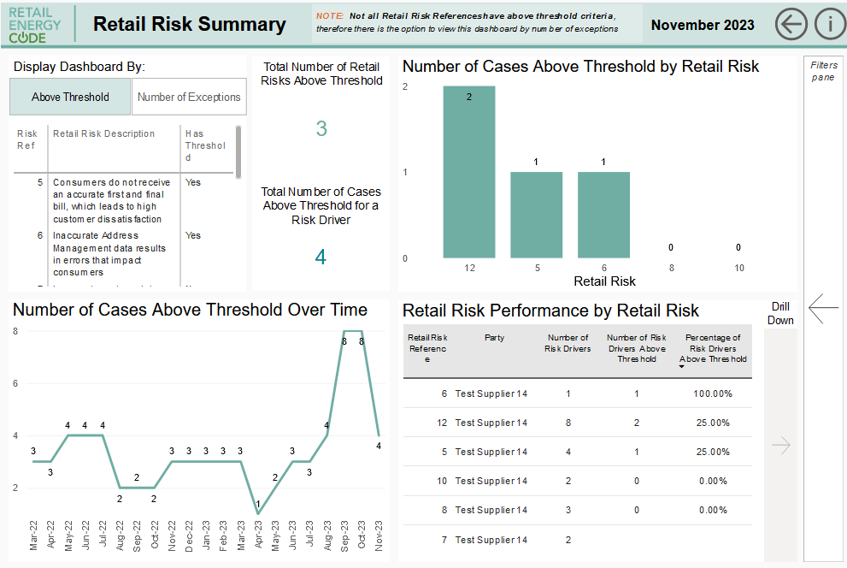
Dashboards

Slide 35
Audience Q&A Session
ⓘ Start presenting to display the audience questions on this slide.

Slide 36
Break

Slide 37
Change management
Elise handy & james hardy

Slide 38
What does the change team do?
Alongside other areas of the Code Manager, the Change Team operates a fair and transparent change process for all stakeholders and ensures that consumer outcomes are at the heart of the process.
The Change Team will:
Assess Change Proposals that have been raised.
Validate the issue described in the Change Proposal and that it has a reasonable prospect of success
Once it is determined that it can be progressed, make a plan for its progression and determine a Responsible Committee.
Develop the appropriate solution(s) to address the Change Proposal’s problem statement and assess this with the relevant REC Service Providers.
Write suitable and documentation to enable Stakeholders to effectively feedback on the change and solution.
Impartially weigh up the pros and cons of the solution based on analysis, business case and stakeholder feedback and make a determination on whether it should be accepted and implemented or rejected.
Maintain the Change Management Portal pages, Change Proposal Master Tracker and engage with industry expert groups on our changes.

Slide 39
the change analysts
Lydia Bentley
James Hardy
Caroline Freimuller
Elise Handy
Gemma Dixon
Harriet Truss

Slide 40
Change categories
REC Document
Final Decision
Timescale
Category 1
Self-Governance
Urgent
Category 2
Authority Determined
Standard
Category 3

Slide 41
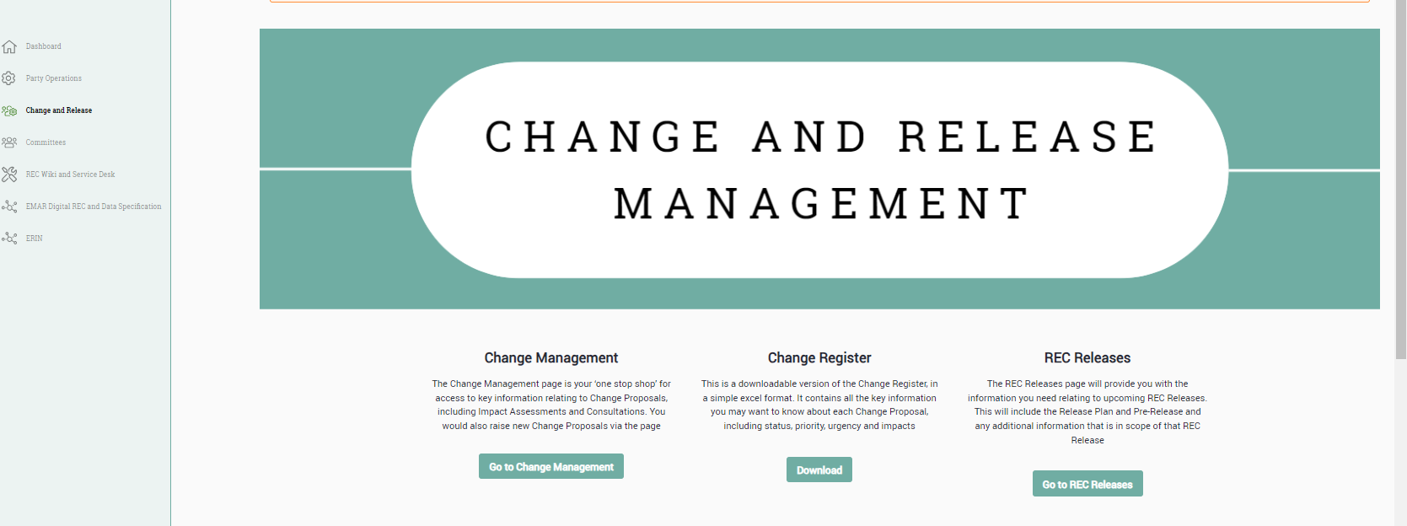
Rec portal – change and release

Slide 42
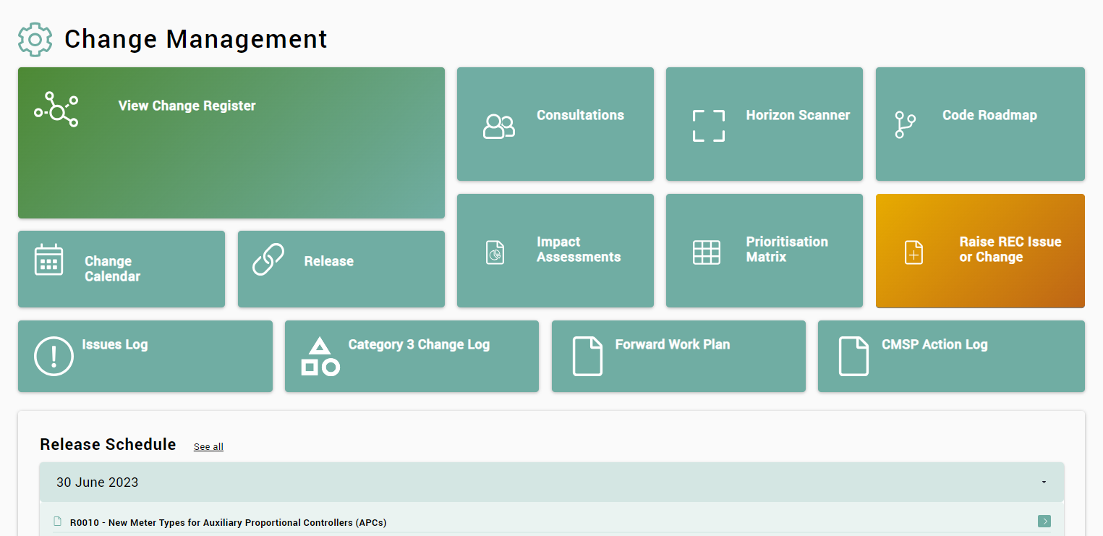
Rec portal – change and release

Slide 43
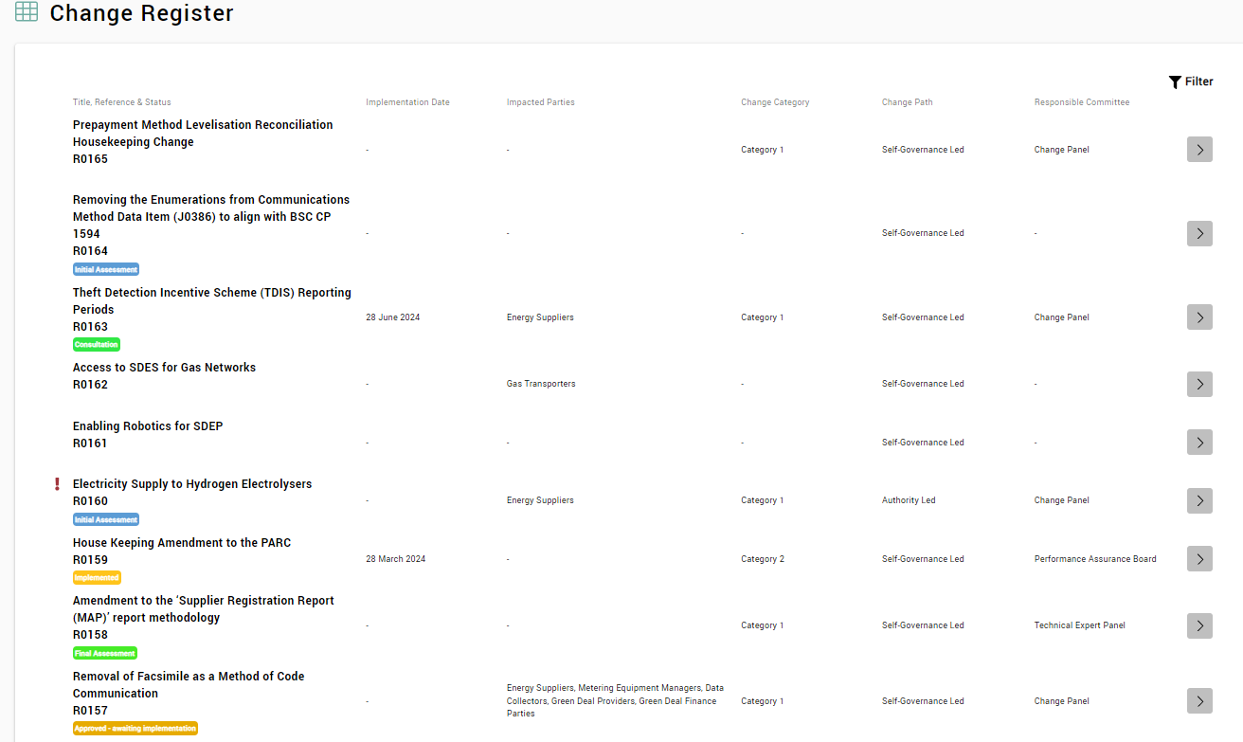
Rec portal – change and release

Slide 44
Change Process Overview
Notes:
Change Process Overview

Slide 45
Key documentation
Initial Assessment Report (IAR)
Defining the Problem Statement and Solution Requirements
Preliminary Change Report (PCR)
Final Change Report (FCR)
PCR updated with outputs from consultation to produce the Final Change Report
Collated consultation responses and Code Manager responses to issues raised
Summary of any changes made to address issues raised in the consultation
Confirmed Code Manager Recommendation for Responsible Committee
Proposed solution(s)
Summary of impact assessments
Cost benefit analysis
Plan for Consultation
Code Manager’s “minded-to” Recommendation
Determine Change Path and Responsible Committee
Develop Change Proposal Plan – activities and timetable for Change Proposal
Identify impacts to REC Products, REC Parties and REC Service Providers, and Cross-Codes
Background to Change Proposal and analysis undertaken
Implementation Date

Slide 46
Engagement with the change process
Initial Assessment Report
Impact Assessment
Preliminary Change Report
Consultation
Final Change Report
Invitation to comment on Initial Assessment Report and
Change Proposal Plan prior to Change Panel review
The REC Portal is a key way we engage with industry stakeholders.
Each Change Proposal has a page with all the key information about the change – including proposed legal text changes and reports.
We point stakeholders to the CP pages to access published reports and documents.
On the REC Portal there is also a Change Register (listing all CPs), Consultation and Impact Assessment registers and a Category 3 change proposal register.
Targeted impact assessment request to
identify and clarify business impacts
REC Portal
Invitation to comment on Preliminary Change Report
and plan for consultation prior to review by the
Responsible Committee
Consultation on the Preliminary Change Report
and Code Manager recommendation
Invitation to comment on Final Change Report
prior to vote by Responsible Committee

Slide 47
Additional Engagement and communications
Weekly REC Change Bulletin – emailed out 12pm every Friday
Operational Account Managers (OAMs)
REC Portal Service Desk
Release Webinars
REC Podcasts
To join the mailing list for the Change Bulletin, please email
enquiries@recmanager.co.uk
Notes:
Additional Engagement/Communications

Slide 48
Useful Links
REC Portal – The REC Portal where all changes are managed, all updates are provided, and engagement occurs through.
Change Register – List of all current and historic Change Proposals, and access to Change Proposal Page
Change Proposal Form – Digital form for an interested person to propose a change to the REC
Change Management User Guide – an overview of the change process and products used within the process
Change Management Schedule – this schedule sets out the elements and process for managing changes to the REC
REC News – news section of the portal providing the latest updates, events and podcasts
REC Bulletins – PDF copies of historic bulletins, aggregating the key messages from the Code Manager, can be downloaded here
Notes:
Key Links

Slide 49
Audience Q&A Session
ⓘ Start presenting to display the audience questions on this slide.

Slide 50
The digital rec
Rosalind timperley

Slide 51
the digital REC
We are now going to look at the Digital Navigator, home of the Digital REC
The REC
Schedules
The REC Data Specification
ERIN

Slide 52
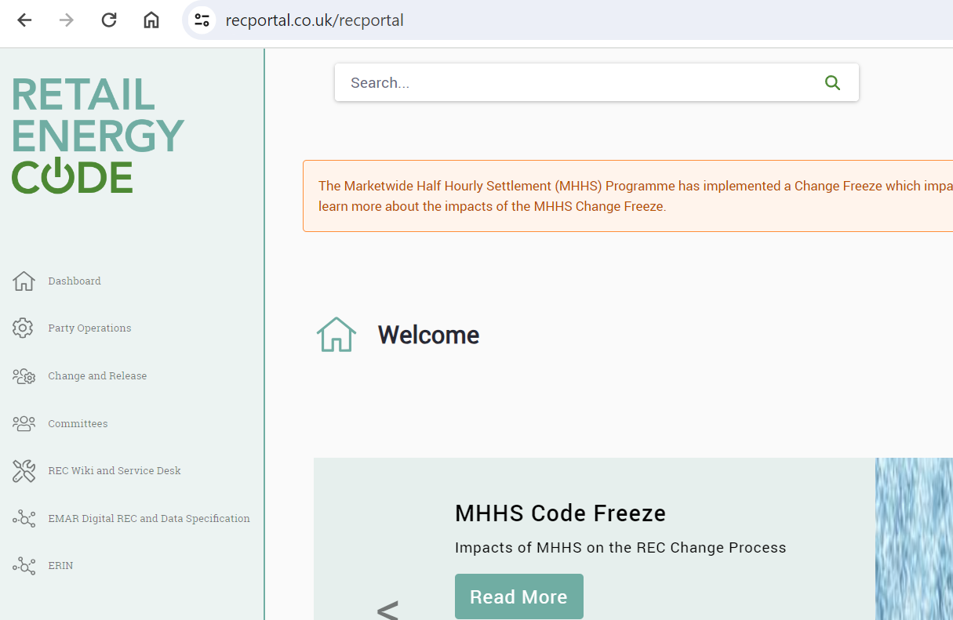
Access
You can access the Digital REC, Data Specification and ERIN via the REC Portal menu bar

Slide 53
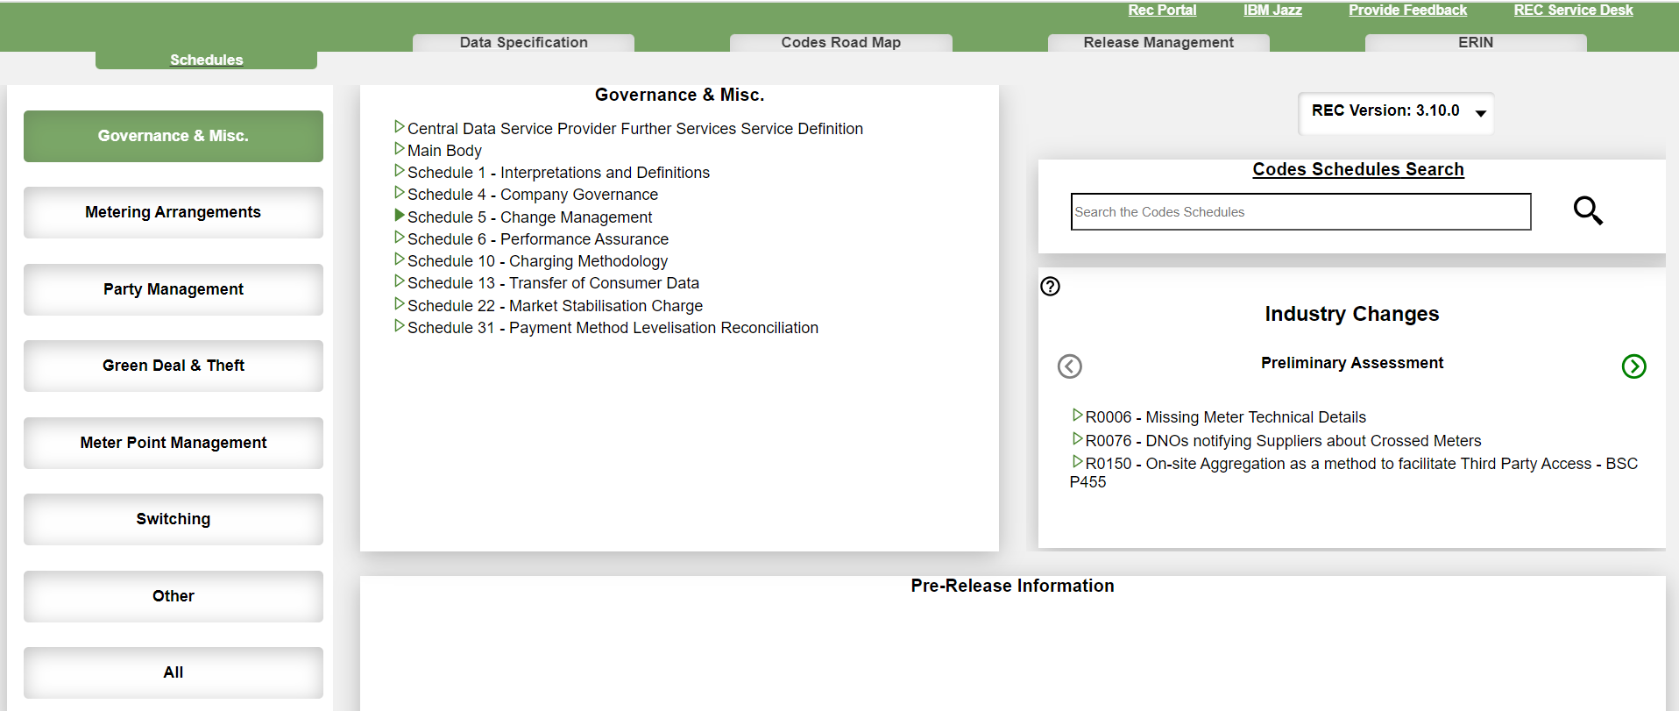
The Digital REC Schedules

Slide 54
The Digital REC Schedules
4
5
1
2
3

Slide 55
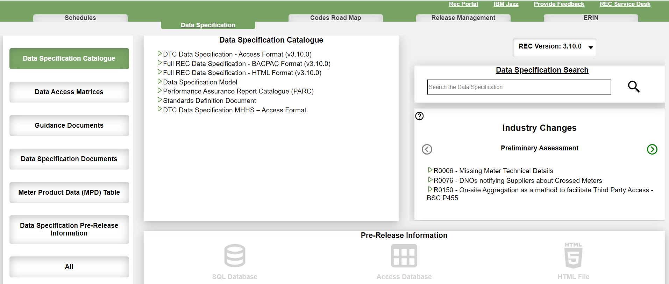
The Data specification

Slide 56
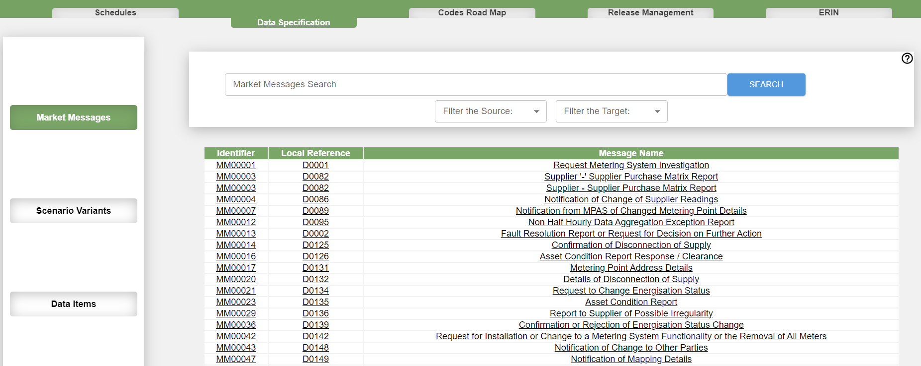
The data specification - Search
1
2
3

Slide 57
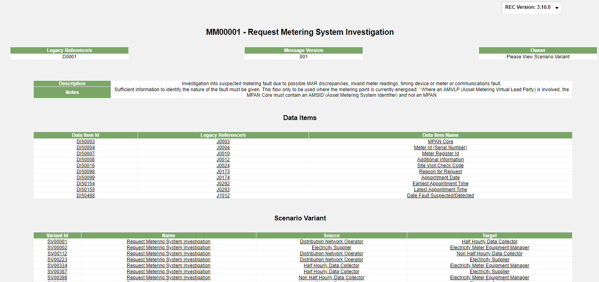
The data specification - Market Message
1
2
3

Slide 58
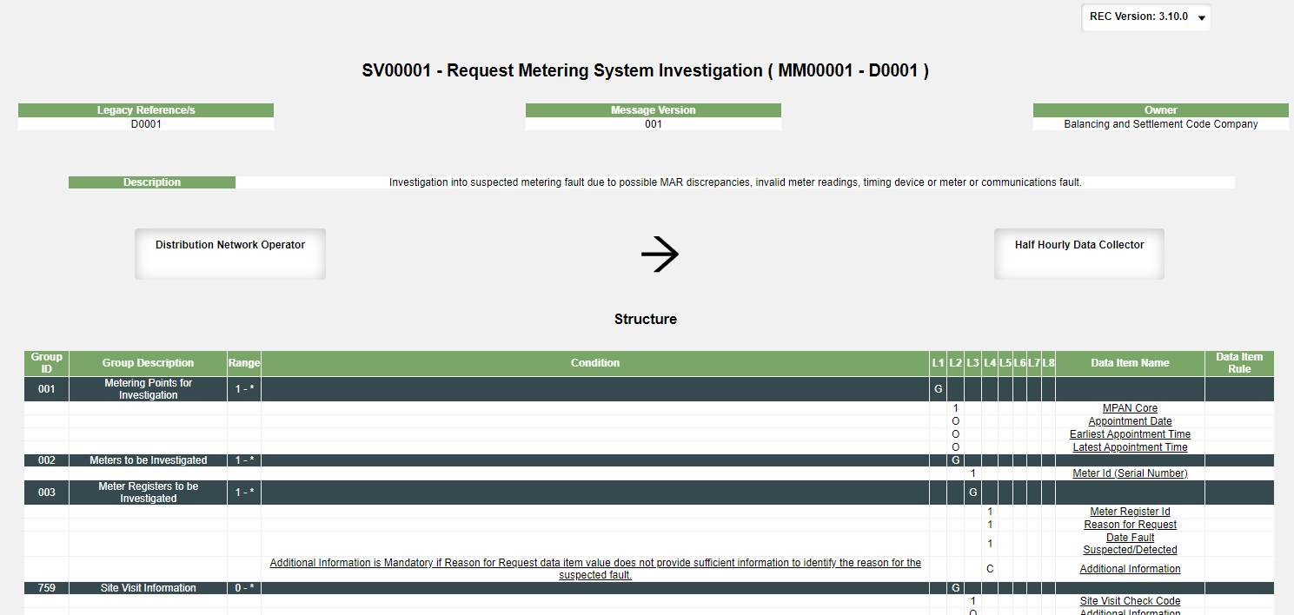
The data specification - Market Message

Slide 59
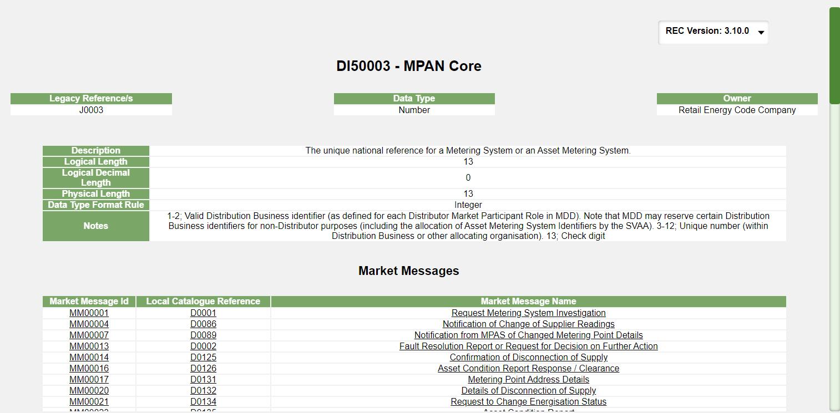
The data specification – Data item

Slide 60
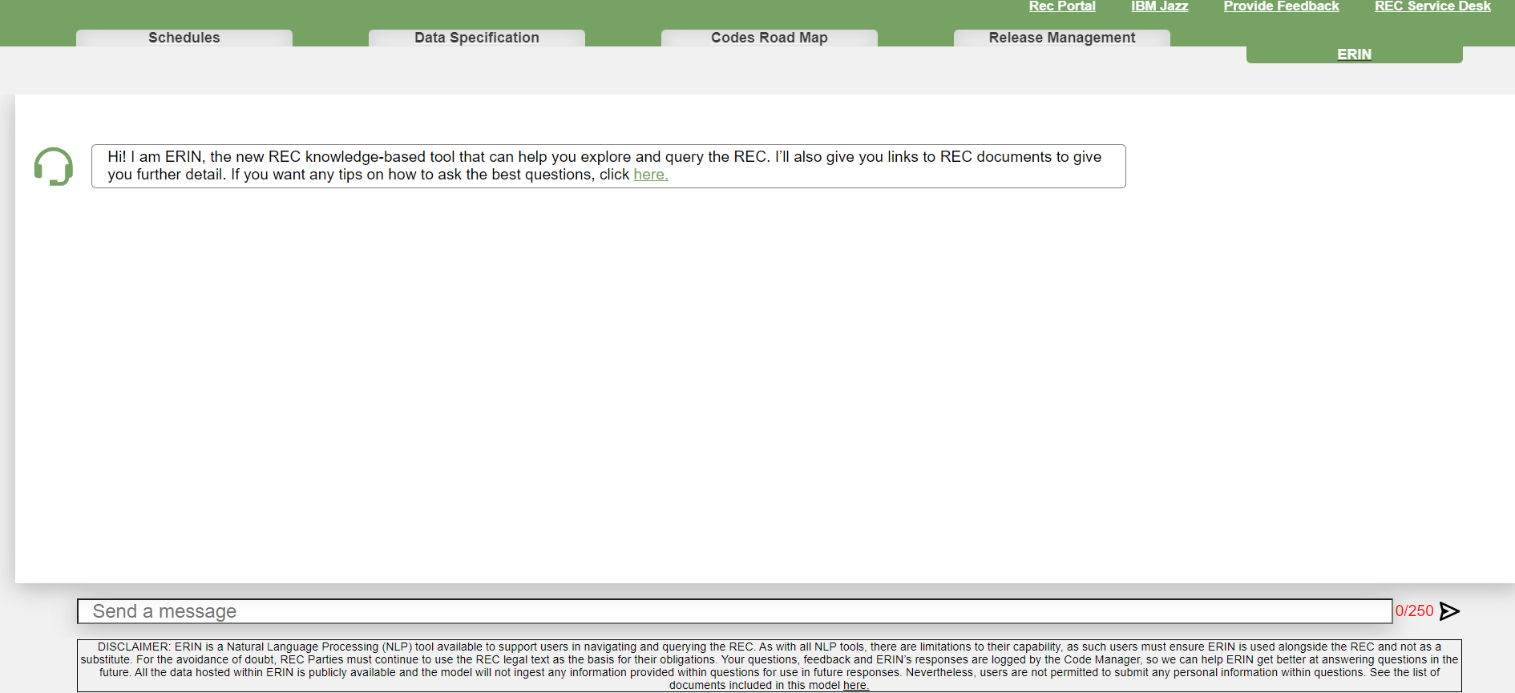
ERIN

Slide 61
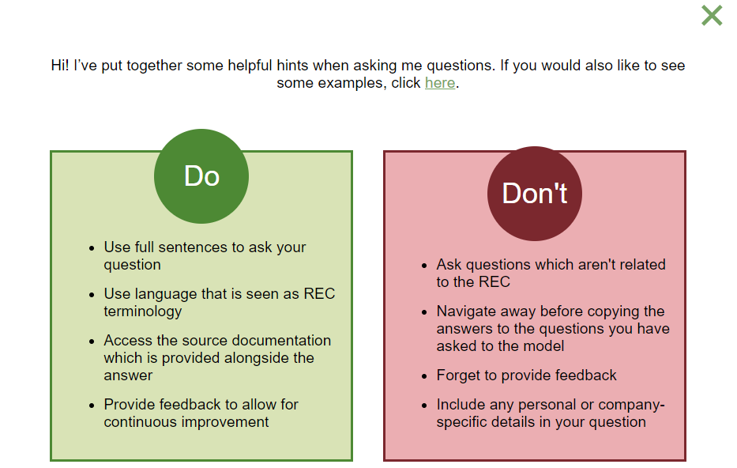
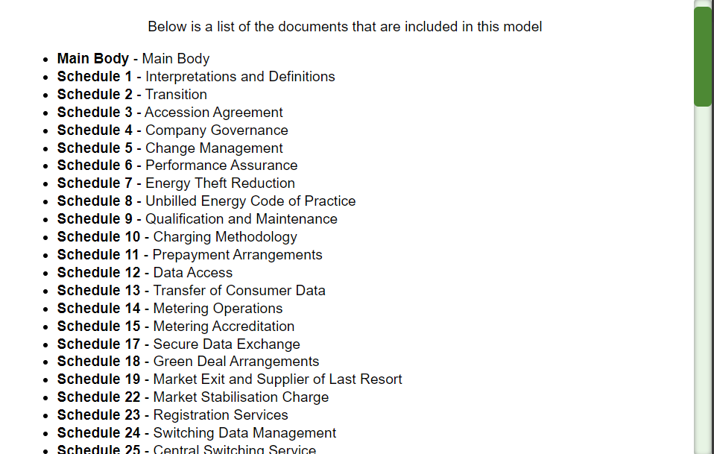
ERIN

Slide 62
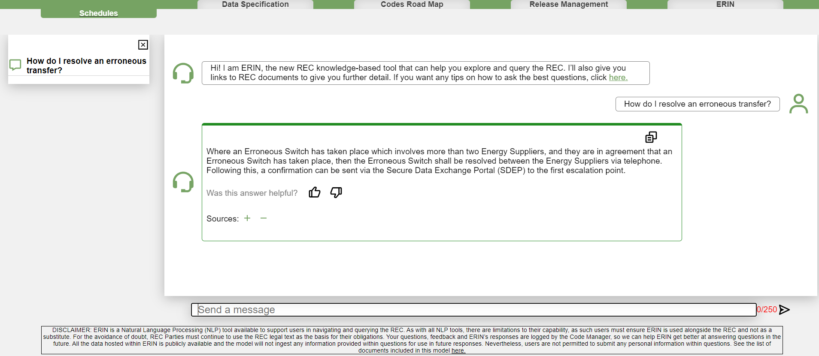
ERIN

Slide 63
Audience Q&A Session
ⓘ Start presenting to display the audience questions on this slide.

Slide 64
Introduction to Market-wide half hourly settlement (MHHS) programme
Harriet truss

Slide 65
MHHS BACKGROUND
Electricity Settlement Reform SCR
Decision to implement MHHS
RECCo Obligations
Launched in July 2017.
Considers opportunity presented by smart meters to make the settlement process more accurate and timelier, and act as an enabler for new products and services.
Can deliver positive outcomes for consumers through lower bills, reduced environmental impacts, enhanced security of supply and better quality of service.
Ofgem published their decision to introduce MHHS in April 2021.
Implements the Target Operating Model recommended by the Design Working Group.
Set out Elexon’s role as Senior Responsible Owner (SRO) & Implementation Manager (IM) of the programme.
Clause 5.25 of the REC obligates RECCo to comply with the requirements of the MHHS Programme, as set out in BSC Section C12
RECCo Programme mobilised to identify and deliver the required changes to the retail energy market to implement MHHS.
Notes:
Ofgem launched the Electricity Settlement Reform Significant to make the settlement Code Review (SCR) in July 2017, to consider the opportunity presented by smart meters to make the settlement process more accurate and timely, and act as an enabler for new products and services. These can deliver positive outcomes for consumers through lower bills, reduced environmental impacts, enhanced security of supply and a better quality of service.
In April 2021, Ofgem published their decision to introduce half-hourly settlement on a market-wide basis, and to implement the Target Operating Model recommended by the Design Working Group. This also set out that Elexon, as the Code Administrator of the Balancing Settlement Code (BSC) would act as the Senior Responsible Owner (SRO) and implementation Manager (IM) of the programme.
RECCo is obligated through Clause 5.25 of the REC to comply with the requirements of the MHHS Programme as set out in the BSC C12. RECCO has mobilised a project to identify and deliver the required changes to the retail energy market wide half0hourly settlement.

Slide 66
WHY MHHS?
Predicted benefits of £1.6bn - £4.5bn
Reduced Settlement timetable
Reduced barriers to entry
Enabler for innovative products and services
Use of smart meter data
Smarter Time-of-use tariffs
Improved forecasting
EV V2X
DSR/Flexibility services
Reduced infrastructure costs

Slide 67
MHHS - Key Milestones
MHHS Go live (Central systems and code changes) = March - June ‘25
MHHS Migration = Apr ‘25 – Oct ‘26
MHHS Qualification = Jan 25 – Mar 26
Cutover to new Settlement timetable = Dec ‘26
All Distribution Network Operators need to be MHHS Qualified prior to go live.
All Suppliers and Metering Equipment Managers (Meter Operator Agents) wanting to operate in the MHHS market need to become MHHS Qualified. They must be qualified before they can migrate MPANs or be agents for MHHS MPANs.
All Suppliers, Distribution Network Operators and Metering Equipment Managers (Meter Operator Agents) required to comply with migration design from MHHS Go Live.

Slide 68
MHHS engagement
First point of call is the MHHS Programme. To get involved and get support directly from the MHHS Programme, contact the Participant Coordinator team at PPC@mhhsprogramme.co.uk
If you are already engaged with the MHHS Programme, but specifically need support on REC MHHS qualification, please contact enquiries@recmanager.co.uk.
Your Operational Account Manager will also be able to signpost you to the right contacts
Dedicated REC Wiki pages:
Market-wide Half Hourly Settlement (MHHS)
MHHS Qualification

Slide 69
Audience Q&A Session
ⓘ Start presenting to display the audience questions on this slide.

Slide 70
How to engage with the rec
Paul rocke

Slide 71
Ways to Engage
Service Desk
REC Portal and Wiki
OAMs
Events
Committees
Change Process
Bulletins
Social Media

Slide 72
questions
all

Slide 73
Audience Q&A Session
ⓘ Start presenting to display the audience questions on this slide.

Slide 74
Useful links
Service Desk: enquiries@recmanager.co.uk or via the portal: https://recportal.co.uk/web/guest/service-desk-landing
REC Portal: https://recportal.co.uk/recportal
REC Wiki: https://recportal.co.uk/rec-wiki-landing
Change Management page: https://recportal.co.uk/change-and-release
EMAR: https://digital-navigator.azurewebsites.net/
ERIN: https://digital-navigator.azurewebsites.net/erin
REC Party Register: https://recportal.co.uk/documents/20121/224177537/Party+Register.xlsx/b16cb301-641d-be74-791b-c6fc9af1623c?t=1699433034336&download=true
Portal Useful Documents section: https://recportal.co.uk/group/guest/party-management

Slide 75
Feedback
ⓘ Start presenting to display the poll results on this slide.

Slide 76
Thanks for attending
Contact us: enquiries@recmanager.co.uk

