Slide 1
R0113 – Data Specification Updates and Clarifications Webinar
13 June 2024

Slide 2
Introducing Your presenters
Jenny Hyskaj
REC Professional Services
Communications and Events Analyst
Elise Handy
REC Professional Services
Change Lead
Ryan Dale
REC Technical Services
Change Technical Lead
Roz Timperley
REC Technical Services
Change SME
Jason Salmon
REC Technical Services
Change Technical Lead

Slide 3
Housekeeping
Videos and microphones
Event recording
Use of Slido
Opportunities for Q&A

Slide 4
Agenda For today
Agenda Item | Presenter
Introduction to R0113 | Ryan Dale and Elise Handy
R0113 Overview | Ryan Dale and Roz Timperley
R0113 Examples | Jason Salmon
Next Steps | Elise Handy
Q&A | Jenny Hyskaj

Slide 5
Introduction to R0113
Ryan Dale and Elise Handy

Slide 6
R0113 introduction
 | From | To
PRELIMINARY CHANGE REPORT AND CONSULTATION ISSUED | 24/05/2024 | 24/05/2024
CONSULTATION | 24/05/2024 | 05/07/2024
FINAL CHANGE REPORT ISSUED | 24/07/2024 | 24/07/2024
RESPONSIBLE COMMITTEE DECISION | 31/07/2024 | 31/07/2024
APPEAL WINDOW CLOSURE | 13/08/2024 | 13/08/2024
What is a Data Specification Housekeeping Change?
- Updating and amending historical errors and issues within the Data Specification
- Non-Substantial changes to Market Messages, Data Items or Legal Text
- Errors include Typographical, Alignment, Displayed information and Data Notes
- Changes will provide greater clarity of the Data Specification

Slide 7
R0113 Introduction
What Criteria determines what is (or isn’t) included in R0113?
The approach taken by the Code Manager to determine if an issue was within scope for R0113 was a balance of 2 elements;-
Useful clarification for end users
That Implementation of the changes caused minimal impact to Parties
How were the issues identified? (Helpdesk/Pre-Post Data spec comparison etc)
Issues were identified by internal review of the Data Spec, queries provided by Parties and, in some cases, resolving long standing, inherited issues from the transition to the REC.
Why is there so much legal text?
In order to assist users in highlighting the changes, The Code Manager has sought to represent the change in physical documentation. R0113 contains a large number of low level changes to a range of Data items and Market Messages, and each change should have a corresponding document for that change.

Slide 8
R0113 Overview
Ryan Dale and Roz Timperley

Slide 9
R0113 Overview
Updates to the Standards Definition Document
Energy-Market-Data-Specification-Standards-Definition-Document R0113 redlined.docx | Adding the rules from DTC Annex A on where the @, _ and [] symbols can be used in Data Items
Energy-Market-Data-Specification-Standards-Definition-Document R0113 redlined.docx | Alignment of Message Scenario Variant Collection table with EMAR tables
Energy-Market-Data-Specification-Standards-Definition-Document R0113 redlined.docx | Provide details on how to find the valid DTC Edifact level B character set
Energy-Market-Data-Specification-Standards-Definition-Document R0113 redlined.docx | Provide details of where to find the Edifact level B gas metering variant characters
Energy-Market-Data-Specification-Standards-Definition-Document R0113 redlined.docx | Explain the characters used in EMAR for the message collection requirement type identifier
Energy-Market-Data-Specification-Standards-Definition-Document R0113 redlined.docx | Standard Definitions Document updated to apply correct Datatype Format Rule Definition for the high resolution datetime Datatype Formal Rule Name.
Energy-Market-Data-Specification-Standards-Definition-Document R0113 redlined.docx | Re-number the pages in the Standards Definition Document to ensure they are continuous
Energy-Market-Data-Specification-Standards-Definition-Document R0113 redlined.docx | Adding in the "/" character as an acceptable character under the REC to reinstate what was previously allowed under the DTS
Energy-Market-Data-Specification-Standards-Definition-Document R0113 redlined.docx | Add new Edifact Level B Variant to SDD to create a scenario that allows @ and _ to be used in the same data item
Energy-Market-Data-Specification-Standards-Definition-Document R0113 redlined.docx | Add new Edifact Level B Variant to SDD to create a scenario that allows _ and [ ] to be used in the same data item
Data Item column headings change redlined | Update the EMAR Data Item tables so that the headings align with the Standards Definition Document
SDD Edifact variant data items folder | Updating the relevant data items with relevant Edifact Level B variants re-instating pre-REC Rules for the use of the @ symbol
SDD Edifact variant data items folder | Updating the relevant data items with relevant Edifact Level B variants re-instating pre-REC Rules for the use of the _ character
SDD Edifact variant data items folder | Updating the relevant data items with relevant Edifact Level B variants re-instating pre-REC Rules for the use of the [ ] characters
SDD Edifact variant data items folder | Updating the relevant data items with the new "At Underscore" variant
SDD Edifact variant data items folder | Updating the relevant data items with the new "Underscore Square Brackets" variant

Slide 10
R0113 Overview
Digital Navigator Display Changes
DN Screenshot DI50010 (Reading Date & Time) | DI50010 | The displayed data item in Digital Navigator reads "Reading Date &amp; Time", this has been updated to "Reading Date & Time"
DN Screenshot DI50021 (MD Reset Date & Time) | DI50021 | The displayed data item in Digital Navigator reads "MD Reset Date &amp; Time", this has been updated to "MD Reset Date & Time"
DN Screenshot DI50059 (Instruction Number) | Instruction Number | A Full stop has been added to the Data Item description for "Instruction Number"
DN Screenshot DI50191 - (Manufacturer Make & Type) | DI50191 | The displayed data item in Digital Navigator reads "Manufacturers Make &amp; Type" this has been updated to "Manufacturers Make & Type"
DN Screenshot DI50209 (CT Ratio) | CT Ratio | The description of this data item has been updated from "Where a meter is used to measure energy in more than one supply by means of summation transformers or by means of parallel CT's an effective CT ratio should be quoted. Example """1500/5""" meaning 1500A primary, 5A secondary. BSCP515 describes the process" has been amended to "Where a meter is used to measure energy in more than one supply by means of summation transformers or by means of parallel CT's an effective CT ratio should be quoted. Example: "1500/5" meaning 1500A primary, 5A secondary. BSCP515 describes the process for maintaining the valid set."
DN Screenshot DI50339 (Effective From) | DI50339 | The displayed data item in Digital Navigator reads "Effective From Date {IAA &amp; SVAA}" this has been updated to Effective From Date {IAA & SVAA}
DN Screenshot DI50346 (Effective To) | DI50346 | The displayed data item in Digital Navigator reads "Effective to Date {IAA &amp; SVAA}" this has been updated to Effective to Date {IAA & SVAA}
DN Screenshot DI50439 (Daily CC) | Daily CCC Corrected Supplier Consumption | Details of length and precision are as per Aggregated Supplier Consumption.
DN Screenshot DI50473 - (Reading Date and Time in UTC) | DI50473 | The displayed data item in Digital Navigator reads "Reading Date &amp; Time in UTC" this has been updated to Reading Date & Time in UTC
DN Screenshot DI51076 (GD Default Bill Payer) | DI51076 | The displayed data item in Digital Navigator reads "GD Default Bill Payer â€“ EFD" this has been updated to GD Default Bill Payer - EFD
DN Screenshot DI51077 (GD Energy Payment) | GD Energy Payment Frequency | The description of this data item has been updated from "The value should reflect the GD Energy Payment Method (J1781) frequency. For Payment On Demand, this would be the frequency of the billing. For Fixed Direct Debit and Variable Direct Debit, it should match the schedule of the Direct Debits if available" to "The value should reflect the GD Energy Payment Method (J1781) frequency. For Payment On Demand, this would be the frequency of the billing. For Fixed Direct Debit and Variable Direct Debit, it should match the schedule of the Direct Debits if available in the valid set, or to Ad Hoc otherwise. For Pre-Payment it should be set to X (Ad hoc).
DN Screenshot DI51103 (GD Savings & Other Fuels) | DI51103 | The displayed data item in Digital Navigator reads "GD Savings â€“ Other Fuels" this has been updated to GD Savings - Other Fuels

Slide 11
R0113 Overview
MRA References
MM00236 - D0302 - 002 - Notification of Customer Details (Redlined).docx | Align the Flow hierarchy / group-ordering shown on the REC Portal Data Specification for D0302 to the original MRA grouping
MRA References Folder | Correct References to the MRA across the data Spec and flows (most instances are BSC owned so not included in this CR)
Settlement Period Clarification
Settlement Period MM Redlined Folder | Update the Settlement Period valid set. In the DTC, values 46, 48, 50 were allowable for ranges but the way the REC DS holds the Modality/Cardinality, they show as 46-50.
Baseline Statement & Meter Product Table Changes
298051- DI40116 - A0083 - Model Code-20240311_082700743 (Redlined).doc | Add MPD List to EMAR/ DN (pages exist but needs expanding with latest model codes)
REC Baseline Statement May 2024 redlined.xlsx | Update the Baseline Statement to provide clarity as to which items are associated with the Data Catalogue and remove the split of “Data Item Catalogue” and “Market Message Catalogue” (which is an historic DTN approach) as the REC Data Catalogue covers both messages and Data Items in a single joint format.

Slide 12
R0113 Examples
Jason Salmon

Slide 13
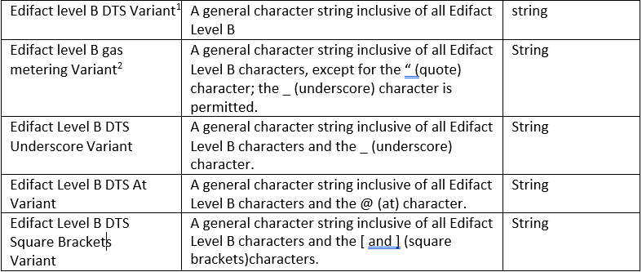
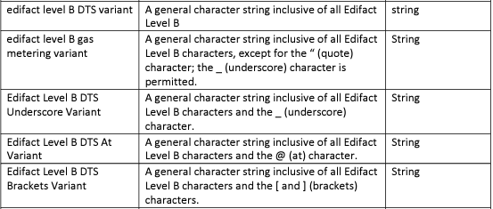
R0113 Examples
Add new Edifact Level B Variant to SDD to create a scenario that allows @ and _ to be used in the same data item
Proposed updated SDD extract
Extract from v2.4 of the SDD
The new legal text includes the additional variants highlighted to the right.

Slide 14
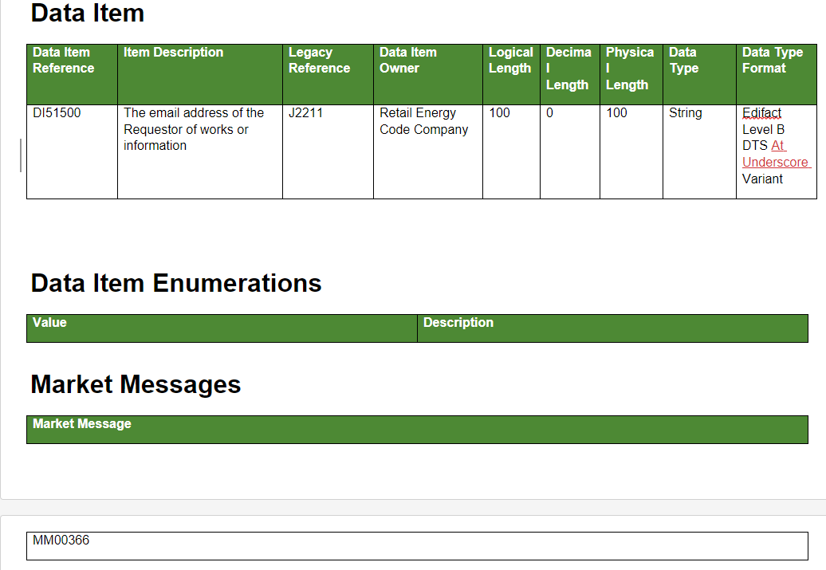
R0113 Examples
Updating the relevant data items with the new "At Underscore" variant
Updated data item

Slide 15
Next Steps
Elise Handy

Slide 16
Next Steps
 | From | To
PRELIMINARY CHANGE REPORT AND CONSULTATION ISSUED | 24/05/2024 | 24/05/2024
CONSULTATION | 24/05/2024 | 05/07/2024
FINAL CHANGE REPORT ISSUED | 24/07/2024 | 24/07/2024
RESPONSIBLE COMMITTEE DECISION | 31/07/2024 | 31/07/2024
APPEAL WINDOW CLOSURE | 13/08/2024 | 13/08/2024

Slide 17
Q&A
Jenny Hyskaj

Slide 18
1) Are there other changes that could be included in a future Data Specification update?
ⓘ Start presenting to display the poll results on this slide.

Slide 19
2) Are there elements of R0113 that should be removed from Scope? If so, why?
ⓘ Start presenting to display the poll results on this slide.

Slide 20
3) What can we do to make reviewing changes of this nature easier for you?
ⓘ Start presenting to display the poll results on this slide.

Slide 21
4) Do you have any general improvement suggestions for the REC Data Specification?
ⓘ Start presenting to display the poll results on this slide.

Slide 22
5) Do you have any questions regarding any of the contents of R0113?
ⓘ Start presenting to display the poll results on this slide.

Slide 23
Audience Q&A Session
ⓘ Start presenting to display the audience questions on this slide.

Slide 24
Thanks for attending
Contact us: enquiries@recmanager.co.uk

Slide 25
Feedback
ⓘ Start presenting to display the poll results on this slide.

