Slide 1
New Change Improvements Webinar
20 June 2024

Slide 2
Introducing your Presenters
Jenny Hyskaj
REC Code Manager
Communications and Events Analyst
Helen Fosberry
REC Code Manager
Continuous Improvement
Glenn Sheern
REC Code Manager
Regulatory Specialist
Gemma Dixon
REC Code Manager
Change Analyst
Tina Pearce
REC Code Manager
Head of Change Management

Slide 3
Housekeeping
Videos and microphones
Event recording
Use of Slido
Opportunities for Q&A

Slide 4
Agenda For today
Agenda Item | Presenter
Introduction | Tina Pearce
Change Improvements | Glenn Sheern
High-Level Change Process | Helen Fosberry
Documentation Review | Gemma Dixon
Q&A | All

Slide 5
Change Improvements
Glenn Sheern

Slide 6
WHY CHANGE IMPROVEMENTS
Listened to industry feedback
Change Process is long
Duplication of Change material
Stakeholder Engagement missing
Membership and role of expert groups, committees and Change Panel inconsistent
Some solutions have needed to be reworked
Changes go into a "black hole"

Slide 7
WHAT WE have done
Established a Change Improvement Project to understand the issues and to create solutions
Created a taskforce to review outstanding change and clear backlog
Reviewed the processes involved in change including documentation, engagement, guidance
Reviewed Schedule 5 and proposed some amendments
Mapped the change process and identified improvements
Used the taskforce as a means to test and sandbox proposed amendments
Engaged directly with parties and stakeholders to ensure fit for purpose
Created a Change Issues Group

Slide 8
R0167 Change Improvements
Series of amendments to Schedule 5 to facilitate some of the findings of the Change Improvement Project
Enhancement to the current Issue process – treat proposals for change as Issues until they have a developed solution
Front end engagement in Issues to ensure effective solution development with the right stakeholders
Removal of Preliminary Change Report (PCR) – assisting consolidation of existing change documentation
Create flexibility in the Change Process
DOES not
Create more work for Proposers
Remove engagement with Service Providers and other Codes
Remove any current information shared in published documents

Slide 9
CHANGE ISSUES GROUP
Purpose
Input into Code Issues
Shape and develop solutions and/or issue resolution
Support the Code Manager by sharing knowledge, best practice, advice
Provides stakeholders an engagement route into the REC Change process.
Meeting Frequency
First Thursday of the month (minimum)
Attendance
Open to all REC Parties and any other interested parties (subject to Chair approval)
First Meeting
Held on 06 June 2024
I0168 - Clarify & strengthen CRS Providers requirements
Attended by ~64 (excl Code Manager)
Change Issues Group Committee Page set up
Next Meeting
04 July 2024 – Agenda published 27 June
REC ISSUES GROUP
The REC Issues Group (RIG) is a forum for the discussion of operational Retail Energy Code (REC) issues raised by industry, which do not obviously fit into an already existing forum.

Slide 10
Next STEPS
R0167 - Change Process Improvements following Code Manager review
Final Change Report published 25 June 2024
Presented to REC Change Panel for decision 02 July 2024
Implementation 19 July 2024
Portal amends
Ability to filter the Change Register for Issues and Change Proposals
New process stages and statuses added to the Proposal page
One unified form to raise Issues or Change Proposals

Slide 11
High Level Change Process
Helen Fosberry

Slide 12
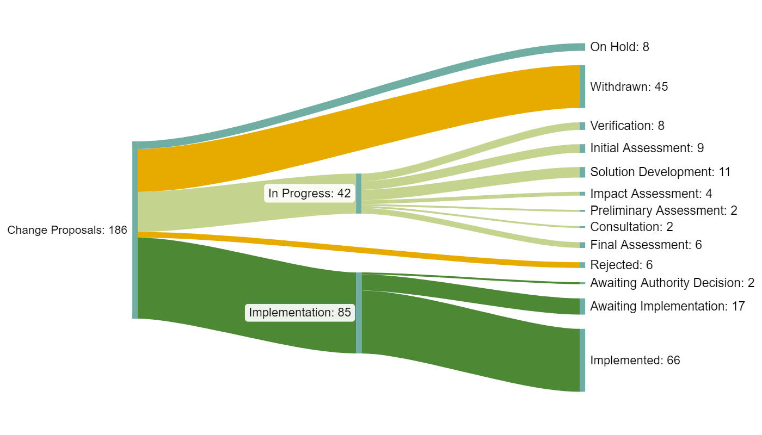
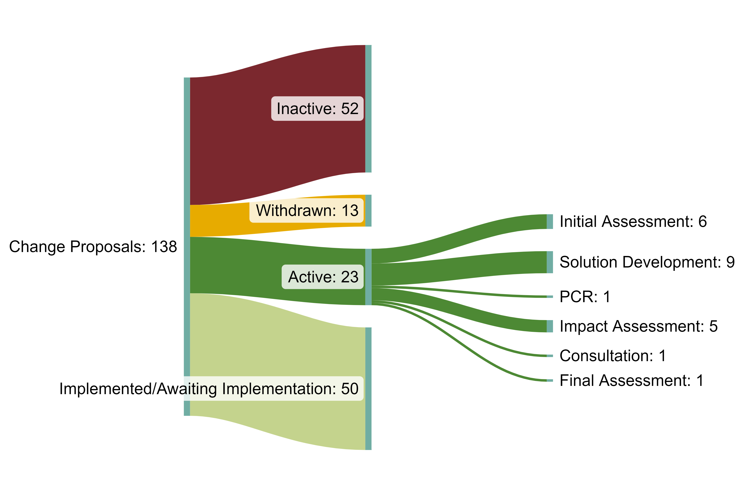
CHANGE PIPELINE SUMMARY POSITION
Change Proposal pipeline as of July 2023
Change Proposal pipeline as of June 2024

Slide 13
PRINCIPLES
Each stage defines several actions - some optional which can be added or removed as required
Code Manager identifies the Change Plan for each change in the Assessment Stage
Change Plan is ratified by the Change Panel
Change Plan is clearly communicated to Industry
Behavioural shift – desire is to preload debate and engagement into the definition stage
Reduce burden – use of SME, focused expert group in definition stage – transparency in output during stage, workflow

Slide 14
VERIFICATION
Notes:
Proposed amendment is raised by any proposer
Code Manager supports proposer as required
Code Manager validates the issue
Meets the REC objectives
Is in scope of REC
Isn’t being considered as part of another change
Is sufficient in detail and depth to explore further
Code Manager accepts or rejects
Prioritisation completed

Slide 15
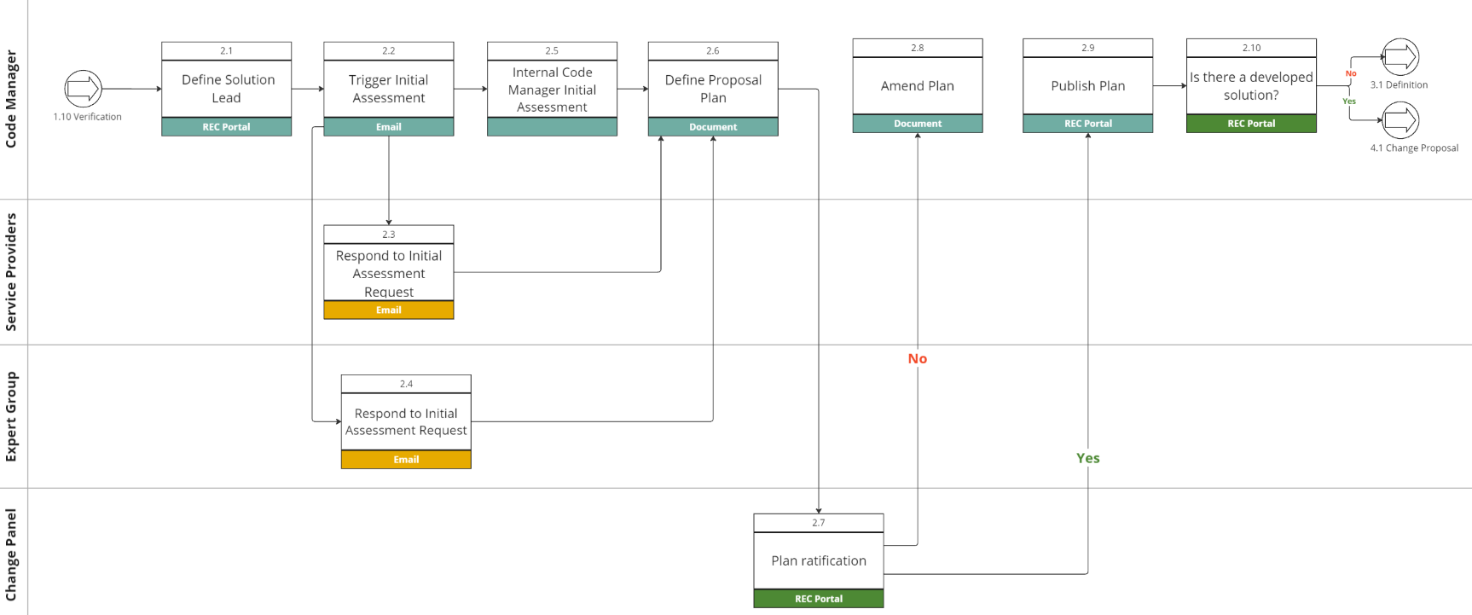
ASSESSMENT
Notes:
Code Manager assessment
Sets out a Change Plan including
Stakeholders to be engaged including affected parties, Technical, Service Providers, Legal, SME
Cross Code Dependencies
Expert groups to be engaged
The Governing body for approval
The Change Path
Timelines
Solution Lead
Change Panel approval
Change Panel decision published and notified to all
Needs solution development
Engagement process
Recorded as an ‘I’
Developed solution
Can be taken straight to consultation
Recorded as an ‘R’

Slide 16
Definition
Notes:
Key working and engagement phase
Covers expert group, cross code, legal, parties, SME, Service Providers as applicable
Code Manager collating and managing multiple parties providing information for a fully realised solution including
Technical
Benefits
Costs
Impacts

Slide 17
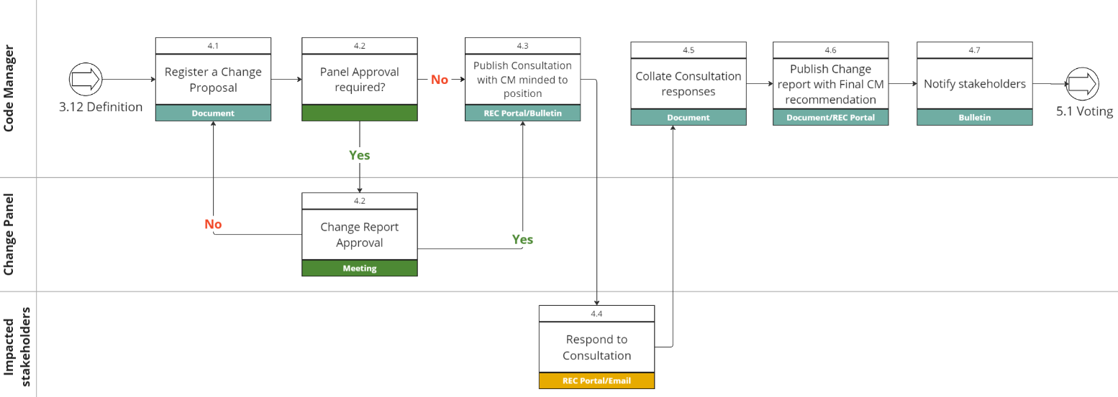
CHANGE PROPOSAL
Notes:
Formal Change Proposal and Change Report now raised
Removes requirement for PCR
Change Panel Approval before publication optional (approved Change Path at Initial Assessment)
Consultation published – message is agreement with the Code Managers Recommendation – Definition Stage is the debate stage
Code Manager transforms an I into an R
No additional work for the Proposer

Slide 18
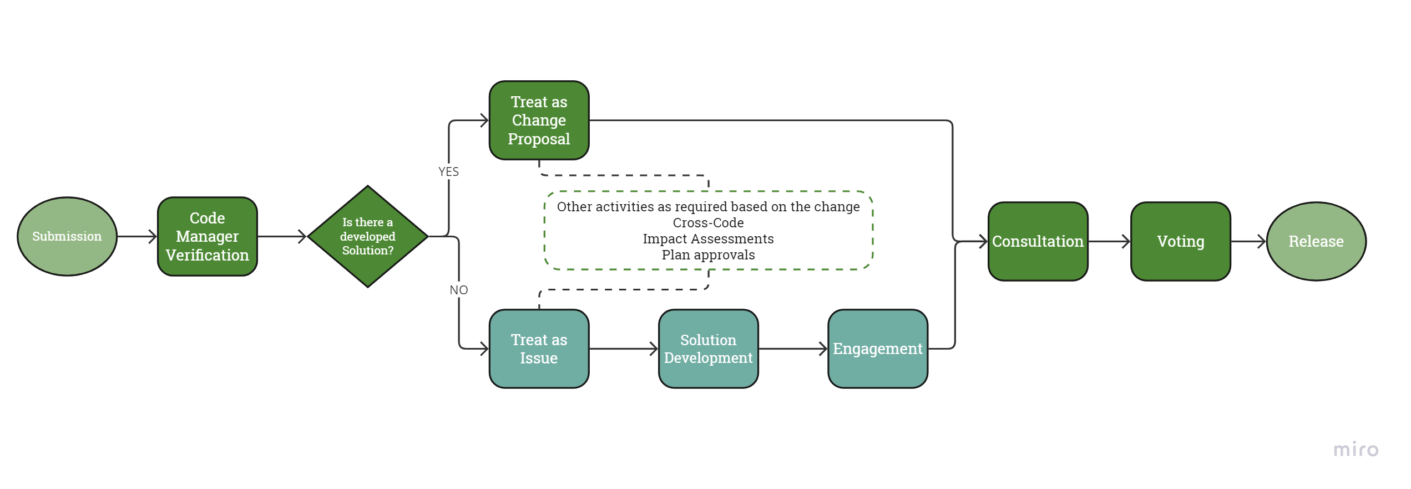
HIGH-LEVEL Process

Slide 19
Documentation Review
Gemma Dixon

Slide 20
Change reports Key changes
Overview of Changes to Reports
2022 refined reports: revised front page, re-ordered and included a glossary
June 2024
One Change report: simple, streamlined, removes duplication and repetition
Four stages, clear on current stage:
 | Existing (June 2022)
Initial Assessment Report | 1 intro page, 9 sections
Change Proposal Plan | 1 intro page, 11 sections
Preliminary Change Report | One template: 2 intro pages, 26 sections
Final Change Report
Revised (June 2024)
Evolves as Change progresses Version controlled
One Change report
01 | Proposal Plan
02 | Impact Assessment
03 | Consultation
04 | Final Recommendation

Slide 21
One change report: revised, four stages
Summary of Impact Assessment Activity
Summary of Consultation Responses
Proposed Implementation Date and Approach
Responsible Committee
Change Path
Priority Status and Urgency
Code Manager points of Contact
Background and Summary
Proposal Plan for progression with associated activities Appendix Glossary RAID log
Summary of Analysis Undertaken
Proposed Solution
Draft of Legal Text
Service Provider
Party
Business Case Assessment
Cost Benefit Analysis
Tangible Benefits
Intangible Benefits
Cost Benefit Analysis Summary
Case for Change
Authority Determined
Self-Governance
Code Manager minded to position
Details of Responses
Summary of Amendments made following Consultation
Code Manager Recommendation
Document Version
PROPOSAL PLAN
IMPACT
ASSESSMENT
CONSULTATION
FINAL
RECOMMENDATION

Slide 22
Q&A
All

Slide 23
Audience Q&A Session
ⓘ Start presenting to display the audience questions on this slide.

Slide 24
Thanks for attending
Contact us: enquiries@recmanager.co.uk

Slide 25
Feedback
ⓘ Start presenting to display the poll results on this slide.

