Slide 1
R0021 –safe isolation provider services for premise owners
05 July 2022

Slide 2

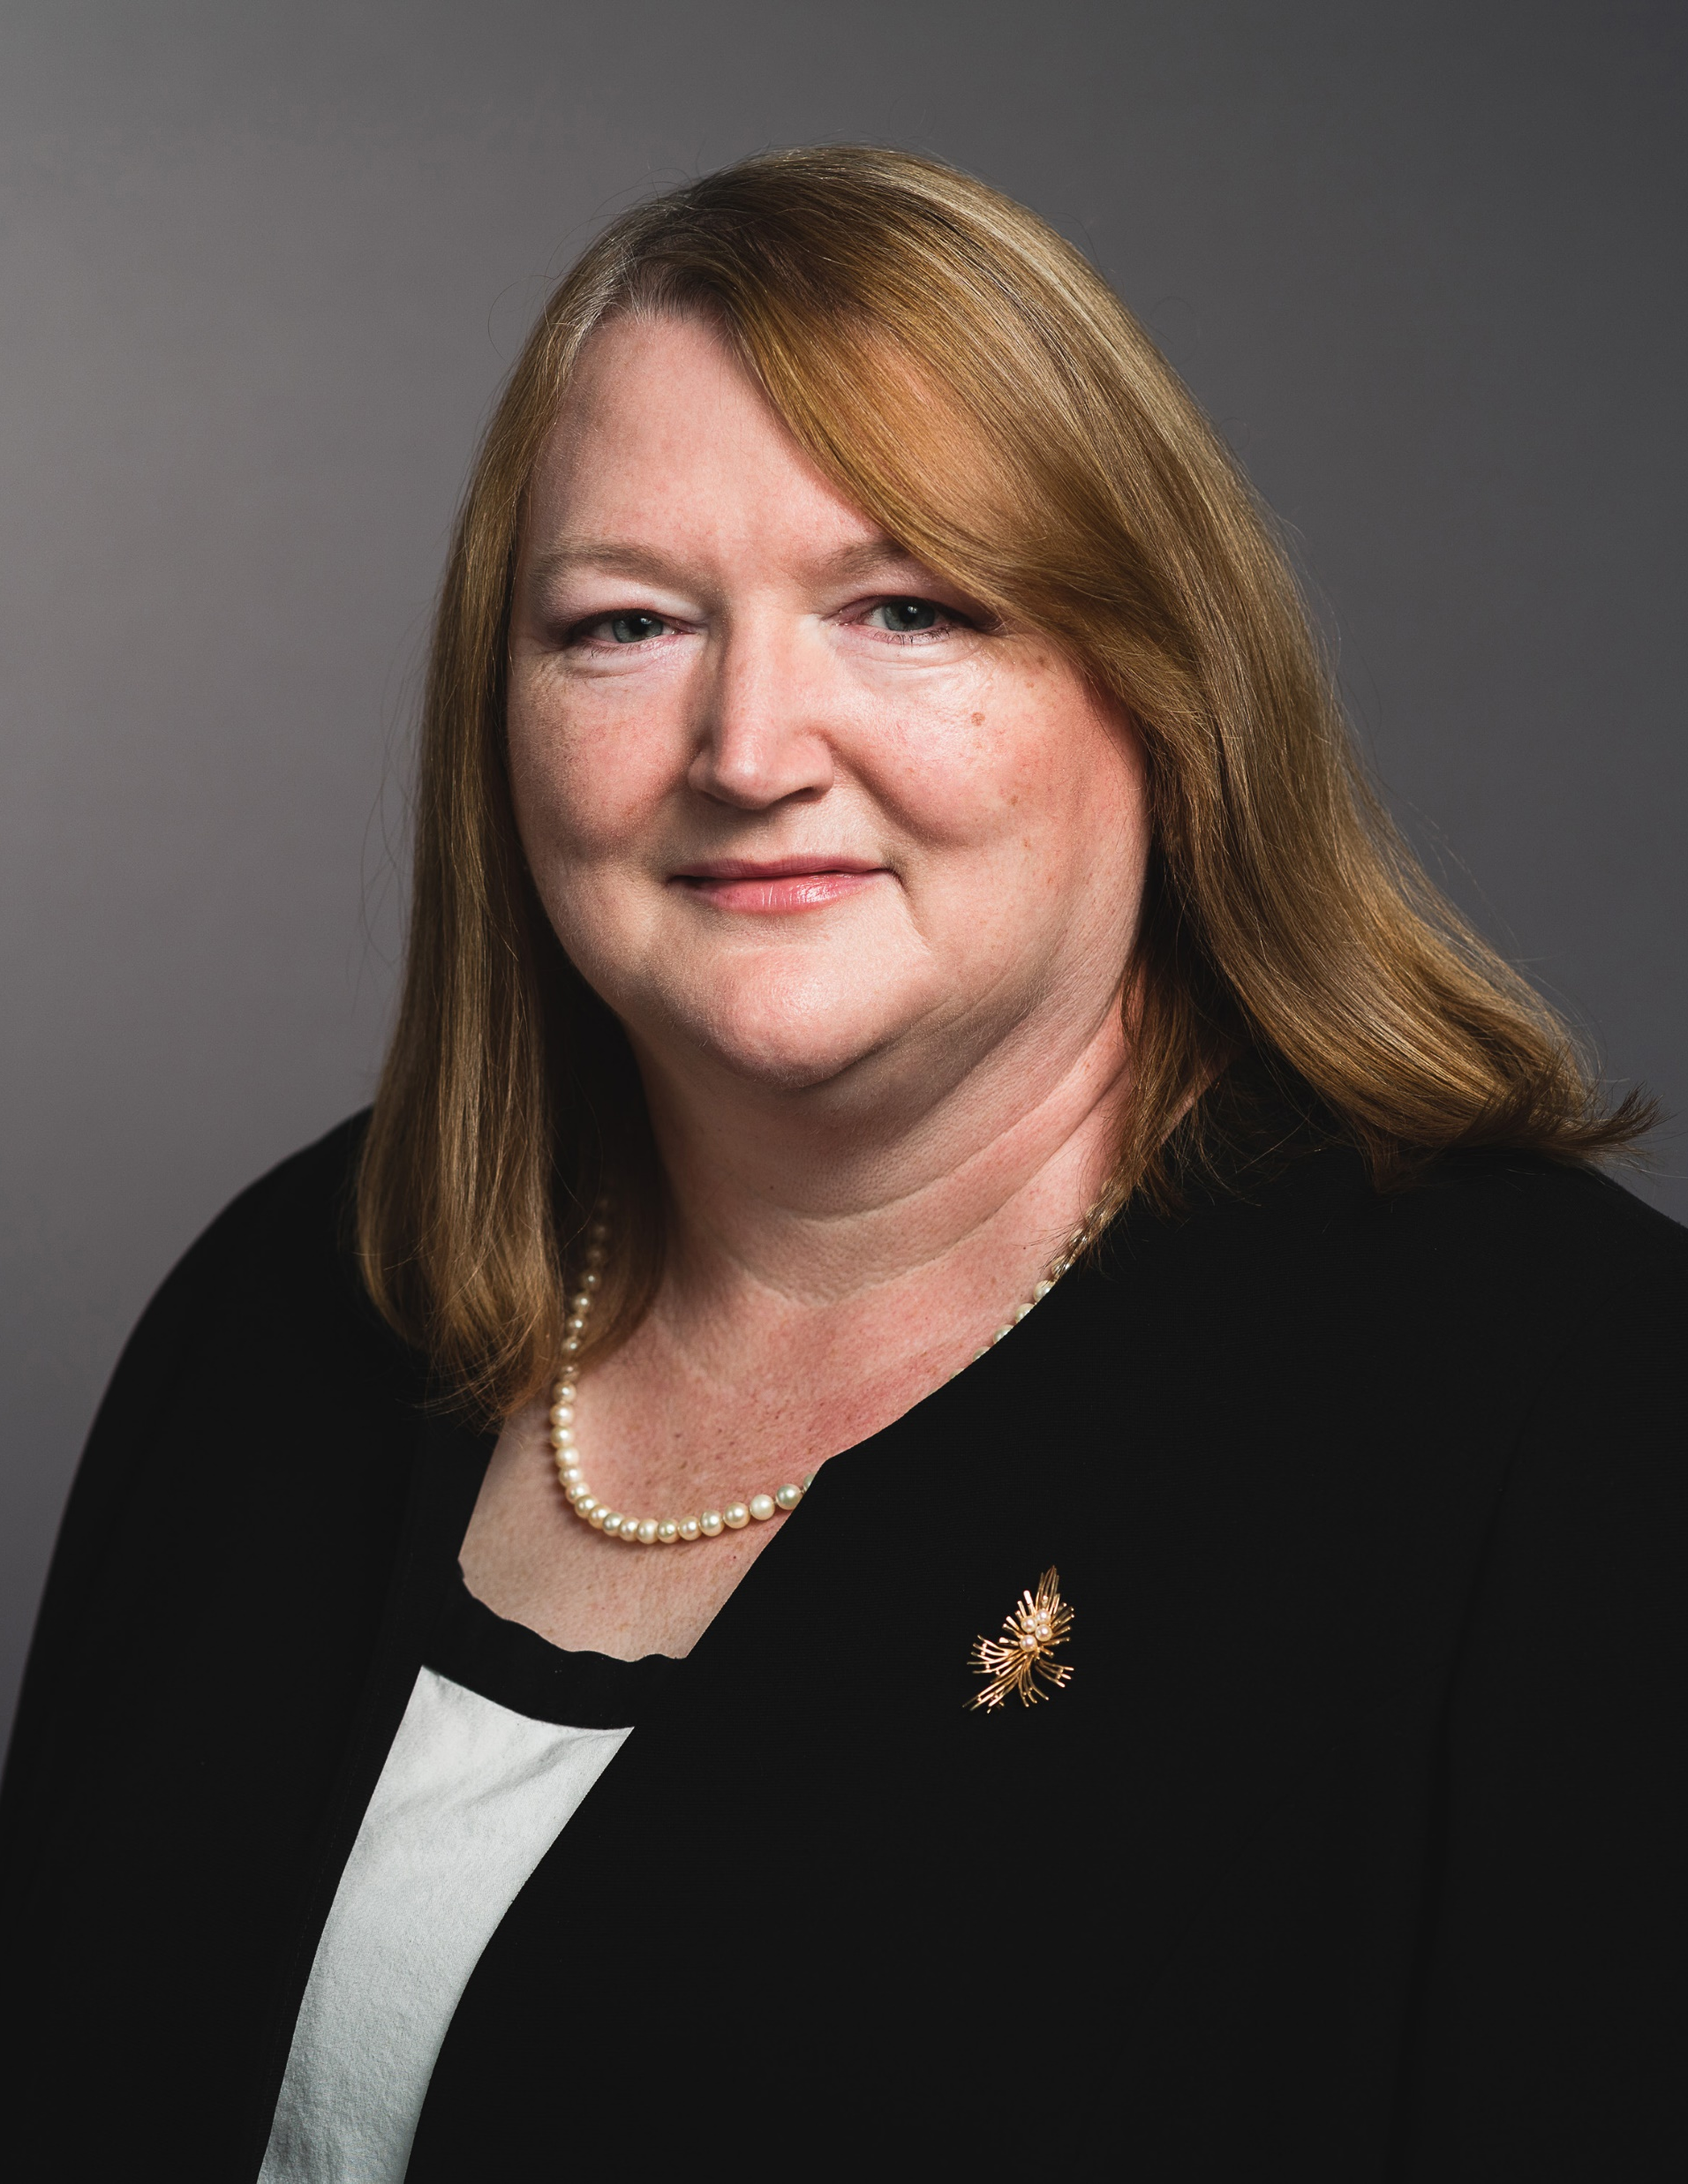

Introducing Your presenters
Amie Lauper-Bull
REC Code Manager
Events and Communications Officer
Colette Baldwin
REC Code Manager
Regulatory Design Manager
Richard Colwill
DCUSA – Code Administrator
Operational Change Manager

Slide 3

Housekeeping
Please keep Cameras and microphones switched off
The event is being recorded and will be published online
Access Slido to ask questions and leave feedback
Opportunities for Q&A

Slide 4


Join at slido.com
#4221277
ⓘ Start presenting to display the joining instructions on this slide.

Slide 5
Agenda For today
Agenda Item | Presenter
Introduction | Amie Lauper-Bull
Overview of the REC Change Proposal R0021 | Colette Baldwin
Overview of the DCUSA Change Proposal DCP394 | Richard Colwill
Feedback on REC Impact Assessment responses | Colette Baldwin
Q & A | Colette Baldwin & Richard Colwill
Next steps R0021 | Colette Baldwin
Next steps DCP394 | Richard Colwill
Final Questions | Colette Baldwin & Richard Colwill

Slide 6
Overview of r0021
Colette baldwin

Slide 7

Overview of R0021 Change Proposal
Creates a new role in the REC which only REC MEMs can apply to become, provided they have acceded to DCUSA as a SIP.
They will work directly with Landlords to provide Isolation for the fitting of an isolator, or for the installation of Low and Zero Carbon Technology (L&ZCT) equipment – such as electric vehicle charging points, heat pumps, etc.
They will not act as a MEM when they are on site as a SIP, and can only do what is strictly necessary to facilitate the fitting of isolators or installation of L&ZCT equipment. They cannot perform any other MEM activities, such as moving or exchanging meters etc.
They will not need the consent of the supplier to undertake this very narrow scope of activities.
There will communication between SIPs, suppliers and DNOs

Slide 8
Scope of work sip can undertake
The role of the SIP is defined separately from that of the REC MEM, and they should not be conflated.
They purposefully have a very narrow scope of activities that they can undertake:
(a) De-energise that Metering Point.
(b) (if reasonably necessary) adjust the terminals of the meter and associated equipment and re-make the connection to them to make safe and remedy any disturbance of the connection that may have occurred.
(c) If required, terminate replacement customer tails into the Suppliers Meter, customer tails having been presented and tested by the electrical contractor as part of their works
(d) Re-energise that Metering Point.

Slide 9
PROCESS diagram walk through
Colette Baldwin

Slide 10
Process – Becoming a SIP

Slide 11
Process – Contractual requirements

Slide 12
process – on-site activities

Slide 13
Process – work completion

Slide 14
Overview of dcp394
Richard Colwill - ElectraLink

Slide 15
Overview of DCUSA change proposal dcp394
DCP 394 has been raised to establish the necessary legal arrangements, which would allow a REC accredited MEM, to accede to DCUSA in order to act as a SIP to undertake Safe Isolations Work.
If DCP 394 is approved, the legal text will contain the following:
  Condition that only a REC accredited MEM can apply to become a SIP
  Definition of Safe Isolation Works
  Obligation that works will only be undertaken by someone working on behalf of the SIP and with the permission of the customer
  Obligations that the SIP will act in accordance with Good Industry Practice and comply with the REC Meter Operation Code of Practice
  Clauses in relation to the provision of information to the Supplier and Distributor
  Clauses in relation to liability in relation to any actions, proceedings, costs, demands, claims, expenses, liability, loss or damage
  Confirmation that the SIP can raise changes and vote on changes specific to the legal text introduced by DCP 394

Slide 16
Feedback on impact assessment
Colette baldwin

Slide 17
Impact assessment feedback
We issued our Impact Assessment to the industry for their feedback and were heartened to receive 13 response from across the spectrum of parties…Thank you.
Many of the responses raised additional questions that either hadn’t been covered in the initial assessment, or were clarifications on the proposed solution.
We have created and shared an FAQ document with you in advance of today’s session, which we hope you found helpful and addresses your areas of concern, however, please feel free to raise any additional questions – using Slido or the Chat.
A copy of the FAQ document can be found on the Change Proposal page on the REC Portal

Slide 18
Summary of feedback received
Supplier
  Broadly supportive, but needed clarity on roles, responsibilities, liabilities, and costs.
  Preference for the use of Market Messages over SDEP.
  Implementation timescales between 8 weeks – 18 months
DNO
  Broadly supportive, concerned about impacts on Smart Metering Installation Alerts and reporting/funding.
  Recognised additional providers available to Landlords while suppliers are focused on Roll-out activities, and would improve DNO resources to focus on maintaining and improving the network particularly Net Zero targets.
MEM
  Again, Broadly supportive, including the use of Market Messages
  Believed implementation would be relatively simple and that the lead time should reflect that.
  Some MEMs believed the scope of work should have been wider.

Slide 19
Question & answer - Slido
Colette Baldwin & Richard Colwill

Slide 20

Audience Q&A Session
ⓘ Start presenting to display the audience questions on this slide.

Slide 21
REC change proposal r0021 next steps
Preliminary Change Report (PCR) will be updated following this event, incorporating any new issues raised.
The PCR will be then be shared with the Metering Expert Panel on the 8 July.
The PCR will be circulated for consultation on 12th July with comments closing on the 2 August 2022.
Draft legal text will be prepared and added to the Change Proposal Page on the REC Portal.
Final Change Report will be issued on 26 August 2022.
Metering Expert Panel will make a Recommendation to the Authority at their meeting on the 14 September to either approve or reject this Change Proposal.
The Appeal Window for the Metering Expert Panel’s recommendation will close on the 29 September.

Slide 22
DCUSA change proposal dcp394 next steps
There is a DCP 394 consultation out at the moment, with a deadline for responses set at 18 July 2022. Further information in relation to this consultation can be found here.
The Working Group will then review the consultation responses, with the aim of submitting the final Change Report to the DCUSA Panel on 17 August 2022.
If approved at the DCUSA Panel, the Change Report will be issued to DCUSA Parties (DNOs, IDNOs and Suppliers) for vote. Parties will have until 9 September 2022 to submit their votes.
A Change Declaration (outcome of the vote) will then be issued to DCUSA Parties and Ofgem on 13 September 2022.
The outcome of the vote will act as a recommendation to Ofgem but Ofgem will ultimately decide on whether DCP 394 should be accepted or not.

Slide 23
Opportunity for final questions

Slide 24
Audience Q&A Session
ⓘ Start presenting to display the audience questions on this slide.

Slide 25
Thanks for attending
Contact us: enquiries@recmanager.co.uk

Slide 26

Feedback
ⓘ Start presenting to display the poll results on this slide.

