Slide 1
Electricity metering obligations training
10 October 2022

Slide 2

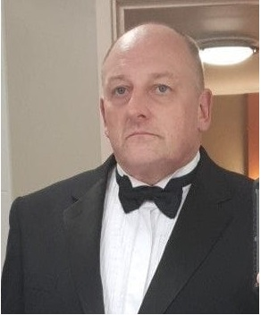
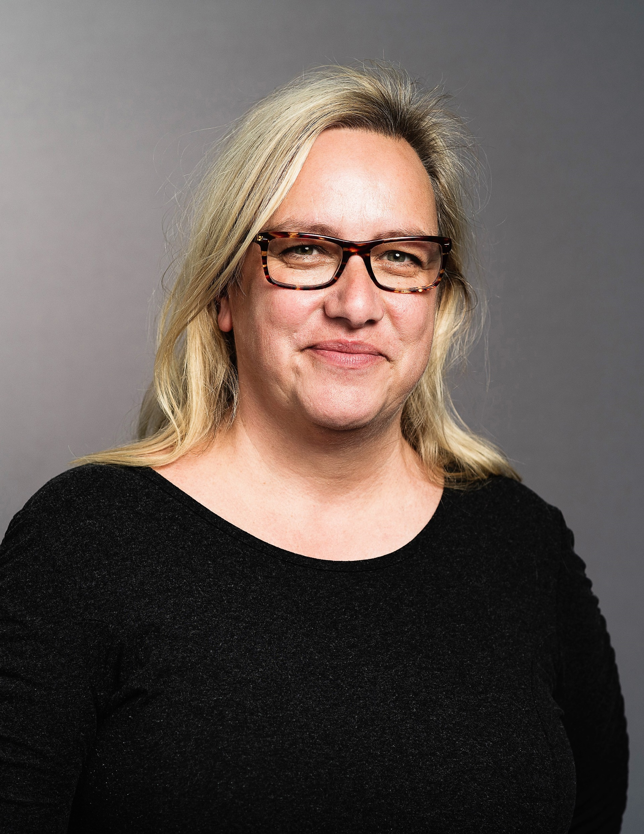
Introducing Your presenters
Amie Lauper-Bull
REC Code Manager
Communication and Events Officer
Dave Wright
Metering Consultant
Helen Fosberry
REC Code Manager
Continuous Improvement Manager

Slide 3

Housekeeping
Videos and microphones
Event recording
Use of Slido
Opportunities for Q&A

Slide 4


Join at slido.com
#6699998
ⓘ Start presenting to display the joining instructions on this slide.

Slide 5
Agenda For today
Agenda Item | Presenter
Who’s who in the Industry | Dave Wright
Installation | Dave Wright
Navigating the REC Portal | Dave Wright
Q&A | Amie Lauper-Bull
Close and Survey | Amie Lauper-Bull

Slide 6
WHO’s WHO?
Dave wright

Slide 7
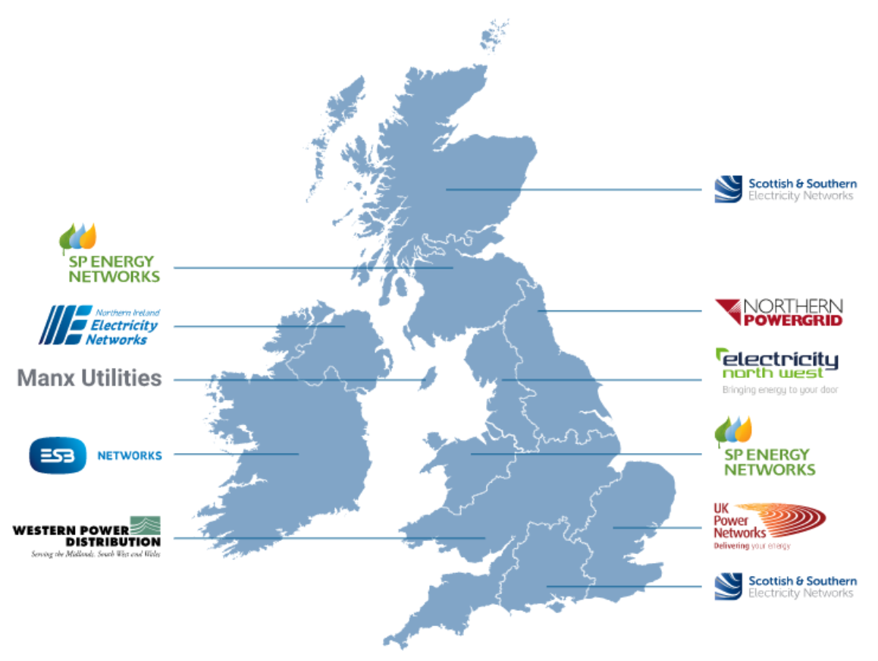
ELECTRICITY

Slide 8
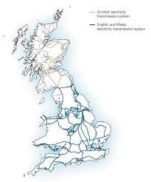
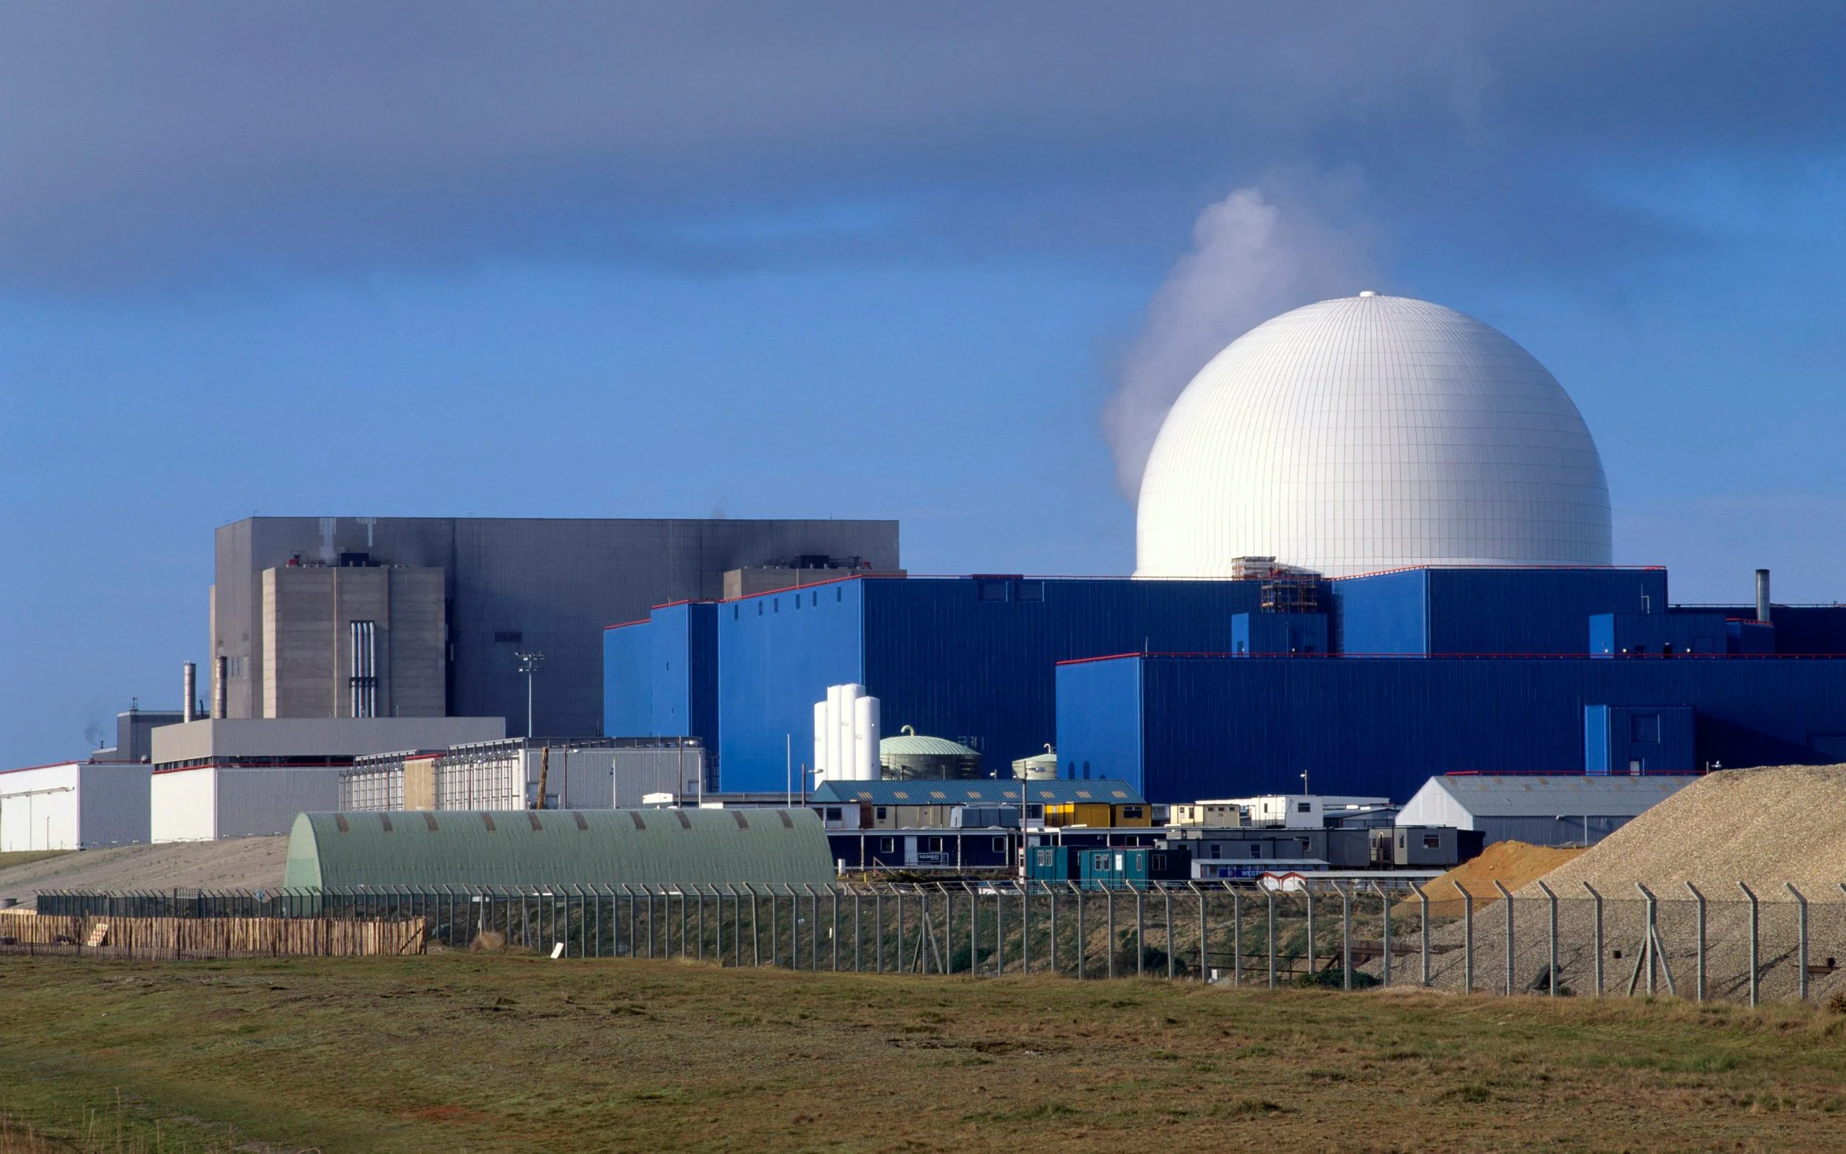
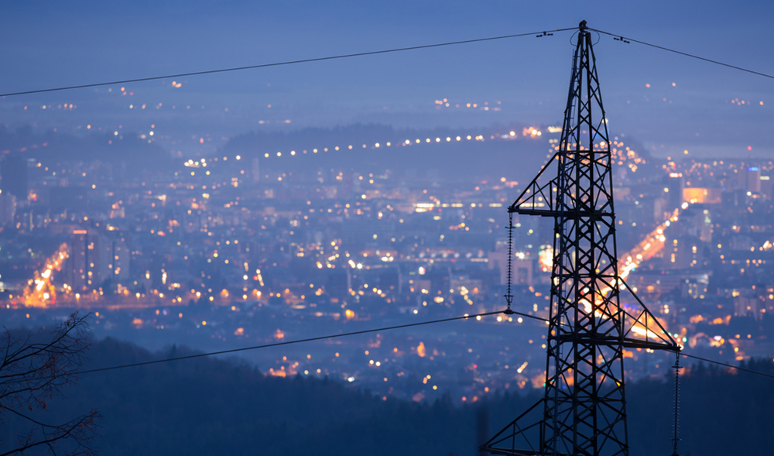
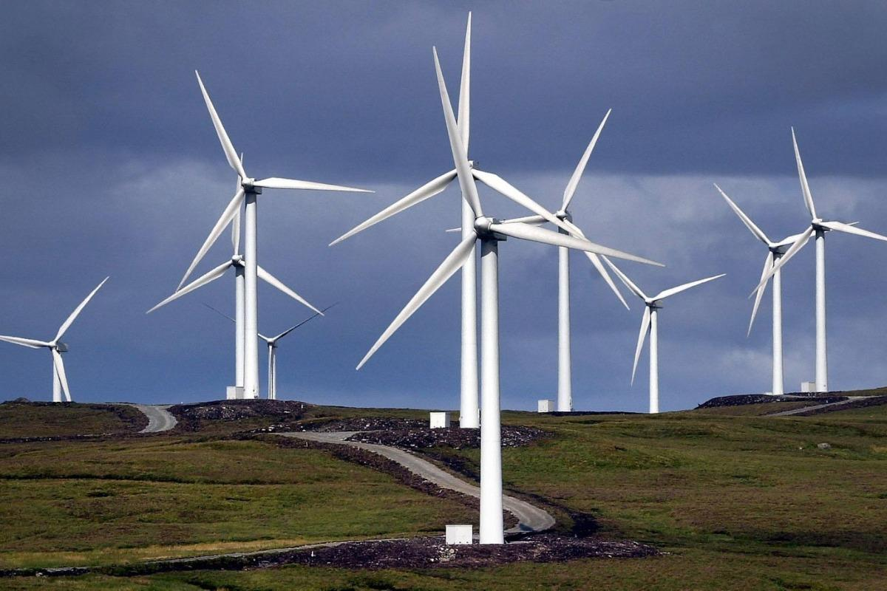
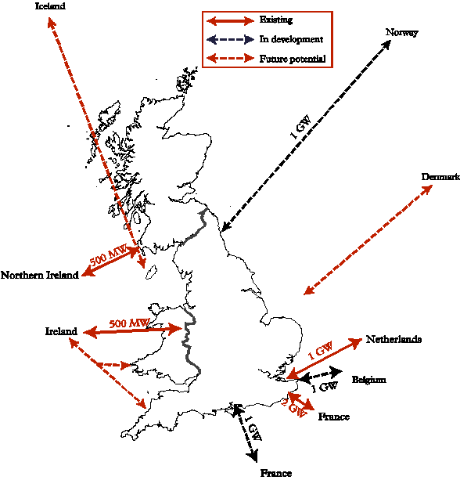
WHO’S WHO IN THE ELECTRICITY INDUSTRY
Generators
DNO / IDNO
Interconnectors
Notes:
Generators – these are the companies responsible for the production of the electricity transmitted around the grid.
There are many forms of generation – from the old coal and oil fired to gas the controversial nuclear which divides opinion to that of the greener methods of solar wind hydro and tidal.
Shipping involves buying gas from producers, arranging for it to be conveyed to supply points via the NTS (National Transmission System) and selling it to gas suppliers.
Shippers pay National Grid to run their gas through the national transmission network and LNG importers pay for the right to land LNG at the importation terminals.
Shippers also pay National Grid and other gas distribution network operators to transport their gas to homes and businesses. These charges are passed on to consumers and reflect the cost of building, maintaining and operating the networks and running a 24-hour gas emergency helpline.
Gas consumers – homes and businesses throughout the UK – have many gas supply companies to choose from. The supply companies pay the gas shippers who buy gas and arrange for it to be transported.

Slide 9
Industry facts
GENERATORS | INTERCONNECTORS | GRID/DNO | SUPPLIERS
There are more than 2000 electricity generation stations in the UK The use of electricity in the UK is currently split 29% Domestic 29% Industrial 18% Commercial 8% Losses 8% Energy Industries 5% Public Administration 2% Transport 1% Agriculture | There are 5 interconnectors currently in use Viking link is the latest project to be started. | The high voltage transmission system comprises of 24,600 kms of overhead lines and approx. 1000 km of underground cables The distribution network operators manage 800,000 kms of overhead and underground cables | There are currently 37 registered suppliers Over the last 12 months circa 70 suppliers have ceased trading
Notes:
Interconnectors –
BritNed is an independent joint venture with TenneT, connecting the UK and the Netherlands since 2011.
IFA is our first link between the UK and France, operated together with RTE since 1986.
A joint venture with Elia connecting the UK and Belgium. In operation since January 2019.
IFA2 (Interconnexion France-Angleterre 2) is our latest interconnector to come into operation. It helps us to exchange clean energy between the UK and France and is capable of exporting or importing 1000MW of electricity – enough to power one million homes
North Sea Link (NSL), a joint venture with Norwegian system operator Statnett, is our latest interconnector to come into operation. Stretching 720 kilometres under the North Sea, at depths of up to 700 metres, NSL is capable of sharing up to 1400 megawatts of electricity – enough to power around 1.4 million UK homes.
Viking Link is an electricity Interconnector currently under construction together with Energinet. When complete, Viking Link will be the world's longest sub-sea and land connection between Denmark and the UK. ​When wind generation is high and electricity demand low in the UK, Viking Link will allow up to 1,400MW of power to flow from the UK. When demand is high in the UK and there is low wind generation, up to 1,400MW can flow from Denmark

Slide 10
Current generation

Slide 11










Who’s who
Notes:
Ofgem – formerly offer - Starting in the 1990s, the supply of electricity and gas to retail consumers in the UK has been unbundled from the rest of the industry. At the time of privatisation, British Gas and the regional public electricity suppliers held a monopoly on supplying all domestic gas and electricity consumers respectively. In 1997, British Gas was split (demerged) into Centrica and BG plc, in order to separate gas supply from its production and distribution.^{[15]} Between 1996 and 1999, domestic energy consumers were gradually able to choose their supplier. Finally, in May 1998 the domestic gas market was fully opened to competition, followed by the domestic electricity market in May 1999.
BSC – Balancing & Settlement Code
Signed by all players – multi-party contract, owned by NGET
Energy rules only – notifying contracts, imbalance, settlement, meters
Administered by Elexon
CUSC – Connection Use of System Code
Signed by those connected to/using NGET
Covers transmissions rules & charges
Grid Code – Technical
Signed by power plants, DNOs & larger users
Series of Operational Codes
DUSCA - Managed by Electralink the Distribution Use of System Code Agreement
Covers all distribution issues
Administered by DNOs – central governance
Master Registration Agreement (MRA) – managed by Gemserv
Protocols for DNOs and Suppliers for change of supplier along with the ECOES system
BSI – Their role as the UK national standards body reaches across the international standards community and sets the benchmark for components and equipment.
BEIS- One of the government departments responsible for amongst other things Smart metering- this was formerly the DTI – This department is also rs
OPSS - Consumer confidence in the accuracy of their measured consumption is vital. This is the responsibility of the body once known as ‘National Weights and Measures’. Since January 2018 its name has become the Office for Product Safety and standards.
There are statutory specifications for the required accuracy of energy meters (and for a myriad of other measuring instruments used to calculate charges for consumers – e.g. weighing scales, petrol pumps, taxi meters, beer pumps…) The OPSS has a role in the certification of new meters but perhaps more importantly manages the in-service testing regime. This is known as the measurements instruments directive.
The legislation is quite black and white – a meter must operate within the accuracy limits. However, it would be impossible (or at least stupendously costly) to guarantee that ever one of the 53million meters in Britain was always within the limits. A pragmatic answer is to have a scheme for routinely testing samples of meters so that the statistical confidence of their performance can be calculated. If the analysis shows that the performance of the sample is outside limits then decisions can be made to replace all similar meters of that kind that are out in the field.
This should give consumers confidence that there is only a low probability that their meter is faulty. But if a consumer does believe that their meter is inaccurate then they have a right to have it independently tested.
HSE – Overarching legislation – especially ESQCR
Electralink - ElectraLink is responsible for operating the data hub that underpins the UK energy market.

Slide 12
Cont…
Notes:
C:\Users\amelia.bray\GEMSERV LTD\RECCo - Documents\08 REC Portal\News Image Library

Slide 13
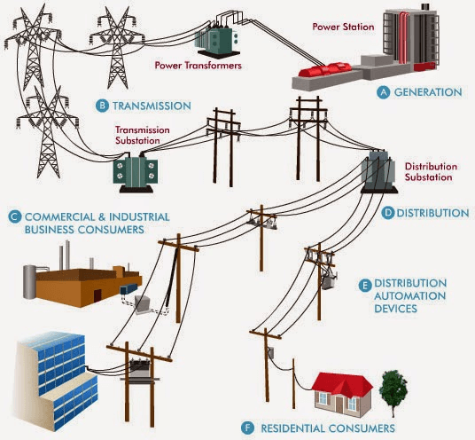
How they interact
Notes:
Gas Transmission – as discussed this is done via the National Grid in high pressure pipelines 7-10 bar, due to the distances and friction he pressure may drop so has to be increase at compressor stations once it comes to the local area pressure reduction stations are used and this is where id is handed over to the local distribution companies GDNO’s. All these connections and pipes must comply with the pipeline safety regulations 1996 and the pressure safety systems regulations which are owned and governed by the HSE. Most electricity generators on the network are connected at this level
The GDNO operates three pressure tiers , Intermediate, medium and low pressure network
Intermediate between 2 and 7 bar, medium 75mbar and 2 bar and low between 30mbar and 75mbar dependant on the end consumer the end supply will be taken off at one of these pressures. Predominantly domestic customers will either by on medium pressure or most commonly low pressure. Much of this work again is covered by HSE legislation such as safety cases and gas safety management regulations(GS(M)R). These regulations even cross over into highways .
In this area alone there are over 20 IGEM publications and over 93 British standards this list does not include the international standards. All of these sit outside the REC.
At this point we have not even got to the end consumers property.
The handover point to the MAM – Meter asset manager. This is the old term they are now called a MEM- meter equipment manageris at the outgoing point of the ECV – Emergency control valve
Dependent on the type and usage of the property

Slide 14

Audience Q&A Session
ⓘ Start presenting to display the audience questions on this slide.

Slide 15
INSTALLATION
DAVE WRIGHT

Slide 16
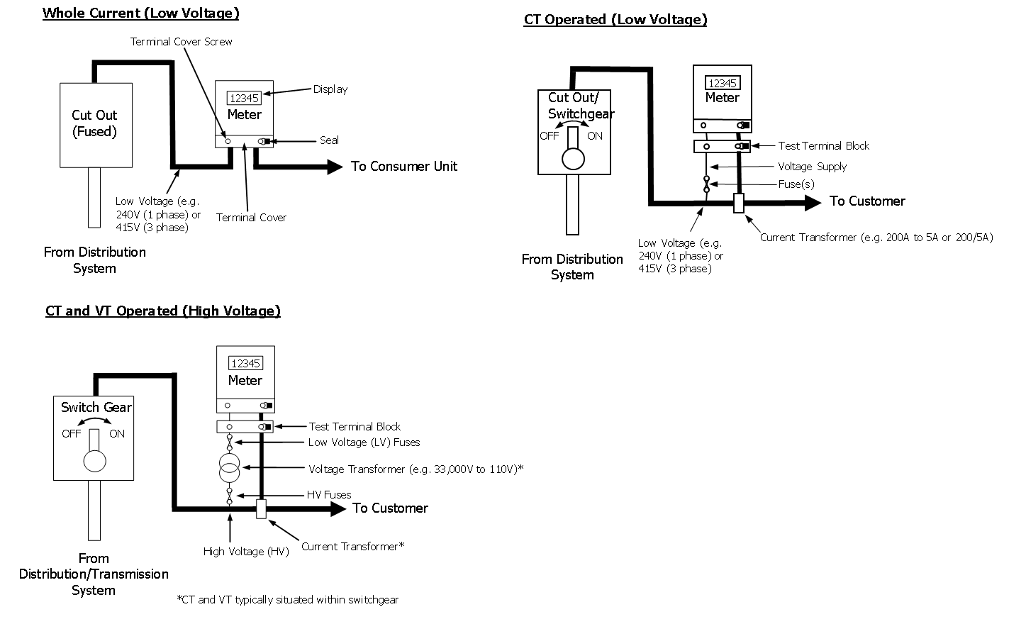
installations
Notes:
This is only a small example of a large gas installation.
In realistic terms many of these rigs can come on a low loader and need cranes to put them in place.
To give you a better example , The Shard’s gas meter and installation was put in as the building was being built around it as a complete installation. The only way that, it is coming out is in bits

Slide 17
Domestic installation

Slide 18
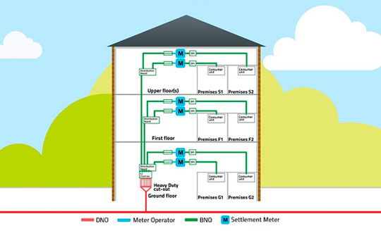
Building network operator (BNO)

Slide 19
Audience Q&A Session
ⓘ Start presenting to display the audience questions on this slide.

Slide 20
Changes in the rec
Dave wright

Slide 21
Changes under the rec
Original
New
SMICoP.
SMICoP
MOCoPA - Document
MOCoP
MOCoPA
Technical decisions
MOCoPA
Audit
REC
Metering Expert Panel
REC
Performance Assurance Board
Notes:
SMICOP continues to exist
The MOCOPA has been split across different sections – explain the split
Also mention Electricity operational forum

Slide 22
Navigating the rec portal

Slide 23
Navigating the rec portal

Slide 24
Navigating the rec portal

Slide 25
Navigating the rec portal

Slide 26
Navigating the REC Portal

Slide 27
Audience Q&A Session
ⓘ Start presenting to display the audience questions on this slide.

Slide 28
Thanks for attending
Contact us: enquiries@recmanager.co.uk

Slide 29

Feedback
ⓘ Start presenting to display the poll results on this slide.

