Slide 1
Gas metering obligations training
26 September 2022

Slide 2

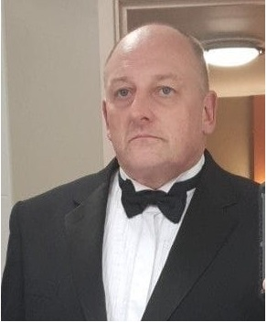

Introducing Your presenters
Amelia Bray
REC Code Manager
Communication and Events Manager
Dave Wright
Metering Consultant
Paul Rocke
REC Code Manager
Head of Communications

Slide 3

Housekeeping
Videos and microphones
Event recording
Use of Slido
Opportunities for Q&A

Slide 4
Agenda For today
Agenda Item | Presenter
Who’s who in the Industry | Dave Wright
Installation | Dave Wright
Navigating the REC Portal | Dave Wright
Q&A | Amelia Bray
Close and Survey | Amelia Bray

Slide 5
WHOSE WHO?
Dave wright

Slide 6
GAS

Slide 7
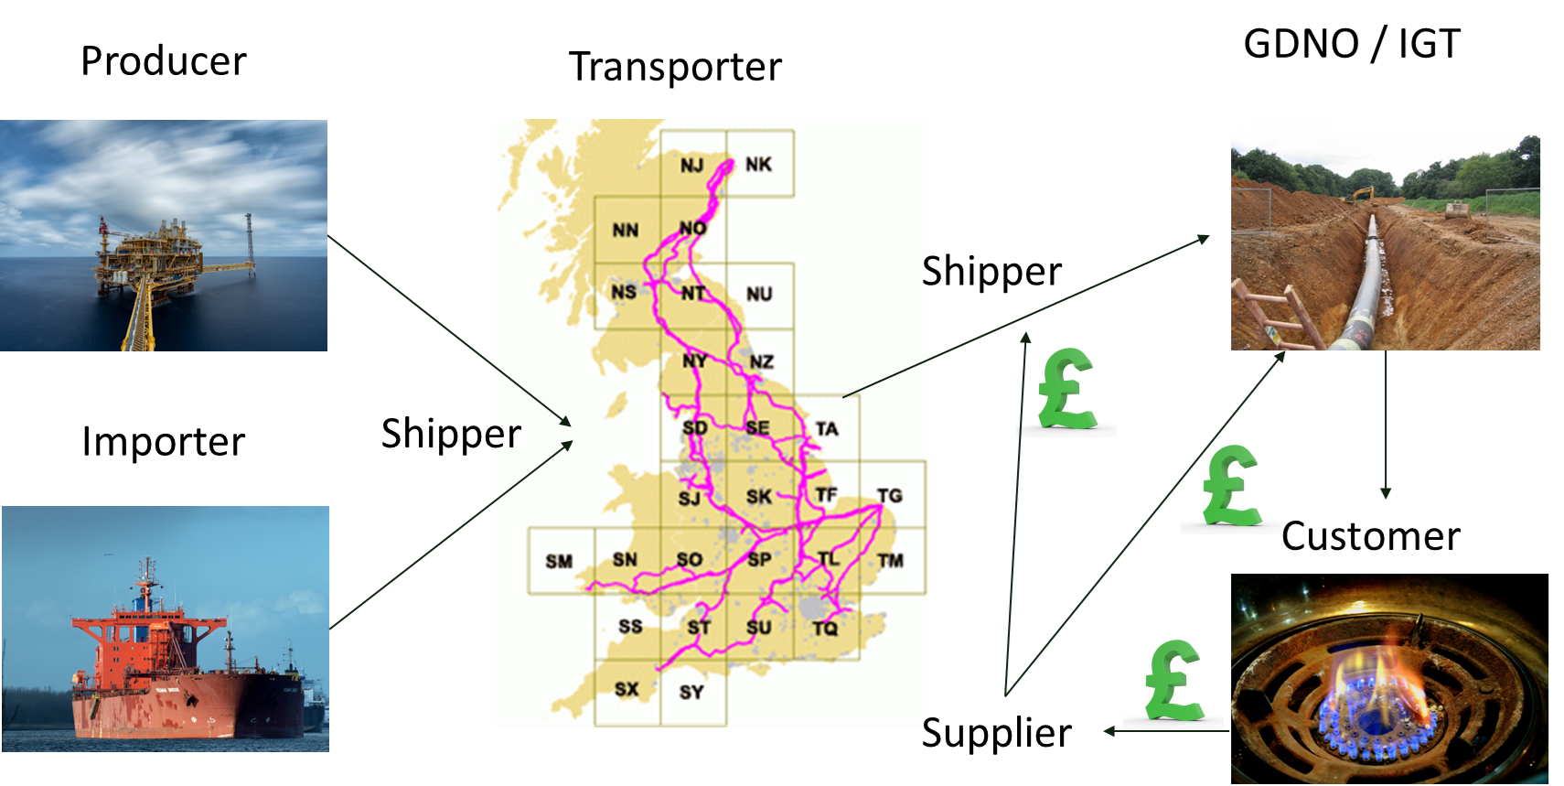
WHO’S WHO IN THE GAS INDUSTRY
Notes:
Gas producers and importers sell gas to licensed shippers who then own the gas as it travels through the network of transmission and distribution pipes.
Shipping involves buying gas from producers, arranging for it to be conveyed to supply points via the NTS (National Transmission System) and selling it to gas suppliers.
Shippers pay National Grid to run their gas through the national transmission network and LNG importers pay for the right to land LNG at the importation terminals.
Shippers also pay National Grid and other gas distribution network operators to transport their gas to homes and businesses. These charges are passed on to consumers and reflect the cost of building, maintaining and operating the networks and running a 24-hour gas emergency helpline.
Gas consumers – homes and businesses throughout the UK – have many gas supply companies to choose from. The supply companies pay the gas shippers who buy gas and arrange for it to be transported.

Slide 8
Industry facts
PRODUCER/IMPORTER | TRANSPORTER | GDNO/IGT | SUPPLIERS
There are 8 gas terminals in the UK where gas can be imported onto the network. 50% of the UK gas comes from the North Sea. 33% comes from Norway, the rest is made up from LNG imports from Qatar and the US with a minimal amount from Russia. | National Grid operates the high pressure gas network, before transferring ownership to IGT’s and GDNO’s. The network consists of approximately 7,660 kilometres (4,760 miles) of pipeline. | Between them GDNO’s and IGT’s serve approximately 23.1 million customers. Responsible for the maintenance and repair of 275,000km (170,877 miles) of pipework. There are 4 GDNO’s that cover the whole country. There are currently 15 IGT’s registered in the UK excluding Northern Ireland. | There are currently 37 registered Suppliers. Over the last 12 months circa 70 Suppliers have ceased trading.

Slide 9






Who’s who cont…
SPAA
ASPCoP
MAMCoP
SPAA Exec Committee
Joint Office
of Gas Transporters
AMICoP
Notes:
Ofgem – formerly ofgas - Starting in the 1990s, the supply of electricity and gas to retail consumers in the UK has been unbundled from the rest of the industry. At the time of privatisation, British Gas and the regional public electricity suppliers held a monopoly on supplying all domestic gas and electricity consumers respectively. In 1997, British Gas was split (demerged) into Centrica and BG plc, in order to separate gas supply from its production and distribution.^{[15]} Between 1996 and 1999, domestic energy consumers were gradually able to choose their supplier. Finally, in May 1998 the domestic gas market was fully opened to competition, followed by the domestic electricity market in May 1999.
Joint Office - Are the Code Administrator for the Uniform Network Code (UNC), which sets out the common transportation arrangements for Great Britain’s gas industry. Their role is to administer the governance of the processes for modifying the UNC and for a number of sub-committees that oversee its operations.
SPAA - The Supply Point Administration Agreement (SPAA) sets out the inter-operational arrangements between gas suppliers and transporters in the UK retail market. It is a multi-party agreement to which all domestic gas suppliers and all gas transporters are required by their Licences to accede. The SPAA was created to provide a governance arrangement covering processes which are not ordinarily covered by existing contracts or agreements, but which are nonetheless considered important to the effective and efficient transfer of consumers between suppliers. The Agreement provides a robust mechanism for making changes to the operational arrangements such as the sets of data that parties must share when a consumer wishes to switch supplier.
SPAA Exec committee – Supplier / GDNO governance committee where MAMCoP and Amicop reported in to .
XoServe –Is the gas industry’s Central Data Service Provider (CDSP), they provide a suite of vital services for gas Suppliers, Shippers and Transporters.
They ensure Britain’s retail gas market runs efficiently and reliably and provide a single, consistent point of service for our customers and make sure their data is transported securely and their central register holds details of all gas supply points. They are governed and owned by the gas industry.
BSI – Their role as the UK national standards body reaches across the international standards community and sets the benchmark for components and equipment.
IGEM - Are the professional engineering institution for gas, here to support individuals and organisations connected with the gas industry.
As advocates of excellence, our core aim is to help all those involved with gas to achieve and maintain the highest standards of professional competence.
We do this by publishing technical standards, delivering high quality events and courses that contribute to professional development and by bringing people together through membership to share knowledge, expertise and best practice. IGEM is not a statutory body but sets industry standards that would be viewed as the starting point by courts if called to judge whether an operator has worked in accordance with industry best practice.
HSE – Overarching legislation
MAMCoP – Meter Asset Manager Code of Practice this was facilitated by SPAA which managed the code of practice and the audit process- attended by MAMS and GDNO’s
AMICoP – Approved meter installer code of practice – theses attended the MAMCoP board meetings
ASPCoP – Automated meter reading service provider code of practice. This is a voluntary code of practice for those using AMR devices. This is for non domestic only.
Electralink - ElectraLink is responsible for operating the data hub that underpins the UK energy market.

Slide 10
How they interact
Notes:
Gas Transmission – as discussed this is done via the National Grid in high pressure pipelines 7-10 bar, due to the distances and friction he pressure may drop so has to be increase at compressor stations once it comes to the local area pressure reduction stations are used and this is where id is handed over to the local distribution companies GDNO’s. All these connections and pipes must comply with the pipeline safety regulations 1996 and the pressure safety systems regulations which are owned and governed by the HSE. Most electricity generators on the network are connected at this level
The GDNO operates three pressure tiers , Intermediate, medium and low pressure network
Intermediate between 2 and 7 bar, medium 75mbar and 2 bar and low between 30mbar and 75mbar dependant on the end consumer the end supply will be taken off at one of these pressures. Predominantly domestic customers will either by on medium pressure or most commonly low pressure. Much of this work again is covered by HSE legislation such as safety cases and gas safety management regulations(GS(M)R). These regulations even cross over into highways .
In this area alone there are over 20 IGEM publications and over 93 British standards this list does not include the international standards. All of these sit outside the REC.
At this point we have not even got to the end consumers property.
The handover point to the MAM – Meter asset manager. This is the old term they are now called a MEM- meter equipment manageris at the outgoing point of the ECV – Emergency control valve
Dependent on the type and usage of the property

Slide 11


Audience Q&A Session
ⓘ Start presenting to display the audience questions on this slide.

Slide 12
GAS INSTALLATION
DAVE WRIGHT

Slide 13
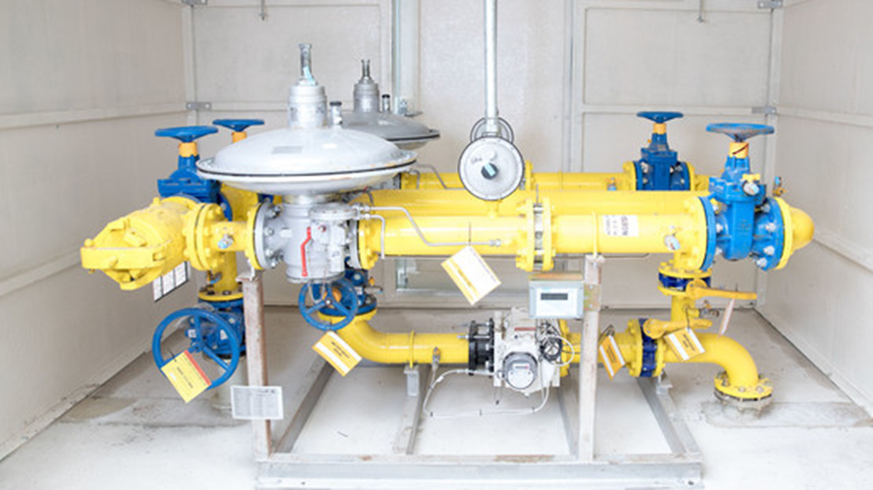
Large gas installation
Notes:
This is only a small example of a large gas installation.
In realistic terms many of these rigs can come on a low loader and need cranes to put them in place.
To give you a better example , The Shard’s gas meter and installation was put in as the building was being built around it as a complete installation. The only way that, it is coming out is in bits

Slide 14
Domestic Installation
Notes:
This shows a normal low pressure installation and on the right a medium pressure installation.
The hand over point from the GDNO can be clearly seen and is marked as the ECV.
So going back to our whos who how does this work.
To work on any gas installation an operative has to be a qualified gas fitter and this is managed by gas safe register. The do not do the training and assessment thisis left to registered companies but they do maintain the register of qualified fitters and investigate and audit organisations for compliance.
The MAMCoP an the AMICoP.
An Ami is an approved meter installer – formerley an OAMI –Ofgem approved meter installer. To fit a gas meter an operative not only needs to be a qualified gas fitter under gas safe the company has to be registered as an AMI and prove by audit that they can comply with the COP. This used to sit under the SPAA and was conducted be Wilcox consulting.
Note only this the AMI has to work for a registerd MAM – Meter asset manager who is responsible for transmitting the data back to the relevant parties using the elektralink communication system. Although there are exceptions to this though it must follow the RGMA designated flow protocols. The MAM must comply with the MAMCoP and again is audited by wilcox. This is a 3 yearly audit split into 3 sections. MAMCoP amoungst other documents references BS6400 part 1 2 and 3 dependant on the size and type of meter fitted.
The meters are procured by the supplier and these must comply with the BSI and international standards along with the Measurements instruments directive set by BEIS and OPPS. The supply is also responsible for appointing the MAM who may or may not be an AMI. The MAM is not allowed to be appointed to a meter position that they cannot maintain.
The positioning and location of the meters also fall under the HSE for example the DSEAR (Dangerous substances and explosive atmopheres regulations) this can even relate to domestic situations where a domestic meter is housed in a commercial premises or that there are three or more meters in one internal location and this is known as a meter bank.

Slide 15
Audience Q&A Session
ⓘ Start presenting to display the audience questions on this slide.

Slide 16
CHANGES UNDER THE REC
DAVE WRIGHT

Slide 17

CHANGES UNDER THE REC
Original
New
ASCoP
ASCoP.
MAMCoP - MAM
MCoP- MEM
AMICoP - AMI
- AMI
SPAA
Exec Committee
REC
Metering Expert Panel
REC
Performance Assurance Board
Notes:
Lets deal with the easy one first – ASCoP this currently has just been a lift and shift and no fundamental changes have been made to the document only the place it is now stored and governed.
The combining of fuel governance is not a new concept.
Earlier we discussed around the formation of Ofgem which was really one of the first introductions to combining the fuels. This made logical sense due to the fact that many of the suppliers were now dual fuel. This will be discussed further during the REC session
The combining of the MAMCoP and AMICoP documents had already begun under the SPAA and agreed by what was then the MAMCoP board. It therefore made perfect sense for this work to continue until is completion and place into the EMAR
The MCOP is a searchable document held in the EMAR (Energy market Architecture Repository) and now combines both documents. This now makes the navigation of this document much easier
The original terminology for a meter operative name was a MAM – Meter asset manager under the REC theses are now classed as meter equipment managers.
Organisations could be classified as a MAM and an AMI although many only register as an AMI.
Also mention operational forums.
A MAM does not have to use a registered AMI to fit a meter although under the regulations if an AMI is not used then the MAM has an obligation to have the installation inspected by a MAM within 30 days of installation. Irrespective of whether an AMI is is used then they have to be gas safe registered.
A further consolidation piece is now underway looking at the auditing

Slide 18
Navigating the rec portal
Dave wright

Slide 19

Navigating the rec portal

Slide 20
Navigating the rec portal

Slide 21
Navigating the rec portal

Slide 22
Navigating the rec portal

Slide 23
Navigating the rec portal

Slide 24
Navigating the rec portal

Slide 25
Navigating the rec portal

Slide 26
Audience Q&A Session
ⓘ Start presenting to display the audience questions on this slide.

Slide 27
Thanks for attending
Contact us: enquiries@recmanager.co.uk

Slide 28

Feedback
ⓘ Start presenting to display the poll results on this slide.

