Slide 1
Metering in the rec
24 October 2022

Slide 2



Introducing Your presenters
Amie Lauper-Bull
REC Code Manager
Communication and Events Officer
Dave Wright
Metering Consultant
Helen Fosberry
REC Code Manager
Continuous Improvement Manager

Slide 3

Housekeeping
Videos and microphones
Event recording
Use of Slido
Opportunities for Q&A

Slide 4


Join at slido.com
#6022556
ⓘ Start presenting to display the joining instructions on this slide.

Slide 5
Agenda For today
Agenda Item | Presenter
REC Committees | Dave Wright
Accession | Dave Wright
Audits | Dave Wright
Change Process | Dave Wright
EMAR | Dave Wright
Q&A | Amie Lauper-Bull
Close & Survey | Amie Lauper-Bull

Slide 6
REC COMMITTEES
DAVE WRIGHT

Slide 7

THE COMMITTEES UNDER THE REC
REC Change Panel
REC Green Deal Panel
REC Metering Expert Panel
REC Technical Expert Panel
REC Performance Assurance Board
Notes:
To enable the REC to function effectively a number of committees were established with specific responsibilities
All the panels are populated via a nomination and election process and are elected for a two year term.
The Committees are primarily tasked with the review and ratification of Code Manager proposals for change. Committees also play a role in issue definition, but the responsibilities for solution identification sit primarily with the Code Manager. REC Committees meet with clear agendas and a focus on the progression of change.
REC Change Panel consists of – The Change Panel is primarily tasked with approving Change Proposal Plans, Initial Assessment Reports, Preliminary Change Reports, and Final Change Reports. The REC Change Panel provides oversight of the REC Change Process.
Domestic Gas and/or Electricity Supplier.
Non-Domestic Gas and/or Electricity Supplier.
Gas Network Operator.
Electricity Network Operator.
Metering Equipment Manager
Metering Expert panel - The REC Metering Expert Panel is a sub-committee of the REC Change Panel and is responsible for all metering related Change Proposals and for updates to the Meter Product Data.
Two Gas and/or Electricity Suppliers.
Two Gas Transporters and/or Distribution Network Operators.
Two Metering Equipment Managers
Green Deal Panel – The Green Deal Panel is a sub-committee of the REC Change Panel and is tasked with overseeing all Green Deal related matters such as the Green Deal Arrangements and the GDCC Service Definition.
Three members nominated by Electricity Suppliers.
Three members nominated by Green Deal Providers.
One independent Subject Matter Expert appointed by RECCo.
Technical expert panel - The REC Technical Expert Panel is a sub-committee of the REC Change Panel and is responsible for REC System related issues and Service Definitions.
One Domestic Supplier
One Non-Domestic Supplier
One Gas Transporter
One Electricity Network Operator
One Metering Equipment Manager
Performance Assurance Board - The REC Performance Assurance Board (PAB) is primarily tasked with Performance Assurance, Qualification, and Maintenance of the Code.
Three Suppliers
One Gas Transporter
One Distribution Network Operator
One Meter Equipment Manager
One BSC Performance Assurance Administrator
One UNC Performance Assurance Framework Administrator
One consumer representative
Three independent performance management experts appointed by RECCo

Slide 8
Responsible committee
Change Panel
Technical Expert Group
Performance Assurance Board
Main Body
Interpretations and Definitions
Transition
Accession Agreement
Company Governance
Change Management
Energy Theft Reduction
Unbilled Energy CoP
Charging Methodology
Prepayment Arrangements
Data Access
Transfer of Consumer Data
Smart Meter Installation
Secure Data Exchange
Market Exit
MRA/SPAA Transition Schedules
EES Service Definition
CDSP Further Services Definition
SDES Service Definition
Data Specification
Performance Assurance
Qualification and Maintenance
Green Deal
Metering Expert Group
Green Deal Arrangements
GDCC Service Definition
Metering Operations
Metering Accreditation
Gas MCoP
Electricity MOCoP
ASPCoP
REC Board
Change Panel ToR
Performance Assurance ToR
Reserved Matters (Dual-Key)
Notes:
REC Performance Assurance aims to measure and improve market performance. The Performance Assurance Board (PAB) oversees a risk-based Performance Assurance Framework (PAF) to do so. The PAF is made up of the following key documents:
Performance Assurance Methodology (download) – the Code Manager’s methodology for identifying, analysing, and evaluating risk, as well as how these processes interact with risk assurance.
The Retail Risk Register (download) - identifies applicable Retail Risks that measure where consumer outcomes or the effectiveness of the retail market are degraded by a failure by a REC Party, REC Service User, REC Service Provider or other stakeholders to meet the objectives, standards or core processes under the REC.
Performance Assurance Techniques (PATs) (download) - the mechanism by which the Code Manager understands the causes of poor performance and acts to improve performance.
Performance Assurance Report Catalogue (PARC) (download) - a list of reports and relevant data items that will be utilised for measuring performance against the REC on a regular basis. Required data has been identified based on the Risk Register or from Performance Measures defined in the appropriate REC Service Definition. This includes data that Parties are required to provide directly and data that is collected by the Code Manager from central sources.
Reports are required from on either monthly or quarterly basis as identified in the catalogue
DNO/ GDNO
Supplier
Gas MAM
Performance Assurance Operating Plan (PAOP) (download) - the Code Manager’s activity and plan for the first year of market opening. The PAOP will be updated each year and it covers each of the components of the PAF, describes the activities, dates and dependencies which are needed to track the development of the PAF

Slide 9
QUESTIONS?

Slide 10

Audience Q&A Session
ⓘ Start presenting to display the audience questions on this slide.

Slide 11
ACCESSION
DAVE WRIGHT

Slide 12
ACCESSION TO THE REC
Required Parties
Non-Party REC service user
Gas and Electricity Suppliers
Distribution Network Operators
Gas Transporters; and
Metering Equipment Managers
Electricity Enquiry Service (EES)
Gas Enquiry Service (GES)
Green Deal Central Charge Database (GDCC); and
Central Switching Service (CSS)
Notes:
Right hand side - Certain categories of organisations are required to become a REC Party as part of their market role
Left Hand side - Other categories of organisations can apply for access to certain REC services without becoming REC Parties. This is known as becoming a Non-Party REC Service User. These services include
ll applications to the REC are made through the Party Operations area (available for Portal account holders) of the REC Portal.

Slide 14
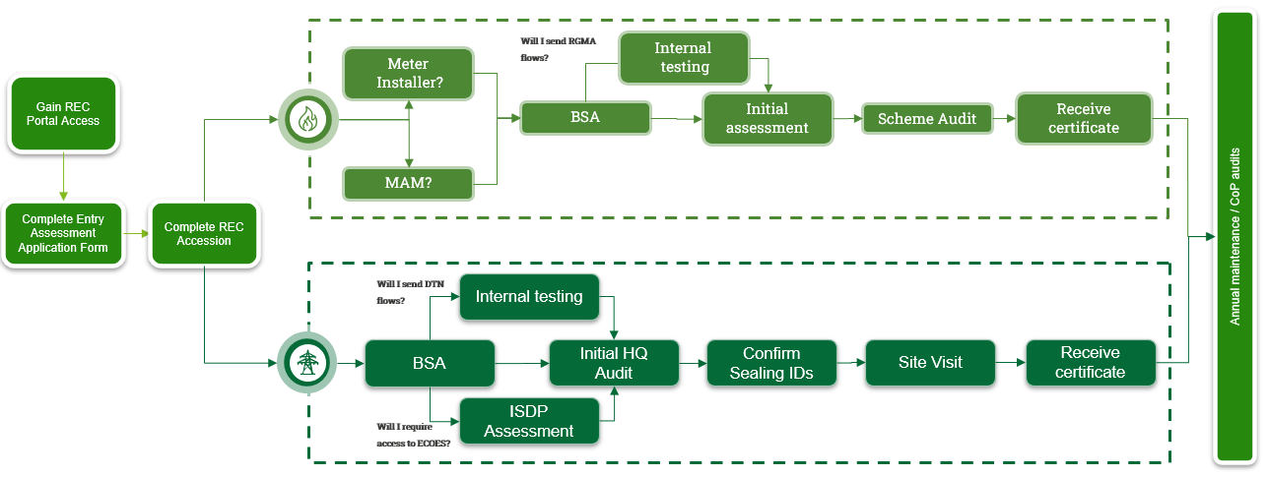
Becoming accredited
Specific questions within the BSA will not be applicable to you if you only intend to become a Meter Installer.
If you want access to ECOES, you will need to complete an ISDP. If you plan on sending data flows, you will need to complete internal testing.
The Code Manager will take a risk based approach to internal testing, evaluating your ability to send data flows to central systems based on evidence you submit.

Slide 15
Rec accession

Slide 16
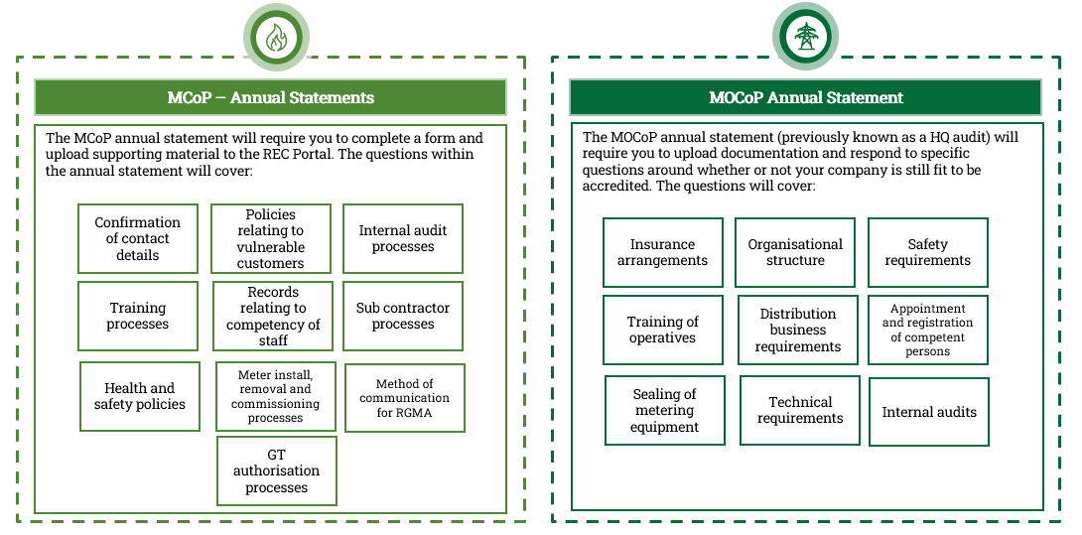
bsa
Accession
Maintaining
MCoP
MOCoP
Contact details for engineers
Training processes
Org chart
Agents and sub-contractors
Health and safety processes
Policies for vulnerable customers
Insurance
Company policy
Records relating to competency of staff
Sub-contractor processes
Training and expertise
Working practices
Meter install, removal, and commissioning processes
Method of communication for RGMA
Technical competency
Provisional registration
Internal audit processes
GT authorisation processes
Systems and processes in relation to data flows
Internal testing of systems
Systems and processes in relation to data flows
Internal testing of systems

Slide 17
QUESTIONS?

Slide 18
Audience Q&A Session
ⓘ Start presenting to display the audience questions on this slide.

Slide 19
AUDITS
DAVE WRIGHT

Slide 20
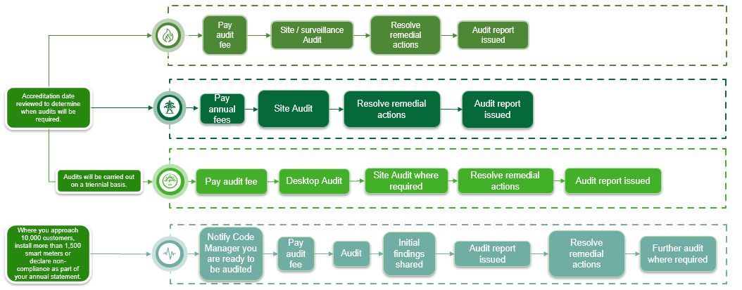
AUDITS
Notes:
Regular audits are required to monitor ongoing compliance with the Codes of Practice. Please note that it is your responsibility to pay the relevant audit fee – a failure to make payment could be escalated to the PAB. The scheme auditor will work with you to schedule and execute audits and report findings to the Code Manager.

Slide 21
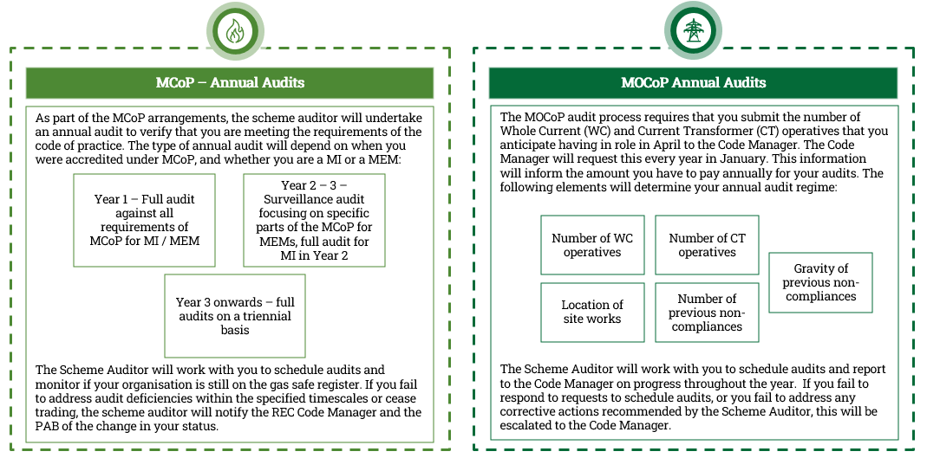
AUDITS

Slide 22
QUESTIONS?

Slide 23
Audience Q&A Session
ⓘ Start presenting to display the audience questions on this slide.

Slide 24
Change process
DAVE WRIGHT

Slide 25
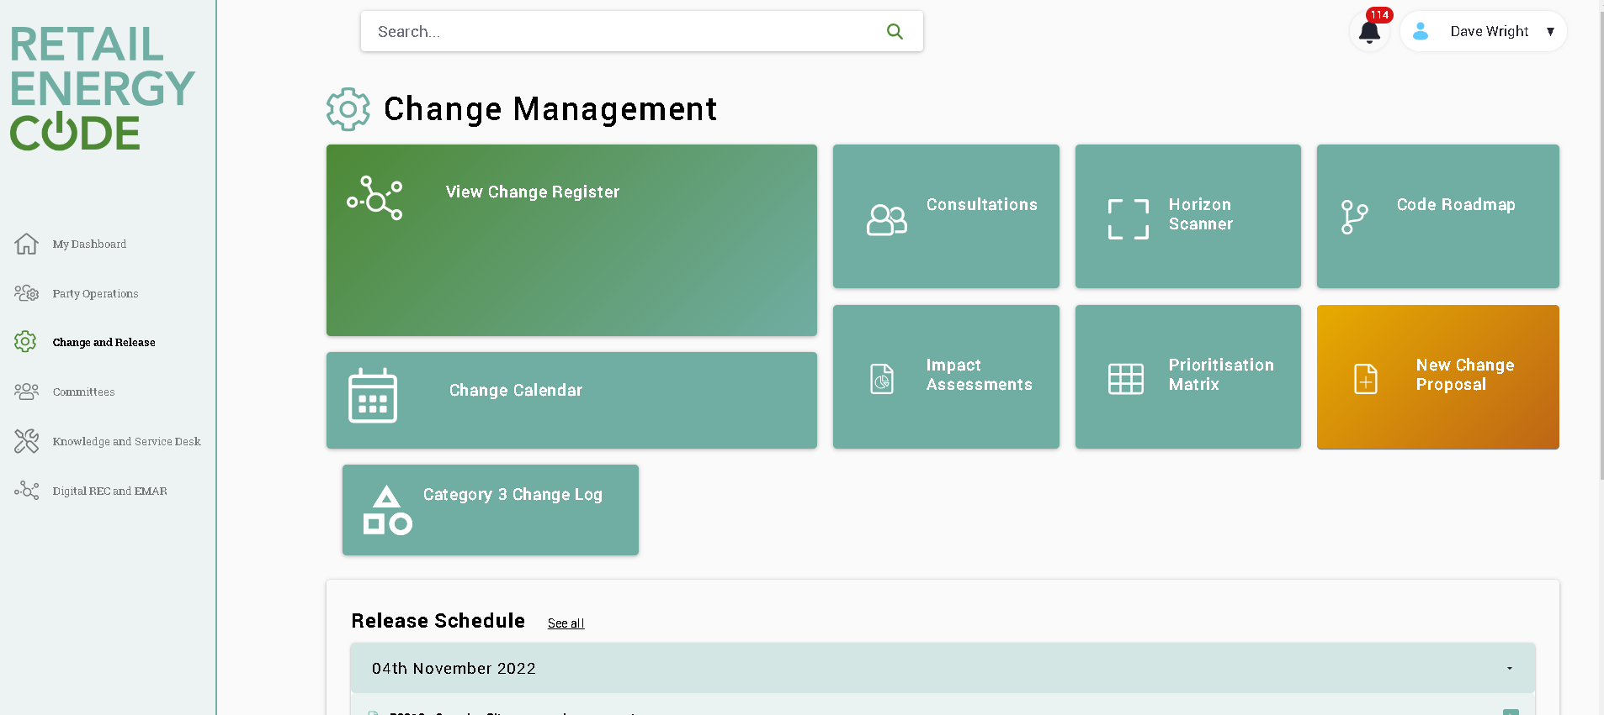
change

Slide 26
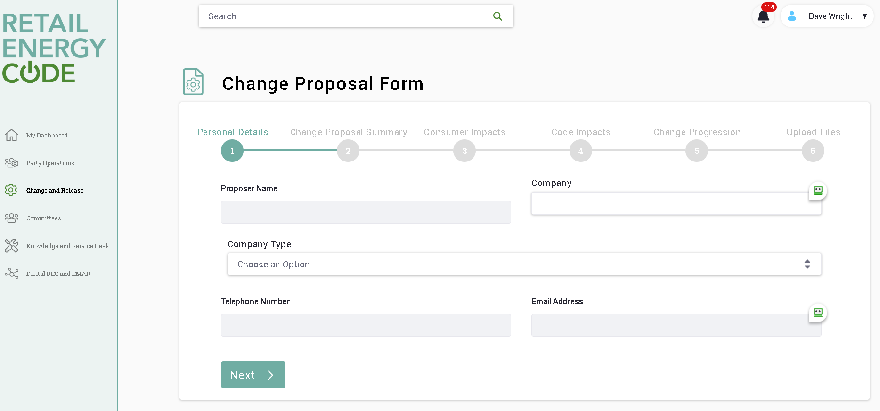
change

Slide 27
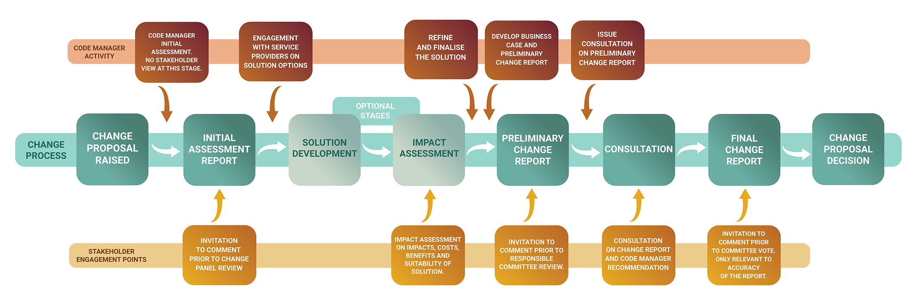
Change process overview

Slide 28
Change roles
Code Manager
Planning and prioritising the change agenda
Change Panel
Approval of Change Proposal Plans
Responsible Committee
Review Preliminary Change Report and plan for consultation
Escalation of issues from sub-committees (MEP, TEP and GDP)
Proactive raising of Change Proposals
Development and execution of Change Proposal Plan
Solution Development
Stakeholder Engagement
Recommendation to Responsible Committee
Responsible Committee for most Category 1 documents
Vote to approve or reject REC Change Proposals, taking into account the recommendation of the Code Manager.

Slide 29
Weighting in change
Importance | Weighting | How much will change compared to the current arrangement
Consumer Impacts | 30 | Deliver benefits to consumers through improved experiences, reduced detriment, reduced cost or wider societal benefits.
Security Impacts | 25 | Resolve issues or facilitate improvements relating to data protection and information security in the energy market
Legal/Regulatory compliance | 20 | Ensure that RECCo, Parties and Service Providers meet the obligations of all relevant laws, regulations and licence conditions
Strategic Direction | 15 | Support the implementation of the REC Strategy and strategic objectives, and wider regulatory strategies
Cost Benefit/Value | 10 | Realise financial benefits compared to the cost of the change and the impact of doing nothing

Slide 30
QUESTIONS?

Slide 31
Audience Q&A Session
ⓘ Start presenting to display the audience questions on this slide.

Slide 32
emar
DAVE WRIGHT

Slide 33
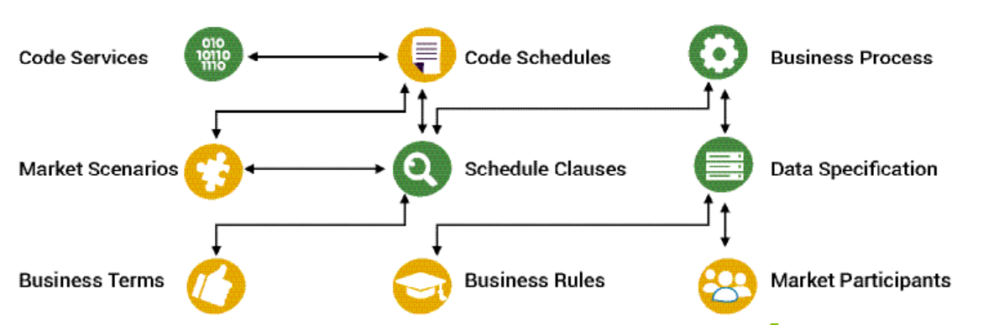
Emar artifacts and links
Notes:
Code Services
Code Schedules – these are the legal text and the main body of the schedule
Schedule clauses – the individual clauses that sit within a schedule
Business Terms – these are the defined terms that are used in the REC
Market particapants – these are the responsible parties within the REC
Data specification – this contains a list of the defined messages between market particapants. Note this is used by all codes i.e DCUSA , BSC etc
Business rules - the rules that define when an action is triggered
Business process – these are the actions that are triggered based on the rules
Market scenarios – these are the flow diagrams of how each scenario operates in relation to the business rules

Slide 34
Navigating emar

Slide 35
Final QUESTIONS?

Slide 36
Audience Q&A Session
ⓘ Start presenting to display the audience questions on this slide.

Slide 37
Thanks for attending
Contact us: enquiries@recmanager.co.uk

Slide 38

Feedback
ⓘ Start presenting to display the poll results on this slide.

