Slide 1
MARKET ENTRY ENGAGEMENT SESSION
12 DECEMBER 2022

Slide 2
Introducing Your presenters
Amie Lauper-Bull
REC Code Manager
Events and Communications Officer
Georgina Scott-Picton
REC Code Manager
Market Entry Team Lead
Daniel Rogers
REC Code Manager
Market Entry Team Member

Slide 3
Housekeeping
Videos and microphones
Event recording
Use of Slido
Opportunities for Q&A

Slide 4
Join at slido.com #2524592
ⓘ Start presenting to display the joining instructions on this slide.

Slide 5
Agenda For today
Agenda Item | Presenter
Introduction | Georgina Scott-Picton
Market Entry Process Covers REC Parties (excluding Metering) and Non-REC Parties Business Solution Assessment (REC Party) Information Security and Data Protection Form (REC Party and Non-REC Party) Internal Testing (REC Party) External Testing (REC Party) Pre-Requisites and CME (REC Party) Non-REC Parties | Georgina Scott-Picton Daniel Rodgers
Metering Accreditation Covers Gas Meter Equipment Managers (MEMs) and Meter Installers (MIs), Electricity MEMs, Automated Meter Reading Service Providers, and Smart Metering Installers. BSA (Gas and Electricity) HQ Audits (Electricity only) Site Audits (Gas, Electricity, Automated Metering Reading and Smart Metering) | Daniel Rodgers
Maintenance of Qualification | Georgina Scott-Picton
Q&A | Georgina Scott-Picton Daniel Rodgers

Slide 6
Market Entry Process
Georgina Scott-Picton and
Daniel Rodgers

Slide 7
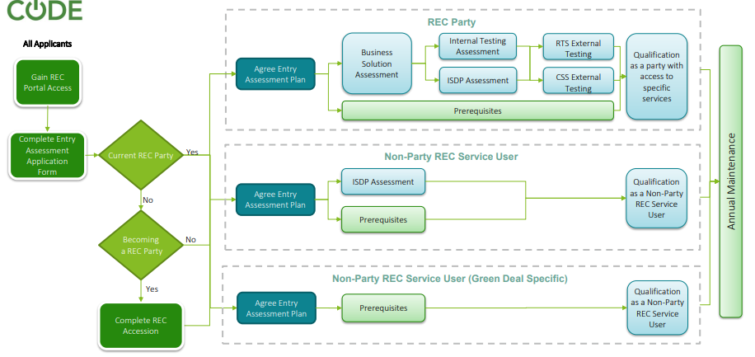
Market entry - overview

Slide 8
Business solution assessment (bsa)
Scope
The Business Solution Assessment (BSA) is required for Suppliers, DNOs or MEMs.
Overview
The aim of the BSA is to evaluate the applicant’s systems and processes to make sure they are adequate and will enable them to comply with Code obligations.
If the REC Code Manager finds issues against specific requirements this will be communicated to the applicant via the REC Portal. This could be in the form of follow ups, findings or observations – and will need to be addressed accordingly before Qualification to the market can be granted.
Guidance on responses and example supporting evidence can be found in Section 2 of the ‘Understanding the Entry Assessment Forms’ document on the Portal.
Process
Outcome
Once the applicant has submitted the BSA to the Code Managers’ satisfaction, with all findings resolved, they will then move on to the Internal Testing phase.
Receipt of BSA
The applicant completes the BSA and submits to the Code Manager.
Assessment
The Code Manager assesses the applicant’s business processes, ensuring REC obligations are met
Remediation
A risk-based approach is used to assess the BSA. Findings are communicated back to applicant.

Slide 9
BUSINESS SOLUTION ASSESSMENT- top tips
Clearly demonstrate the relationship between your business plan and solution. The solution will be expected to be proportionate to the plan (E.g. To serve 100 customers you need a different team structure, technology, experience and premises than if you want to rival the largest organisations).
01
Display knowledge and competency to operate in the market by directly showcasing an understanding of the regulations applicable to you and the processes you are affected by.
02
Flag to the Performance Assurance mailbox if you have any questions on the initial assessment form – or about follow up questions/requests made by the REC Market Entry team as part of the remediation phase.
03

Slide 10
Information security and data protection (isdp) assessment
Overview
The ISDP Assessment is to ensure that applicants have adequately identified and looked to address risks in their IT framework. The Applicant will provide responses to the questions in the assessment and also provide supporting evidence. Where any gaps or non-compliances in the submitted responses/evidence have been identified, the applicant will be requested to resubmit as appropriate.
Guidance on responses and example supporting evidence can be found in Section 3 of the ‘Understanding the Entry Assessment Forms’ document on the Portal.
Process
Outcome
Once an applicant has completed the ISDP assessment, they will be able to access the EES Database – which is one of the prerequisites that will allow them to enter the market
Repeated as necessary
Submission
Applicant submits the ISDP and supporting documentation
Code Manager Review
The document will be reviewed by the Code Manager
Remediation
Follow Up Queries/Requests Provided

Slide 11
Information Security and Data Protection – Top Tips
We tailor our assessment to your systems architecture and your information security risk register. Ensure you provide these in your first submission, as delays in these will cause additional rounds of remediation to be required.
01
Many of the ISDP questions can be covered by providing supporting policies as these will substantiate your written answers and can help reduce follow-up questions. We recommend that you attach a supporting policy to substantiate each answer where relevant and available.
Please ensure these policies and other pieces of evidence are clearly labelled in your answers for easy identification at the assessment stage.
02
A key area of consideration is risk management which is assessed via the risk register and risk methodologies. Demonstrating how you identify and resolve these risks builds assurance that you can protect data from the enquiry services.
The risk register is not required to contain in-depth details of individual vulnerabilities you might want to keep confidential.
03

Slide 12
INTERNAL Testing
Scope
Internal Testing is required for Suppliers, DNOs or MEMs (if dataflows are sent on the DTN). This differs from other stages of assessment as it is not a prescribed list of questions.
Overview
The Internal Testing Assessment involves the applicant running tests to demonstrate their systems and processes can operate against a defined list of market scenarios. The full list of the scenarios can be found in the Joint BSC and REC Storyboards document on the portal. The Code Manager’s objective of this stage is to ensure that the applicant has good test management and to ensure that all scenarios are completed successfully. The criteria for Internal Testing is based on the BSA.
Process
Outcome
Once the Code Manager has passed the applicant Internal Testing Assessment they will refer them to the External Testing provider.
Submission
Applicant submits Internal testing documentation for the Code Managers Review.
Assessment
The Code Manager will assess the Internal Testing and supporting documentation.
Remediation
The Code Manager will go back to the Party with any supporting any areas that have been missed.

Slide 13
INTERNAL TESTING – Top Tips
The Internal Testing storyboards are based on the scenarios your business is likely to face on a regular basis; the more information you provide us about your business structure, the better we can ensure these scenarios are appropriate. However, testing does not have to be based solely on the storyboard scenarios, a critical assessment step is you having clarity on the processes that you need to deliver to comply with the REC.
01
Internal Testing is not just about ensuring your IT systems are able to handle the business scenarios, it’s also to ensure you have appropriately documented work instructions in place, and that your front-line business users know how to use them. Your testing can also incorporate wider areas such as access controls and disaster recovery.
02
Internal testing also focuses on defect management; the purpose of internal testing is not to show that you have no defects, but to gain assurance that when issues are identified, you have appropriate change management processes in-place to update your systems and workplans accordingly.
03

Slide 14
Dtn External Testing
Scope
External testing is carried out by the REC Code Manager Technical Services team and is a requirement for both Suppliers and DNOs.
Overview
The outputs found from Internal Testing will be used to determine the scenarios that will be tested in the external testing. The Code Manager team will agree with the applicant when external testing can begin. A 2 week slot is usually booked out in advance with the external testing team.
The Code Manager evaluate results from testing and where an applicant has outstanding findings, they will request the applicant resolves these before proceeding.
Process
Outcome
Once the Code Manager Market Entry team receives the Test Certificate from the Technical Services team the applicant will have ‘passed external testing’.
If the Code Manager are unable to pass the applicant, the applicant will be required to re-perform external testing until they are deemed fit to proceed.
Handover
The Market Entry team hold a joint meeting with the Technical Services team and the applicant to discuss testing.
Testing Conducted
The Code Manager conducts live External Testing with the Party over Teams
Test Certificate Issued
The test certificate is issued to the Market Entry team and the applicant via the Portal.

Slide 15
DTN EXTERNAL TESTING – Top Tips
Set up a meeting with the External Testing Team well ahead of when you plan to commence testing. They’ll share a “Welcome Pack” with you and discuss what will be required
01
Reserve a testing slot with the External Testing Team (this may change closer to the date if you have not yet finished your Internal Testing)
02
Ensure you build time in your plan to get your DTN connection in place before your schedule testing slot
03

Slide 16
CSS External Testing
Scope
External testing is carried out by the DCC testing team and is a requirement for both Suppliers and DNOs, and optional for other parties such as MEMs.
Overview
The outputs found from internal testing will be used to determine the scenarios that will be tested in the external testing. The Code Manager will raise an onboarding request to CSS for the applicant, and will agree the scope and start date of the external testing scenarios with the applicant. Further CSS External Testing guidance can be found in the Category 3 Documents.
The External testing will then be carried out by the DCC testing team, who will provide a summary of the testing results to the Code Manager. The Party will have dedicated CSS technical contacts to support them through the testing process.
The Code Manager evaluate results from testing and where an applicant has outstanding findings, they will request the applicant resolves these before proceeding.
Process
Outcome
Once the Code Manager Market Entry team receives the Test Certificate from the DCC Testing team the applicant will have ‘passed external testing’. If the Code Manager are unable to pass the applicant, the applicant will be required to re-perform external testing until they are deemed fit to proceed.
Handover
The Market Entry team hold a joint meeting with the DCC testing team and the applicant to discuss testing.
Testing Conducted
The Code Manager conducts live External Testing with the Party over Teams
Test Certificate Issued
The test certificate is issued to the Market Entry team and the applicant via the Portal.

Slide 17
CSS EXTERNAL TESTING – Top Tips
You will need to have started your internal testing before we are able to raise your CSS testing request to DCC. Your internal testing is also used to help determine the scope of your CSS external testing.
01
Your DCC technical contacts will get in touch with you prior to your testing start date with an Entry Quality Gate Checklist that will help determine your readiness to commence CSS External Testing. This is required to be submitted to DCC 10 working days before the testing start date.
02
Ensure you build time in your plan to get your (or your CSS Interface Provider’s) UIT-A connection in place before your schedule testing slot.
03

Slide 18
PREREQUISITES AND CONTROLLED MARKET ENTRY CONDITIONS (CMEC)
Overview
There are a different list of prerequisites that Parties have to achieve depending on their market role. A Party is unable to Qualify until these conditions are met. Some of the Prerequisites are:
Becoming a user of ETTOS, DTSA, SDEP, EES/GES and the REC Portal.
Having a valid licence (for their market role) and MPID
Acceding to the relevant Energy Codes: REC, SEC, BSC, DUCSA and CUSC etc.
Process
Outcome
The Code Managers will decide for a Party to Qualify when all relevant stages have been completed and all findings closed. Any outstanding observations will continue to be tracked by the Code Manager.
The Party will then enter into CME where they will be able to operate in the market subject to established conditions.
Prerequisites
A party cannot qualify until they meet all relevant prerequisites.
Code Manager
The Code Manager decides for a Party to Qualify upon completion of the Market Entry process.
CMEC
Once the Party has Qualified through the PAB they can operate in the market under conditions.
Qualification
When establishing CMEC, there will be a defined number of site a Party must ‘prove’ before they exit.

Slide 19
PREREQUISITES AND CONTROLLED MARKET ENTRY CONDITIONS (CMEC)
Entering into CME
Parties will submit a CMEC proposal for the Code Manager to approve. This should include:
A short summary of the business and structure
Growth plans and justification on how this will be supported
Proposed CMEC conditions including
Max registration per month
Max registrations whilst in CME
Number of proven registration points to exit
Whilst in CME
Parties will be required to send weekly reports to the Code Manger to ensure they are operating within their conditions.
Exiting from CME
A Party is required to submit a self assessment form to the Code Manager for their decision in order to leave CMEC and operate in the market without conditions..
Guidance on responses and example supporting evidence can be found in Section 4 of the ‘Understanding the Entry Assessment Forms’ document on the Portal.
Parties will also be assessed on their performance against each of their risk drivers as part of the Code Manager’s consideration to exit them from CME.

Slide 20
NON-REC PARTIES
Scope
There are some organisations that want to access some of the services that the REC has to offer, they are known as Non-REC Parties. Elidable organisations allowed access to such services are listed on Schedule 12 Data Access.
Service
The services that the REC has to offer currently is Electricity Enquiry Service (EES), Secure Data Exchange Portal (SDEP), Green Deal Central Charge (GDCC) Database, Gas Enquiry Service (GES) and Central Switching Service (CSS).
The different types of EES and GES access on offer are: GUI (web portal), API, UIT, and Sandbox (a GES only test environment).
Different types of organisations are allowed different levels of access in EES, this is defined in the Data Access Matrix (DAM). A Party is not allowed to view any data line items that are not reflected in the DAM.
Process
Outcome
Once the organisation has passed all phases of entry assessment and met Qualification Prerequisites, the Code Managers will grant them access.
Entry Plan
The Code Manager sends an email with the entry process, and offers a meeting
Assessment
The Code Manager will review docs and communicate outcomes.
Contact RECCo
An Access Agreement is created and signed and payment made via RECCo.
Submit Documents
The applicant will submit the relevant application form and the ISDP.

Slide 21
METERING ACCREDITATION
Daniel Rodgers

Slide 22
Metering codes
The REC Performance Assurance Board (PAB) is the key oversight body for all Codes of Practice (CoPs). Each CoP has a dedicated scheme auditor to work with you to obtain and maintain accreditation.
MCoP
MOCoP
ASPCoP
SMIS
Gas Metering Code of Practice
Electricity Metering Code of Practice
Automated Meter Reading Service Provider Code of Practice
Smart Metering Installation Schedule
For MEMs who would like participate in the retail gas market
For MEMs who would like to participate in the retail electricity market
An optional code of practice within the gas market
For gas and electricity suppliers of domestic and micro business consumers.

Slide 23
Accreditation journey – gas (mcOp)/ELECTRCITY (MOCOP)
MCoP
MOCoP
ASPCoP
SMIS
After the applicant submits an application form, they will receive an email outlining the following steps in further detail; they will then also be offered a meeting if they have any further questions
Will I send data flows?
Internal testing
Meter Installer?
Gain REC Portal Access
Receive certificate
BSA
Scheme Audit
ISDP assessment
MEM?
Will I require access to GES?
Complete Entry Assessment Application Form
Complete REC Accession
Annual maintenance / CoP audits
MCoP Qualification process
Will I send data flows?
Internal testing
BSA
Initial HQ Audit
Site Visit
Receive certificate
Confirm Sealing IDs
Will I require access to EES?
ISDP Assessment
MOCoP Qualification process

Slide 24
Accreditation journey – mcOp/MOCOP
MCoP
MOCoP
ASPCoP
SMIS
MCoP
Parties undergoing MCoP accreditation can qualify as Gas Meter Installer (MI) and/or a Meter Equipment Manager (MEM). These are two separate accreditations and therefore requires two separate Business Solution Assessment (BSA) forms/site audits to be completed.
The current scheme auditor responsible for performing both the desktop and site audits is Wilcock.
MOCoP
Parties undergoing MOCoP accreditation are required to fulfil both meter installation work and general meter equipment management responsibilities. They will therefore be required to demonstrate their capabilities to perform both these roles in practice as part of their site audit.
The desktop audit (aka the HQ audit) is currently performed by the REC Code Manager.
The current scheme auditor responsible for performing the site audit is Gemserv.

Slide 25
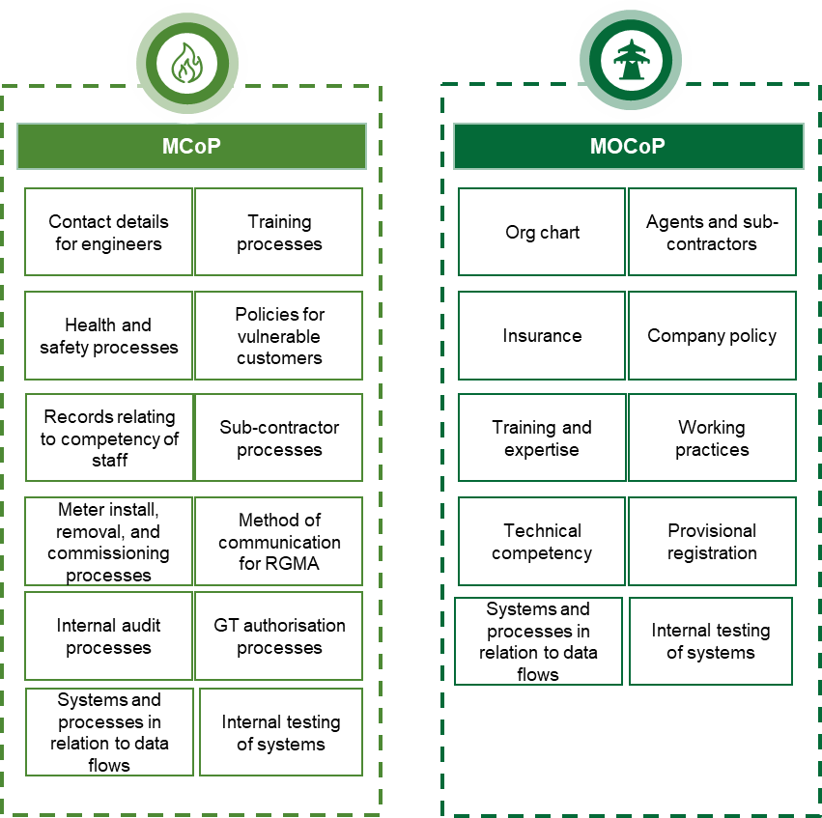
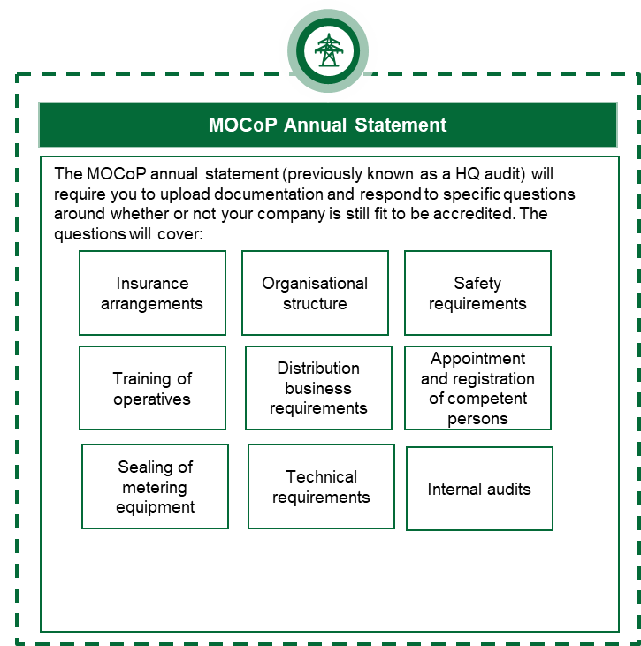
Accreditation journey – mcOp/MOCOP
MCoP
MOCoP
ASPCoP
SMIS
Business Solution Assessment (BSA) – MCoP and MOCoP
As part of the BSA, MEMs will need to submit evidence relating to the following areas so that the Code Manager can decide whether they meet the requirements of the CoP to proceed with the process for obtaining their accreditation.
HQ Audit – MOCoP only
The HQ Audit is a desktop audit that is only required to be completed by MOCoP MEMs. This is required as part of the initial accreditation process as well as on an annual basis to maintain accreditation.

Slide 26
Accreditation Journey – ASPCoP
MCoP
MOCoP
ASPCoP
SMIS
The Automated Meter Reading Service Provider Code of Practice (ASPCoP) is a voluntary code of practice. This code is not underpinned by any specific regulatory obligation and its purpose is to inform best practice. Accordingly, REC Parties are not required to become accredited to the ASPCoP as part of market entry, and there is no requirement for ASPs to complete BSAs, ISDPs, any internal testing or any annual statements in respect of their ASP role.
However, any organisation wishing to be registered as an ASP will be required to complete an audit with the ASPCoP Scheme Auditor TuffenTech. The Code Manager will send the applicant’s details to the ASP Scheme Auditor, who will undertake a desktop audit of the application. If necessary, the ASP Scheme Auditor will undertake a site audit to validate whether the ASP can meet the requirements of ASPCoP, and provide the audit report to the Code Manager.
Gain REC Portal Access
Complete application form
Desktop Audit
Site Audit
Receive certificate
Triennial Audit

Slide 27
Accreditation Journey – SMIS
MCoP
MOCoP
ASPCoP
SMIS
The provisions of the SMIS are applicable to Energy Suppliers who install smart meters for Domestic Customers and Micro Business Customers.
On instances where an existing supplier before the REC went live, which previously met these thresholds under SMICoP, they will not be required to complete a BSA, however the relevant SMIS declarations will be part of their annual statement.
There is no formal requirement to become ‘accredited’ under SMIS – by virtue of acceding to the REC, they are agreeing to the provisions of the SMIS. Suppliers need to reach out to the REC Code Manager 6 months in advance of when they either expect to have 10,000 customers or to have installed 1,500 meters. The Code Manager will then notify the SMIS auditor Grant Thornton to arrange an audit of compliance with the party to ensure the party is meeting their obligations, and whether the party needs to undertake any corrective action.
Yes
BSA
Annual Statement
As part of the market entry process, you will be required to provide specific evidence around your ability to meet the requirements of the SMIS, including
Details of business processes around the installation of smart meters
Details of how you will maintain compliance with all relevant clauses of the SMIS
As part of your annual statement, you will be required to make a self declaration confirming that your organisation:
Is compliant with the relevant clauses of the SMIS
The type of supplier you are (e.g. Large Supplier, Small Supplier or Micro Business Supplier)
Gain REC Portal Access
Complete Entry Assessment Application Form
Complete REC Accession
Were you supplying electricity or gas on 31 August 2021?
No

Slide 28
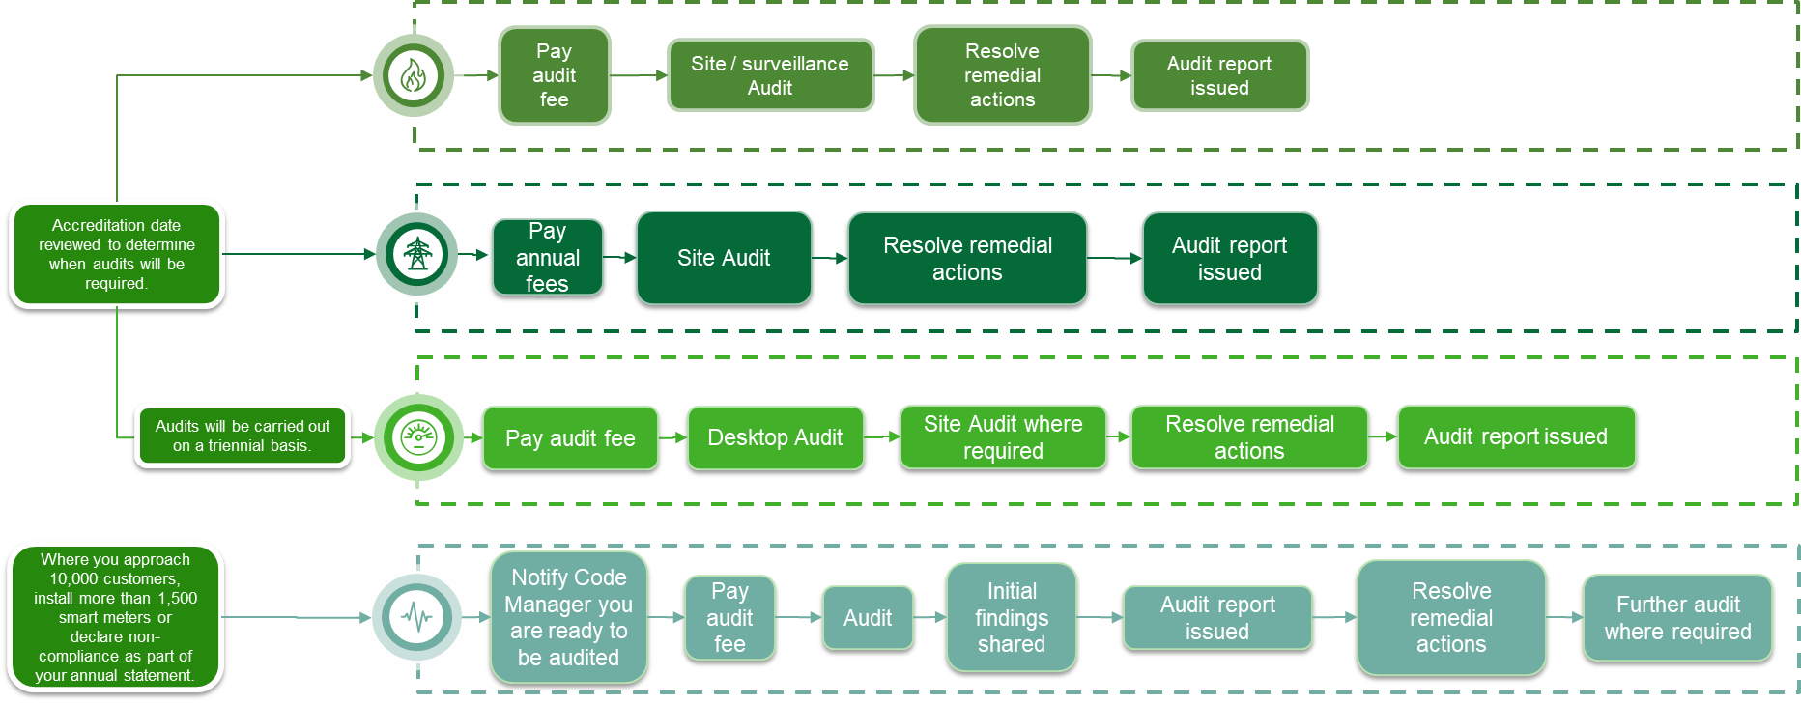
Metering audits
MCoP
MOCoP
ASPCoP
SMIS
Metering audits occur on initial entry as well as on a regular basis under the different Codes of Practice. This is to monitor ongoing compliance with the Codes, as well as to assess the extent of non-compliance should this be declared in the annual statement. Please note that it is the REC Party’s responsibility to pay RECCo the relevant audit fee in line with the steps shown below – a failure to make payment could be escalated to the PAB. The scheme auditor will work with them to schedule and execute audits and report findings to the Code Manager.

Slide 29
METERING – Top Tips
Ensure you provide a sufficient amount of information and evidence during Business Solutions Assessment, such as your business model, and the policies and procedures you have in place. This will allow the Code Manager to reduce and tailor any follow-up queries, reducing the rounds of remediation required.
01
Some of the requirements for metering parties are optional e.g. MCoP categories, directly sending dataflows, and enquiry service access. Knowing your business needs up-front enables the Code Manager to better outline the steps required to enter the market.
02
To avoid unnecessary delays, ensure that you have appropriate documentation in-place and trained engineers ready before the respective site and office audits.
03

Slide 30
Maintenance of Qualification
GEORGINA SCOTT-PICTON

Slide 31
Metering audits
MCoP
MOCoP
ASPCoP
SMIS
Each year all REC Service Users (i.e. Parties and Non Parties) need to maintain their qualification/access to REC Services.
This involves a combination of:
.
The different REC Service User obligations are set out in the REC Service User Categorisation and Assessment Document.
Required by all REC Service Users.
External Assessments are an assessment of information security and data protection risks and controls. This is performed every 3 years.
The Compliance Statement is a shorter sign off that is required in the intermediary 2 years.
This is only completed if a system or process change is being made. This can be submitted at any point during the year – and the Code Manager should be notified at the early stages of the change being implemented.

Slide 32
Q&A

Slide 33
Audience Q&A Session
ⓘ Start presenting to display the audience questions on this slide.

Slide 34
Thanks for attending
Contact us: enquiries@recmanager.co.uk

Slide 35
Feedback
ⓘ Start presenting to display the poll results on this slide.

