Slide 1
The Theft Estimation Methodology
13 December 2022
Notes:
Amie

Slide 2
Introducing Your presenters and Q&A Panel members
Ursula Mulholland
REC Code Manager
TEM Project Lead
Alex Kaye
REC Code Manager
Data Scientist
Jaypee Ambon
REC Code Manager
Workshop facilitator
Name: Rosalind Timperley
REC Code Manager
Workshop Facilitator
Amie Lauper-Bull
REC Code Manager
Events and Communications Officer
Notes:
Amie to do standard intro

Slide 3
Housekeeping
VIDEOS AND MICROPHONES
EVENT RECORDING
USE OF SLIDO
OPPORTUNITIES FOR Q&A
Notes:
Amy

Slide 4
Join at slido.com #2952939
ⓘ Start presenting to display the joining instructions on this slide.

Slide 5
Agenda For today
1
Part 1- Background and High-Level Overview
Background of the TEM
Methodology Overview
Estimated Theft Value
Next Steps
Q&A
2
Part 2 – Deep Dive
Deep Dive into the Methodology
Q&A
Notes:
Roz
5 mins intro
10 mins demo
20 Break out sessions (6 mins on each section on menti)
5 mins next steps

Slide 6
Part 1 – Background and High level overview
Notes:
Dec and Mark
Then break out rooms

Slide 7
Background of the theft Estimation Methodology
Rosalind Timperley

Slide 8
Objective
To establish a robust methodology to benchmark the volume of energy theft in Great Britain

Slide 9
The Initial Methodologies
The project started with three estimation methodologies….
1. Whole System Energy Balance
Energy In
Sources of unallocated/ unidentified Energy include:
THEFT
Leakage/ Line Losses
Metering Errors
Erroneous Consumption/Generation values
Profiling Errors
Line Loss Factor Inaccuracies
Unmetered Supply Errors
Energisation Status Errors
Aim: to understand the order of magnitude for potential volume of theft as a baseline.​
Unallocated /Unidentified Energy
Allocated /Identified Energy
Energy Out
2. Network Centric Energy Balance
3. Prior Theft Extrapolation
NHH
HH
HH
HH
HH
HH
Feeder Metering
HH
Confirmed Thefts
HH
HH
HH
HH
HH
HH
Segmentation data
Extrapolation
Aim: to understand the order of magnitude for potential volume of theft in geographical segments, then extrapolate out.
Aim: to identify patterns and drivers of theft and extrapolate for the entire network.
Notes:
Whole system energy balance: Comparing the energy going into the total system against the energy leaving. Then analysing the gap between these two values to establish the sources of error and associated volumes, to then establish the likely volume of theft.
Network Centric Energy Balance: Taking a sample of network sections (electricity only) with feeder meters and a high penetration of smart meters and analysing these to identify anomalies that might indicate theft. Then analysing these anomalies using other data sources (e.g. confirmed thefts, deprivation data) to build a picture of theft across GB.
Prior Theft Extrapolation: Characterising and segmenting confirmed theft incidents to extrapolate the likely volume of similar theft across the population.

Slide 10
Data Gathering
We reached out to parties across the energy industry to gather data to feed into these methodologies, including:
Seeking performance assurance data that would enable unallocated/unidentified energy to be allocated across the different sources of error
Seeking Half-Hourly feeder meter data from Distribution Network Operators, alongside the downstream Half-Hourly meter readings for a selection of feeders
Engaging directly with a number of Suppliers to establish what data sets they hold that could feed into the methodologies (e.g. count of cases of theft associated with cannabis cultivation)
This exercise established that the data available, at present, wouldn’t be sufficient to take forward the methodologies. We, therefore, developed a revised methodology to make optimum use of the data obtained.

Slide 11
Methodology Overview
Ursula Mulholland
Notes:
Dec and Mark
Then break out rooms

Slide 12
Summary of Methodology
1
2
3
4
5
Data Gathering
A data gathering exercise is required to acquire key data sets that can be used to identify theft
Methodology
A methodology was developed based on the data available
Hypothesis
A set of hypothesis is required to test the methodology against
Hypothesis testing results
Based on the data analysed and hypothesis, some valuable insights will transpire
Final Estimation
Analyses of the insights will provide key points for us to take forward

Slide 13
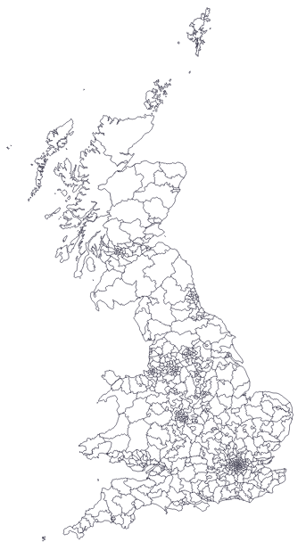
Methodology overview
Prior to the development of the methodology a data gathering exercise was required before defining the 6 step process. The goal of this approach is to close the gap on existing estimations by refining the range of possible theft across GB using robust statistical approach
Steps
Pre methodology development
Development of Methodology
1 Data Gathering Exercise
2 Target definition
3 Regional Breakdown
Collection of data that enabled the development of methodology
The data collated enabled us to identify:
It was enriched with external data to understand :
TRAS
Will be referenced as all theft’ data
ETTOS
Visual representation
Regional energy deprivation
Regional demographics
Meter information
Etc.
Post TRAS confirmed thefts
Other
Deprivation indices
Will be used to identify predictors and gain insights on theft activity by region
Unproven Suspicion of theft
Housing
Regional energy deprivation
Regional demographics
Meter information
Etc.
External
Predictors
Crime
Confirmed Theft (with a value for energy loss)
Population
TRAS Investigations
Urban/Rural
Fuel Poverty
No Thefts
Regional energy deprivation
Regional demographics
Meter information
Etc.
Reference
LSOA
LDZ
GSP
Regional energy deprivation
Regional demographics
Meter information
Etc.
Elexon
Used to validate theft estimates
Exoserve
1&2
3
4
5
Notes:
1
An extensive data gathering exercise was undertaken with a long list of data requested in Autumn 2021.
A reduced collection of data were acquired after a year of discussions to enable a methodology to be developed.
2
Based on the data gathered, a methodology is established which makes optimal use of the data obtained. From the data collated it enabled us to identify whether there was:
No Thefts
Confirmed Thefts
Unproven suspicion of theft
Other
Within a certain region of the country
3
It is then enriched with external data such as demographics, census and publications that may be contributing factors to the energy gap (Highlighted pink ‘Other’) and volume of theft
The number of each investigation can also be aggregated based on building type, fuel type, and country.

Slide 14
Methodology overview Continued
Steps
Development of Methodology
4 Defining Reliable Regions
5 Predictive Modelling
6 Validation Assurance
The predicted volume of losses can be aggregated at GSP/LDZ level and compared with published data from energy distributors (XOServe and Elexon)
Regions can be classified into two categories as shown below:
Predictors from reliable regions can be used to train two ML models
Visual representation
External predictors of regions with a small gap
Possible theft range
GB-wide theft range
Aggregate predicted assessed losses to GSP/LDZ level:
Reliable regions
Predicted Gas Theft
XOServe Reconciliation Data
Realistic proportion of confirmed theft investigations
Consistency across suppliers
Contain mix of urban/rural geographies
Have few ‘Under Investigation’ cases
vs
Regions to refine
ML Model
Predicted Electricity Theft
Elexon Reconciliation Data
Unaccounted for energy gap is a large percentage of total energy balance
ETTOS reports and investigations are not close in volume
External predictors of regions with a large gap
Refined theft range
vs
1&2
1&2
3
4
5
Notes:
4
Reliable regions: a small energy gap suggests most of the theft has been identified; this can be further supported by a close number of ETTOS reports and investigations
Regions to refine: a large energy gap means that analysis needs to be undertaken to close the range of estimation
5
Predictors from reliable regions can be used to train two ML models:
Classification model: to determine the outcome of an investigation (either confirmed theft, no theft or unproven suspicion of theft)
Regression model: to determine the volume of energy theft from confirmed cases
By applying these models to the GB-wide consumption dataset, an estimate of the total number of theft instances, and volume of losses can be obtained.
6
The predicted volume of losses can be aggregated at GSP/LDZ level and compared with published data from energy distributors (XOServe and Elexon)

Slide 15
Hypothesis
A set of hypothesis is required to test and find reliable regions and predictors. It will support the statistical methodology to analyse the data and derive as estimation
H1
Some suppliers are better at proactive investigations
H1
True
Suppliers have differing levels of proactive investigations
H2
Those committing energy theft do not change supplier
H3
Theft can occur equally in the properties with or without smart meters
H4
Thefts may incorrectly be reported as faulty meters
H6
True
Outcomes show a much higher pro-portion of investigations where the meter is prepaid
H5a
Parties who have stolen in one instance are likely to do so in others
H5b
Theft may recur at the same property
H6
Thefts are more likely to be detected by suppliers in prepaid meters than credit meters
H8
True
In Scotland it is less skewed and resulting in a more consistent rate of confirmed thefts
H7
Supplier don't monitor credit meter enough where significant amount of theft occurs
H8
Potential thefts in remote locations are less likely to have been investigated
H9
Unclear due to reducing volumes of investigations during covid and subsequently incomplete datasets with the transition of data capture.
H9
Incidence of theft is likely to have increased due to the financial impact of Covid and lockdowns
Unknown
H10
Cost of living impacts will increase theft
Outcomes
H11
Potential thefts in difficult to resource locations are less likely to have been investigated
H11
Unknown
There are too many external forces to reliably conclude this hypothesis
H12
Crimestoppers campaign areas will have increased theft rates
H13
There has been a bias to investigations within deprived areas
H14
High deprivation are likely to have higher levels of theft
H13
True
Investigations are highly skewed to high deprivation areas
H15
Fuel poverty levels may show high association with the levels of theft
H16
Newly subdivided property area have more unregistered meters (error /theft)
H14
True
There are higher rates of confirmed thefts in high deprivation areas but not as skewed as investigations
H17
Social housing areas are likely to have higher levels of theft
H18
Non energy crime is an indictor of energy theft
H19
Energy theft levels strongly relate to the levels of other types of crime
H15
True
Differing levels across residential and commercial however investigations are at similar levels across the deciles
H20
There may be correlation with water theft for some theft types (e.g. cannabis farms)
H21
Theft is more likely to be detected in cannabis farms
H22
Theft is more likely in hospitality relating businesses, nursing homes, laundrettes
H19
Unknown
Mixed, there is a higher correlation for commercial energy theft with levels of crime within an area but not for residential
H23
Theft is more likely in poor quality businesses such as those with low hygiene levels
H24
Small/ medium business are more likely be involved in energy theft than large corporations
3
1&2
4
5
Notes:
Highlight the ones we tested / new pack end of hypothesis summary plus indivdualselctions
Slides 12 and 13

Slide 16
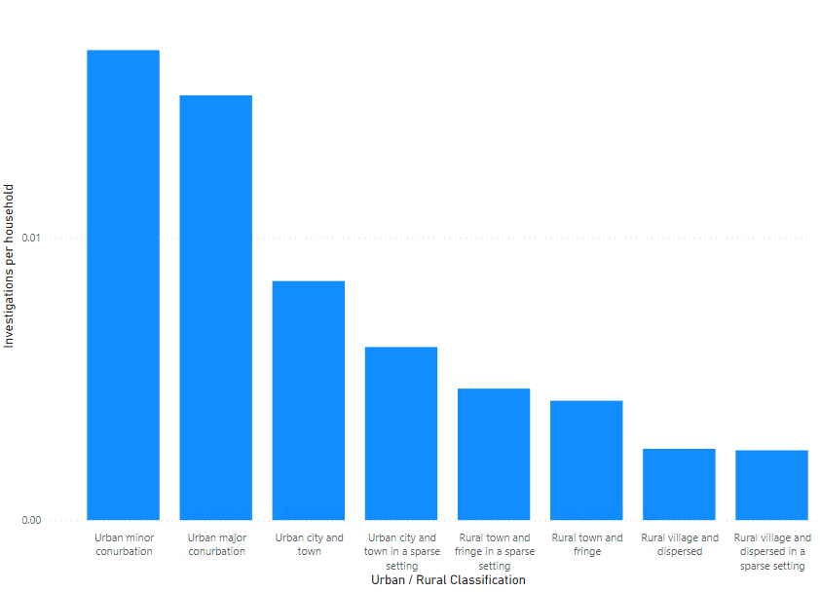
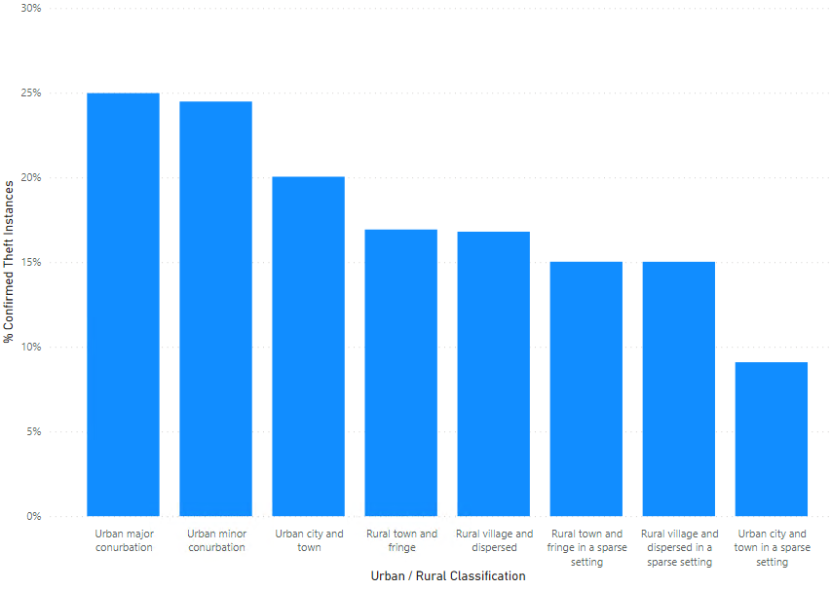
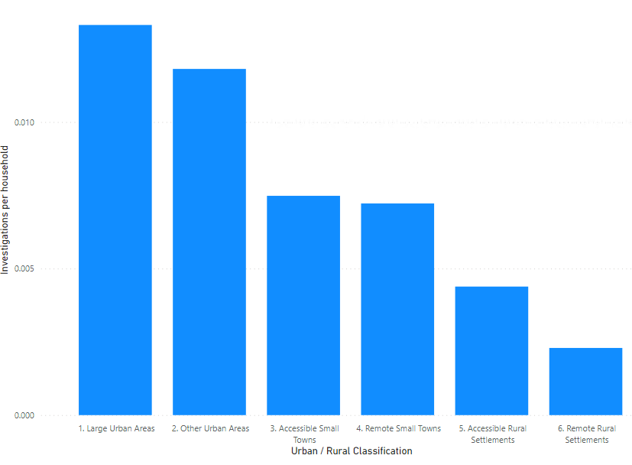
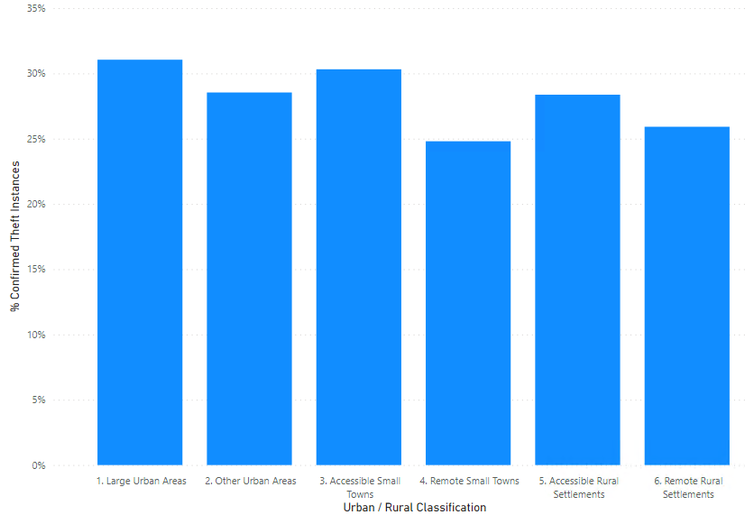
Hypotheses testing results 1/3
Based on the outcome of the statistical analysis we were able to test our hypotheses
H8
POTENTIAL THEFTS IN REMOTE LOCATIONS ARE LESS LIKELY TO HAVE BEEN INVESTIGATED
No. Investigations per household
% Confirmed Theft Instances
Conclusion
More investigations per household in urban areas
England and Wales
True – In Scotland it is less skewed and resulting in a more consistent rate of confirmed thefts
True – In Scotland it is less skewed and resulting in a more consistent rate of confirmed thefts
More
Urban
More
Rural
More
Urban
More
Rural
Scotland
More
Urban
More
Rural
More
Urban
More
Rural
4
1&2
3
5
Notes:
There are more investigations per household in urban regions than rural
Scotland is achieving a more consistent confirmation of theft in all regions than England and Wales

Slide 17
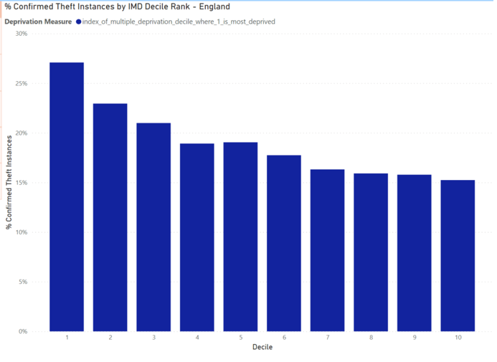
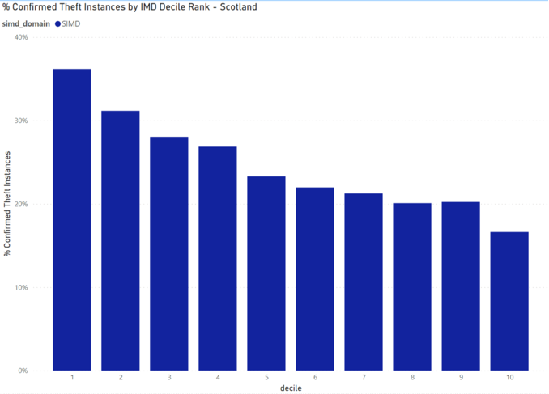
Hypotheses testing results 2/3
Based on the outcome of the statistical analysis we were able to come up with some interesting insights and test our hypothesis
H14
HIGH DEPRIVATION ARE LIKELY TO HAVE HIGHER LEVELS OF THEFT
England no investigations per decile
Scotland no investigations per decile
Conclusion
True – There are higher rates of confirmed thefts in high deprivation areas but not as skewed as investigations
4
1&2
3
5

Slide 18
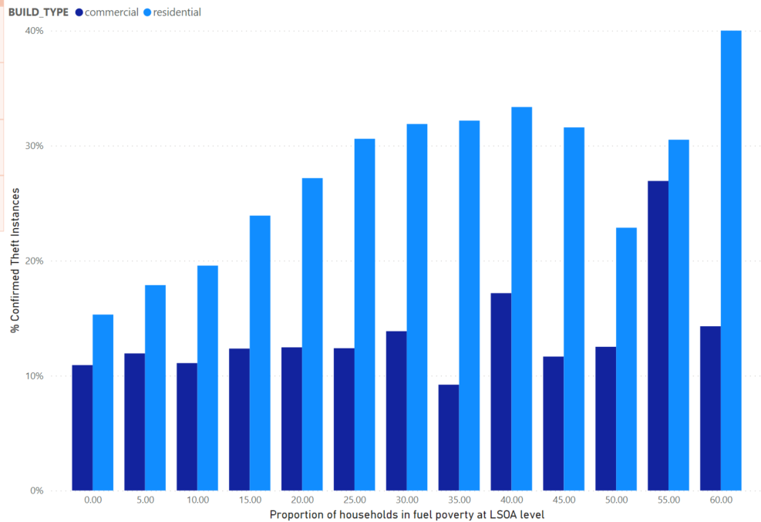
Hypotheses testing results 3/3
Based on the outcome of the statistical analysis we were able to come up with some interesting insights and test our hypothesis
H15
FUEL POVERTY LEVELS MAY SHOW HIGH ASSOCIATION WITH THE LEVELS OF THEFT
Conclusion
Percentage of confirmed theft investigations per fuel poverty band - England
Analysis
To Edit
For residential buildings:
The percentage of confirmed thefts increases within areas where fuel poverty levels are higher.
For commercial buildings:
The percentage of confirmed thefts shows a weaker correlation with fuel poverty levels
4
1&2
3
5
Notes:
For residential buildings, the percentage of confirmed thefts increases within areas where fuel poverty levels are higher.
For commercial buildings, the percentage of confirmed thefts shows a weaker correlation with fuel poverty levels. There is a notable spike in confirmed theft rates within the 55-60% fuel poverty band.
As discussed before, the reason for the fluctuation in confirmed theft rates in the higher fuel poverty bands, is due to the lack of LSOA’s that fall within these categories. These higher bands are easily skewed by the results of single investigations.
,

Slide 19
Energy Theft Value
Ursula Mulholland

Slide 20
Final estimation
TRAS peak
Model Predictions
Unallocated energy
TRAS confirmed thefts indicate the absolute minimum level of theft happening, as this is theft that has been found.
The model has an accuracy rating of 68% - 93% which when averaged could provide a further range of ±21%.
Unallocated energy represents the upper limit of what potential energy theft could be that, noting that not all unallocated energy is a result of theft
5
1&2
3
4
Notes:
Idivdually describe the three elements prior –
Also include limitations
Take out 1,2,3,

Slide 21
Final estimation
TRAS peak
Model Predictions
Unallocated energy
Gas
-21%
636 GWh – 1059 GWh
+21%
117 GWh
6526 GWh
502 GWh
1281 GWh
1281 GWh
Electricity
-21%
1703 GWh – 2837 GWh
+21%
189 GWh
130,400 GWh
1345 GWh
3433 GWh
3433 GWh
5
1&2
3
4
Notes:
Idivdually describe the three elements prior –
Also include limitations

Slide 22
Analysis Limitations
1
Early TRAS data was not validated by the TRAS system
2
Corruption and missing data in the confirmed thefts post-TRAS prevented inclusion within the model
3
The short history of time series data with significant influencing factors (covid) meant that time series analysis was not an option
4
There are additional attributes which are likely to support a better model, such as business type and hygiene ratings
5
Generic meter data can only predict so far, and therefore more tailored attributes for meters such as tamper indicators and actual readings could lead to a greater confidence in the model
6
Without the ability to reconcile the inputs and outputs to the low voltage network it is not possible to identify the theft at a granular level so the reconciliation can only be completed through a top down approach
7
TRAS consumption data has been used as a base reference for the MPRN/MPAN population, however, this will exclude those not registered on a network
8
Basing the analysis off the properties connected to the network will miss the theft occurring upstream of the meters
5
1&2
3
4
Notes:
The classification accuracy scores ranged from 68% to 93% in testing so there will be some mis classifications within the wider population
A 5% sample size was used to balance the additional computing needs within the timeboxed exercise
Without accurate consumption data at a granular level, it is difficult to provide better than an average of volumes lost due to theft

Slide 23
Next Steps
Rosalind Timperley

Slide 24
Next steps
The methodology has been built within an Azure system and can be re-run with updated data in future years, as required.
We can also see potential for the methodology to be enhanced in future years subject to additional data being obtained (e.g. Distributor feeder meter data; HH meter readings; Smart Alerts)
Next steps for the Theft Estimation Methodology
Notes:
The classification accuracy scores ranged from 68% to 93% in testing so there will be some mis classifications within the wider population
A 5% sample size was used to balance the additional computing needs within the timeboxed exercise
Without accurate consumption data at a granular level, it is difficult to provide better than an average of volumes lost due to theft

Slide 25
Next steps
Next steps for the Theft Estimation Methodology
13 Jan:
RECCo Consult on draft Forward Work Plan
13 Dec:
Feedback from TEM webinar
Mid-Jan:
RECCo publish draft Theft Reduction Strategy
Mid-Feb:
RECCo publish 2023/24 budget and 3-year forecast
Late March:
RECCo publish 2023/24 Forward Work Plan
Early April:
RECCo publish final and costed Theft Reduction Strategy
Mid-Jan:
Final TEM report published
Notes:
The classification accuracy scores ranged from 68% to 93% in testing so there will be some mis classifications within the wider population
A 5% sample size was used to balance the additional computing needs within the timeboxed exercise
Without accurate consumption data at a granular level, it is difficult to provide better than an average of volumes lost due to theft

Slide 26
Audience Q&A Session
ⓘ Start presenting to display the audience questions on this slide.

Slide 27
Part 2 – Methodology Deep Dive

Slide 28
Content
1
2
3
4
5
Data Acquired
Key data sources to enable methodology
Linking data sources
To facilitate methodology
Quality of data
To determine right model to build
Model Development
High level overview
Step 1
Pre-processing
6
7
8
9
10
Step 2
Model Setup
Step 3
Train model
Step 4
Test Model
How the predictions were run
Assurance

Slide 29
Data acquired for methodology
Source
Data
- Theft Risk Assessment Data (TRAS)
- Reconciliation by month
- Theft of Gas reporting
- Gas Total Shrinkage
- Gas Total Assessed
- Demand Total
- Temperature
- GSP Group take corrected 3ySFRF
- GSP Aggregated Metered Volume
- ADR components
- P315+P0276+p0277
- Reports on energy theft
- Deprivation data
- Rural/Urban
- Housing
- Crime data
- Population density
- Fuel poverty
- Spatial data
- Confirmed theft post TRAS
Performance Assurance Team
1
2
3
4
5
6
7
8
9
10
Source | Data | Status
Experian | Theft Risk Assessment Service (TRAS Data)
Xoserve | Reconciliation by month Theft of Gas Reporting
National Grid Data | Gas Total Shrinkage Gas Total Assessed Demand Total Temperature
REC Performance Assurance Team | Confirmed Thefts Post TRAS
Elexon Data | GSP Group Take Corrected 3ySFRF ADR components GSP Aggregated Metered Volume P315 + P0276 + P0277
Crimestoppers | Reports of Energy Theft
ONS | Deprivation data Crime data Fuel poverty Housing Rural/Urban Population density Spatial data
Notes:
Additional data sources expected in the revised methodology included technical losses for GAS and consumption data from suppliers.
Technical losses are not captured separately to non technical losses.
Suppliers declined to provide consumption data at MPAN level which would have enabled a different approach to the methodology, only GSP/LDZ aggregated data was available.
There were further sources identified on resuming the project, however they were not able to be accessed an utilised within the time frame of the project
Published hygiene data for food outlets
Business classification for commercial consumers
Housing data for conversion properties

Slide 30
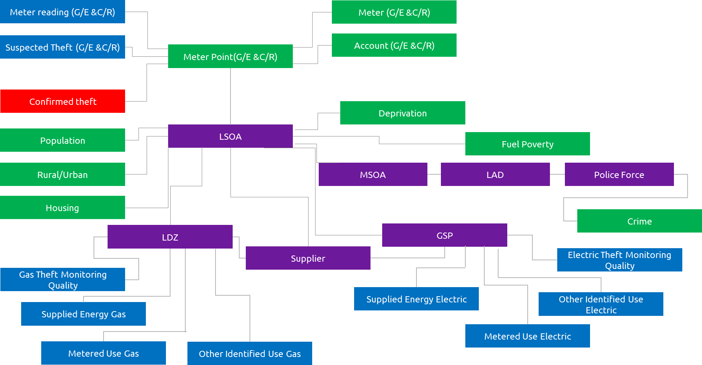
Linking all the data sources together
The logical data model on the left highlights how the sources connect together
Key:
TRAS and supply data
Confirmed theft
Predictors
Geographical
2
1
3
4
5
6
7
8
9
10

Slide 31
An understanding of the quality of the data as well as building insights was required to determine the right model to build
DATA PREPARATION & SCOPING
Consolidated dataset ready for analysis
Summary statistics
Identification of analysis subsets
Link TRAS to other data sets
Run summary statistics and Treat invalid and missing values.
EXPLORATORY DATA ANALYSIS
Multivariate Analysis, Correlation analysis and Spatial analysis.
Construct attributes
Key variables influencing theft
Summary of key findings from analysis
Strength & direction of correlation
Hypothesis validation
OUTCOMES
PREDICTION MODEL
Identified clusters or segments
Characterisation of the segments
Variables importance's & models
Performance measures and model evaluation
Segment the theft incidents
Model the losses or losses to consumption ratio
Analyse the impact of different variables on theft
EXTRAPOLATION & ESTIMATION
Theft estimates
Range of possible values
Pro-rated approach or scenario modelling approach
Extrapolate the TRAS theft incidents and suspected ones
3
1
2
4
5
6
7
8
9
10
Notes:
Reduce and summarise

Slide 32
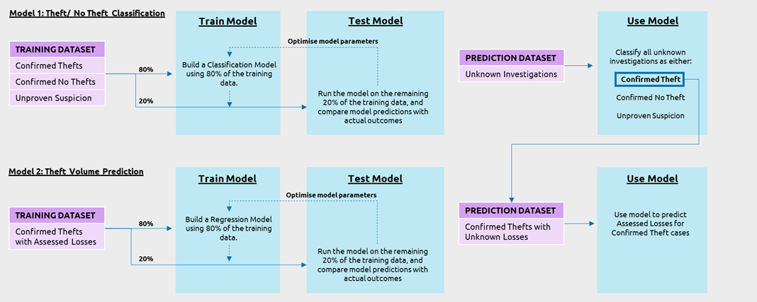
Model development – high level predictive modelling overview
The approach taken here was two-fold, as described below:
A two model approach was taken to first identify theft and then to assign a quantification
4
1
2
3
5
6
7
8
9
10
Notes:
Build and train a classification model that uses the predictors from known theft outcomes to classify other potential or unknown cases of theft as either ‘Confirmed Thefts’, ‘No Thefts’ or ‘Unproven Suspicion of Thefts’.
Build and train a regression model that uses the predictors from ‘Confirmed Theft’ and ‘Unproven Suspicion’ instances with a valid associated theft value, to predict the volume of energy theft in ‘Confirmed’ or ‘Unproven Suspicion’ instances identified from the classification model
Since these models are built using data with known outcomes, they both fall into the category of supervised machine learning. As such, whilst the models serve different purposes, their general structure is very similar

Slide 33
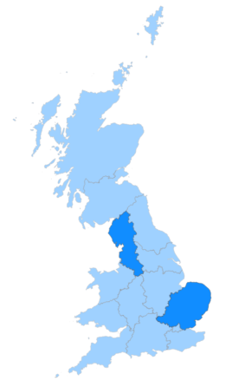
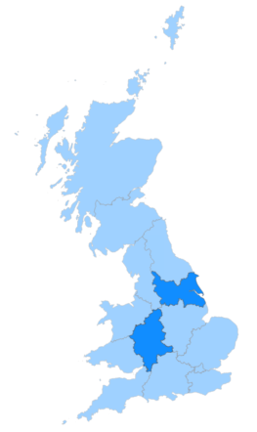
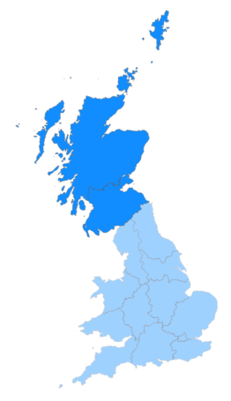
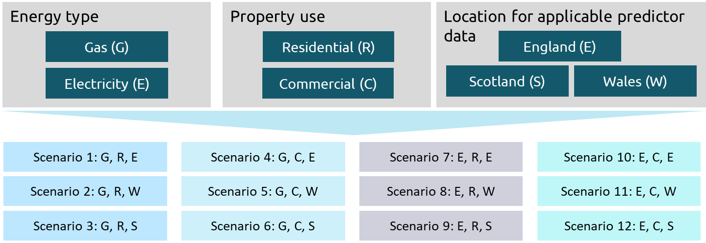
Model Development – Step 1: Pre-processing
A
Within the model, 12 scenarios were run to train each classification and regression model
B
Grid supply point provided a common aggregated base and were used to define a ‘Region’ when selecting training data
GSP Region Names:
A – East England
G – North West England
E – West Midlands
M – Yorkshire
P – North Scotland
N - South and Central Scotland
P
N
G
M
A
E
Regions A and G were selected for electricity properties in England and Wales
Regions E and M were selected for gas properties in England and Wales
Regions P and N were selected for gas and electricity properties in Scotland
5
1
2
3
4
6
7
8
9
10
Notes:
The data from this analysis was imported directly into Azure Databricks from the SQL database using Java Database Connectivity (JDBC) within a Python notebook environment.
In addition, the accurate reporting of theft investigations was found to be dependent on the energy supplier and geographical location of the theft instance. To limit biases in the classification model, “reliable regions” were selected for each country.
The tables of relevance to this analysis include:
Regression Table (SQL table name: regression.regression_2022_11_14): this contains predictors, investigation outcome and assessed losses (in the case of confirmed thefts)
Predictor Table (SQL table name: regression.prediction_2022_11_14_thinned_to_5_percent): this contains predictor data for a 5% sample (~3 million records) of the GB-wide energy consumption data extracted from the TRAS database. Sampling was undertaken at an LSOA level to ensure the sample is representative of the wider GB population.
Through discussions with RECCo’s SMEs, combined with hypothesis testing, it was clear that each country (England, Scotland and Wales), building type (residential and commercial) and fuel type (electricity and gas) generated very different patterns of energy theft. It was therefore deemed appropriate to split the data into 12 distinct datasets and build a unique model to capture the specific nuances for each scenario. The 12 scenarios are outlined in Figure20 below. In total, this resulted in the training and testing of 24 separate models; 12 classification models (1 per scenario) and 12 regression models (1 per scenario).
“Reliable regions” were defined at Grid Supply Point (GSP) level and aimed to capture regions that met the following criteria:
The conversion rate of suspected investigations to confirmed cases was around 20% (in line with SME advice)
The conversion rate was relatively consistent across all suppliers within the region
There was a good balance of urban and rural geographies, and
There were comparatively few “Under Investigation” cases.
The use of reliable regions was applied to the Classification model only. For the Regression model, any confirmed theft case with a valid energy loss value (i.e. greater than zero and not NULL) was used to build the model. The reasoning behind this was because the quality of reporting a value for energy theft was assumed to be equal across all confirmed theft cases. Furthermore, by using all regions, this provided a larger training set to build the most robust regression model possible.
The factors influencing the building of each model were therefore:
Classification Model: Fuel type, Building Type and Reliable Region
Regression Model: Fuel Type and Building Type

Slide 34
Model development – step 2: model set up
Each dataset was randomly split into a training and test dataset in the ratio of 80:20
Categorical variables were first converted into a numeric data type
This is done by assigning each distinct value within a category field a unique integer value. This is necessary to enable the machine learning algorithm to ingest the data.
The purpose of this is to enable the model to be ‘learn’ from 80% of the data and then test its performance by comparing the predicted model outcome with the known outcome, using the remaining 20% of the data
5
6
1
2
3
4
7
8
9
10

Slide 35
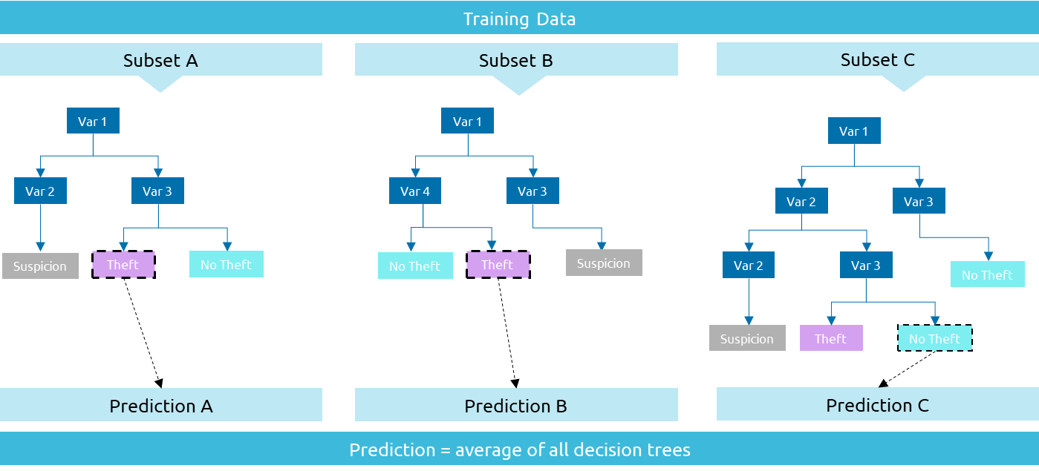
Model development –Step 3: train model
Random Forest Algorithm was chosen for the analysis
A higher level of accuracy compared to other machine learning algorithms
Lower risk of over-fitting to the data due to large number of trees and random sampling process
Benefits
Robustness to outliers
Ability to handle a large number of predictors as well
Efficiency when running on large datasets
Ability to fine tune model parameters to optimise model performance
Reduced transparency into the model details since the final outcome is averaged across all the decision tress
Limitations
Inability to extract the significance of each feature since this varies across each decision tree
3
5
6
7
1
2
4
8
9
10
Notes:
In summary, it builds multiple classification/regression decision tress, each of which predict an outcome based on a sunset of the full training dataset. The final result is taken as an average of all the individual predictions

Slide 36
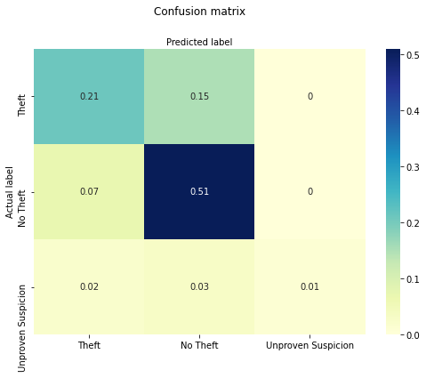
Model development –Step 4: test model
Below summarises the performance metrics used to evaluate each scenario, for both the classification and regression models.
All models were run using their respective test datasets and the predicted values were compared against the known results.
Model Scenario | Classification Model Performance Metrics | Regression Model Performance Metrics
 | Accuracy Score (%) | R² | MSE (kWh) | RMSE (kWh)
Scenario 1 (G, R, E) | 75.8 | 0.035 | 1,547,197,731 | 39,334
Scenario 2 (G, R, W)
Scenario 3 (G, R, S) | 76.2
Scenario 4 (G, C, E) | 90.0 | -0.220 | 25,017,648,508 | 158,170
Scenario 5 (G, C, W)
Scenario 6 (G, C, S) | 93.0
Scenario 7 (E, R, E) | 73.4 | -0.018 | 69,643,830,330 | 263,901
Scenario 8 (E, R, W)
Scenario 9 (E, R, S) | 68.0
Scenario 10 (E, C, E) | 79.5 | -0.005 | 61,565,139,027 | 248,123
Scenario 11 (E, C, W)
Scenario 12 (E, C, S) | 76.4
Output from the regression model indicates poor results. Therefore, it was replaced with an average calculated at GSP level per scenario
2
3
4
5
6
7
8
1
9
10
Results from the regression model indicates that it was a poor model so it was not progressed further

Slide 37
The predictions were run on a representative sample of the population
Extract 5% (population-weighted) sample of full prediction dataset
Run the optimised classification model on the sampled dataset for each scenario
Multiply the number of predicted theft instances by the average volume of theft per scenario
1
Sampling
2
3
Convert to Volume
Run Model
4. Extrapolate
Multiply volumes by 20 to extrapolate the 5% sample to the wider GB population
6. Annualise
Divide estimated theft volumes by the assumed time period over which the thefts occurred
6. Convert to Costs
Use 2022 current cap prices for electricity and gas to convert volumes to cost
4
Extrapolate
5
6
Convert to cost
Annualise
1
2
3
4
5
6
7
8
9
10
Notes:
-How we run the predictions and validation
-Slide 23 of other pack assurance

Slide 38
Assurance
National Grid - Demand Actual, D+6 per LDZ
Shrinkage, NTS Shrinkage factor = 2.5%
Typically takes 3 years to reconcile gas demand to supply so taking earliest available data
Xoserve % allocation reconciled chart to establish allocation levels between April 2019 and March 2020
Demand Actual D+6
Shrinkage
% unallocated in reconciliation
Unallocated gas volume
GAS
6,526,157,049 kWh
Average annual losses 2016 to 2021
Unallocated electricity volume
Total annual losses by year 2016 to 2021 provided by Ofgem following FOI
ELECTRICITY
Year | 2016 | 2017 | 2018 | 2019 | 2020 | 2021 | Average
Total GB Electricity Losses (GWh) | 132,806 | 135,374 | 134,045 | 124,709 | 125,925 | 129,543 | 130,400
1
2
3
4
5
6
7
8
9
10

Slide 39
Audience Q&A Session
ⓘ Start presenting to display the audience questions on this slide.

Slide 40
Thanks for attending
Contact us: enquiries@recmanager.co.uk

Slide 41
Feedback
ⓘ Start presenting to display the poll results on this slide.

