Slide 1
R0021 – SAFE ISOLATOR PROVIDER WEBINAR
02 MARCH 2023

Slide 2
Amelia Bray
REC Code Manager
Events and Communications Manager
Colette Baldwin
REC Code Manager
Regulatory Design Manager
Richard Colwill
DCUSA – Code Administrator
Operational Change Manager
Ryan Dale
REC Code Manager
Senior Consultant

Slide 3
Housekeeping
Videos and microphones
Event recording
Use of Slido
Opportunities for Q&A

Slide 4
Join at slido.com #3991695
ⓘ Start presenting to display the joining instructions on this slide.

Slide 5
Agenda For today
Agenda Item | Presenter
Introduction | Amelia Bray
Overview of the REC Change R0021 | Colette Baldwin
Overview of the DCUSA Change DCP394 | Richard Colwill
Details of the Technical Implementation | Ryan Dale
DCUSA Accession Process | Richard Colwill
Party Register Update | Colette Baldwin
Q&A | All

Slide 6
Overview of r0021
Colette baldwin

Slide 7
Overview of R0021 Change Proposal
Creates a new role in the REC which only REC MEMs can apply to become, provided they have acceded to DCUSA as a SIP.
They will work directly with Landlords to provide Isolation for the fitting of an isolator, or for the installation of Low and Zero Carbon Technology (L&ZCT) equipment – such as electric vehicle charging points, heat pumps, etc.
They will not act as a MEM when they are on site as a SIP, and can only do what is strictly necessary to facilitate the fitting of isolators or installation of L&ZCT equipment. They cannot perform any other MEM activities, such as moving or exchanging meters etc.
They will not need the consent of the supplier to undertake this very narrow scope of activities.
There will communication between SIPs, suppliers and DNOs

Slide 8
Scope of work sip can undertake
The role of the SIP is defined separately from that of the REC MEM, and they should not be conflated.
They purposefully have a very narrow scope of activities that they can undertake:
(a) De-energise that Metering Point.
(b) (if reasonably necessary) adjust the terminals of the meter and associated equipment and re-make the connection to them to make safe and remedy any disturbance of the connection that may have occurred.
(c) If required, terminate replacement customer tails into the Suppliers Meter, customer tails having been presented and tested by the electrical contractor as part of their works
(d) Re-energise that Metering Point.

Slide 9
Overview of dcp394
Richard Colwill - ElectraLink

Slide 10
Overview of DCUSA change proposal dcp394
DCP 394 has been raised to establish the necessary legal arrangements, which would allow a REC accredited MEM, to accede to DCUSA in order to act as a SIP to undertake Safe Isolations Work.
The DCP 394 legal text contained the following:
Condition that only a REC accredited MEM can apply to become a SIP
The definition of Safe Isolation Works
Obligation that works will only be undertaken by someone working on behalf of the SIP and with the permission of the customer
Obligations that the SIP will act in accordance with Good Industry Practice and comply with the REC Meter Operation Code of Practice
Clauses in relation to the provision of information to the Supplier and Distributor
Clauses in relation to liability in relation to any actions, proceedings, costs, demands, claims, expenses, liability, loss or damage
Confirmation that the SIP can raise changes and vote on changes specific to the legal text introduced by DCP 394

Slide 11
Overview of Technical requirements
RYAN DALE

Slide 12
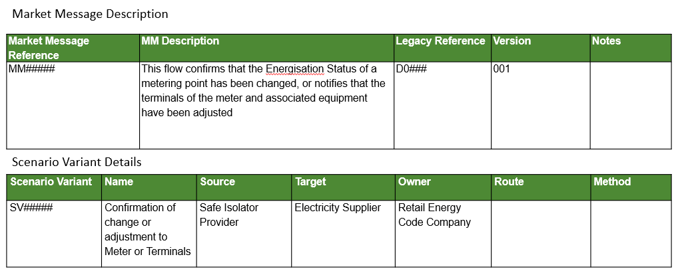
R0021 – Market Message – Data Flow

Slide 13
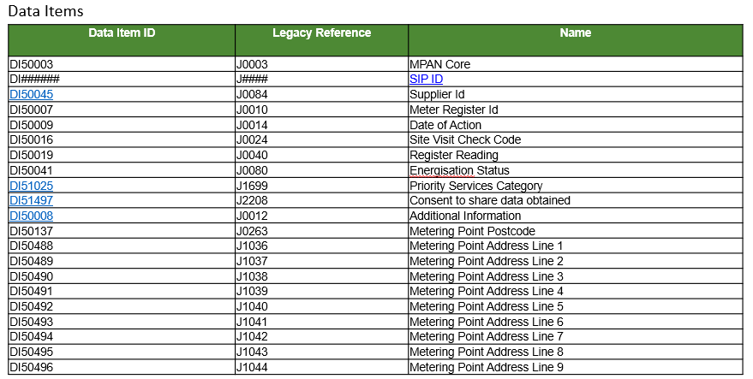
R0021 – Data Items

Slide 14
R0021 New Data Item
Here is the link to the Change Documents in the Energy Market Architecture Repository (EMAR)
https://emar.energycodes.co.uk/rm/cm/changeset/_oaz78KunEe2m8NYTm6tmTQ

Slide 15
Onboarding Process – DCUSA & REC
Colette Baldwin & Richard Colwill

Slide 16
DCUSA Accession Process

Slide 17
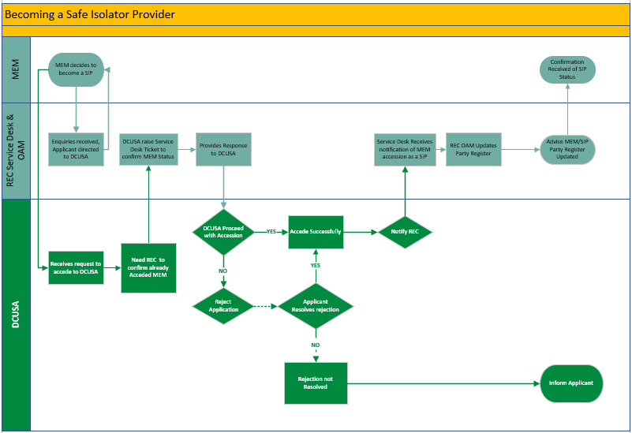
Onboarding process to become a SIP

Slide 18
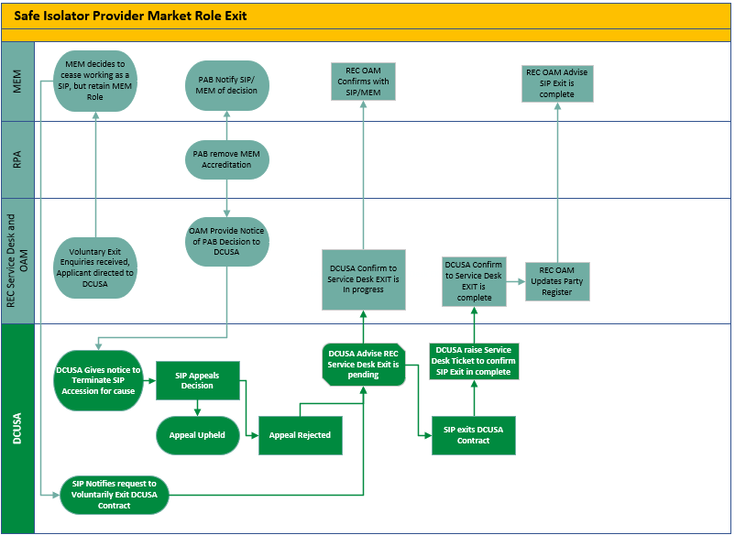
REC Removal of sip role

Slide 19
Q&A
ALL

Slide 20
Audience Q&A Session
ⓘ Start presenting to display the audience questions on this slide.

Slide 21
Feedback
ⓘ Start presenting to display the poll results on this slide.

Slide 22
Thanks for attending
Contact us: enquiries@recmanager.co.uk

